Slide 1
React Native
Toby Dussek
January 2020

Slide 2
Welcome
What you currently know
What you would like to know

Slide 3
Course Times
9:30 start
11:00 break
12:30-1:30 lunch
3:00 break
4:30 end

Slide 4
Objectives
Build apps from scratch and also navigation between screens
The app we make can be very simple in terms of what it does but it's more for us to cover areas that we need to know about for us to continue working on our app with confidence

Slide 5
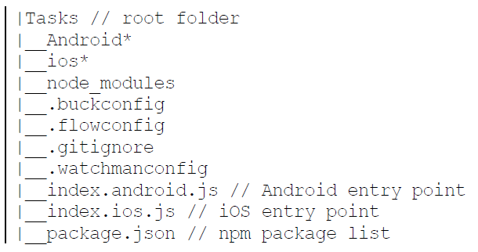
CLI Architecture

Slide 6
React Native Development
https://facebook.github.io/react-native/docs/getting-started.html
Install Node, React Native command line interface, Python2, a JDK, and Android Studio
May need to set ANDROID_HOME and platform-tools environment variables
install -g react-native-cli
npm install –g yarn
react-native init FirstProj
then cd into the app folder
react-native start // or npm start starts React packager in separate window
react-native run-android
or
react-native run-ios
Can take a very very long time to build and to then run on device/emulator

Slide 7
Running on Real Android Device
https://facebook.github.io/react-native/docs/running-on-device
Running on Android Emulators

Slide 8
Genymotion Emulator
Subscription-based emulator
Many more tools and more performant
https://genymotion.com/download/

Slide 9
View Android Device on Windows PC
droid@screen
java -jar droidAtScreen-1.2.jar
Android screen mirroring
https://github.com/Genymobile/scrcpy
Windows 10 ‘your phone’ app (for Android 7 or better)

Slide 10
Potential bug (as at Oct 2018)
The development server returned response error code: 500URL
Unable to resolve module `@babel/runtime/helpers/interopRequireDefault`
Solution
npm add @babel/runtime

Slide 11
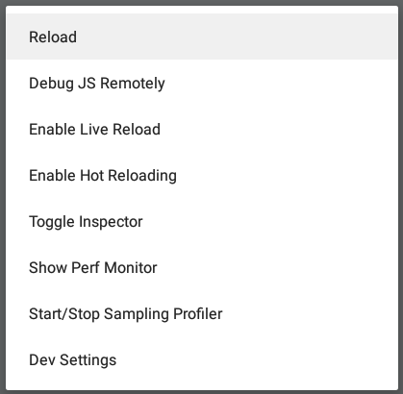
Emulator Controls
When emulator has focus
Double-press r on keyboard
Forces app to reload taking account of any changes
Ctrl+M
Shows a menu in emulator
Choose ‘Debug JS Remotely’ to see console.log in browser dev tools

Slide 12
Debug menu on actual device
Shake the device (or press menu) to show the same debug options

Slide 13
Expo
https://expo.io/
http://reactnative.com/

Slide 14
Expo (requires a free Expo account)
Development machine and device must be on same wifi network
npm install exp --global
exp init my-new-project
cd my-new-project
exp start

Slide 15
Compare Popularity of Technologies
https://trends.google.com/

Slide 16
Android Studio
Configure for
Android
HAXM
SDK build tools
https://facebook.github.io/react-native/docs/getting-started.html#caveats

Slide 17
Component We Use
View, Text etc.
NOT html or css

Slide 18
Understanding Flex Box

Slide 19
React Native Packager
The React Native Packager uses Babel to transpile JSX code
Babel automatically converts JSX code into React.createElement
e.g. return React.createElement(Text,{name:’fred’}, 'Hi there’);
Same as <Text name=‘fred’>Hi there</Text>
Always make the React object available to source code whenever you write JSX

Slide 20
React Native: Unidirectional Data Flow
UI = f(state)

Slide 21
Styles in React
Replace kebab-case-convention with camelCaseConvention for css

Slide 22
Chrome Developer Tools
Also Hot Module Reload (HMR)

Slide 23
React Native Bridge
Write JavaScript (ECMAScript)
Compiles to native code
Efficient to run at ~60fps
Data is passed as serializable messages exchanged between JavaScript and native modules

Slide 24
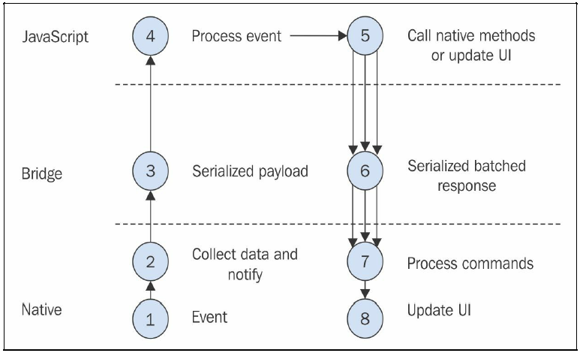
React Native Bridge

Slide 25
Attach Simulator to Chrome Developer Tools
Ctrl-D

Slide 26
Navigation
The most common community solution is react-navigation
https://reactnavigation.org/en/
Typically we may need to:
npm install --save react-navigation
npm install --save react-navigation-gesture-handler
react-native link (may not be needed)
Make sure the navigator code is placed AFTER the screen classes

Slide 27
Flux and Redux
The motivation of Flux is to increase predictability in large applications
To achieve this Flux introduces
Unidirectional dataflow
Removal of shared mutable state
In Flux architecture, each arrow points in only one direction
Flux encapsulates all state mutations in Stores

Slide 28
Actions and action creators
In Flux an action is a JavaScript object that has both a type and an optional payload of data
An action object is created as a result of user interaction or some other event
The type of the action is often a constant string that reflects the interaction's intent

Slide 29
Dispatcher
The dispatcher's role is to accept actions one at a time and hand them off to the stores

Slide 30
Stores
Responsible for storing application state
Stores are broken up by logical domain, each responsible for a small part of the Application
E.g. one store might be for user profile and another for the user posts
Responsible for updating application state as a result of actions received from the dispatcher
This encapsulation of state and mutation logic helps reduce complexity by removing shared mutable state from all other parts of the application

Slide 31
Controller Views (aka Containers)
Controller Views are connected to the stateful part of an application
They fetch data from stores and store them in their own internal state when rendering updated data

Slide 32
Redux
Redux is an implementation library for data handling in client applications
Inspired in large part by Flux
Draws on the ideas of Flux and adds immutability and the principles of functional programming
Redux mandates that state is made up of immutable objects, using the principles of functional programming
By centralizing all mutations, Flux provides a clear place to look when a bug is discovered

Slide 33
Principles of Redux
All application state is contained within a single store
Reducer functions are responsible for managing smaller parts of the state
Application state is immutable
Use reducer functions to create a new state object when an action is dispatched, leaving the old state unmodified
All functions that compute the new state (i.e.reducer functions) must be pure functions
Pure functions produce no side-effects and are deterministic
For a given set of inputs, the output will always be the same
See example here: https://github.com/reduxjs/react-redux

Slide 34
Installing Redux and React-Redux
npm install redux –save
npm install react-redux --save

Slide 35
Command-Line Operations
sdk-tools-bin
Contains batch files for avd and sdk management

Slide 36
Currying
A common technique in Functional Programming
The process of converting a function that takes multiple arguments into a function that takes one argument at a time, returning another function
Instead of const add = (x, y) => x + y
Define the function as const add = x => y => x + y
Use:
const add1 = add(1)
add1(2) // 3
add1(3) // 4
Convenient way of writing functions
First value is stored after the application of the first parameter
Can reuse the second function multiple times

Slide 37
Testing
Currently there is a problem with the default test configuration
Alter package.json to have the following code:
"jest": {
"preset": "react-native",
"transform": {
"^.+\\.js$": "<rootDir>/node_modules/react-native/jest/preprocessor.js“ }
}
see https://pastebin.com/97JifN9P

Slide 38
Unit Testing with Snapshots
Initially, run the test to create snapshots
npm
Then for future tests, this snapshot will be compared each time
Any differences will fail the test
Snapshots can be updated
npm test -- -u

Slide 39
Assemble, Act, and Assert
describe('', ()=>{
beforeEach( ()=>{
});
it('', ()=>{
});
});

Slide 40
https://flow.org/
https://nuclide.io/docs/languages/flow/#doc_nav
See the .flowconfig file
npm i flow-bin@0.33.0 --save-dev
Add a script to package.json so we can npm run flow
E.g. "flow": "flow“
We can invoke Flow in IDE via comments
/* @flow */
Start writing type-safe code
function multiply(n1: number, n2: number): number {
return n1 * n2;
}

Slide 41
Deployment
Build a release version for testing
Create a signing certificate
See https://facebook.github.io/react-native/docs/signed-apk-android
Create a release version
react-native run-android --variant=release
Build a production release
gradle assembleRelease

