Slide 1
Developing the equivalent of student whiteboards for use in Adobe Connect tutorials and in forum posts.
Nick Chatterton and Eleanor Crabb
LHCS

Slide 2
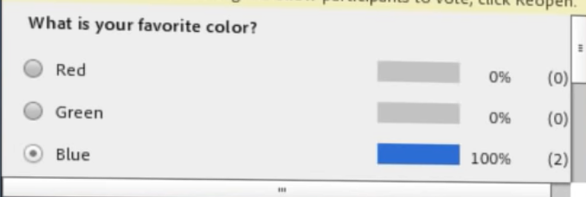
How do we understand what they do and don’t understand?
Polls
Chat box
Forum
Email/phone
TMA answers…etc

Slide 3
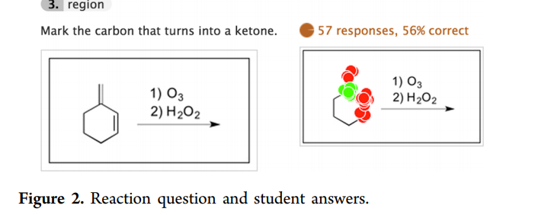
Polls in Adobe Connect
Equivalent of clickers at face-to-face
Multiple choice, true/false, numerical
Not generative or diagrammatic

Slide 4
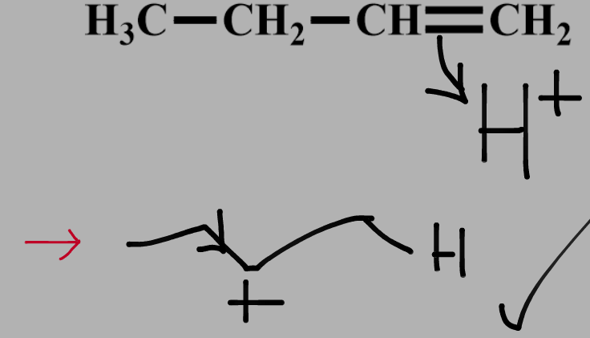
Student drawings
On A/C screen
Cumbersome and only one student can work at a time

Slide 5
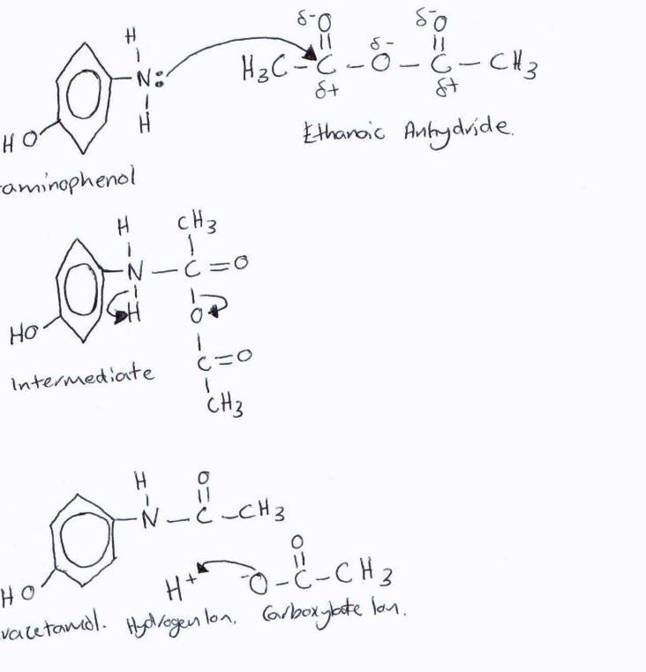
Student diagrams
Key in many sciences
Accurate student drawing
And interpret meaning
Difficult to handle in Adobe Connect

Slide 6
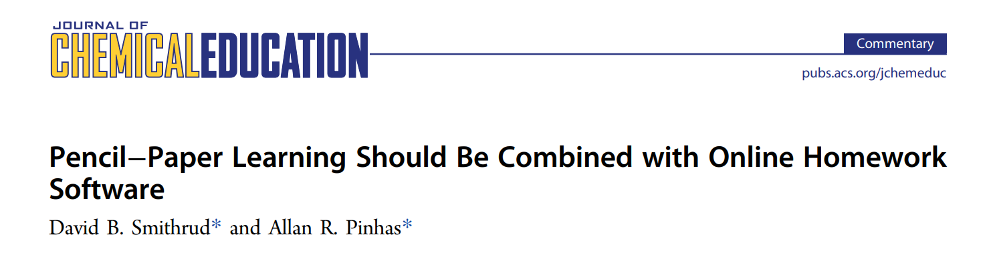
Effect on assessment scores?
Exams etc require students to write answers/draw accurately
Online quizzes/homeworks etc don’t test the same thing
“lack of handwriting may account for part of the poor examination performance”. J. Chem Ed, 2015, 92, 1965

Slide 7
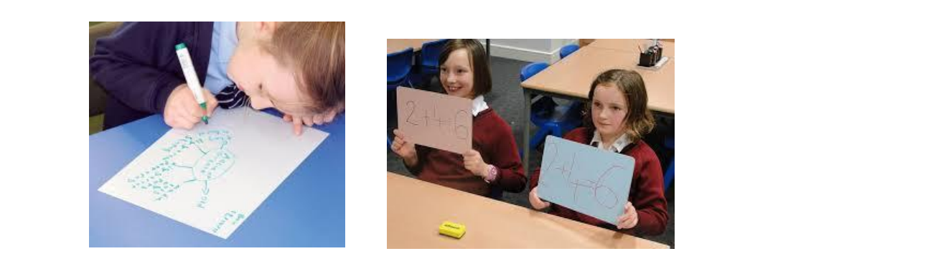
Whiteboards in face-to-face teaching
https://www.sharingbestpractice.camden.gov.uk/wp-content/uploads/2016/08/TLC-Resource-Formative-Assessment-Booklet.pdf

Slide 8
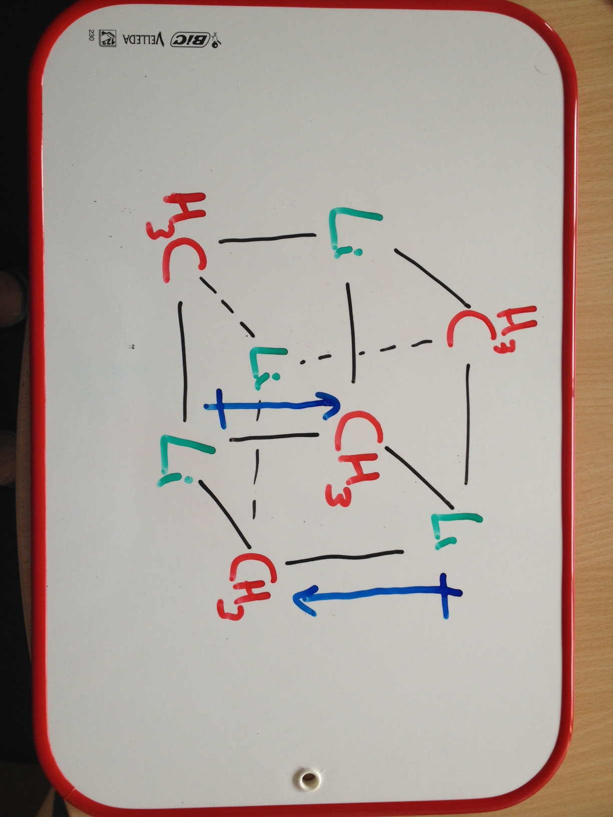
Flipped lectures at f-2-f institutions
Pre-recorded class
Followed by quiz
Focus of teaching time based
on student misconceptions

Slide 9
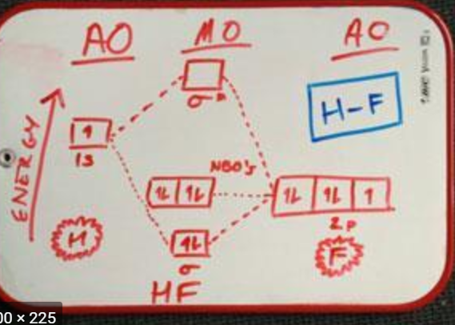
Role of whiteboards
Part of in-class teaching
Problem solving; summarising
Often involve group discussion

Slide 10
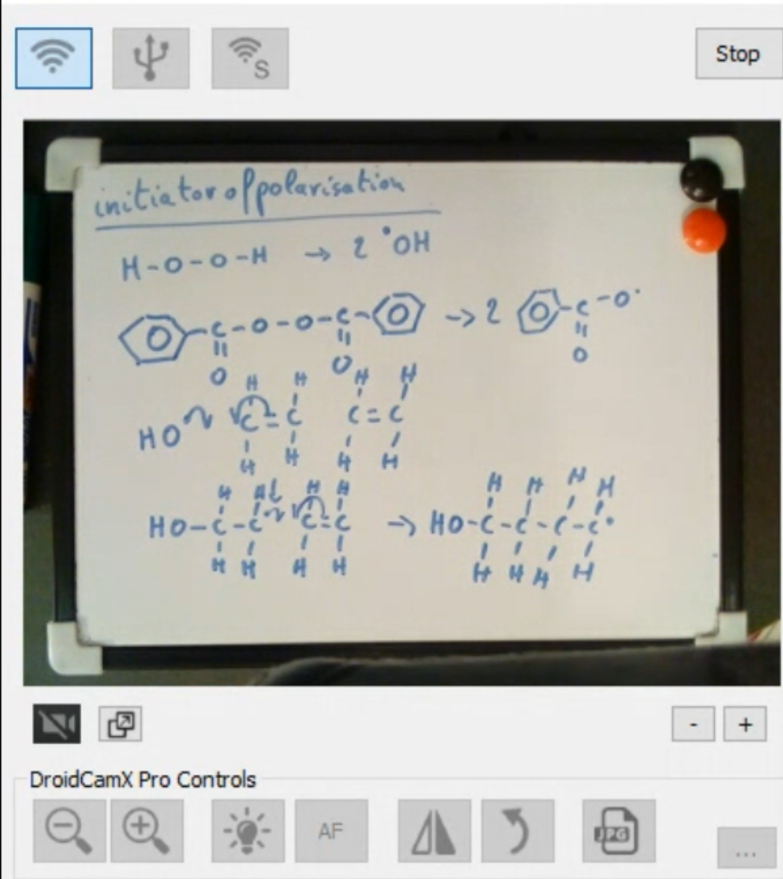
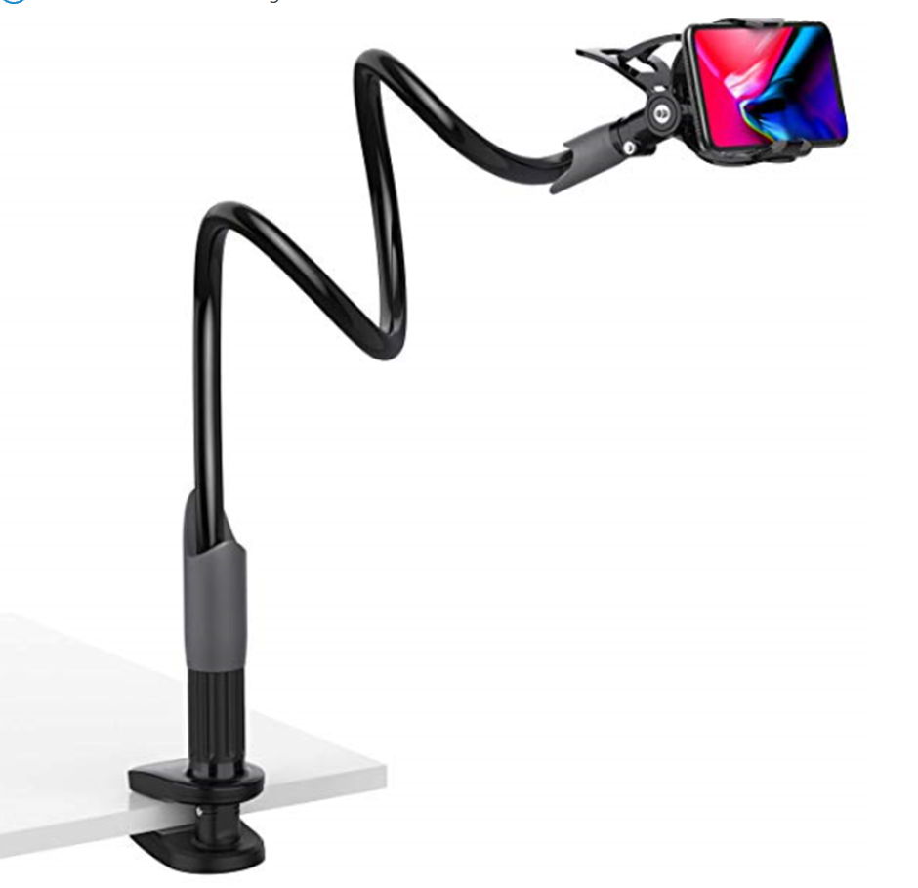
Online equivalent?
Droidcam (Android) or EpocCam (Apple)

Slide 11
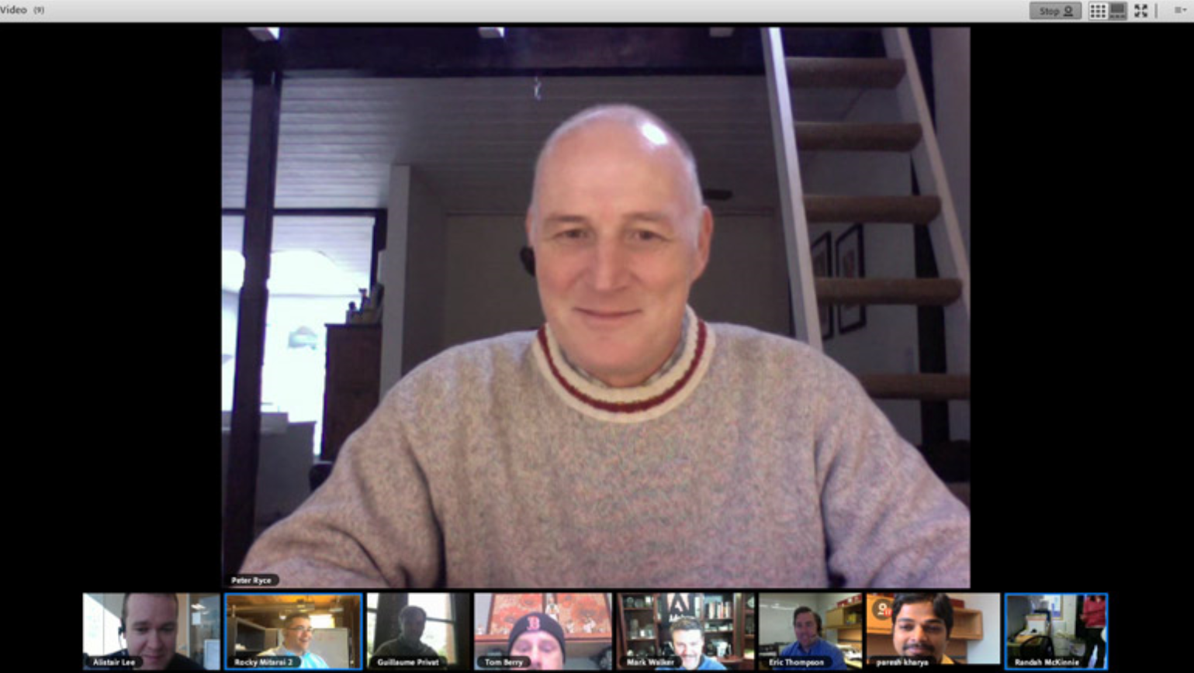
In Adobe Connect

Slide 12
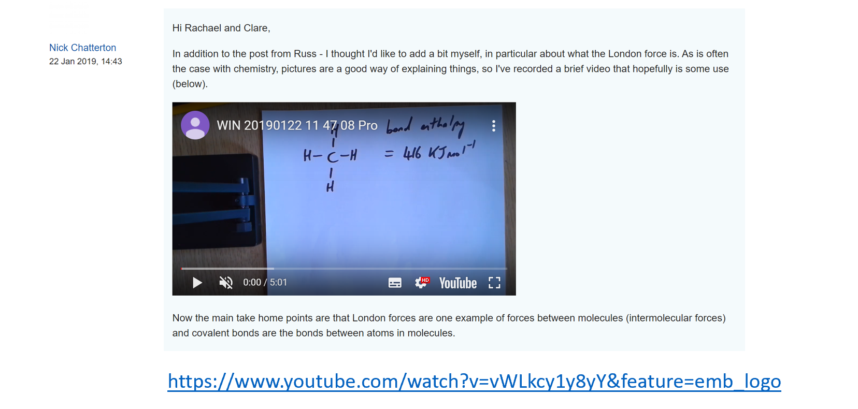
Forum work
Other eSTEeM project on video in response to student queries and tutor use of video in AC tutorials (workshop tomorrow session J 9.30 am)

Slide 13
Student produced videos queries?
We would see how they approached problem and student could talk through/show what they couldn’t do and why
Applicable to mathematical problems also

Slide 14

Issues
GDPR
Class time?
Student Engagement?

Slide 15
Interested? Project will focus on:
Use of ad hoc video in teaching (student and teacher)
Pros and cons
Technological barriers
Unexpected consequences
nicholas.chatterton@open.ac.uk

