Slide 1
Using Adobe Connect Pro CEIT Workshop
Duane Lefevre
Boston University School of Management

Slide 2
Adobe Connect is web conferencing software that allows you to conduct virtual classes
You can securely present PowerPoint slides, conduct discussions via voice and chat, bring guest speakers into the classroom virtually and take polls to be sure students remain engaged
It is technology like this that our students will be using to manage in their increasingly global careers
It uses a web browser and the Adobe Flash Player runtime, which is installed on more than 98% of Internet-connected personal computers
The technology gives the faculty greater flexibility and the students valuable experience

Slide 3
Boston University holds a multiple-seat license that you can use at no charge just by registering
You can host a class or meeting with participants from around campus, the country or the World
You can bring far flung guest speakers into your classroom expanding your guest speaker options
You can have special guests (hundreds of them) join a special class
You can teach class from a remote location if you are at a conference or unable to make class in person for some reason
You can provide students with a taste of how they will increasingly interact in the new global economy
Notes:
Conducted lunch and learns for BofA
Story of my virtual class
Story about Carol Milam

Slide 4
Adobe Connect Pro strikes a nice balance between simple and feature rich capabilities
Allows hundreds of people to attend from multiple locations
Can share video feed -requires all have high speed Internet
Can share PowerPoint, Word or your computer screen
All participants can listen in and speak
Chat room allows for more orderly discussions among a large group of people
Polling feature allows you to get feedback and to track how many people are ‘tuned in’
Break out rooms allow you to go into sub conference mode and divide the meeting up into working groups or teams (VOIP only)
Can be set to record the session so others can listen later
Notes:
It’s why BU telecom selected it over WebEx and others
More than ten people talking can be confusing. Shift to chat for such situations

Slide 5
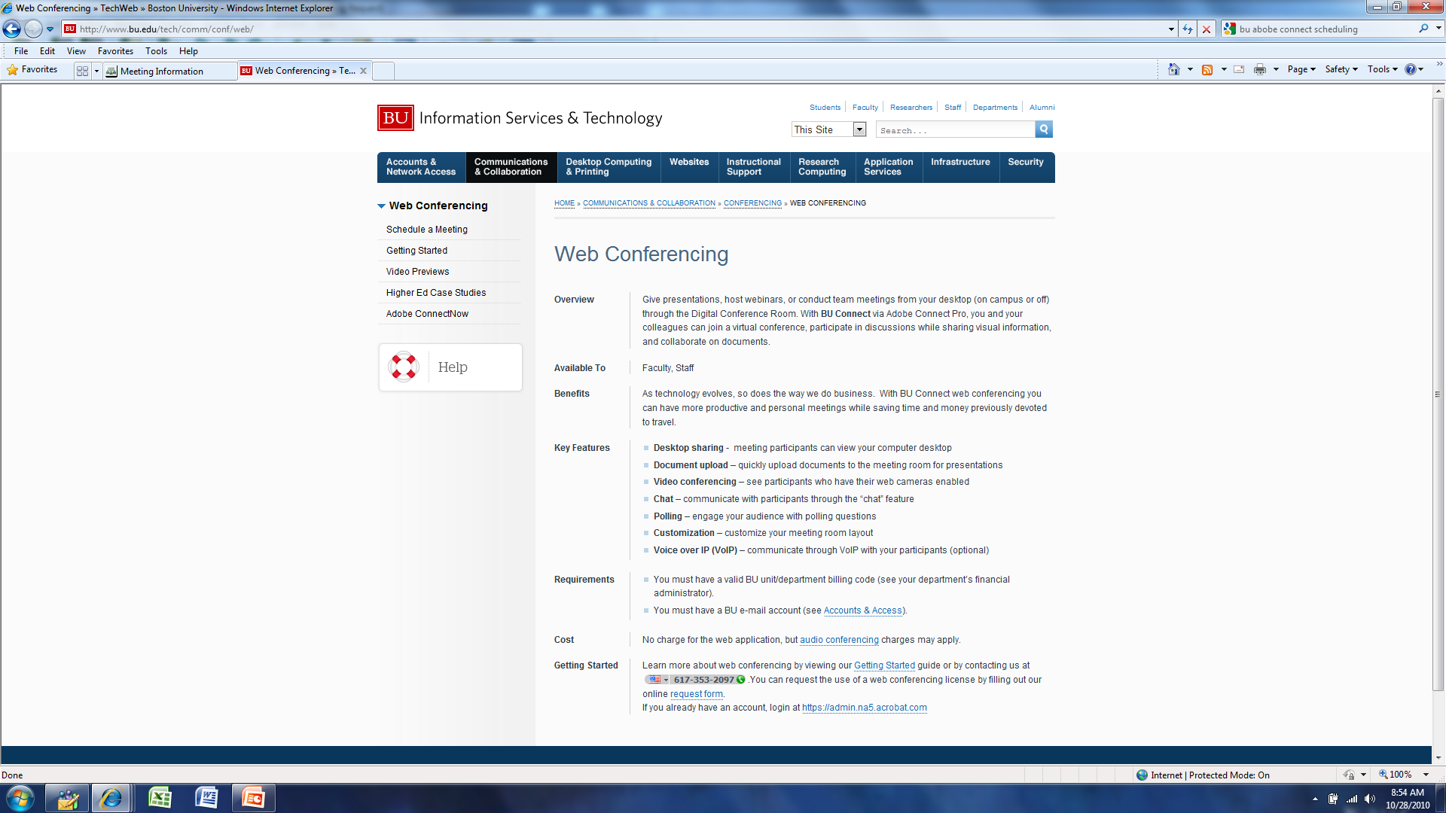
Start here: www.bu.edu/tech/comm/conf/web/
Notes:
http://www.bu.edu/tech/comm/conf/web/

Slide 6
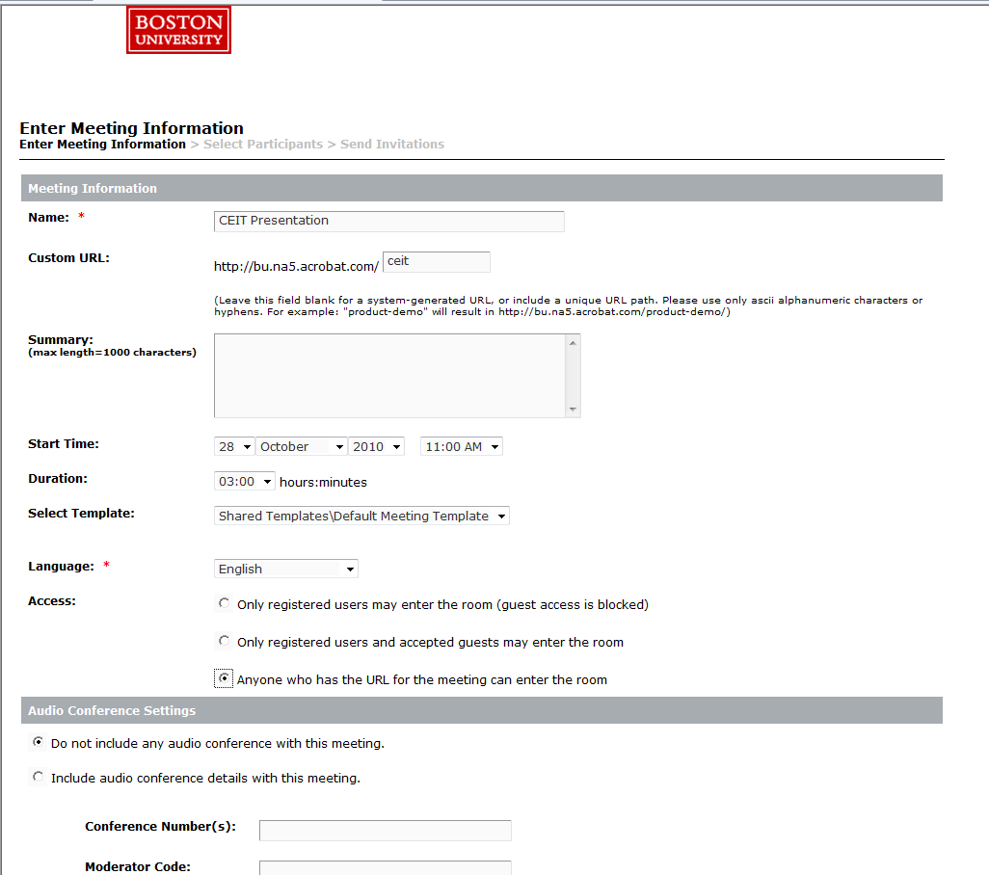
Once registered and signed in, fill in the details of your web conference/class meeting

Slide 7
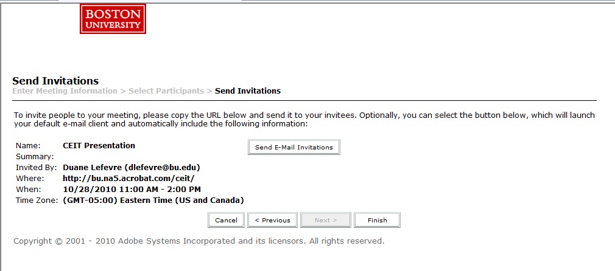
You can set access up a variety of ways from invite-only-with-password to open access

Slide 8
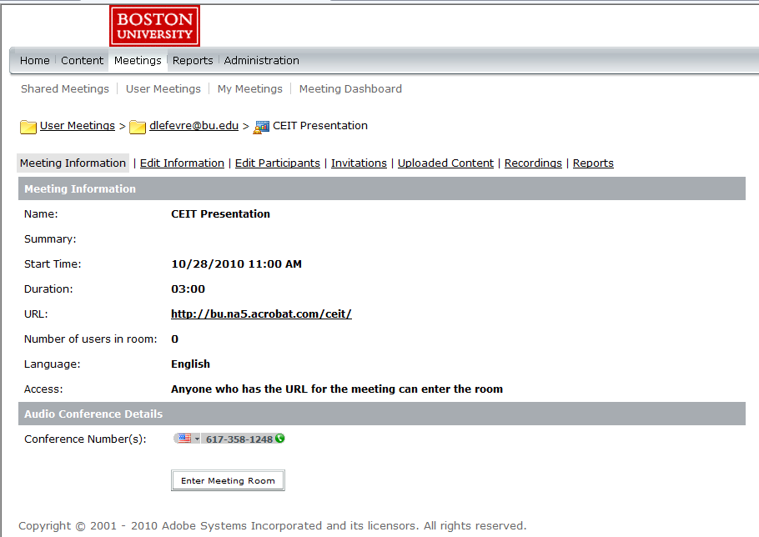
Once registered and set up, this is your dashboard to manage all your meetings and content

Slide 9
You have several telecomm options from VOIP to BU conference line; some free some not
Voice Over Internet Protocol (VOIP)
No telecom charges for you or your participants
Participants need a ‘non-slow’ net connection for good voice quality
Participants need at least a basic headset (mic and headphones) $25
Can mute all participants centrally
Ability to record the session and post a URL so participants can go back or those who missed can ‘attend later’
Capability to transfer the recording to your own PC or server. BU Telecom saves them ‘for a while’
BU Meet Me phone line 617-353-xxxx
No telecom charge for you or and your local participants
Long distance charges for non-local participants (incl. International)
Limit of 25 people
A BU phone number must be the first on the call to ‘open the line’
Participants can call from a cell or landline
Limited ability to mute all participants
Cannot record and post audio
Cannot do breakout rooms; all participants will still be in one pool
Notes:
First caller gets continuous ringing

Slide 10
There is a toll-free option and the charges are billed to you
BU Telecom will give you an 800 number
Charge is 2.9 cents per minute per participant
International lines are available from 8 to 55 cents per minute
When participants log in they get a pop up box asking for their telephone number and the system dials out to them
Recording & posting as well as breakout room options are not possible
Notes:
Toll free number yours forever
Intl can just call in and pay their own phone charges. Via landline, mobile or Skype

Slide 11
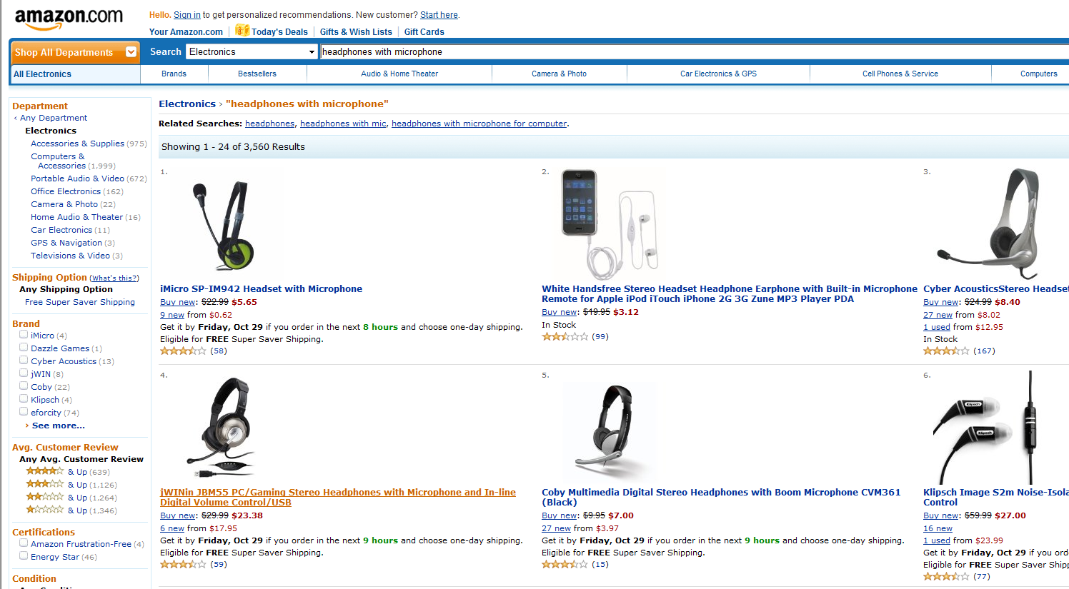
The equipment you’ll need is inexpensive and easily acquired - headsets start at under $10

Slide 12
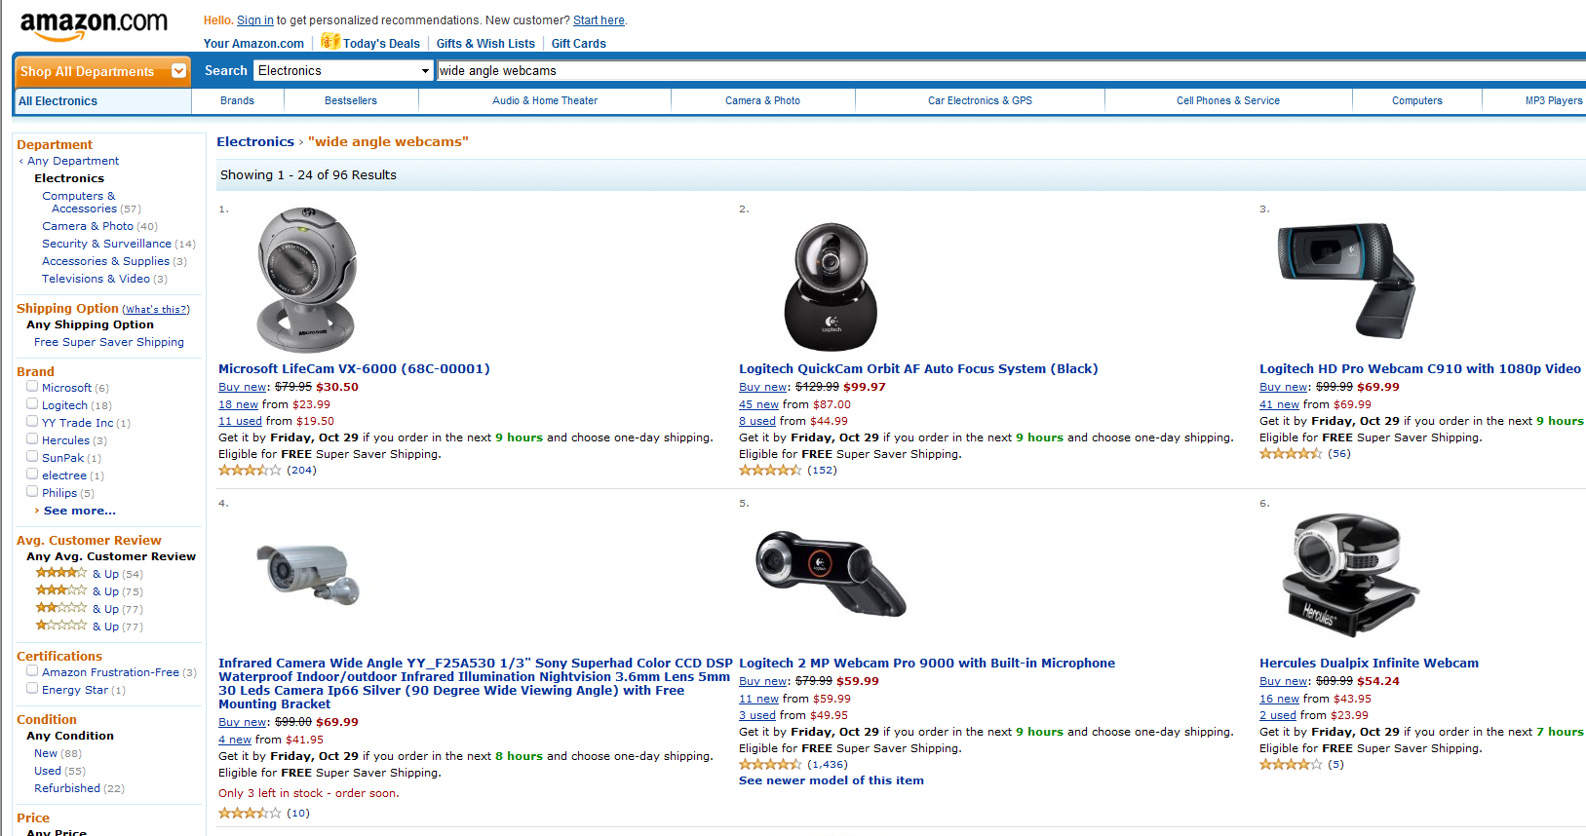
Wide angle webcams will capture a whole conference table and they start as low as $50
Notes:
Don’t need this but it’s a nice feature to have and barely costs extra.

Slide 13
Here are a few practical tips so you don’t have to reinvent the wheel
Demand is not so high now so you can access your conference days before and get set up
Upload your presentations and things you want to share early
Practice using the features you want to use in the actual conference
Turn off your email and instant messenger programs during the conference
Try to get a TA or helper for the actual day; there are lots of moving parts to coordinate (ie: polling)
Notes:
Lots of moving parts so prep early

Slide 14
I can field basic questions. Contact Jason Pina at BU IT for more advanced questions
Duane Lefevre
School of Management
Boston University
T 617-504-3819
dlefevre@bu.edu
Jason Pina
Information Services & Technology
Boston University
T 617-353-6430
jpina@bu.edu
http://www.bu.edu/tech

