Slide 1
Django
Toby Dussek
October 19-21 2020

Slide 2
Times
9:30 start
breaks in the morning
12:30 lunch
breaks in the afternoon
4:30 end
All times are moveable to suit

Slide 3
Introductions
What do you know about Python and web servers
…and any SQL
What do you want to learn

Slide 4
Django URLs
https://docs.djangoproject.com/en/3.0/intro/tutorial01/
https://docs.djangoproject.com/en/3.0/topics/

Slide 5
Django
The web framework for perfectionists with deadlines

Slide 6
Django, MVC and MTV
Classic MVC decouples the presentation layer from application logic
The Django framework is designed like a pipeline to process each request and prepare a response, called Model-Template-View (MTV)
There is separation of concerns between
database interfacing classes (Model)
request-processing classes (View)
A templating language for presentation (Template)
Compared to MVC
Model is comparable to Django's Models
View is usually Django's Templates
Controller is the framework itself that processes an incoming HTTP request and routes it to the correct view function
Django names the callback function to handle each URL a ‘view’ function
This is not related to the MVC pattern's idea of a View

Slide 7
Django install
Check Python is up to date
Check pip is also up to date
python -m pip install --upgrade pip
Install Django
pip install django
pip install django ==3.0
Go for a long-term support version
https://www.djangoproject.com/download/

Slide 8
Uninstalling Django
pip uninstall Django

Slide 9
Create Django Project
Put your code in some directory outside of the web root
Python –m django-admin startproject django_project
Change into the project folder
cd django_project
Run the development server
python manage.py runserver
Ignore the warning about unapplied database migrations
Visit the dev server
http://127.0.0.1:8000/
The development server automatically reloads Python code for each request as needed

Slide 10
https
Web server
-in a folder

Slide 11
Protecting the SECRET_KEY
When you create a new Django project using startproject, the settings.py file is generated automatically and gets a random SECRET_KEY value
This value is the key to securing signed data
It is vital you keep this secure, or attackers could use it to generate their own signed values

Slide 12
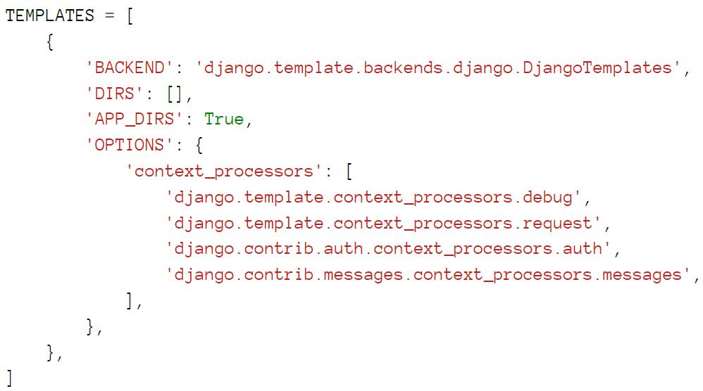
Absolute paths locate the templates directory
Within a projects settings.py file there is a TEMPLATES data structure
You are required to use absolute paths to locate the templates directory
E.g. 'DIRS': ['c:/djapp/templates']
Or TEMPLATE_DIR = os.path.join(BASE_DIR, 'templates') 'DIRS': [TEMPLATE_DIR, ]

Slide 13
Create a Django App in the Project
Choose a location, or stick with the root
i.e. up one level from myapp
Create an app:
python manage.py startapp polls

Slide 14
Using Virtual Environments
Django will work in a Python virtual environment if you need it

Slide 15
About Websites, Web Apps and Content Management Systems
The modern web uses http(s)
Users expect responsive content
HTML CSS and JavaScript are the only tools in a browser
Client-Server interactions (request/response)
URLs and RESTful end-points
Not Single-Page Apps (SPA), but conventional submit-respond
Forms: GET and POST

Slide 16
Django Projects and Apps

Slide 17
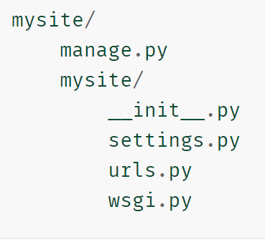
Creating a Django Project
You can check which version of Django is installed
python -m django –version
Create a Django project called ‘mysite’ in the current directory (outside the web server root)
django-admin startproject mysite
Run development server
python manage.py runserver
see http://127.0.0.1:8000/
Can specify which port:
python manage.py runserver 8080

Slide 18
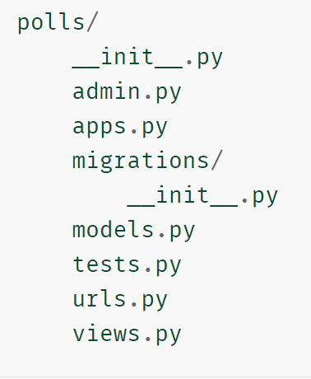
Creating an App and Views in a Django Project
To create an app called ‘polls’ (in the same directory as manage.py)
python manage.py startapp polls
Edit polls/views.py to define a view
Create urls.py in the ‘polls’ directory (this will contain our URLconf)
Once the view is written and configured, see http://localhost:8000/polls/

Slide 19
Project Workflow
Gather requirements
Create conceptual HTML mock-ups
Divide a project into Apps
Write a new app (or reuse an existing one)

Slide 20
Gathering Requirements

Slide 21
Views
The request object parameter is required by all views
Request is the entire request object received from the browser
Includes full URL path, method etc.

Slide 22
Creating templates for views
Django has a powerful template language to specify how data is displayed:
template tags {% tag %}
template variables {{ variable }}
template filters {{ variable|filter }}
Example Filters:
truncatewords truncates the value to the number of words specified
linebreaks converts the output into HTML line breaks

Slide 23
Using class-based views
Call a view via web request
returns a web response
Can define your views as class methods

Slide 24
Staticfiles Template
{% load staticfiles %} tells Django to load the staticfiles template tags provided by django.contrib.staticfiles
You can then use the {% static %} template filter throughout the current template

Slide 25
Customising the Welcome Page
To create a welcome page
define an application entry point (a URL)
tell Django to call a Python function when a visitor accesses this URL

Slide 26
Django on Apache
Django can embed its Python code within Apache
This Python code is loaded into memory when the server starts
Code stays in memory throughout the life of an Apache process, which leads to significant performance gains

Slide 27
Models and Databases

Slide 28
Object-relational mapper
This is one of the most important parts of the Django project
Django's database component (the ORM) provides a bridge between the data model and the database engine
The ORM layer provides encapsulation, portability, safety, and expressiveness to Django's Model Class, which are mapped to the configured database of choice

Slide 29
Django and Databases
Django supports many database servers
Django is officially supported with
PostgreSQL
MySQL
Oracle
SQLite
There are back-ends provided by 3rd parties that allow you to use other databases with Django

Slide 30
Python Database Bindings
In addition to a database backend, make sure Python database bindings are installed
PostgreSQL needs the psycopg2 package
MySQL, needs a DB API driver like mysqlclient
Oracle needs cx_Oracle

Slide 31
Grant Django Database Permissions
Grant SELECT, INSERT, UPDATE and DELETE permissions
After creating a database user with these permissions, specify the details in the project settings file

Slide 32
Models
A model is the single, definitive source of information about your data
Contains the essential fields and behaviours of the data you’re storing
Each model maps to a single database table
Each model is a Python class that subclasses django.db.models.Model
Each attribute of the model represents a database field
Django provides an automatically-generated database-access API
The name of the table is automatically derived from some model metadata (can be overridden)
An id field is added automatically (can be overridden)
Django uses SQL tailored to the database backend specified in your settings file

Slide 33
Fields
The most important part of a model is the list of database fields it defines
This is the only required part of a model
Each field in your model should be an instance of the appropriate Field class
Django uses the field class types to determine
The column type, which tells the database what kind of data to store
e.g. INTEGER, VARCHAR, TEXT
The default HTML widget to use when rendering a form field
e.g. <input type="text">, <select>
The minimal validation requirements
used in Django’s admin and in automatically-generated forms

Slide 34
Field options
Each field takes a set of field-specific arguments such as
CharField require a max_length argument for the size of the VARCHAR database field
Optional common arguments are available to all field type, including
null
If True, Django will store empty values as NULL in the database (Default is False)
blank
If True, the field is allowed to be blank (Default is False)
Note that this is different than null
null is database-related, whereas blank is validation-related
If a field has blank=True, form validation will allow entry of an empty value
If a field has blank=False, the field will be required
choices
An iterable (e.g. list or tuple) of 2-tuples to use as choices for this field
If this is given, the default form widget will be a select box instead of the standard text field and will limit choices to the choices given

Slide 35
How To Configure A Database
configure the settings.py file with settings for any database
MySQL
PostreSQL
SQLite

Slide 36
MySQL
DATABASES = {
'default': {
'ENGINE': 'django.db.backends.mysql',
'NAME': 'djangostack',
'HOST': '/opt/bitnami/mysql/tmp/mysql.sock',
'PORT': '3306',
'USER': 'USERNAME',
'PASSWORD': 'PASSWORD'
}
}

Slide 37
PostgreSQL
DATABASES = {
'default': {
'ENGINE': 'django.db.backends.postgresql_psycopg2',
'NAME': 'djangostack',
'HOST': '/opt/bitnami/postgresql',
'PORT': '5432',
'USER': 'USERNAME',
'PASSWORD': 'PASSWORD'
}
}

Slide 38
SQLite
DATABASES = {
'default': {
'ENGINE': 'django.db.backends.sqlite3',
'NAME': '/opt/bitnami/apps/django/django_projects/PROJECT/PROJECT/PROJECT.db'
}
}

Slide 39
Database setup
Create tables in the database
python manage.py migrate

Slide 40
Creating models
Edit polls/models.py
This tells Django to create a database schema (CREATE TABLE statements) and a Python database-access API for the app
Edit mysite/settings.py to tell Django the app is installed
Add new apps to INSTALLED_APPS then create the model tables in the database
python manage.py migrate ( or just ‘manage.py migrate’ )

Slide 41
Registering Migrations
Can register the changes with the makemigrations command
python manage.py makemigrations polls
A Python script gets created, e.g. 0001_initial.py
contains all the necessary details to create your database schema at that particular migration
You can always view a migration
python manage.py sqlmigrate polls 0001

Slide 42
Restrictions on model field names
A field name cannot be a Python reserved word
would result in a Python syntax error
A field name cannot contain more than one underscore in a row (due to Django’s query lookup syntax)
SQL reserved words are allowed as model field names
Django escapes all table and column names in every underlying SQL query

Slide 43
Creating a Database Management super-user
When running the first migration, a db.sqlite3 file is created in the project’s root
Provide a super user for this database
python manage.py createsuperuser
(Password must be 8 characters)

Slide 44
The Django Shell API
Calling ‘manage.py’ sets the DJANGO_SETTINGS_MODULE environment variable
Also gives Django the Python import path to mysite/settings.py
python manage.py shell
This might use IPython shell

Slide 45
The Admin Interface
The admin interface and it’s views are pre-installed when the app is created
Start the Django development server
manage.py runserver (Enter username and password created on command line)
Can create and manage users here
Edit polls/admin.py to register models in the admin interface
admin.site.register(Page)

Slide 46
Plural vs. Singular Spellings
Edit models.py to specify quantitative spellings
Set ‘class meta’ details
Then the admin interface will use these variations based on quantity

Slide 47
When QuerySets are evaluated
You can concatenate as many filters as you like to a QuerySet
You will not hit the database until the QuerySet is evaluated
Querysets are only evaluated in the following cases:
The first time you iterate over them
When you slice them. for instance: Post.objects.all()[:3]
When you pickle or cache them
When you call repr() or len() on them
When you explicitly call list() on them
When you test it in a statement such as bool(), or , and, or if

Slide 48
Models, Templates and Views

Slide 49
Simple Forms

Slide 50
Form handling functionality
display an HTML form with automatically generated form widgets (e.g. text field or date picker)
check submitted data against a set of validation rules
redisplay a form in case of validation errors
convert submitted form data to the relevant Python data types

Slide 51
Forms Workflow
Create forms.py within the application directory for form-related classes
Create a ModelForm class for each model to be represented as a form
Customise the forms
Create a view to handle the form
Display the form
Validate the form data
Save the form data
Create a template to display the form
Add a urlpattern to map to the form view

Slide 52
ModelForm Classes
a ModelForm is a helper class that allows you to create a Django Form from pre-existing model or models

Slide 53
Working with Templates
Re-structure and refactor templates to use inheritance and remove repetition

Slide 54
The render() Method and the request Context
Best practice to use the render method
Always must pass the request object
Optionally pass the contect_dict

Slide 55
Authorization and Authentication

Slide 56
User Authentication
The auth app is included in the Django installation
located in django.contrib.auth package
It provides the following:
The concept of a User
Permissions, a series of binary flags (e.g. yes/no) that determine what a user may or may not do
Groups, a method of applying permissions to more than one user
A configurable password hashing system, a must for ensuring data security
Forms and view tools for logging in users or restricting content

Slide 57
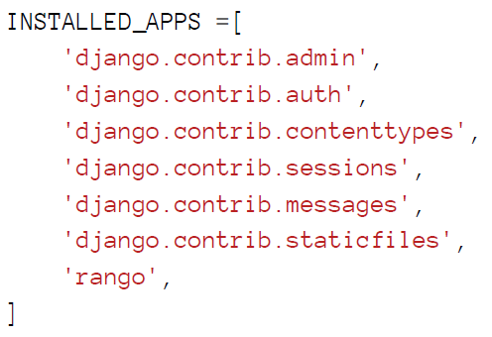
Settings
Within INSTALLED_APPS list of settings.py file
django.contrib.auth
provides Django with access to the provided authentication system
django.contrib.contenttypes
used by the authentication app to track models installed in your database

Slide 58
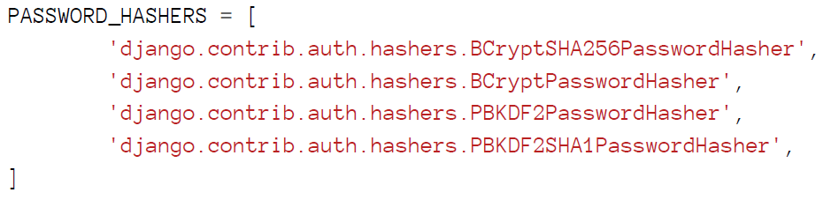
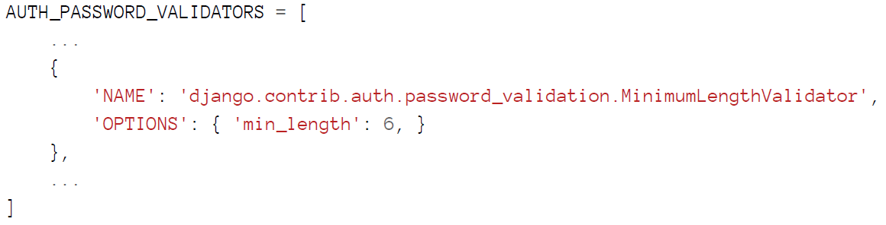
Hashers and Validators
The settings.py file also controls
PASSWORD_HASHERS
AUTH_PASSWORD_VALIDATORS

Slide 59
The User Model
The User model is the core of Django’s authentication system
Five key attributes
username for the user account
account password
email address
first name
surname
Plus other attributes such as is_active, is_staff and is_superuser

Slide 60
Handling Profile Images
The ImageField field has an ‘upload_to’ attribute
It’s value is conjoined with the projects MEDIA_ROOT setting to provide a path where uploaded profile images will be stored
E.g.
MEDIA_ROOT: ‘<workspace>/tango_with_django_project/media/’
upload_to attribute: ‘profile_images’
all profile images will be stored in ‘<workspace>/tango_with_django_project/media/profile_images/’

Slide 61
Python Image Library (pillow)
Install pillow package:
pip install pillow
check what packages are installed:
pip list

Slide 62
Restricting Access
There are two ways in which we can restrict access
Examine the request object in the view to check if the user is authenticated: user.is_authenticated()
Use a decorator function that checks if the user is authenticated: @login_required def restricted(request): return HttpResponse("Since you're logged in, you can see this text!")
… or just use the django-registration-redux app

Slide 63
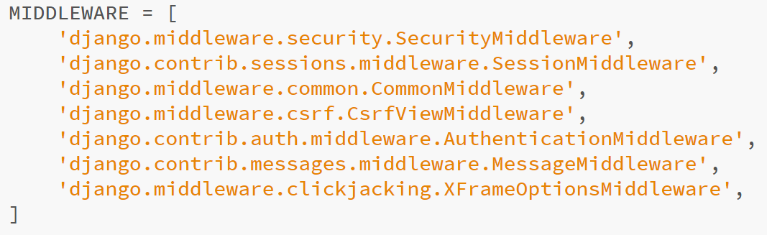
Sessions and cookies
Django implements sessions via middleware in settings.py

Slide 64
All cookie values are returned as strings
Do not assume that a cookie storing whole numbers will return an integer
You have to manually cast this to the correct type

Slide 65
Session Data
To use session based cookies:
Make sure that the MIDDLEWARE_CLASSES list in settings.py module contains
django.contrib.sessions.middleware.SessionMiddleware.
Make sure that django.contrib.sessions is in INSTALLED_APPS in settings.py
If not, add it and run python manage.py migrate
By default a database backend is assumed
You could setup a cache instead
A session ID cookie is still used on the client machine, but all the user session data is stored server side

Slide 66
Storing Session Data Server Side
An advantage of storing session data server-side is its ability to cast data from strings to the desired type
This only works for built-in types, such as int, float, long, complex and Boolean

Slide 67
Browser-Length and Persistent Sessions
browser-length sessions expire when the user closes the browser
In settings.py SESSION_EXPIRE_AT_BROWSER_CLOSE = true (disabled by default)
persistent sessions last over several browser instances, expiring at a time of your choice
In settings.py SESSION_EXPIRE_AT_BROWSER_CLOSE = false (enabled by default) SESSION_COOKIE_AGE = 1209600 (two weeks in seconds)
Periodically clear the cookies database
python manage.py clearsessions

Slide 68
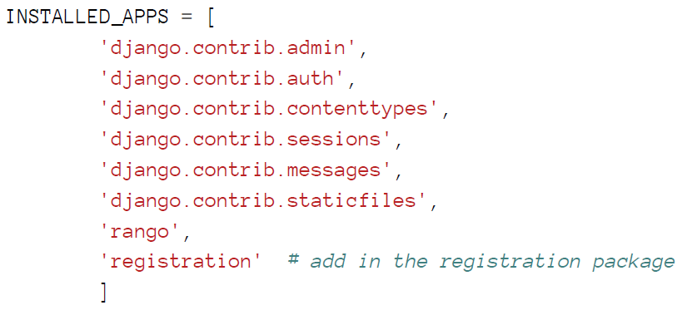
Authentication with Django-Registration-Redux
install django-registration-redux
pip install django-registration-redux
In settings.py update INSTALLED_APPS

Slide 69
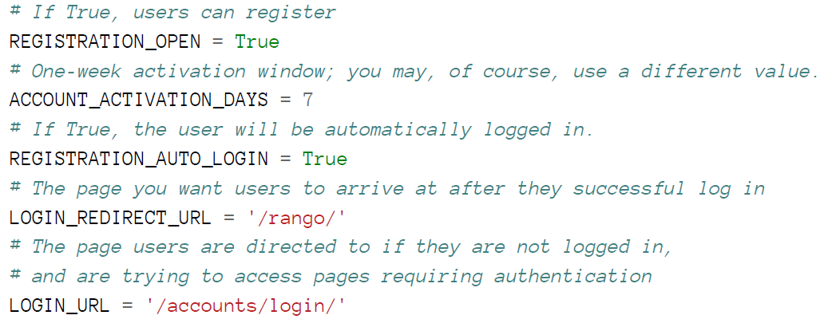
settings.py

Slide 70
Functionality and URL mapping
The Registration Redux package provides numerous functions
registration.backend.simple.urls provides
registration -> /accounts/register/
registration complete -> /accounts/register/complete/
login -> /accounts/login/
logout -> /accounts/logout/
password change -> /password/change/
password reset -> /password/reset/

Slide 71
Activating accounts in a two stage process
activation complete
activate/complete/
activate
activate/<activation_key>/
activation email
activation email body
activation email subject

Slide 72
Using Bootstrap for Styles in Django
pip install django-bootstrap4
https://github.com/zostera/django-bootstrap4

Slide 73
Production Deployment

Slide 74
Web Server Gateway Interface (WSGI)
WSGI is the specification for how web servers communicate with application frameworks such as Django
WSGI servers include
Apache via mod_wsgi
Gunicorn
uWSGI
CherryPy
Tornado
Chaussette

Slide 75
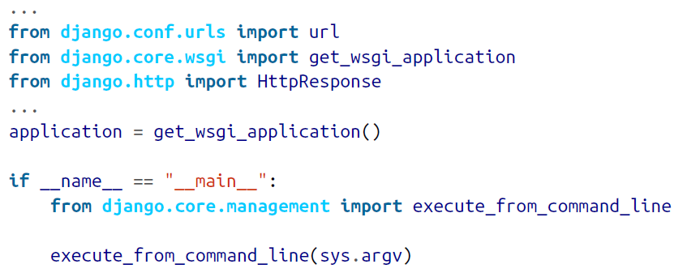
Django WSGI interface
get_wsgi_application
In wsgi.py (created automatically)

Slide 76
Other Topics

Slide 77
How pagination works
Instantiate the Paginator class with the number of objects to display in each page
The page GET parameter indicates the current page number
Obtain objects by calling the page() method of Paginator
If the page parameter is not an integer retrieve the first page of results
If this parameter is a number higher than the last page of results retrieve the last page
Pass the page number and retrieved objects to the template

Slide 78
Review Exercise

Slide 79
Testing Websites

Slide 80
Unit and e2e Testing
unit tests
the focus is on individual components
end-to-end (e2e) tests
the focus is on how the application or a module, as a whole, works, such as confirming the click of a button has certain outcomes

Slide 81
Protractor
Protractor is an end-to-end testing framework
Runs on NodeJS
Tests are written in Jasmine
Runs on any server
Usually use Selenium Server
Automates testing every layer of a web app
UI
Client-side logic
Server-side services

Slide 82
Using npm to install Testing Tools (requires Java SDK)
Choose where you want your web root to be
At a command prompt install karma globally
npm install karma –g
karma --version
At a command prompt install protractor globally
npm install protractor –g
protractor --version
some locations will require admin level access
Then update the webdriver manager (which comes with protractor)
webdriver-manager update
and when done...
webdriver-manager start
then browse to http://localhost:4444/wd/hub
Write tests, then at a command prompt: protractor conf

Slide 83
End to End Test-Driven Development
first write the test
then write the code until it passes the test
then improve the code
then write another test and iterate

Slide 84
Assemble, Act, and Assert
describe('',function(){
beforeEach(function(){
});
it('',function(){
});
});

Slide 85
Locators
Most common locators are
by.css
by.id
by.model
by.binding
For css locator can use jQuery-like syntax

Slide 86
Actions on locators
Nothing happens until an action is called on a locator
Most common actions are
click
sendKeys
clear
getAttribute
They are all async so we can chain them together

Slide 87
Finding Multiple Elements
element.all returns an array
all has helpers
.count
.get(index)
first
last
Find sub elements by chaining selectors

