Slide 1
Python
Toby Dussek
March 2021

Slide 2
Course Times
9:30 start
11:00 coffee
12:30-1:30 lunch
3:00 tea
4:30 end

Slide 3
Your Experience and Expectations
What you currently know
coding experience
What you need to know
What you want from this course

Slide 4
Python Introduction
Introducing Python 2 and 3
Numbers, Strings, Variables and Data Structures
Code Structures
Functions
Namespaces and Scope
Packages and Programs
Objects and Classes
Data Files
Brief Overview of Python in Use

Slide 5
Useful URLs
Online Documentation https://docs.python.org/3/
Python coding style guide https://www.python.org/dev/peps/pep-0008/
Pretty good online book https://diveintopython3.net/

Slide 6
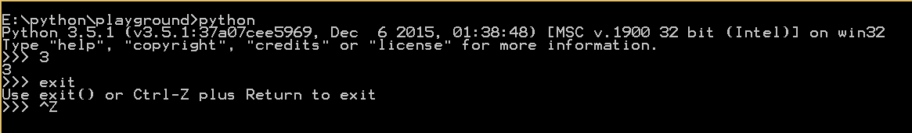
Starting Python Interpreter
At a command prompt, just type python
Should show a version number
Also shows a python prompt
Ctrl-Z to exit

Slide 7
>>> import this (The Zen of Python, by Tim Peters)
Beautiful is better than ugly.
Explicit is better than implicit.
Simple is better than complex.
Complex is better than complicated.
Flat is better than nested.
Sparse is better than dense.
Readability counts.
Special cases aren't special enough to break the rules.
Although practicality beats purity.
Errors should never pass silently.
Unless explicitly silenced.
In the face of ambiguity, refuse the temptation to guess.
There should be one--and preferably only one--obvious way to do it.
Although that way may not be obvious at first unless you're Dutch.
Now is better than never.
Although never is often better than *right* now.
If the implementation is hard to explain, it's a bad idea.
If the implementation is easy to explain, it may be a good idea.
Namespaces are one honking great idea--let's do more of those!

Slide 8
Python variables are just names
Assignment does not copy a value, it just attaches a name to the object that contains the data
The name is a reference to a thing rather than the thing itself
Variable names cannot begin with a digit and can be made up of
Lowercase letters a to z
Uppercase letters A to Z
Digits 0 to 9
Underscore _

Slide 9
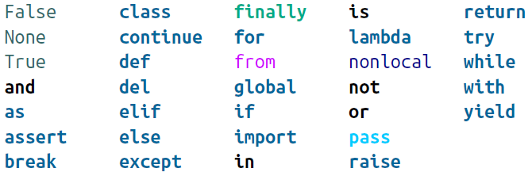
Some Python Reserved Words

Slide 10
Python Types
Simple built-in types:
boolean
integer
float
string
‘long’ type from Python 2 has gone in Python 3

Slide 11
Everything is an Object
Everything in Python is implemented as an object
This includes booleans, integers, floats, strings, large data structures, functions, and programs
if you want to know the type of anything use
type( thing )

Slide 12
Structures
string
w = "hello“
Immutable sequence of characters
list
n = [1,2,3,4]
Mutable sequence of any values, accessed by their offset from 0
tuple
t = 1,2,3,4
t = (1,2,3,4)
Immutable sequence of any values, accessed by their offset from 0
dictionary
d = {"Moe": "huh?", "Larry": “ow!", "Curly": “nyuk!",}
Unordered collection of unique keys and associated values of any type
set
b = {"Moe", "Larry", "Curly"}
Unordered collection of unique keys without associated values

Slide 13
By Reference or By Value
All simple variables are handled by value
a = 1
b = a # b now has the value 1
All other structures are handled by reference
t1 = (5,4,3)
t2 =t1 # t1 and t2 refer to the SAME tuple, containing 5, 4, 3

Slide 14
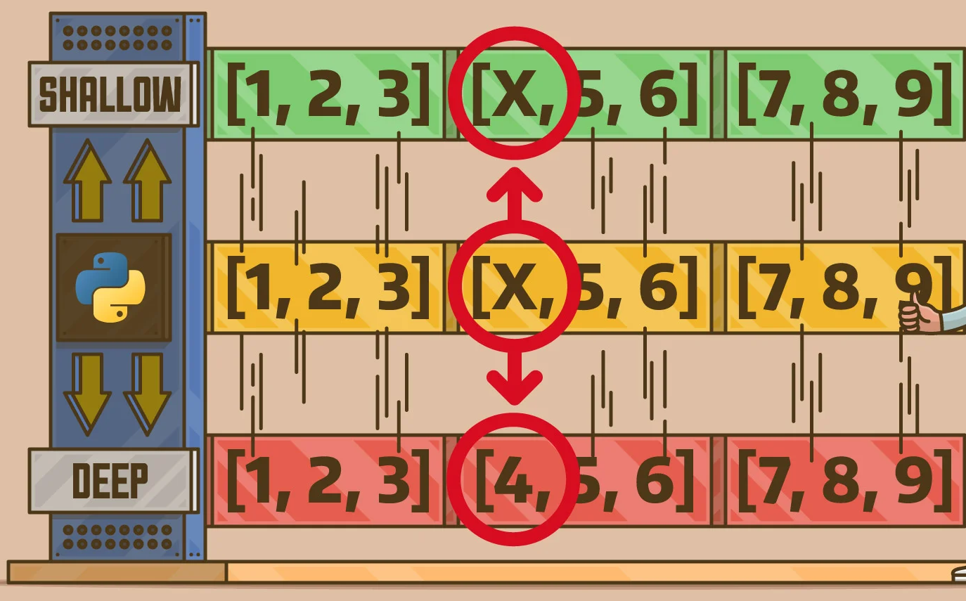
Shallow and Deep
https://realpython.com/copying-python-objects/

Slide 15
Equality and Assignment
Python uses = for assignment
For testing equality use ==

Slide 16
Type
>>> type(58)
<class 'int'>
>>> type(99.9)
<class 'float'>
>>> type('abc')
<class 'str'>

Slide 17
Operators
Operator | Description | Example | Result
+ | addition | 5 + 8 | 13
- | subtraction | 90 - 10 | 80
* | multiplication | 4 * 7 | 28
/ | floating point division | 7/2 , 6/3 | 3.5 , 2.0
// | integer (truncating) division | 7 // 2 | 3
% | modulus (remainder) | 7 % 3 | 1
** | exponentiation | 3 ** 4 | 81

Slide 18
Truthy and Falsy
These are all considered False
boolean | False
null | None
zero integer | 0
zero float | 0
empty string | ''
empty list | []
empty tuple | ()
empty dict | {}
empty set | set()
…anything else is considered True

Slide 19
Computers are good at binary
Real numbers are a problem, but Python is unusual in handling really huge numbers well
Can express literal integers in three bases besides decimal:
0b or 0B for binary (base 2)
0o or 0O for octal (base 8)
0x or 0X for hex (base 16)
How big is an int
An int can be any size
Even greater than 64 bits e.g. googol = 10**100
There is a Math package too

Slide 20
Boolean
Python’s simplest data type is the boolean, which has only the values True and False (note the case)
When converted to integers, they represent the values 1 and 0
>>> int(True)
1
>>> int(False)
0

Slide 21
Type Conversions
To change other Python data types to an integer use the int() function
This will keep the whole number and discard any fractional part
Converting a floating-point number to an integer just lops off everything after the decimal point
>>> int(98.6)
98
>>> int(1.0e4)
10000

Slide 22
Converting a text string containing only digits
int() will make integers from floats or strings of digits, but won’t handle strings containing decimal points or exponents
>>> int('99')
99
>>> int('-23')
-23
>>> int('+12')
12
If you try to convert something that doesn’t look like a number, you’ll get an exception

Slide 23
Writing Python Code
From a terminal via an interactive interpreter
Comes with Python
Enter commands line by line and see the results immediately
In an IDE
IDLE
PyCharm
Anaconda
IPython/Jupyter Notebooks

Slide 24
Adding Python Packages
See what’s installed already
At a Python prompt, type help() then type modules
if Anaconda is installed, type conda list
Make sure pip is installed
At a command prompt type python -m ensurepip
Pip might need to be run from the scripts folder
E.g. c:/python37/scripts
Add more packages as needed
E.g. at a command prompt type python –m pip install pyperclip
Many scientific and mathematical packages
NumPy
SciPy

Slide 25
Virtual Environments
Create a self-contained place to install packages and run Python
python -m venv playground
Invoke the environment
playground\scripts\activate.bat (on Windows)
source playground/bin/activate (on Mac and Linux)
You then have a virtual environment where you can install packages
(playground) $ pip list (on Mac and Linux)
(playground) C:\Python39> pip list (on Windows)
This environment is entirely separate from any other Python installs and packages elsewhere on your system

Slide 26
Python
Python uses white space to define program structure
Usually four spaces for indentation
Comment with #
Continue Lines with \
White-space problems will stop your code working

Slide 27
Code Structures
Indentation and colon
Loops and conditionals

Slide 28
Running Programs
Can include a shebang line at the top of the script to tell the operating system where to locate the correct Python interpreter
#! /usr/bin/python3 - linux
Save the .py file to a home folder
Change the file permissions to make it executable:
chmod +x pythonScript.py
Run your script from a Terminal window:
./pythonScript.py
Open a program in the interactive interpreter
python -i filename.py

Slide 29
Comprehensions
A comprehension is a compact way to create a data structure from one or more iterators
Comprehensions make it possible to combine loops and conditional tests with less verbose syntax

Slide 30
Comprehensions
List Comprehension
Dictionary Comprehension
Generators
range
generator functions

Slide 31
Scope and namespacing
There is always a global scope
Every code block creates it’s own scope
Must state which globals will be available within another scope
Use global keyword
globals() and locals() dictionaries

Slide 32
Creating Programs and Modules

Slide 33
The Python Standard Library
https://docs.python.org/3/library/

Slide 34
Functions
Define and call
Optional parameters
Return value (or None)

Slide 35
Basic inheritance
Every class we create uses inheritance
All Python classes are subclasses of the object class
If we don't explicitly inherit from a different class, classes will automatically inherit from object

Slide 36
**kwargs syntax
Collects any keyword arguments passed into the method that were not explicitly listed in the parameter list
These arguments are stored in a dictionary named kwargs
Can call the variable whatever we like, conventionionally kwargs
When we call a different method (e.g. super().__init__) with a **kwargs syntax, it unpacks the dictionary and passes the results to the method as normal keyword arguments

Slide 37
methods go in classes, which go in modules, which go in packages
Classes can be defined anywhere
They are typically defined at the module level, but they can also be defined inside a function or method

Slide 38
Methods
All methods have one required argument, conventionally named self

Slide 39
__init__
The Python initialization method is the same as any other method, except it has a special name, __init__
The leading and trailing double underscores mean this is a special method that the Python interpreter will treat as a special case
Can use the same syntax Python functions use to provide default arguments
The keyword argument syntax appends an equals sign after each variable name
If the calling object does not provide this argument, then the default argument is used instead
The variables will still be available to the function, but they will have the values specified in the argument list
E.g.
class Point:
def __init__(self, x=0, y=0):
self.move(x, y)

Slide 40
Docstrings
Use triple-quotes at the top of a clas to give th class some documentation

Slide 41
__init__.py
Use it to import from other modules in this package
Write an initialize method to avoid creating classes as soon as imported

Slide 42
Using main
As soon as it’s import, any code at the module level is immediately executed
Can end up running the first program when we really only meant to access a couple functions inside that module
To solve this, we should always put startup code in __main__ function
Only execute that function when we know we are running the module as a script
if __name__ == "__main__":
main()

Slide 43
No private/protected members
Python doesn't enforce laws that might someday get in your way
Instead, it provides unenforced guidelines and best practices
Technically, all methods and attributes on a class are publicly available
If we want to suggest that a method should not be used publicly, we can put a note in docstrings indicating that the method is meant for internal use only
By convention also prefix with an underscore character _
Prefix with a double underscore __ performs name mangling on the attribute in question
There are very few good reasons to use a name-mangled variable in Python

Slide 44
Class Variables
Members defined in the class are part of the class definition, shared by all instances of this class
If you set the variable using self.some_variable, you will actually be creating a new instance variable (associated only with that object)
The class variable will still be unchanged

Slide 45
the list itself extends the object class:
>>> isinstance([], object)
True
Most built-in types can be similarly extended. Commonly extended built-ins are object, list, set, dict, file, and str. Numerical types such as int and float are also occasionally inherited from

Slide 46
PyCharm
Maintains a virtual environment for each project
To add a package
File->settings
Search for your project
Choose ‘Project Interpreter’
Use the + sign (top right corner) to add a package
Type or find the name
Click ‘Install Package’

Slide 47
Python in Use
Data Analysis
Numpy
pandas
MatPlotLab
Sonic Pi

