Slide 1
PILLAR
Smart Legislation Platform
From Paper Archives to Codified Law
Emil V. Capino | BayanAIhan
pillar.bayanaihan.net

Slide 2
THE PROBLEM
349 Ordinances. 35 Years.
Zero Digitized.
• Decades of legislation locked in filing cabinets — no search, no index
• No way to detect contradictions between old and new ordinances
• DILG compliance requires digitized, classified archives

Slide 3
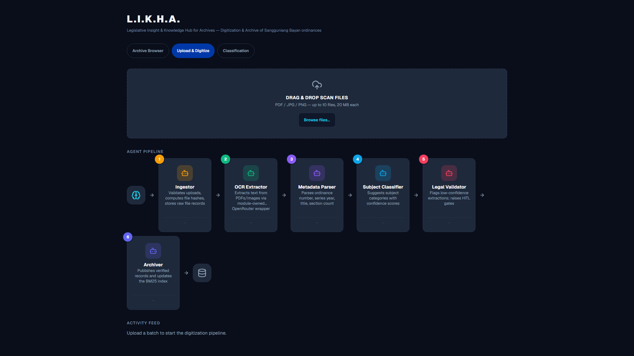
LIKHA — Digitization
Upload, OCR, classify — with mandatory human review

Slide 4
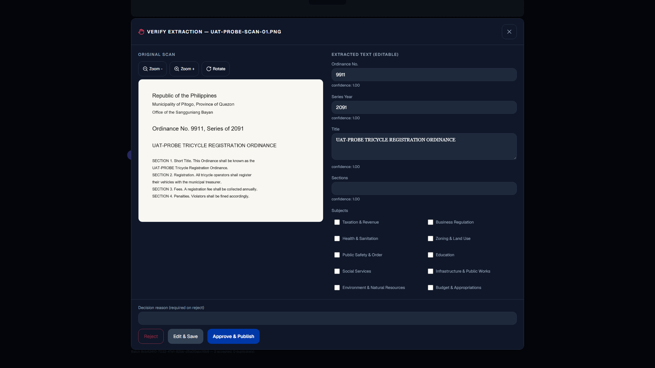
LIKHA — Human-in-the-Loop Review
Every legal decision requires human approval

Slide 5
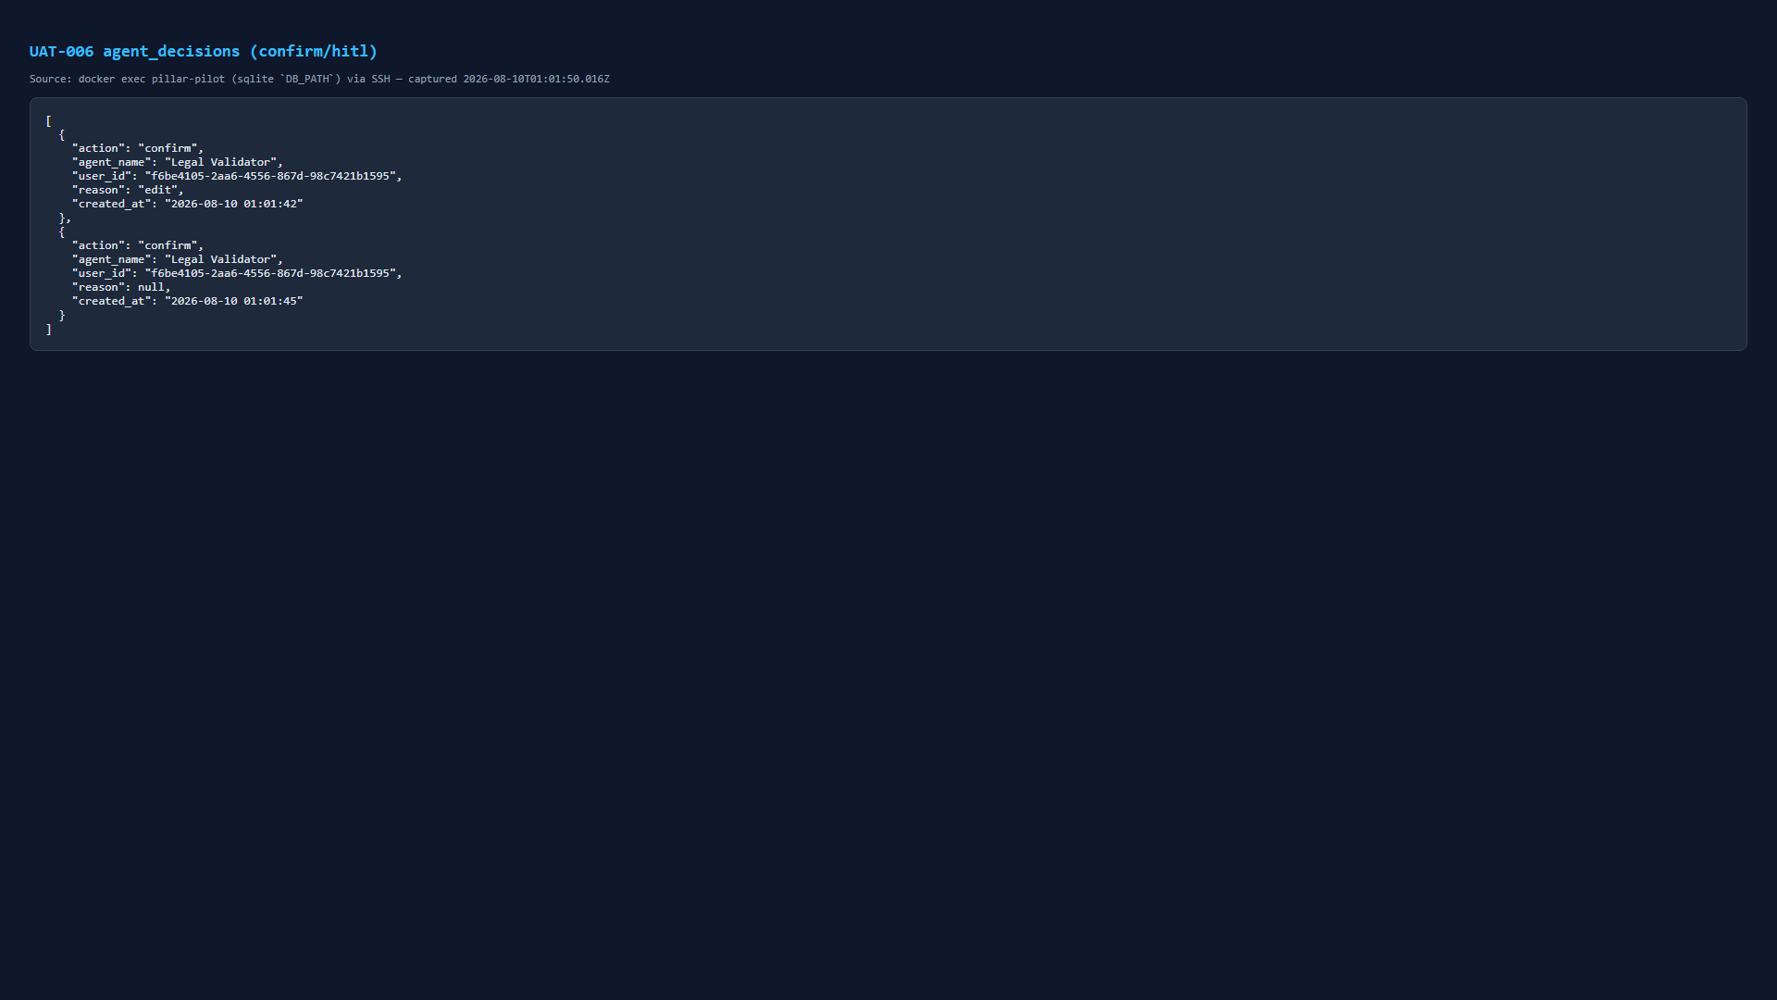
LIKHA — Published Archive
Searchable, classified, DILG-compliant archive

Slide 6
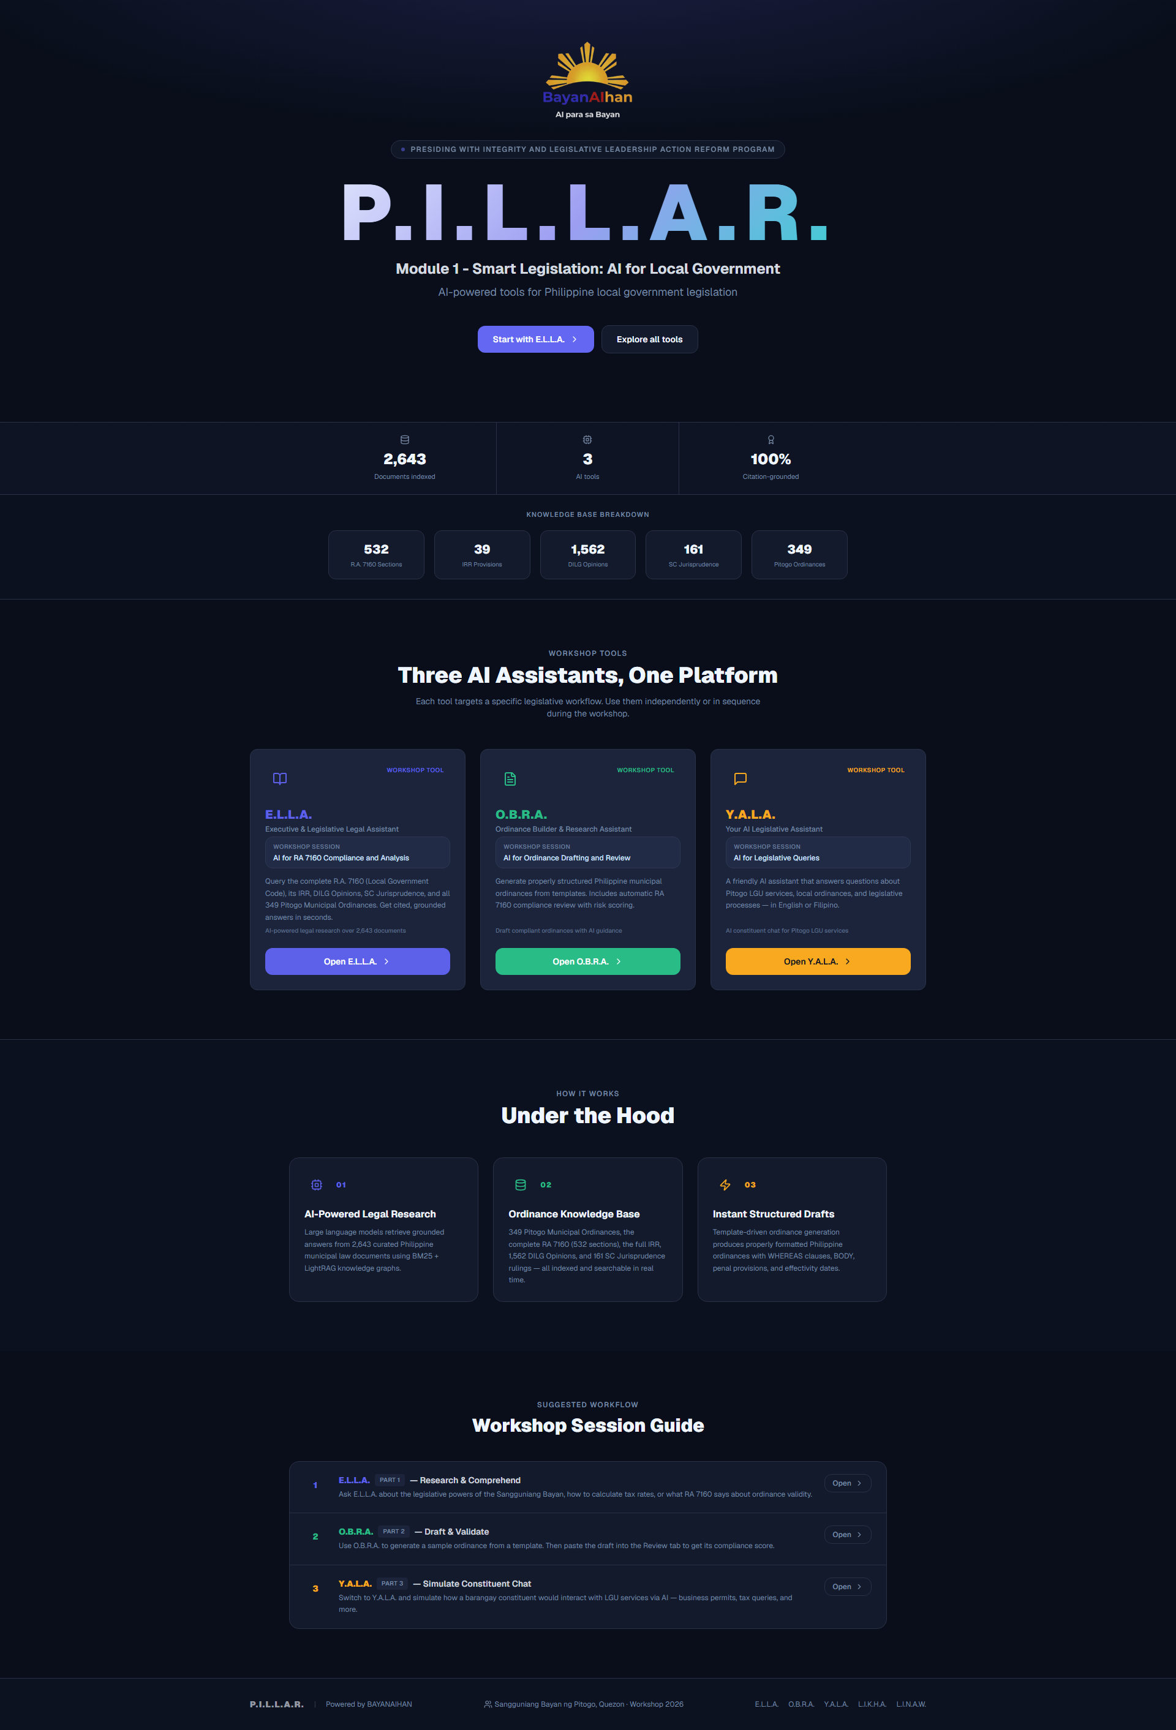
LINAW — Codification Engine
Import, classify, cross-reference, assemble

Slide 7
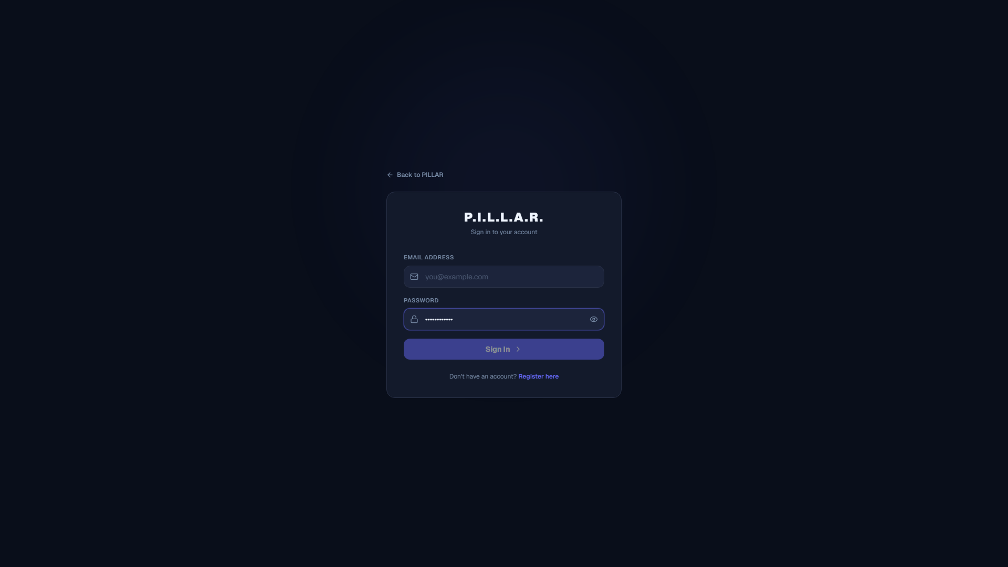
LINAW — Conflict Detection
AI detects contradictions, humans decide

Slide 8
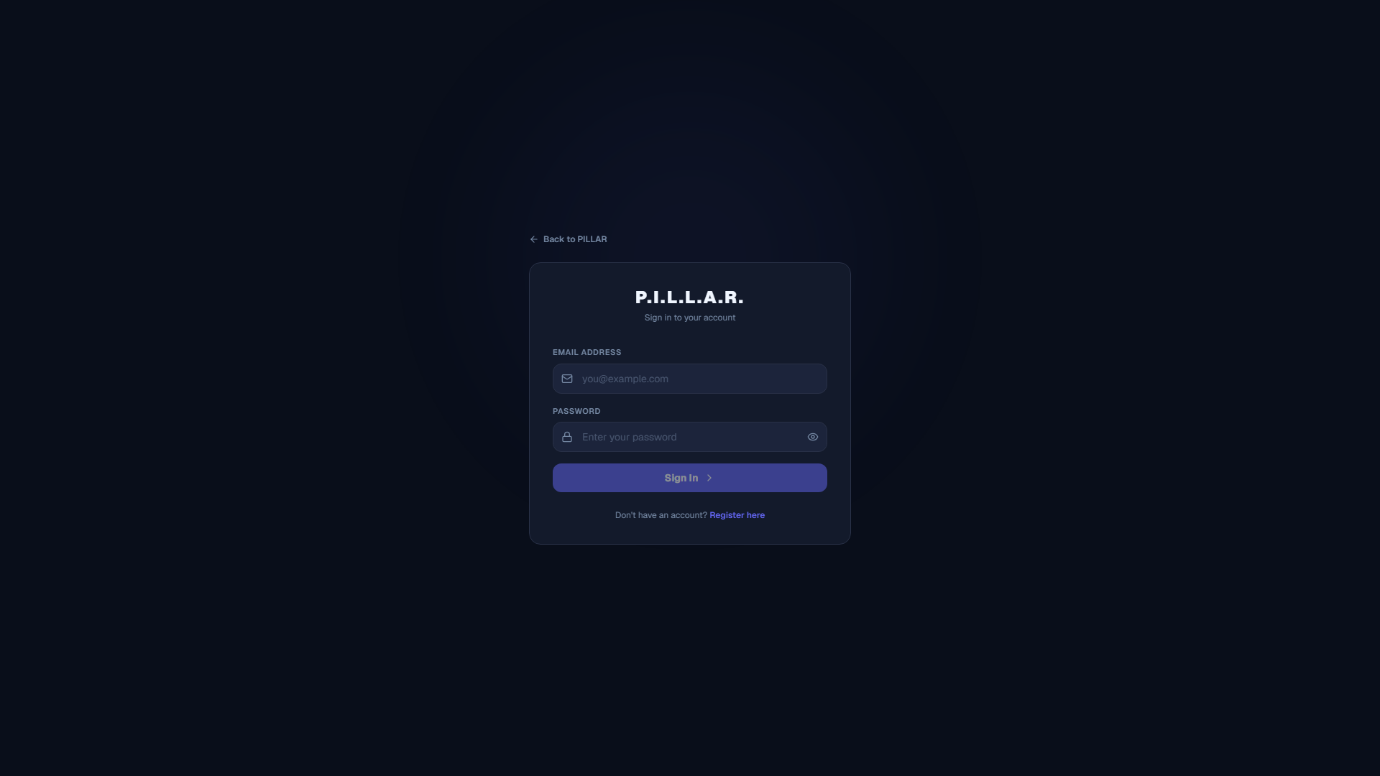
LINAW — Code Assembly
Ordinances → codified volumes, automatically

Slide 9
RESULTS
97.6% UAT Pass Rate.
GO Verdict.
14s
100%
<1ms
Avg. OCR
Processing
Cross-Reference
Precision
Full-Text
Search
349 ordinances digitized • 35 years of legislation indexed • 0 defects in production

Slide 10
Try It Live
pillar.bayanaihan.net
QR
CODE
From paper to codified law, one ordinance at a time

