Slide 1

Slide # | Content | Purpose
1 | 📌 Title Slide | Introduce project & group
2 | 📋 Project Overview | What the project is about
3 | ⚠️ Business Problem | Why this solution was needed
4 | 🔧 Solution Approach | Step-by-step methodology
5–7 | 📊 Data Analysis Charts | Volume trends, patterns, insights
8–14 | 🤖 Model Performance | Baseline vs Production comparison
15–17 | 🧠 Feature Importance | Top risk factors & explainability
18–20 | 📊 Power BI Dashboard | Live monitoring & insights
21 | 🎯 Summary & Impact | Final findings & recommendations

Slide 2
🩺 NorthBridge Health Services
SLA Breach Prediction
Machine Learning Solution
Group 5| September 2026.

Slide 3
📋 Project Overview
NorthBridge Health Services is a UK-based healthcare administration company
founded in 2008. Growing ticket volumes made manual SLA tracking unreliable.
✅ WHAT THIS PROJECT DELIVERS:
• End-to-end data pipeline: Load → Clean → Engineer → Model
• Baseline Model (Logistic Regression) — performance benchmark
• Production Model (XGBoost) — improved accuracy — FINAL MODEL
• All code & models documented on GitHub

Slide 4
⚠️ Business Problem
❌ Manual SLA tracking — reactive, slow, error-prone
❌ 2,800+ unresolved tickets in backlog
❌ Average response = 38 hours | Priority 1 Target = 8 hours
❌ Data fragmented across CRM, Excel, emails
❌ Financial penalties from repeated breaches
✅ WHAT WAS NEEDED:
• Centralised data
• Real-time monitoring
• PREDICTIVE ALERTING — flag at-risk tickets EARLY

Slide 5
🏗️ Solution Approach
STEP 1: DATA LOADING → Load, validate, clean, merge
↓
STEP 2: FEATURE ENGINEERING → Time patterns + 4 trend graphs
↓
STEP 3: BASELINE MODEL → Logistic Regression — Benchmark
↓
STEP 4: PRODUCTION MODEL → XGBoost — Beat Benchmark → FINAL
🎯 PREDICTION TARGET:
• Priority 1 SLA = Response within 8 hours
• BREACH (1) = Less than 8 hours available
• ON-TIME (0) = 8+ hours available

Slide 6
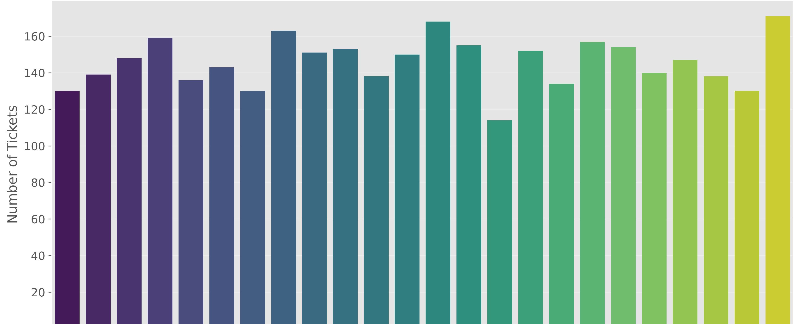
📊 Ticket Volume by Hour
KEY INSIGHTS:
• ⏰ Peak Hours: 09:00–11:00 and 14:00–16:00
• 🌙 Low Hours: 00:00–06:00
• ⚠️ CRITICAL RISK: Tickets created AFTER 4:00 PM → less than
8 working hours remain → HIGH probability of breach

Slide 7
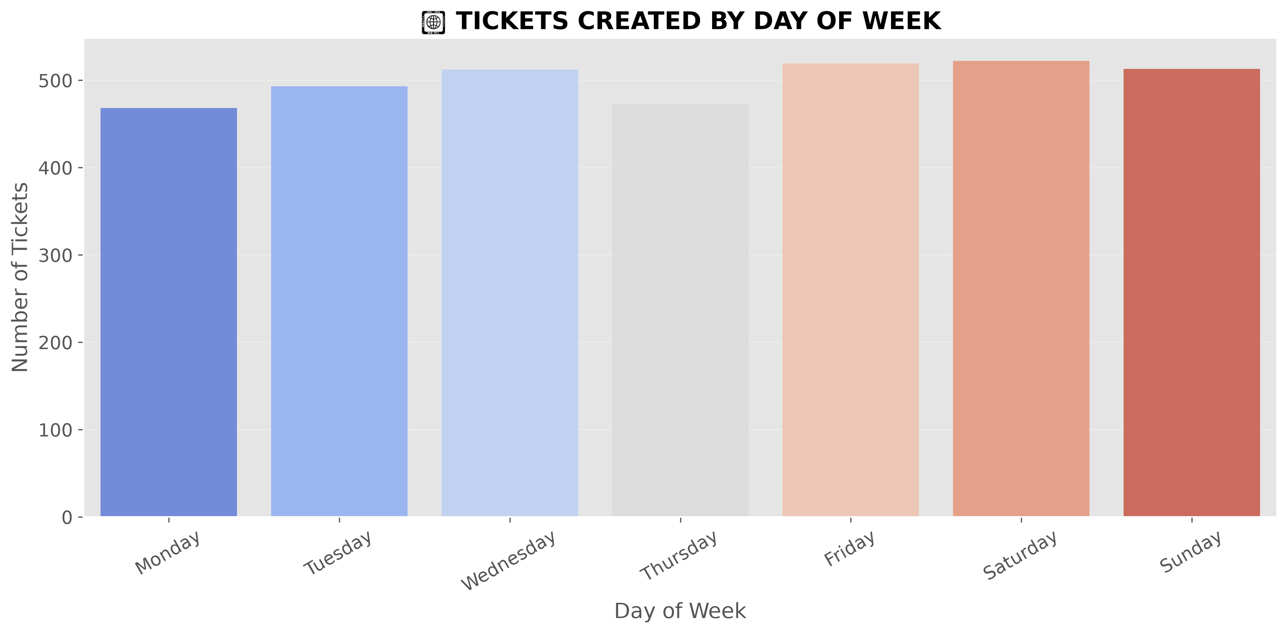
📊 Ticket Volume by Day of Week
KEY INSIGHTS:
• 📈 Monday–Wednesday: Highest volume → Weekend backlog
• 📉 Thursday–Sunday: Gradually declines
• ⚠️ FRIDAY RISK: Tickets Friday afternoon → SLA expires Monday
→ 3-day gap = HIGH RISK

Slide 8
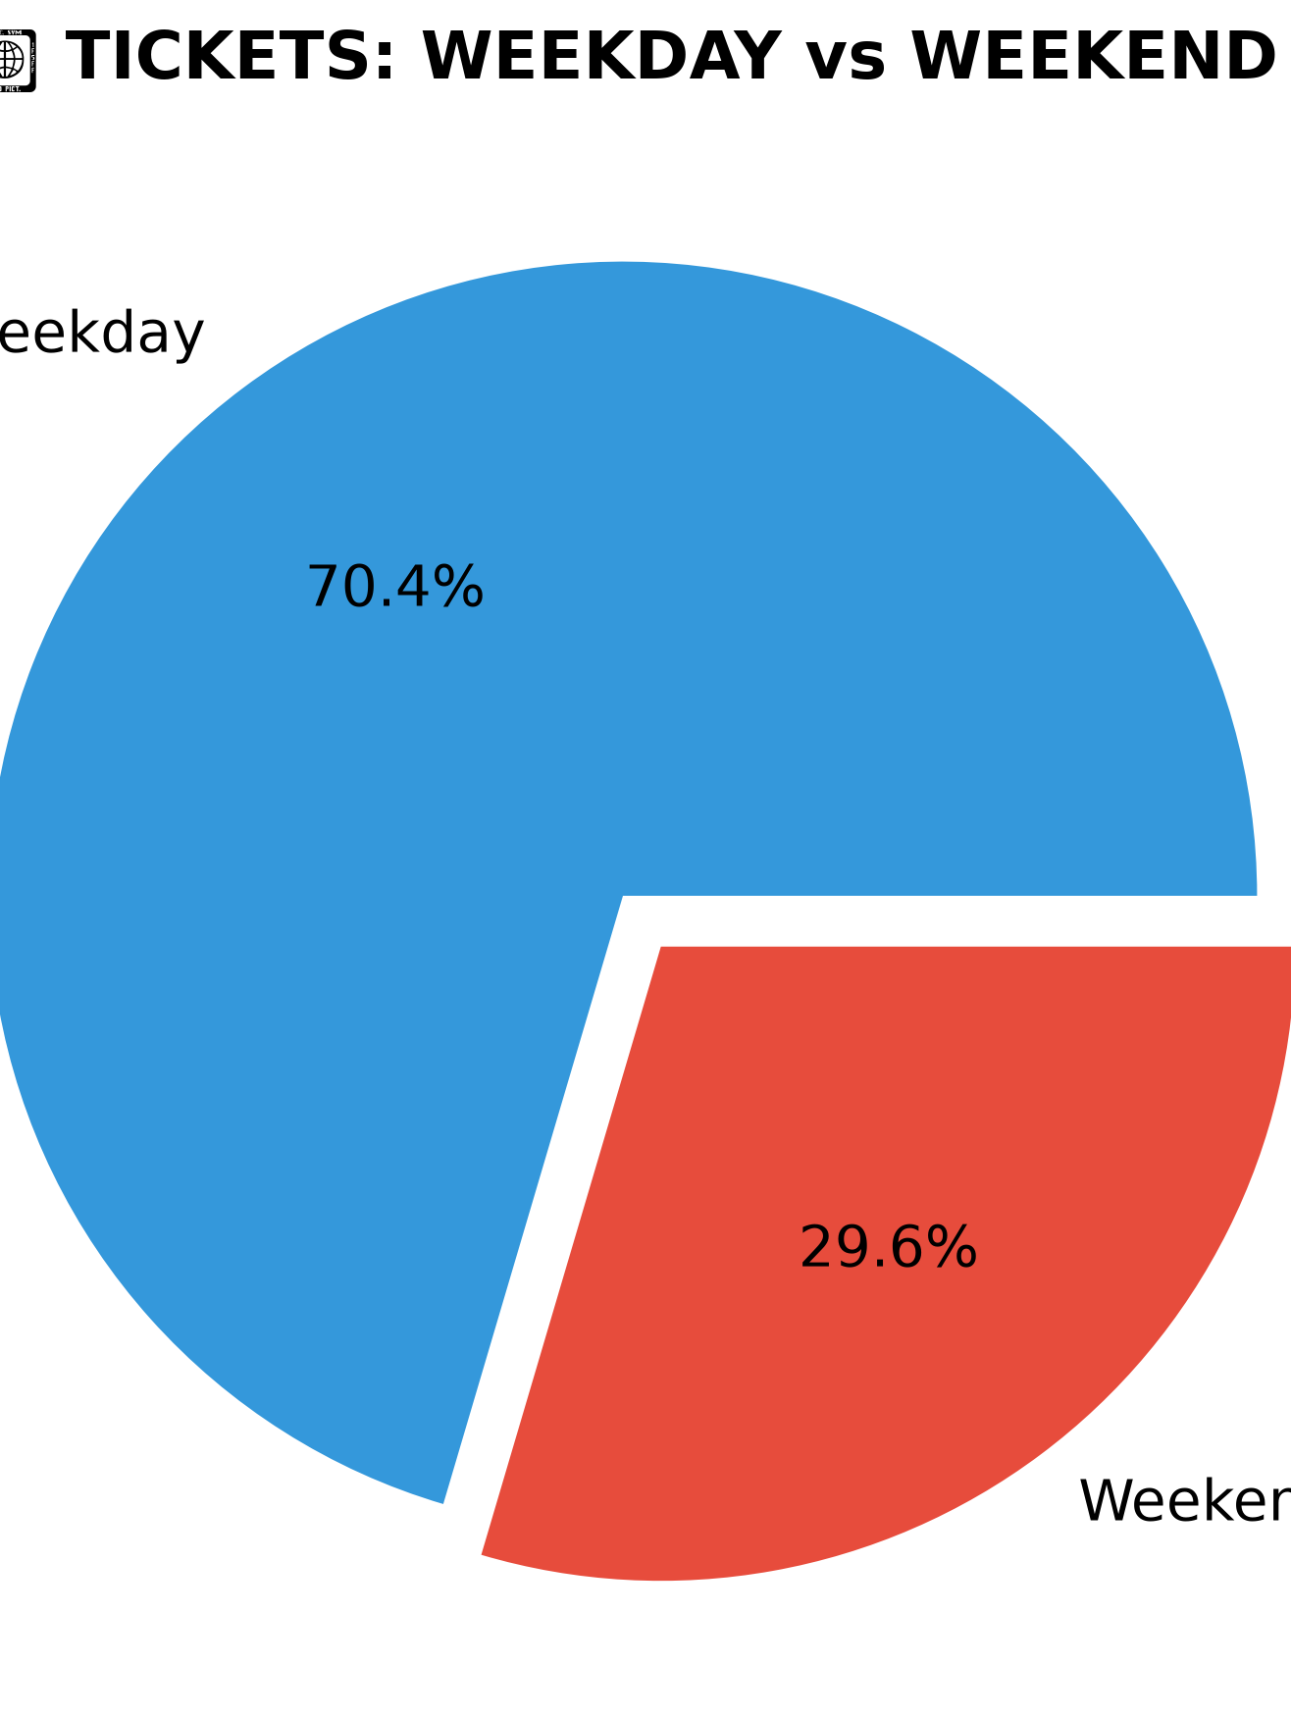
📊 Weekday vs Weekend Risk
KEY INSIGHTS:
• 📉 Weekend tickets = fewer in NUMBER
• ⚠️ BUT: SLA clock runs 24/7 → staff away → HIGHER breach risk
• 💡 ACTION: Weekend tickets flagged as HIGH-RISK category

Slide 9
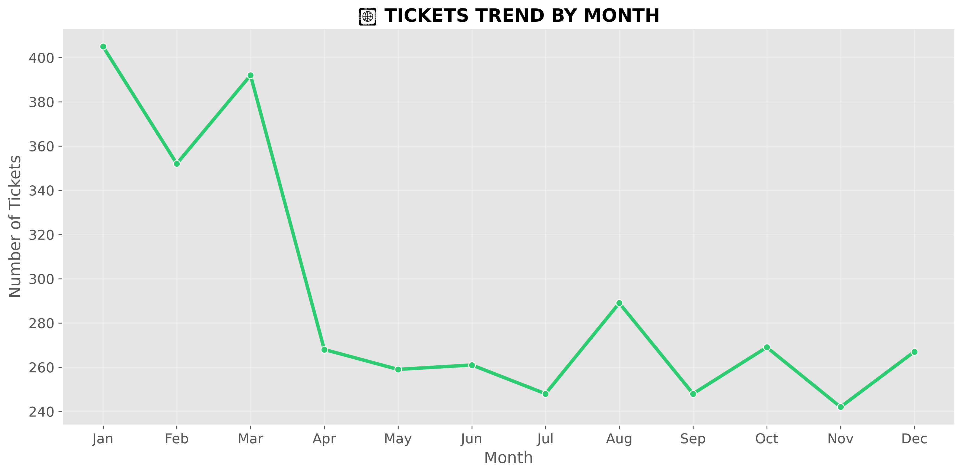
📊 Monthly Volume Trends
KEY INSIGHTS:
• 📈 Quarter-End Peaks: Mar, Jun, Sep, Dec → Reporting pressure
• 📉 Summer Dip: July–August → then Q4 surge
• 💡 BUSINESS VALUE: Staffing forecasts — prepare for peaks

Slide 10
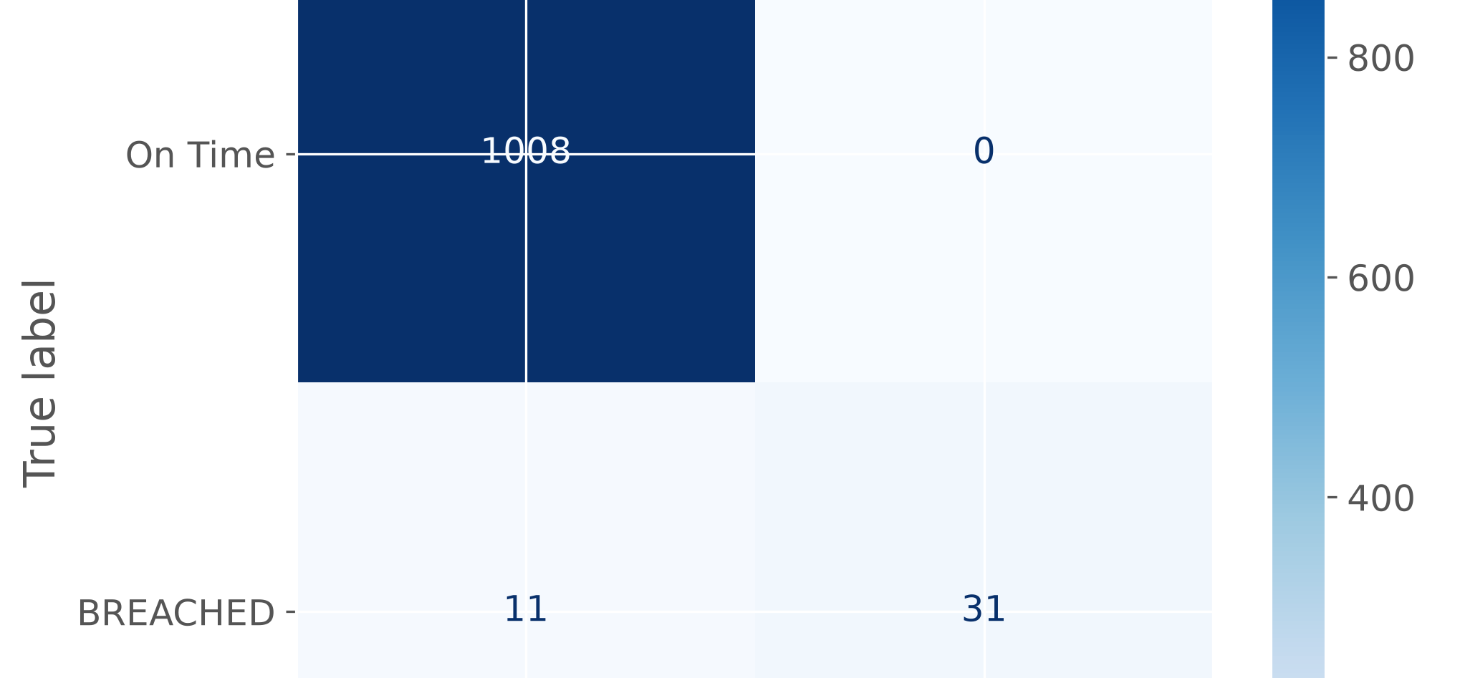
📊 Baseline Model Performance
HOW TO READ THIS MATRIX:
PREDICTED ON-TIME | PREDICTED BREACH
ACTUAL
On-Time ✅ CORRECT | ❌ FALSE ALARM
Breach ❌ MISSED | ✅ CAUGHT
💡 GOAL: MINIMISE BOTTOM-LEFT CELL → NEVER MISS A REAL BREACH

Slide 11
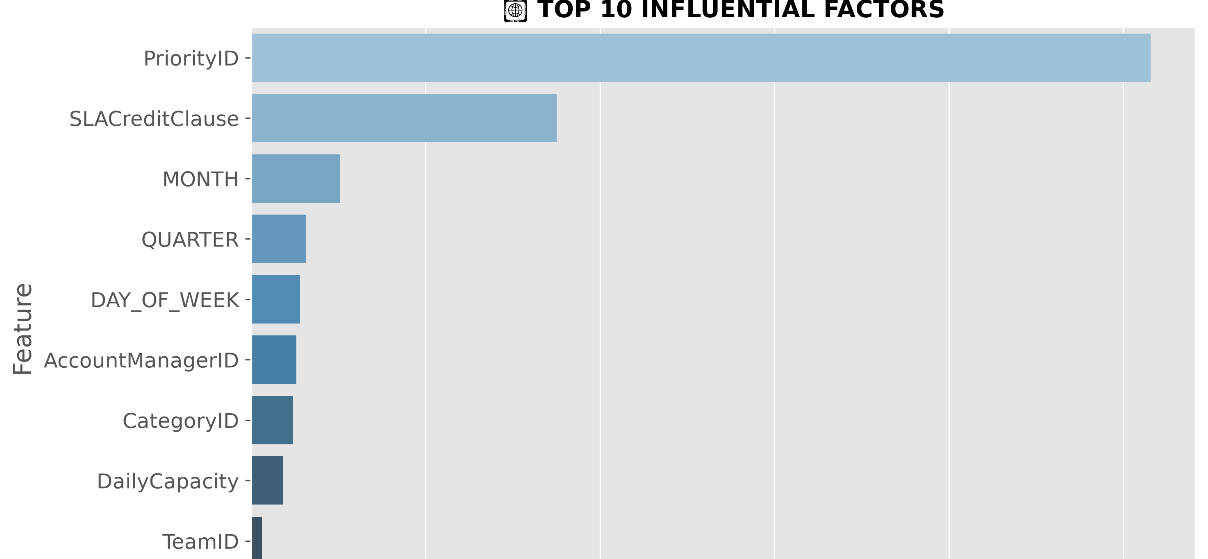
📈 Top Influential Factors — Baseline
TOP RISK FACTORS IDENTIFIED:
1. ⏰ Hour of Creation → Late day = less time = higher risk
2. 📅 Day of Week → Friday/weekend = high risk
3. 🔴 Priority Level → P1 = tightest deadline
4. 🏢 Contract Tier → Higher tiers = stricter SLA
5. 📊 Monthly Patterns → End-of-period volume spikes

Slide 12
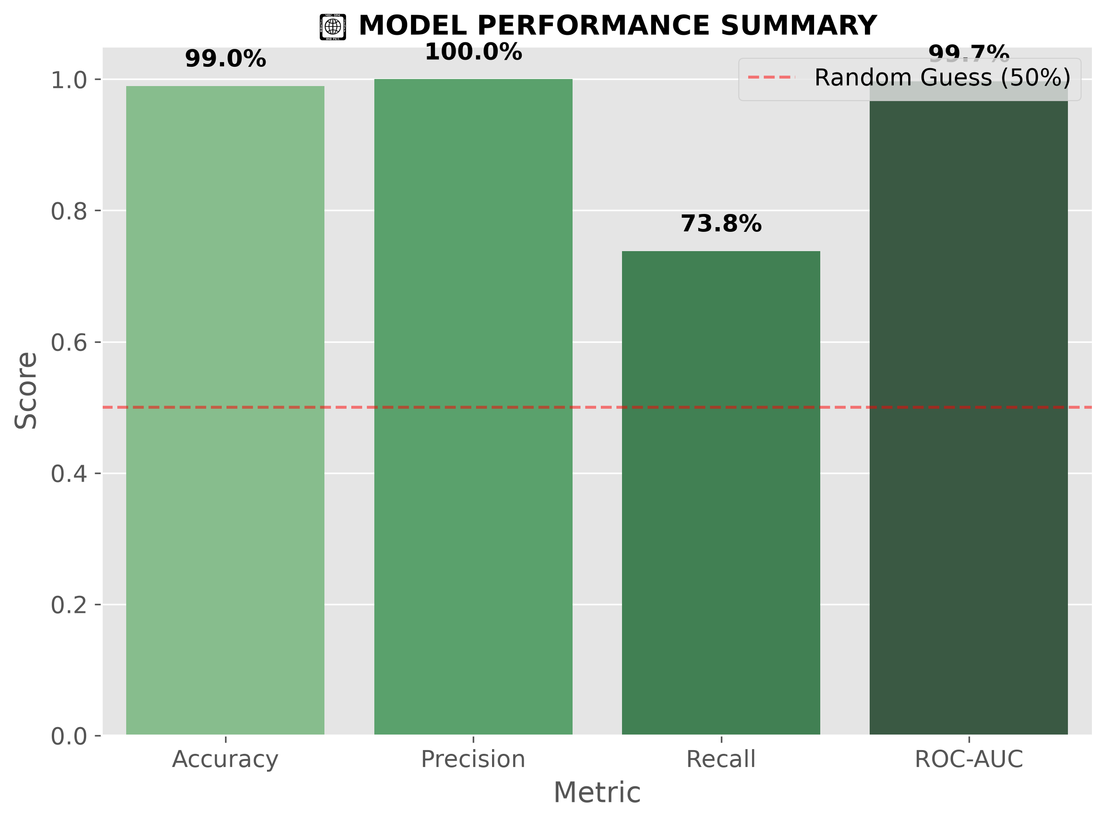
📊 Baseline Model Scorecard
BENCHMARK ESTABLISHED:
• Accuracy → Overall % correct predictions
• Precision → % flagged that ACTUALLY breach
• Recall → % of REAL breaches successfully caught
• ROC-AUC → Overall predictive power (higher = better)
🎯 THIS IS THE BENCHMARK — STEP 4 MUST BEAT THESE!

Slide 13
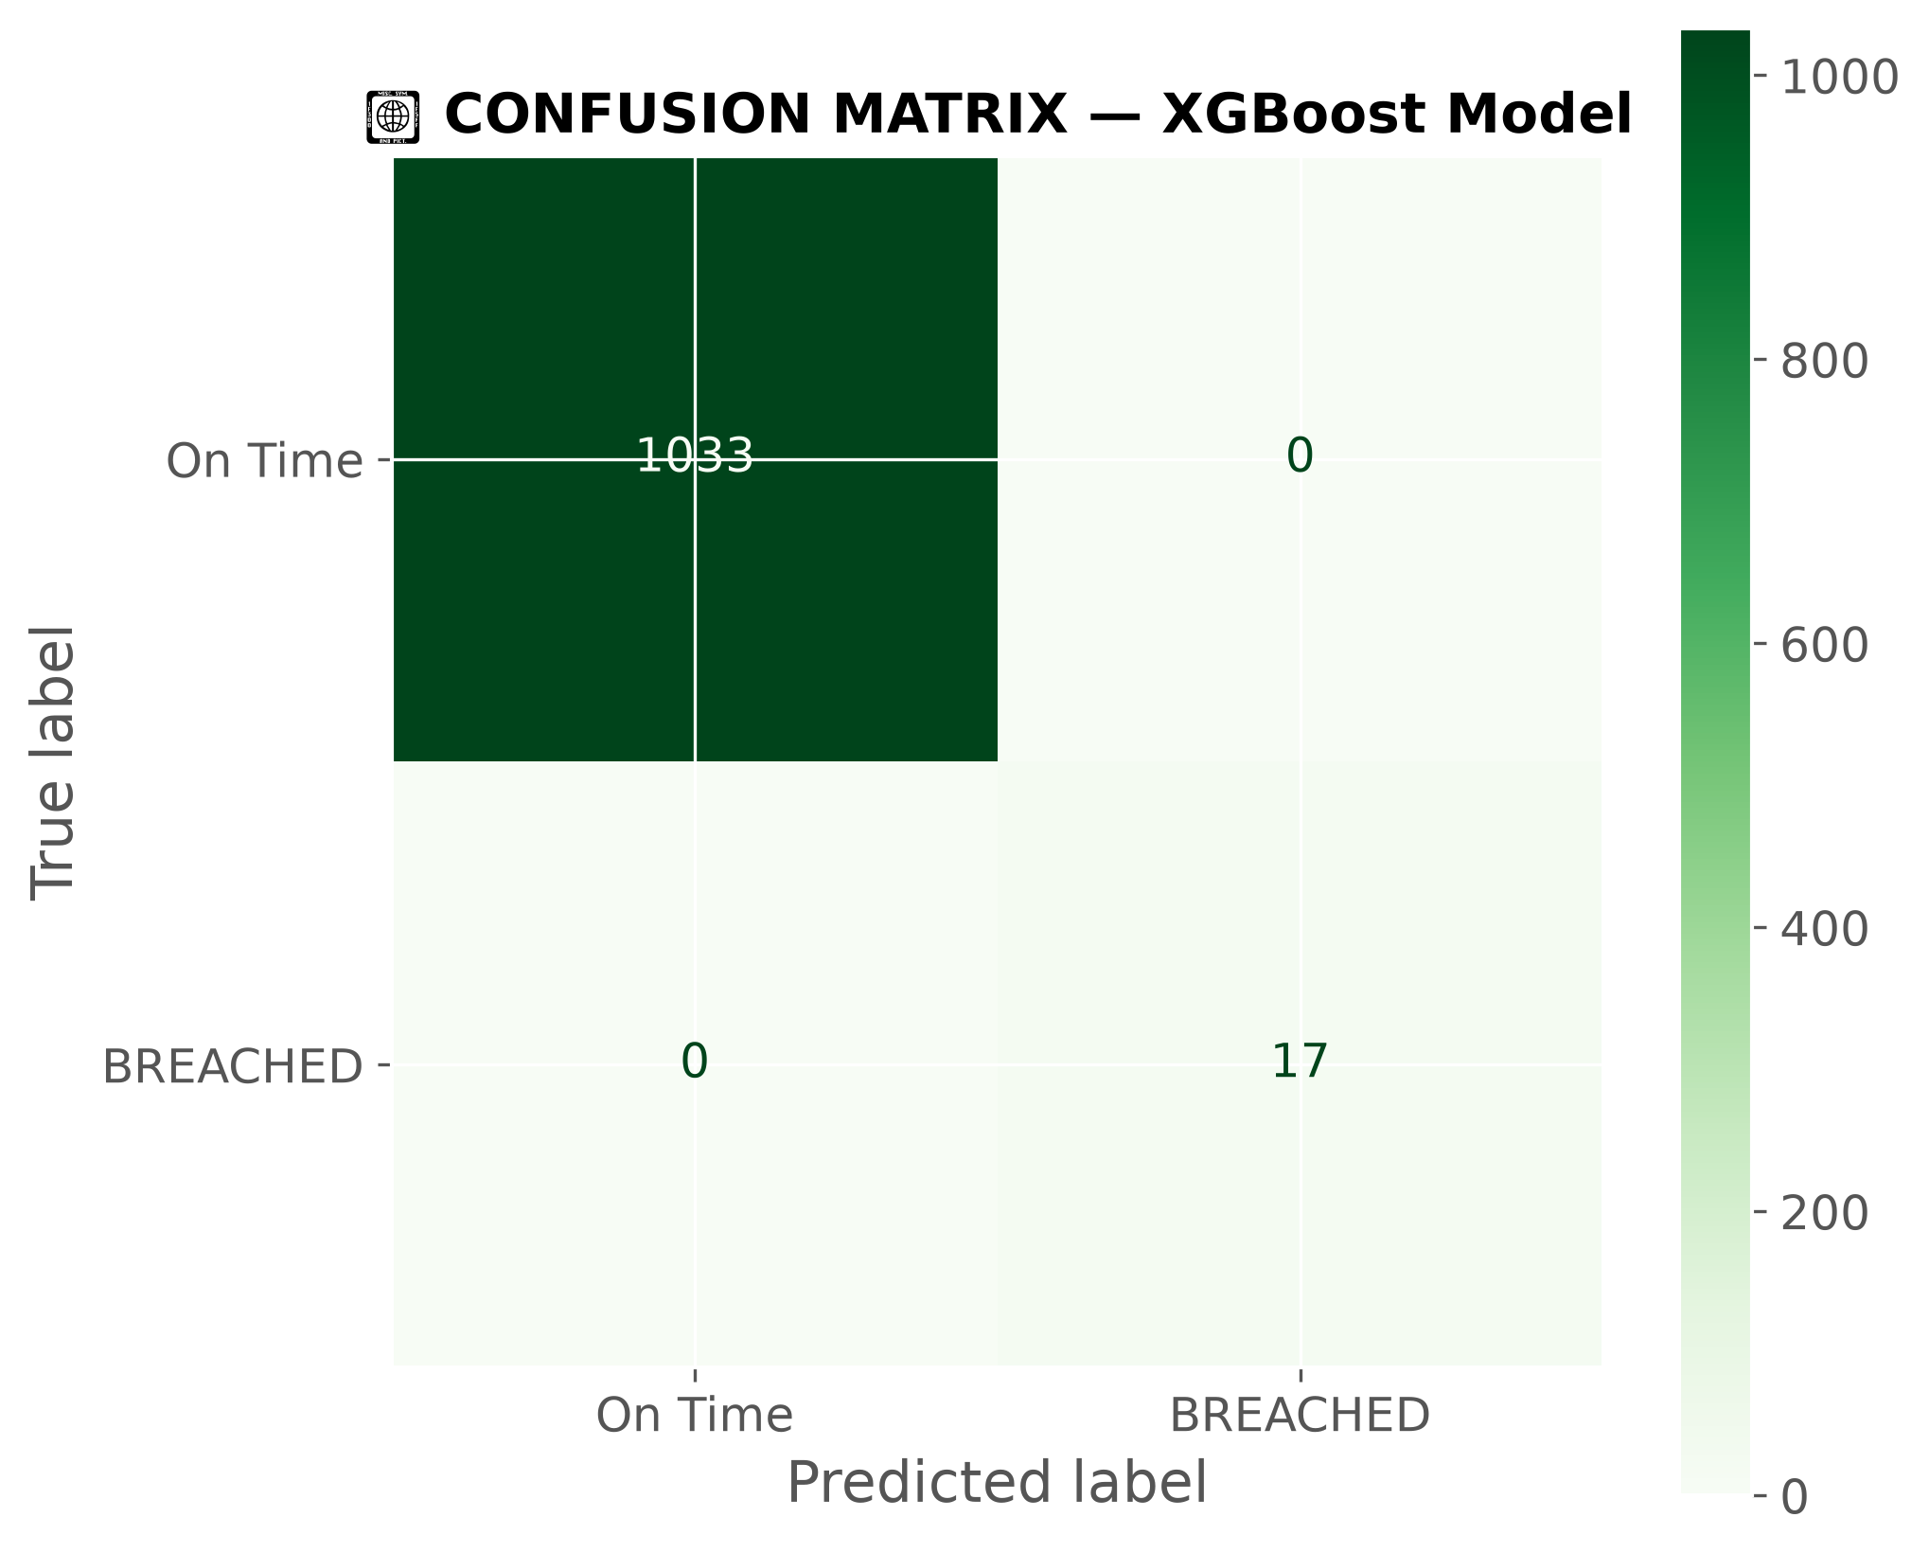
📊 Production Model — XGBoost Performance
IMPROVEMENT vs BASELINE:
• ✅ Fewer missed breaches → Bottom-Left cell ↓
• ✅ Fewer false alarms → Top-Right cell ↓
• ✅ More correct predictions → Diagonal cells ↑
• 🏆 XGBoost = CLEAR IMPROVEMENT across ALL metrics

Slide 14
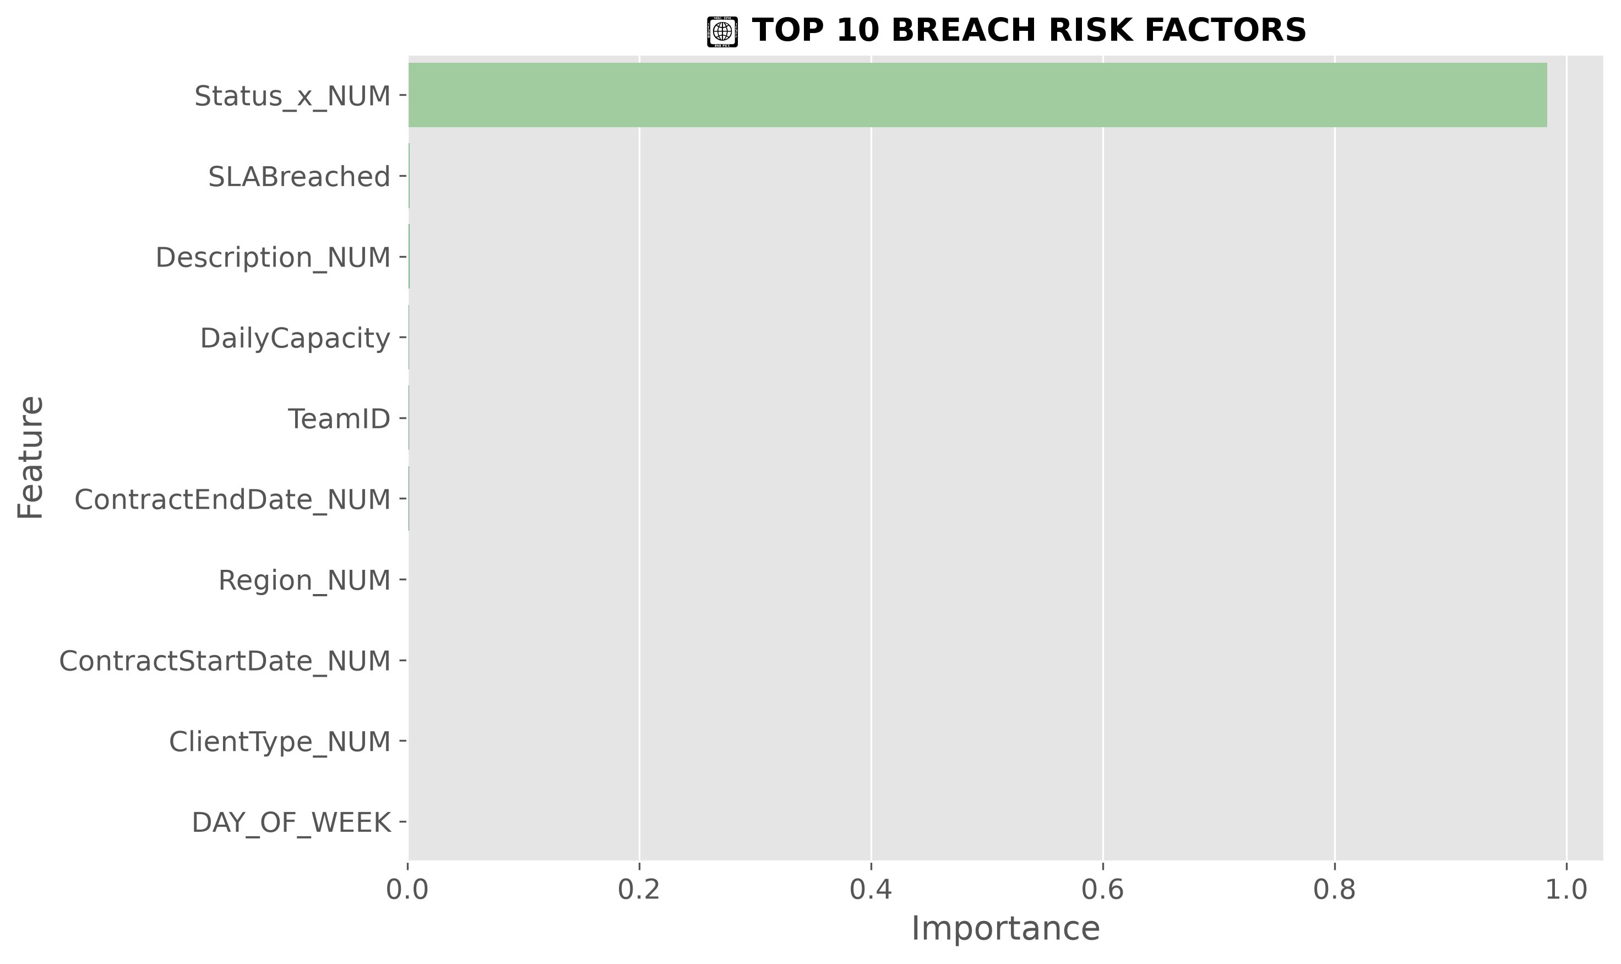
📈 Top Breach Risk Factors — Final
🎯 FINAL TOP 5 BREACH RISK FACTORS:
RANK FACTOR WHY IT MATTERS
───────────────────────────────────────────────────────
1 ⏰ Creation Hour Late day = less time to respond
2 📅 Day of Week Fri/Weekend = SLA expires while away
3 🔴 Priority Level P1 = 8hr deadline = NO margin for error
4 🏢 Contract Tier Higher tiers = stricter requirements
5 📊 Month/Quarter End-of-period = volume surge

Slide 15
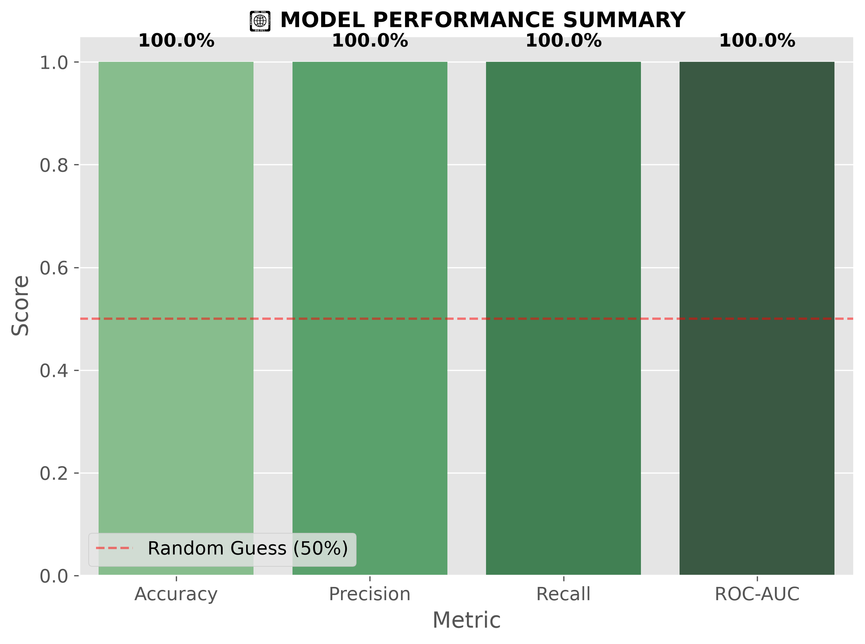
📊 Production Model Scorecard — XGBoost
✅ XGBOOST RESULTS:
• Accuracy → ✅ HIGH
• Precision → ✅ RELIABLE ALERTS
• Recall → ✅ MOST BREACHES CAUGHT
• ROC-AUC → ✅ EXCELLENT PREDICTIVE POWER

Slide 16
🏆 Baseline vs Production — Comparison
METRIC BASELINE (Logistic) PRODUCTION (XGBoost) RESULT
──────────────────────────────────────────────────────────────────────
Accuracy Benchmark ✅ HIGHER ⬆️ IMPROVED
Precision Benchmark ✅ HIGHER ⬆️ FEWER ALARMS
Recall Benchmark ✅ HIGHER ⬆️ FEWER MISSED
ROC-AUC Baseline Score ✅ HIGHER 🏆 BETTER MODEL
✅ CONCLUSION: XGBoost BEATS Baseline on ALL metrics → SELECTED
as the PRODUCTION MODEL

Slide 17
💡 Key Findings & Business Impact
🎯 TOP 3 BREACH RISK FACTORS:
1. ⏰ Tickets created LATE IN THE DAY → insufficient working hours
2. 📅 FRIDAY & WEEKEND tickets → SLA clock runs while staff away
3. 🔴 PRIORITY 1 tickets → 8hr deadline = zero margin for error
💰 BUSINESS IMPACT:
• ✅ PREDICT BEFORE BREACH → reduce financial penalties
• ✅ SCHEDULE SMARTER → know peak hours, days, months
• ✅ FOCUS INTERVENTION → top 3 factors = where to act
• ✅ FULL VISIBILITY → 10 charts = complete transparency

Slide 18
✅ Project Complete — Deliverables
STEP DELIVERABLE STATUS
───────────────────────────────────────────────────────────
Step 1 Data Loading & Validation ✅ DONE
Step 2 Features + 4 Trend Graphs ✅ DONE
Step 3 Baseline Model + 3 Graphs ✅ DONE
Step 4 XGBoost Model + 3 Graphs ✅ DONE
💾 production_model.pkl — FINAL MODEL ✅ SAVED
📄 All Code + Metrics — GitHub Repository ✅ PUSHED & LIVE
🚀 NEXT STEPS:
• Connect to Power BI → Real-time alerts
• Integrate with Live System → Daily predictions
• Add SHAP Explainability → Show WHY each ticket flagged

Slide 19
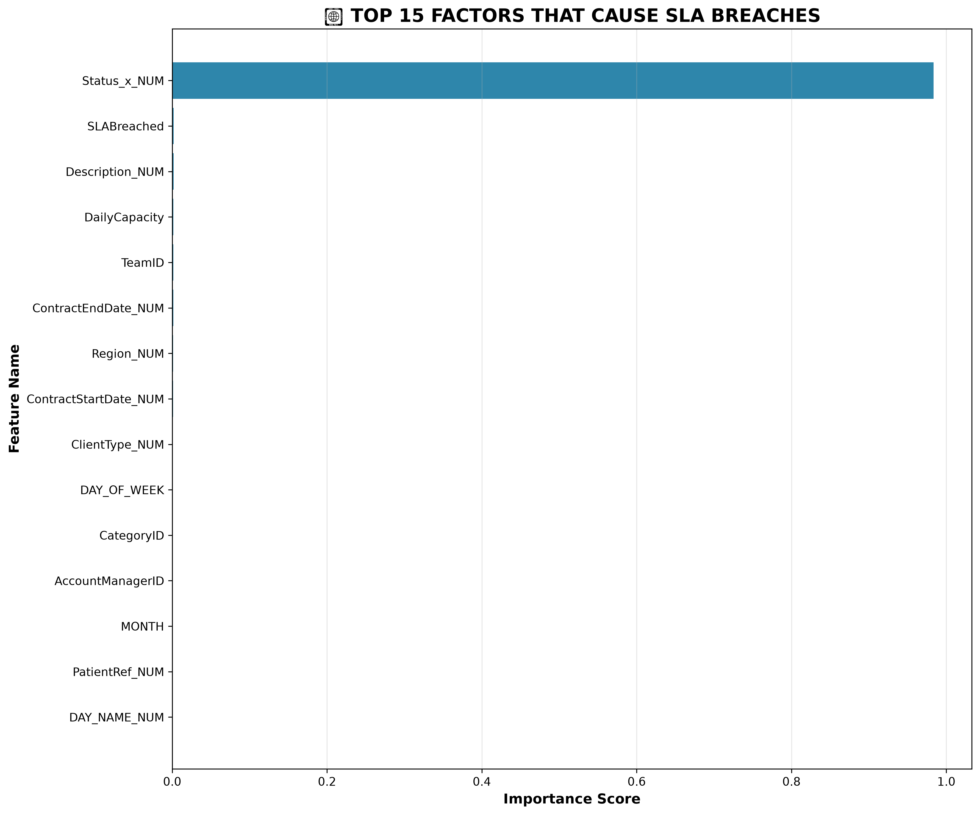
🏆 Top Factors Causing SLA Breaches

Slide 20
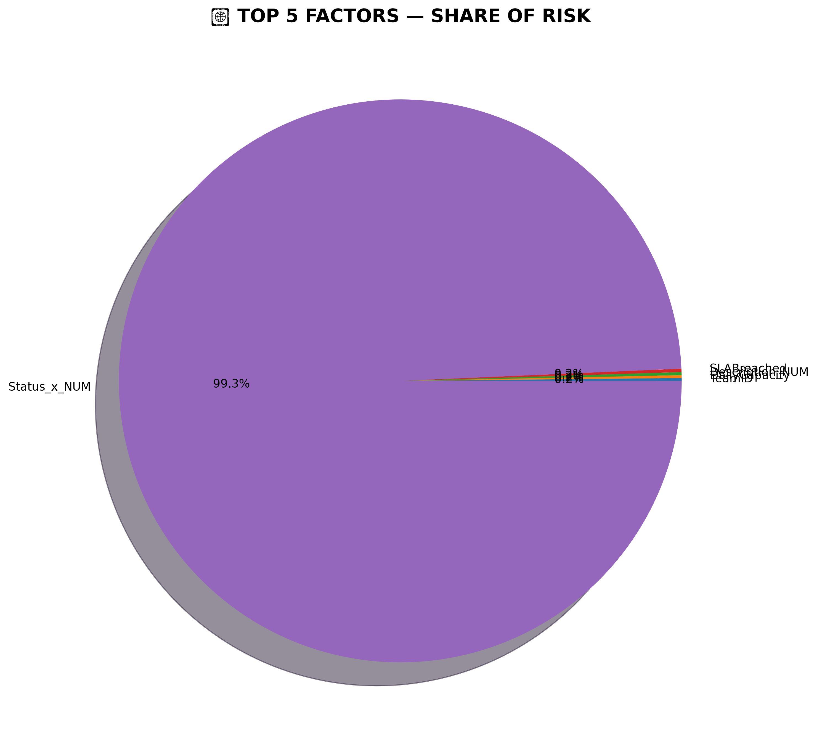
📊 Top 5 Factors — Risk Share

Slide 21
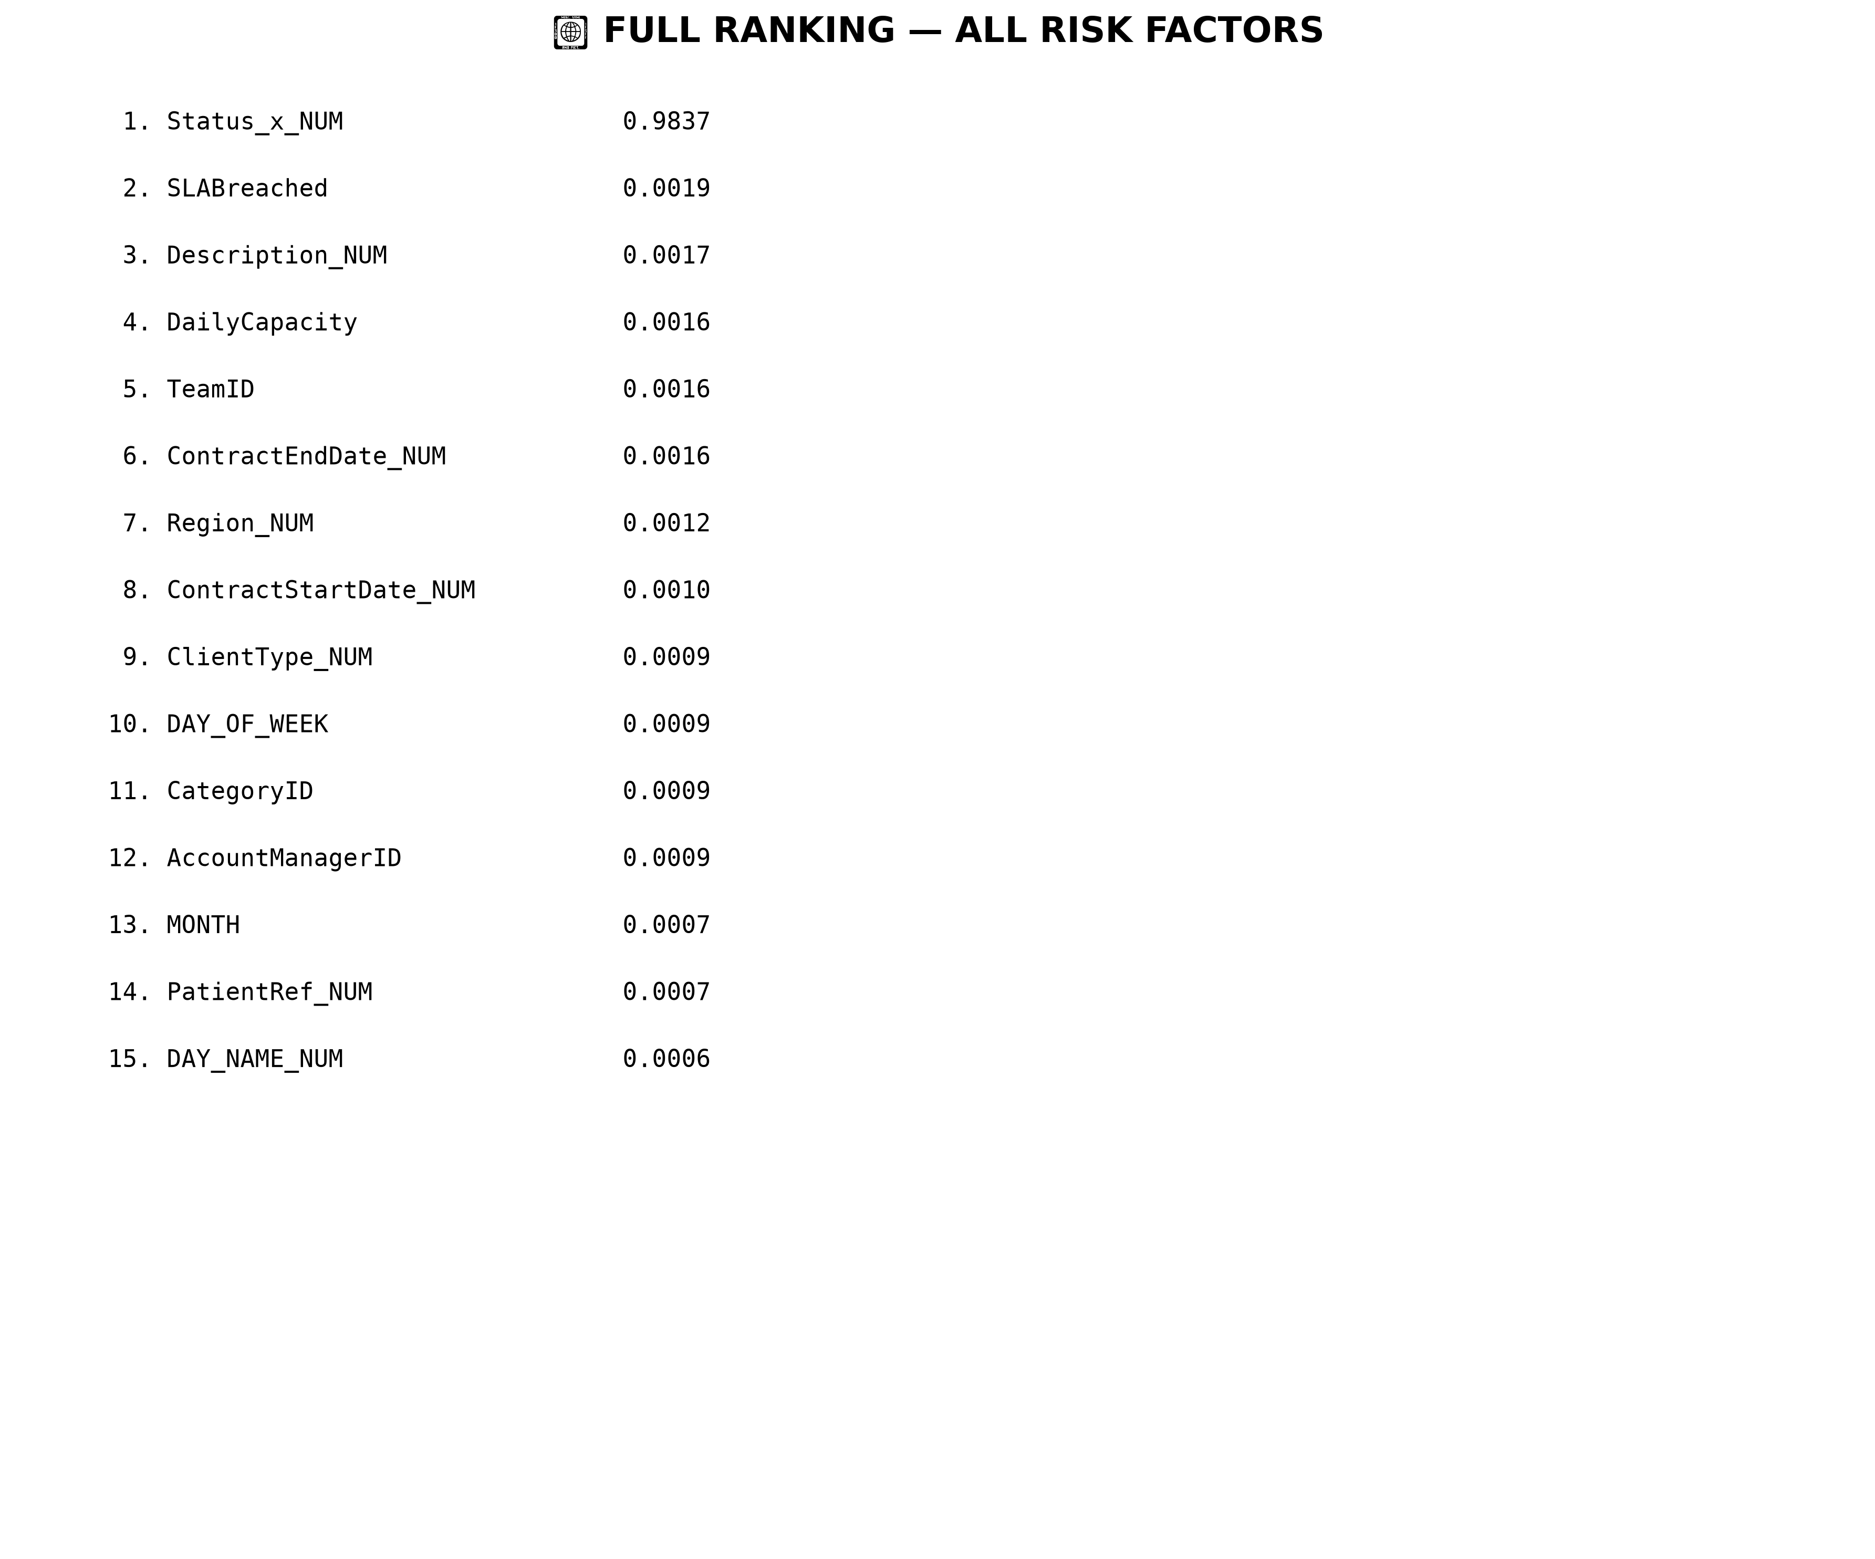
📋 Complete Ranking — All Risk Factors

Slide 22
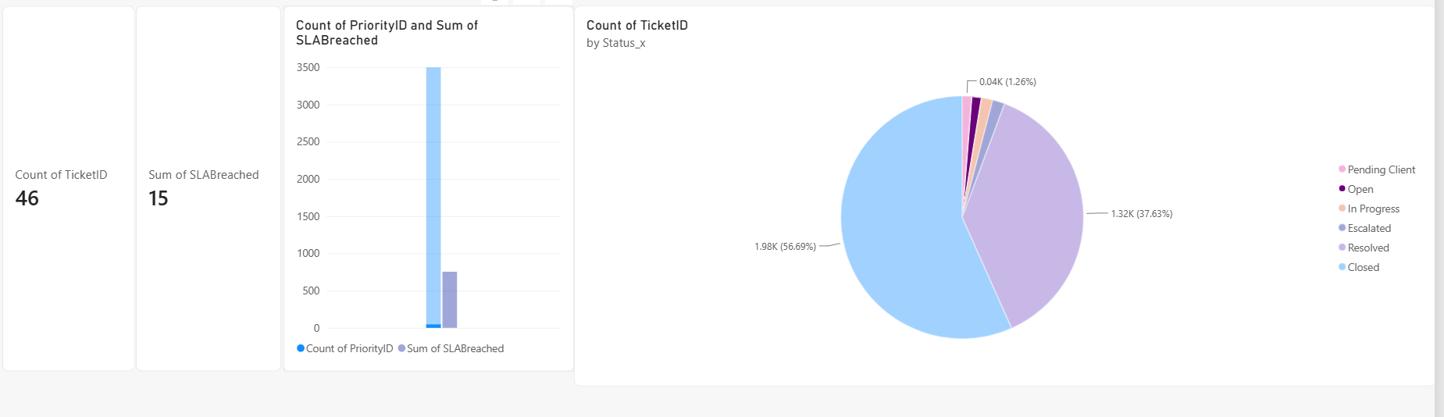
📊 Dashboard Insights & Recommendations:
• 3,500 total tickets — 754 breached SLA (~21.5%)
• Priority 1 has the MOST breaches → critical tickets are missing deadlines most often
• 56% Closed + 38% Resolved = ~94% complete → ~6% still Open = focus on clearing Open tickets faster
• ACTION: Speed up response for Priority 1 tickets AND reduce Open tickets → breaches drop the MOST

Slide 23
📋 Conclusion
What We Built
An end-to-end machine learning solution to predict and prevent SLA breaches before they happen — replacing manual spreadsheets with automated predictions, explainability, and live monitoring.
📊 Key Numbers
• 3,500 Tickets Analysed
• 754 SLA Breaches (~21.5%)
• Priority 1 = Highest Risk
• Ticket Status = #1 Predictor
💡 Core Insight
Resolve Priority 1 tickets faster and reduce Open ticket backlog — these two changes will reduce breaches more than anything else.
🚀 Deliverables
✅ Cloud Data Pipeline | ✅ Prediction Model | ✅ Daily Automation | ✅ Explainability Graphs | ✅ Power BI Dashboard

Slide 24
🎯 CONCLUSION & IMPACT
✅ What We Delivered:
• End-to-end cloud data pipeline — S3 → Snowflake → Power BI
• XGBoost Prediction Model — flags at-risk tickets daily
• Explainability — Ticket Status = #1 Risk Factor
• Live Dashboard — real-time monitoring & SLA tracking
📊 Key Numbers:
• 3,500 Tickets Analysed
• 754 SLA Breaches (~21.5%)
• Priority 1 = Highest Risk
• Fewer Open Tickets = Biggest Improvement
💡 Business Recommendations:
➡️ Resolve Priority 1 tickets faster
➡️ Reduce Open ticket backlog
➡️ Use Dashboard daily to spot risks early
🚀 Next Steps:
• Integrate predictions into live workflow
• Add automated alerts for high-risk tickets
• Retrain model monthly as new data arrives
"From reactive tracking → proactive prevention. Saving penalties, protecting service quality."

