Slide 1
ANOVA (Analysis Of Variance) Wyatt Beyers 080919

Slide 2
What test should you use? First, what type of data do you have?
Examples of Continuous Data (can’t be counted)
Fluorescence Intensity
Protein Concentration
Cell Size
Examples of Discrete Data (can be counted)
Sides on a dice
Number of melanosomes in a melanocyte
Most data I work with is continuous data, meaning there are an infinite number of values that a measurement can take.
Notes:
Important to note that at very high counts of discrete data (such as thousands) it is usually okay to treat it as continuous data.

Slide 3
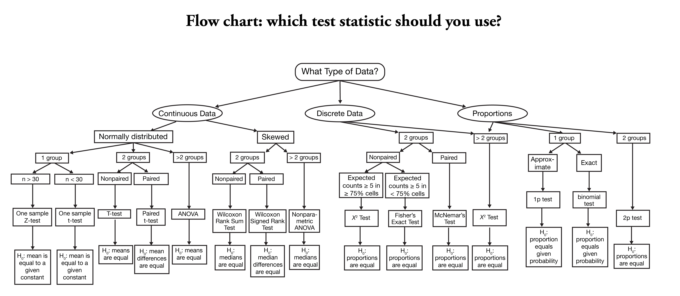
Notes:
For counts → discrete →chi squared
But for very large counts sometimes okay to treat data as continuous as long as there aren’t values close to zero

Slide 4
ANOVA (Analysis Of Variance)
An ANOVA uses the F test – comparison of variance
Significance test used to compare >2 means
Reveals if a difference is present
Does NOT reveal which sample means are different
If there is no significance found, the test is concluded
If there is a difference → Post-hoc test (Tukey or Scheffe test)

Slide 5
Post-hoc pairwise comparison tests
“Rule of thumb”: Use Tukey test when samples are equal in size and Scheffe’s test if samples differ in size.
These tests are similar to a T test in that they do pairwise comparisons, but are adjusted so that they account for the fact that more than 2 means are compared.

Slide 6
One Way vs Two Way ANOVA
One way used if you are only comparing one variable
Example: Bacteria strain influence on recombinant protein yield
Two way used if you are testing two independent variables in the same experiment.
Example: Bacteria strain AND media type influence on protein yield
Does not only determine if each has an influence independently, but if there is interaction effect…Maybe strain has no influence on protein yield in LB Broth, but in 2XYT strain has a major influence. In other words, it tests whether the independent variables are truly independent or if they are somehow connected.

Slide 7
Why can’t I just do multiple pairwise t tests?
“With T test, only 2 means at a time are compared
F test compares all means at once
The more T tests that are conducted, more likely to find significant differences by chance alone (Type I error)
Many means to compare → more tests required
For 10 means, 45 t tests required”
ANOVA greatly reduces Type I errors as the number of treatments to compare increases
-Elementary Statistics, Allan Bluman

Slide 8
Conducting a One-Way ANOVA
Not something you calculate by hand, but if you wanted to….

Slide 9
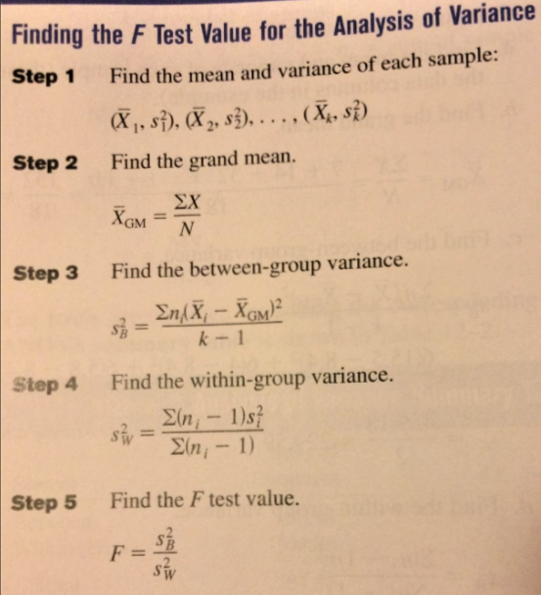
-Elementary Statistics, Allan Bluman

Slide 10
So, how to calculate ANOVA practically?
Online ANOVA and Tukey calculator
https://astatsa.com/OneWay_Anova_with_TukeyHSD/
Input number of treatments
Copy and paste all of your raw data for each treatment that you want to compare
Matlab is free for CSU students and can automate your statistics!
Built in Anova functions make it easy to compare your data

Slide 11
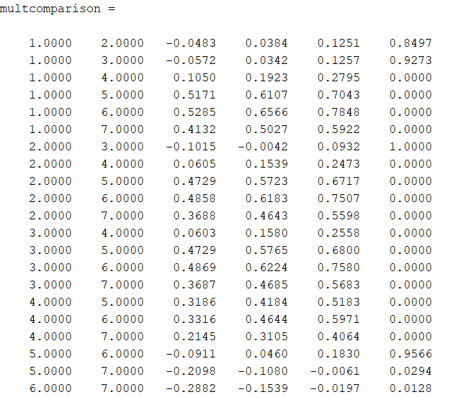
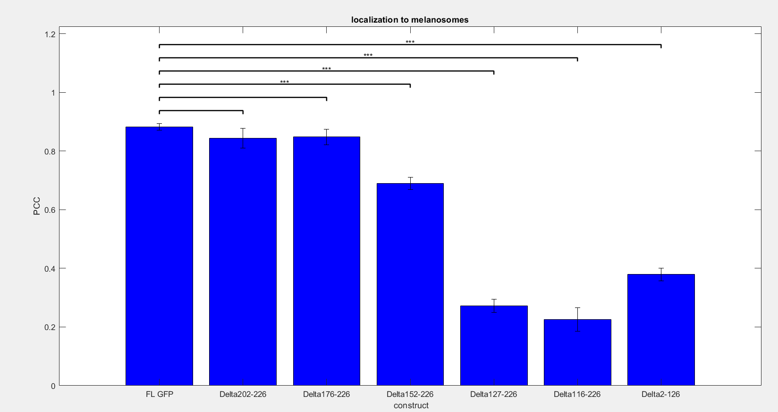
Example: script in matlab performs ANOVA and Tukey test on raw data and generates bar graph with significance stars

Slide 12
Meet with me if you would like to learn how to use matlab for ANOVA!
Wyatt.beyers@colostate.edu

