Slide 1
Principles of Data Visualization
Optimize the trade-off: Ease of interpretation vs. Maximum information
Figures should be, as much as possible, interpretable without a written figure legend
Should be aesthetically pleasing
HOW your data is presented affects how it is received
Flaws are distracting (e.g. misalignment, needlessly unbalanced, identical objects out of proportion, etc.)
Whenever possible, try to use colorblind-friendly color palettes
Use color themes across figures within the same paper for a sense of coherence
Become familiar with plotting multi-dimensional data
Know which techniques are most accurately judged by the human eye
Don’t limit yourself to traditional visualization techniques and graphs!

Slide 2
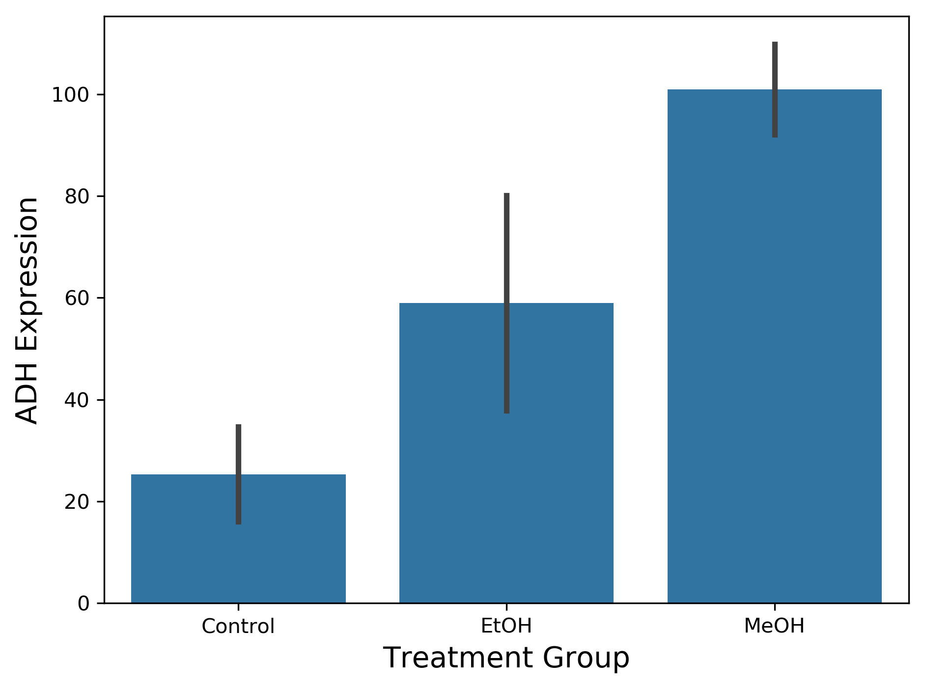
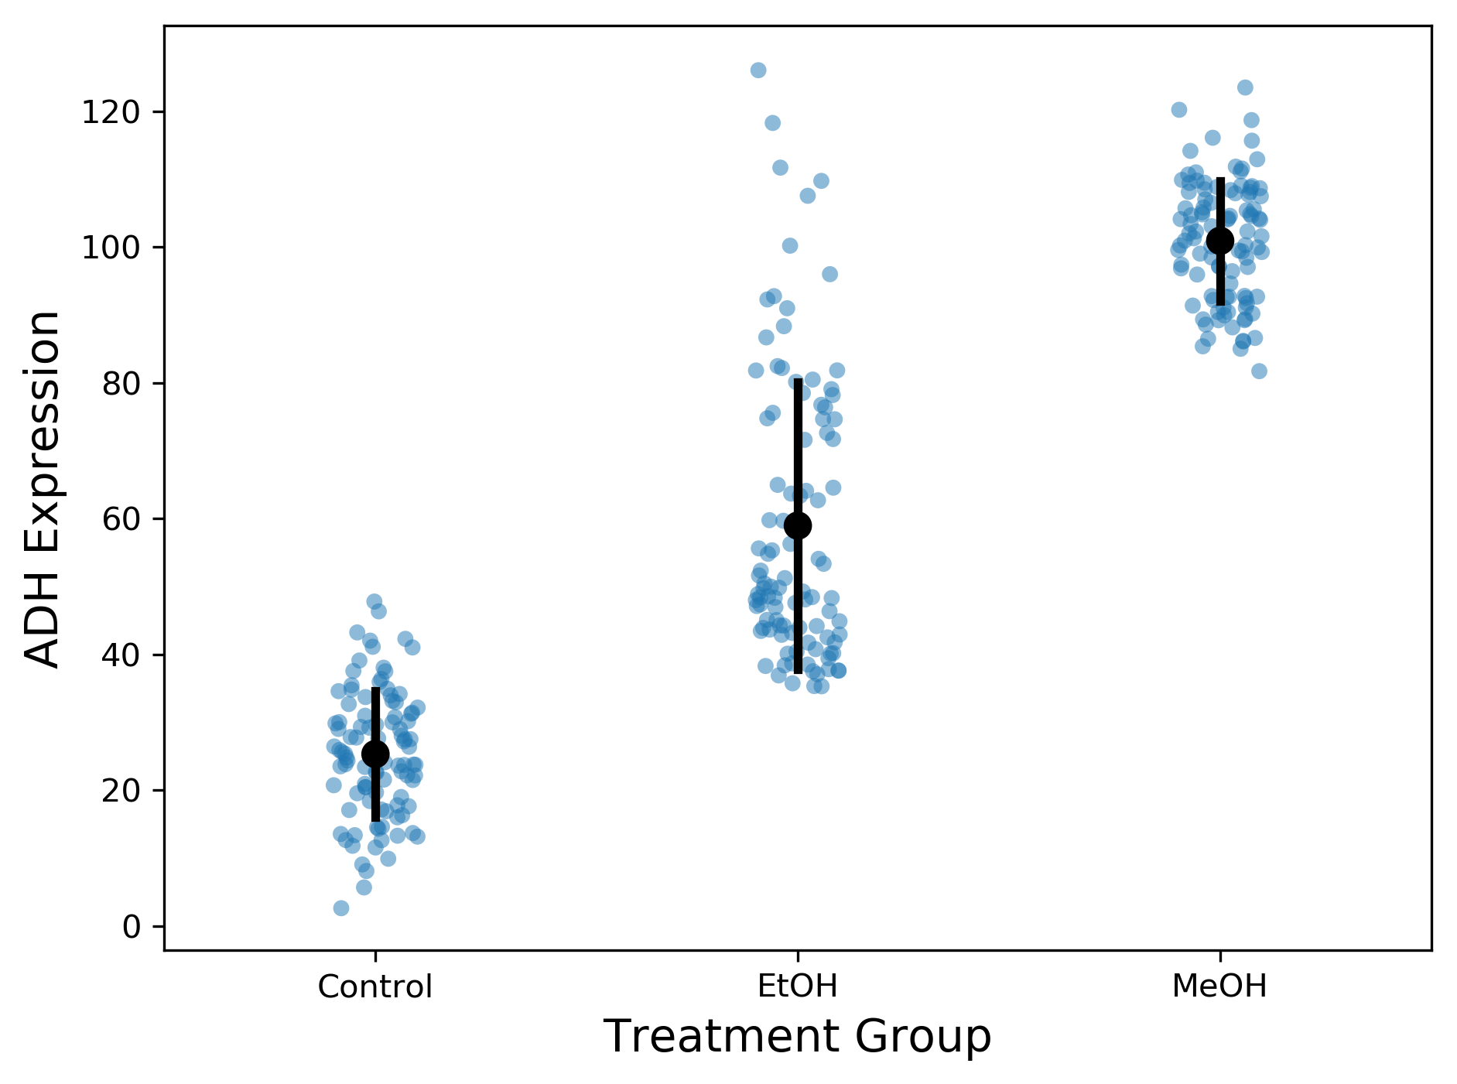
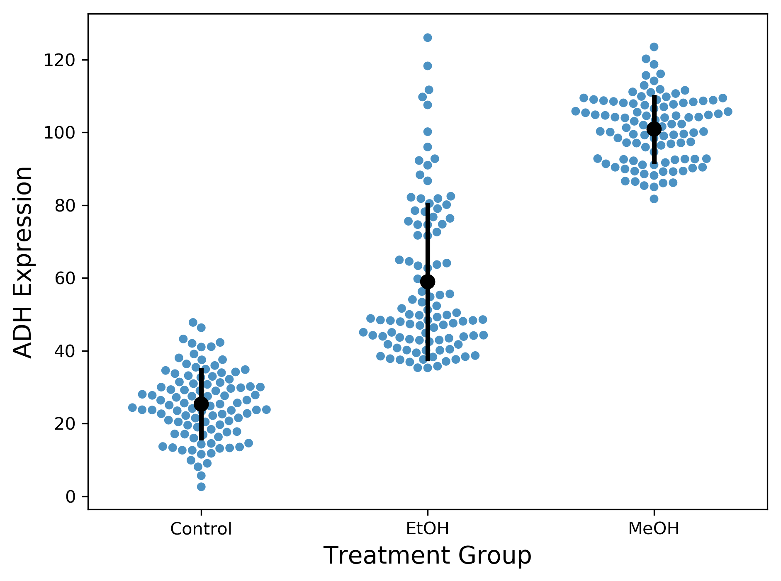
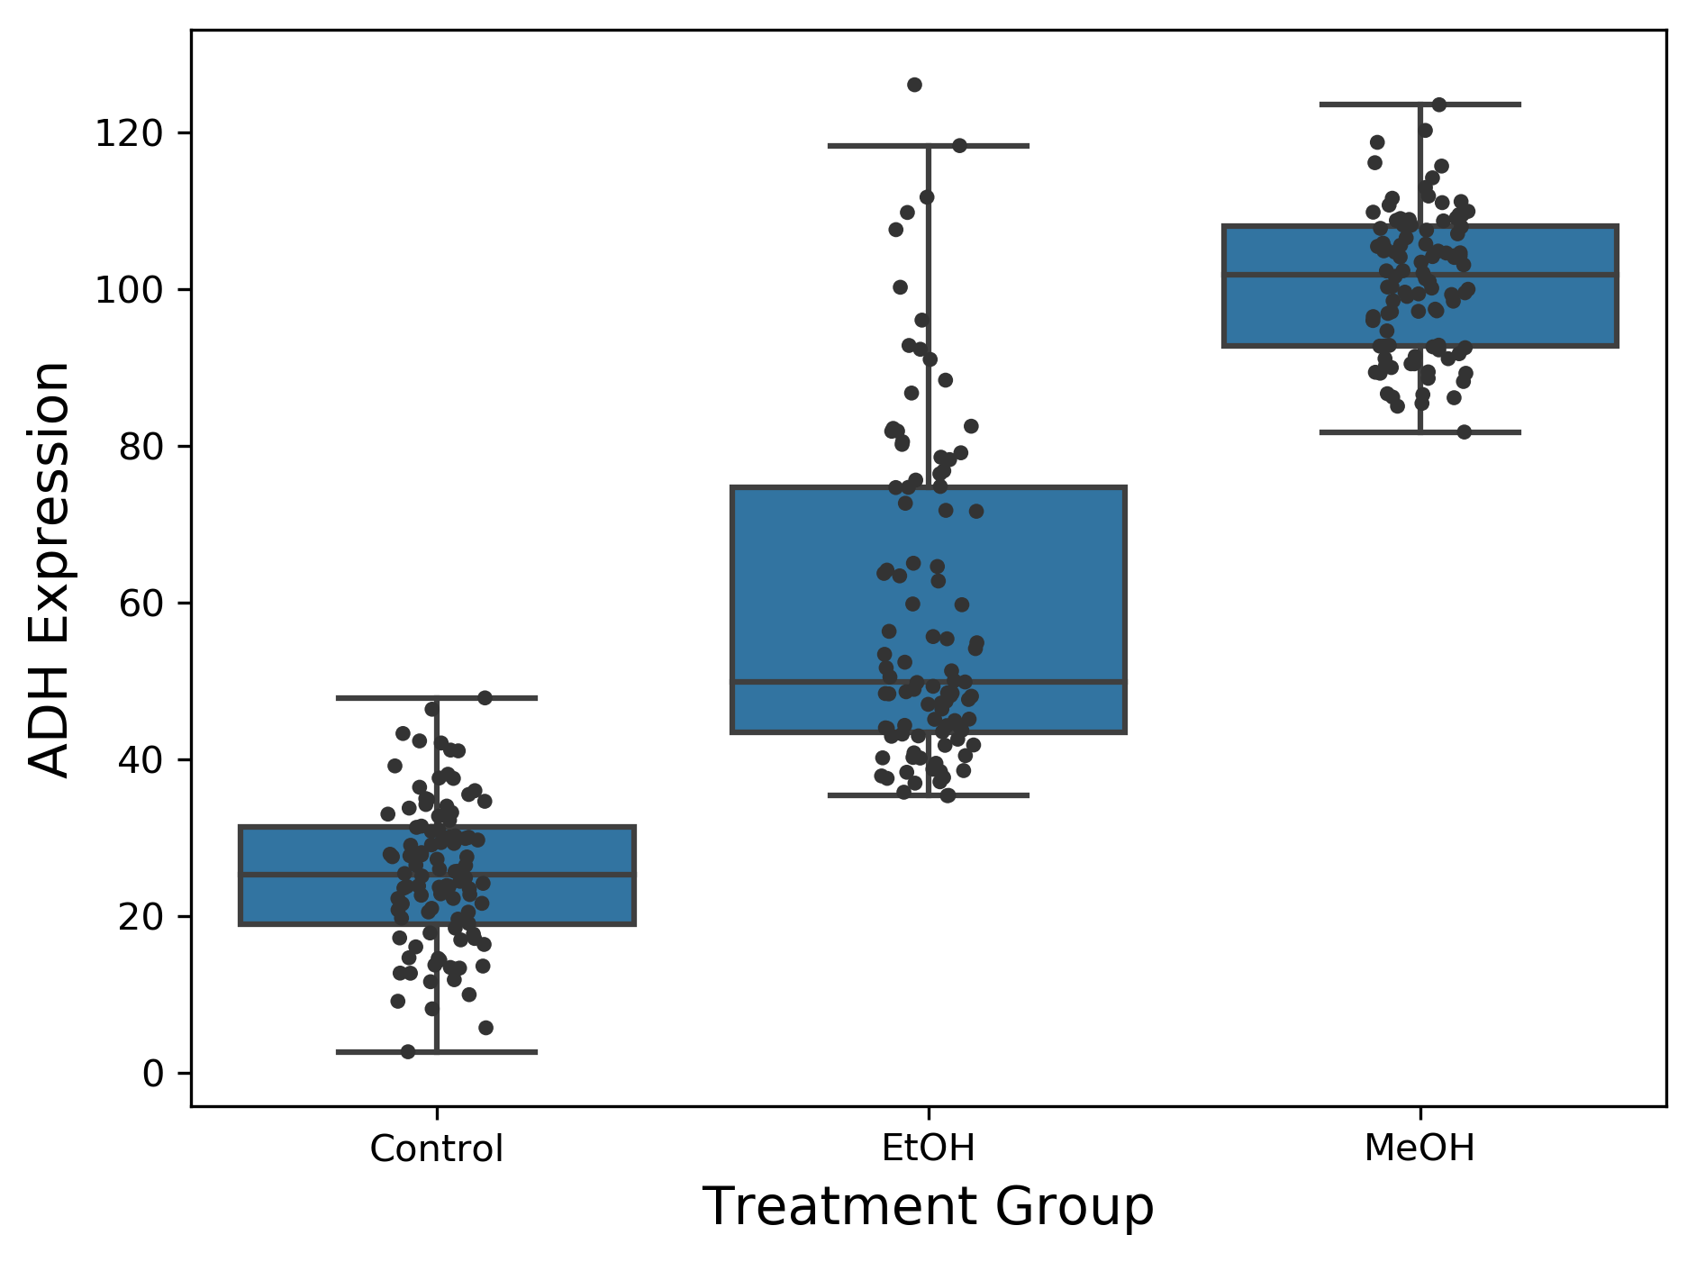
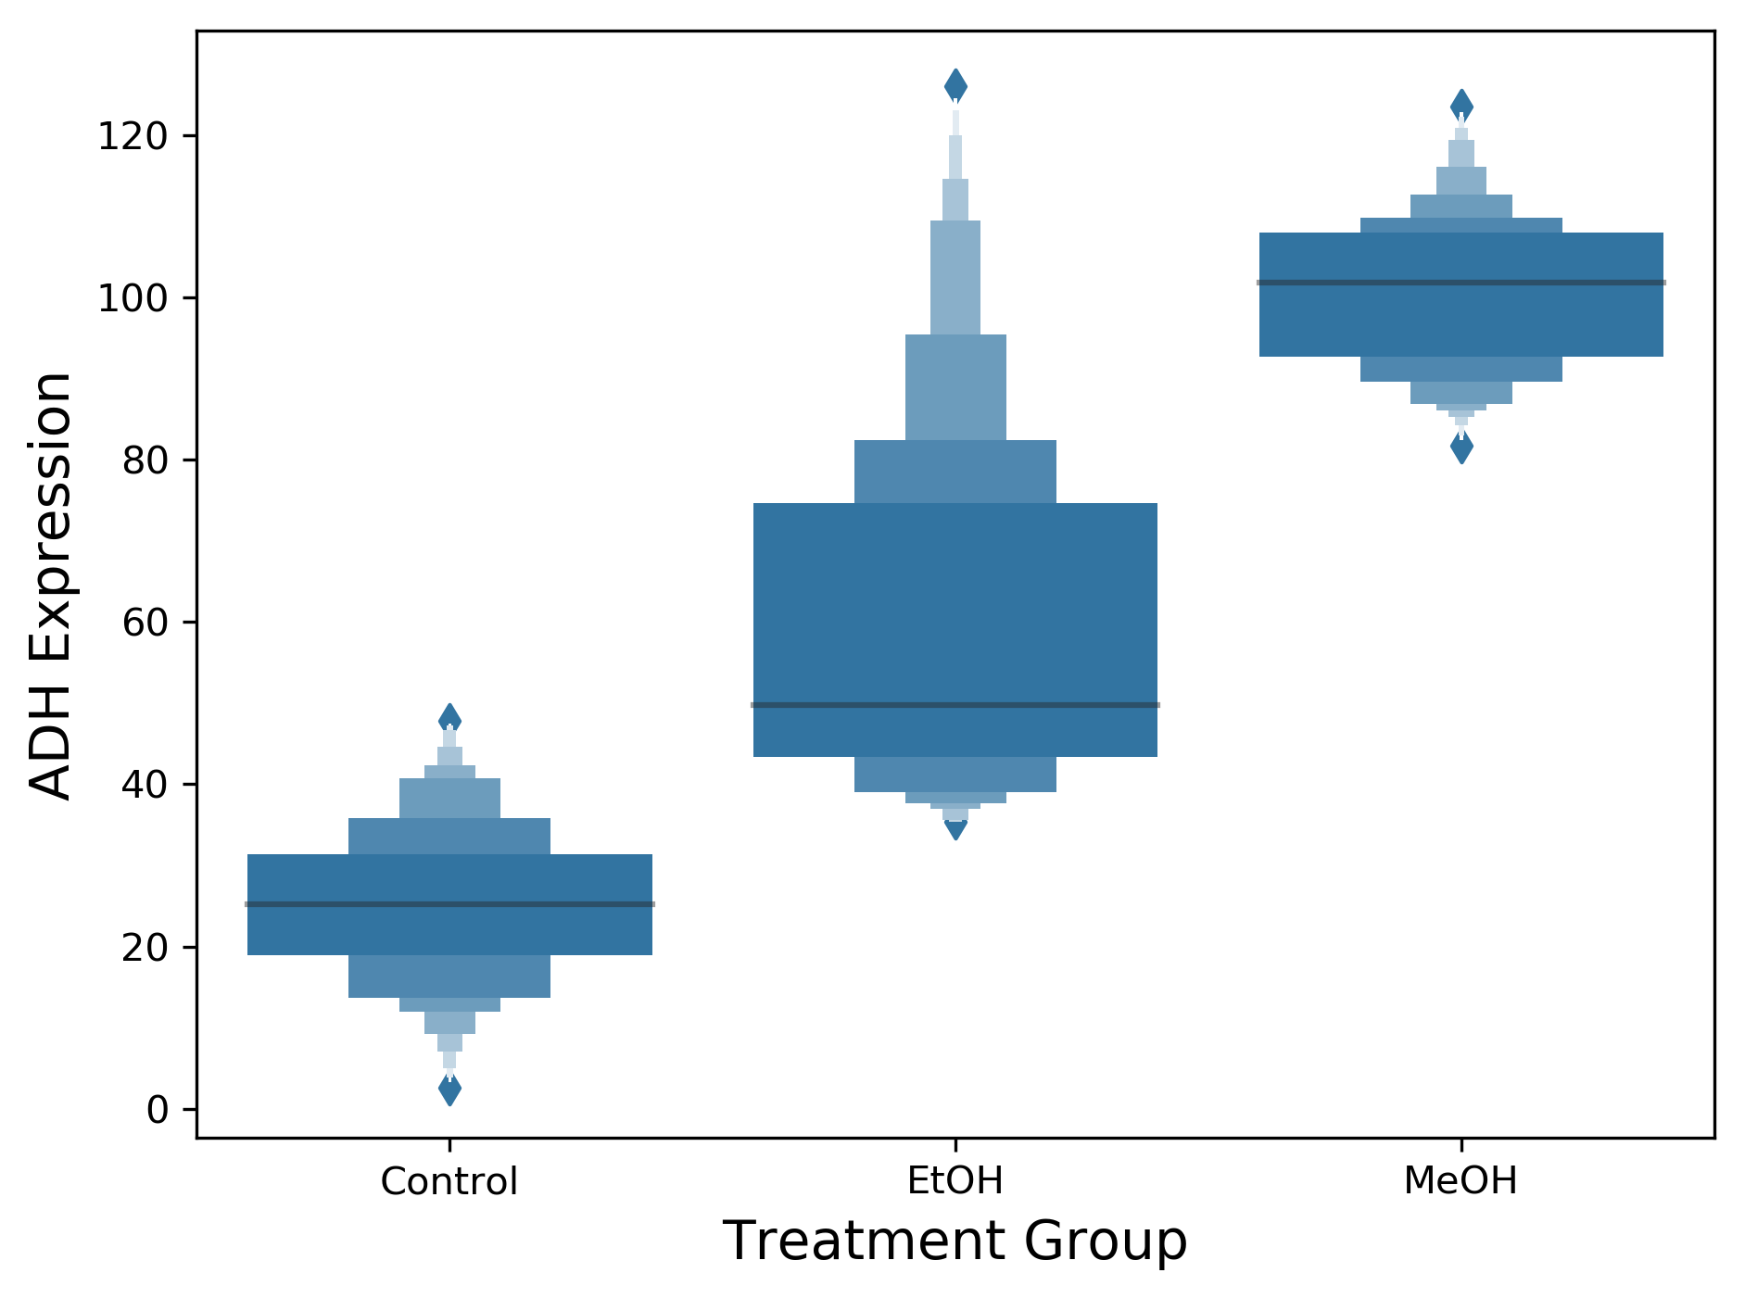
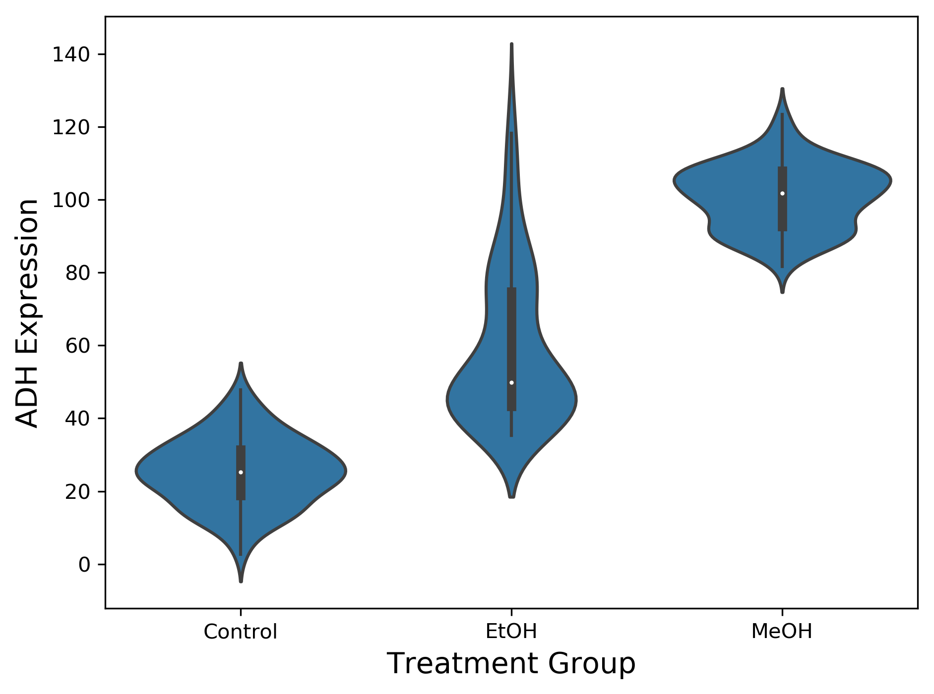
Methods of Plotting Categorical Data

Slide 3
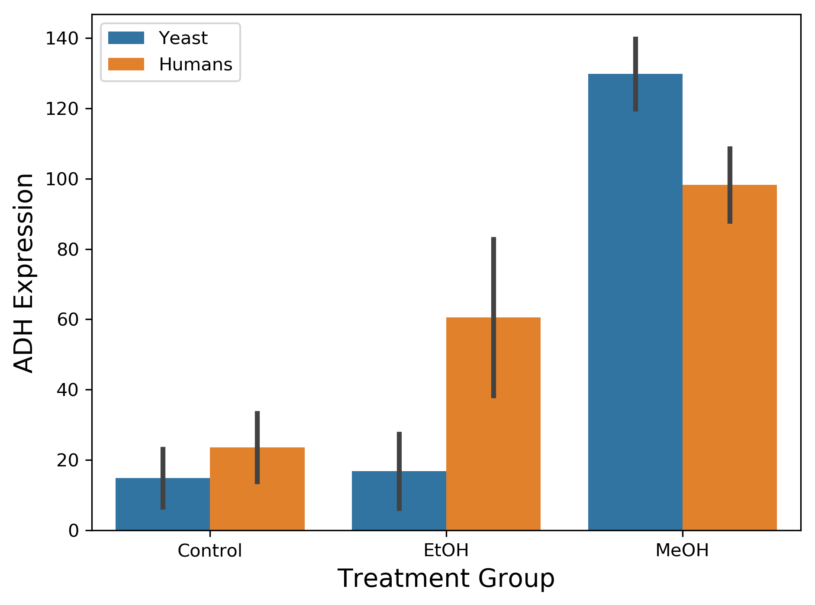
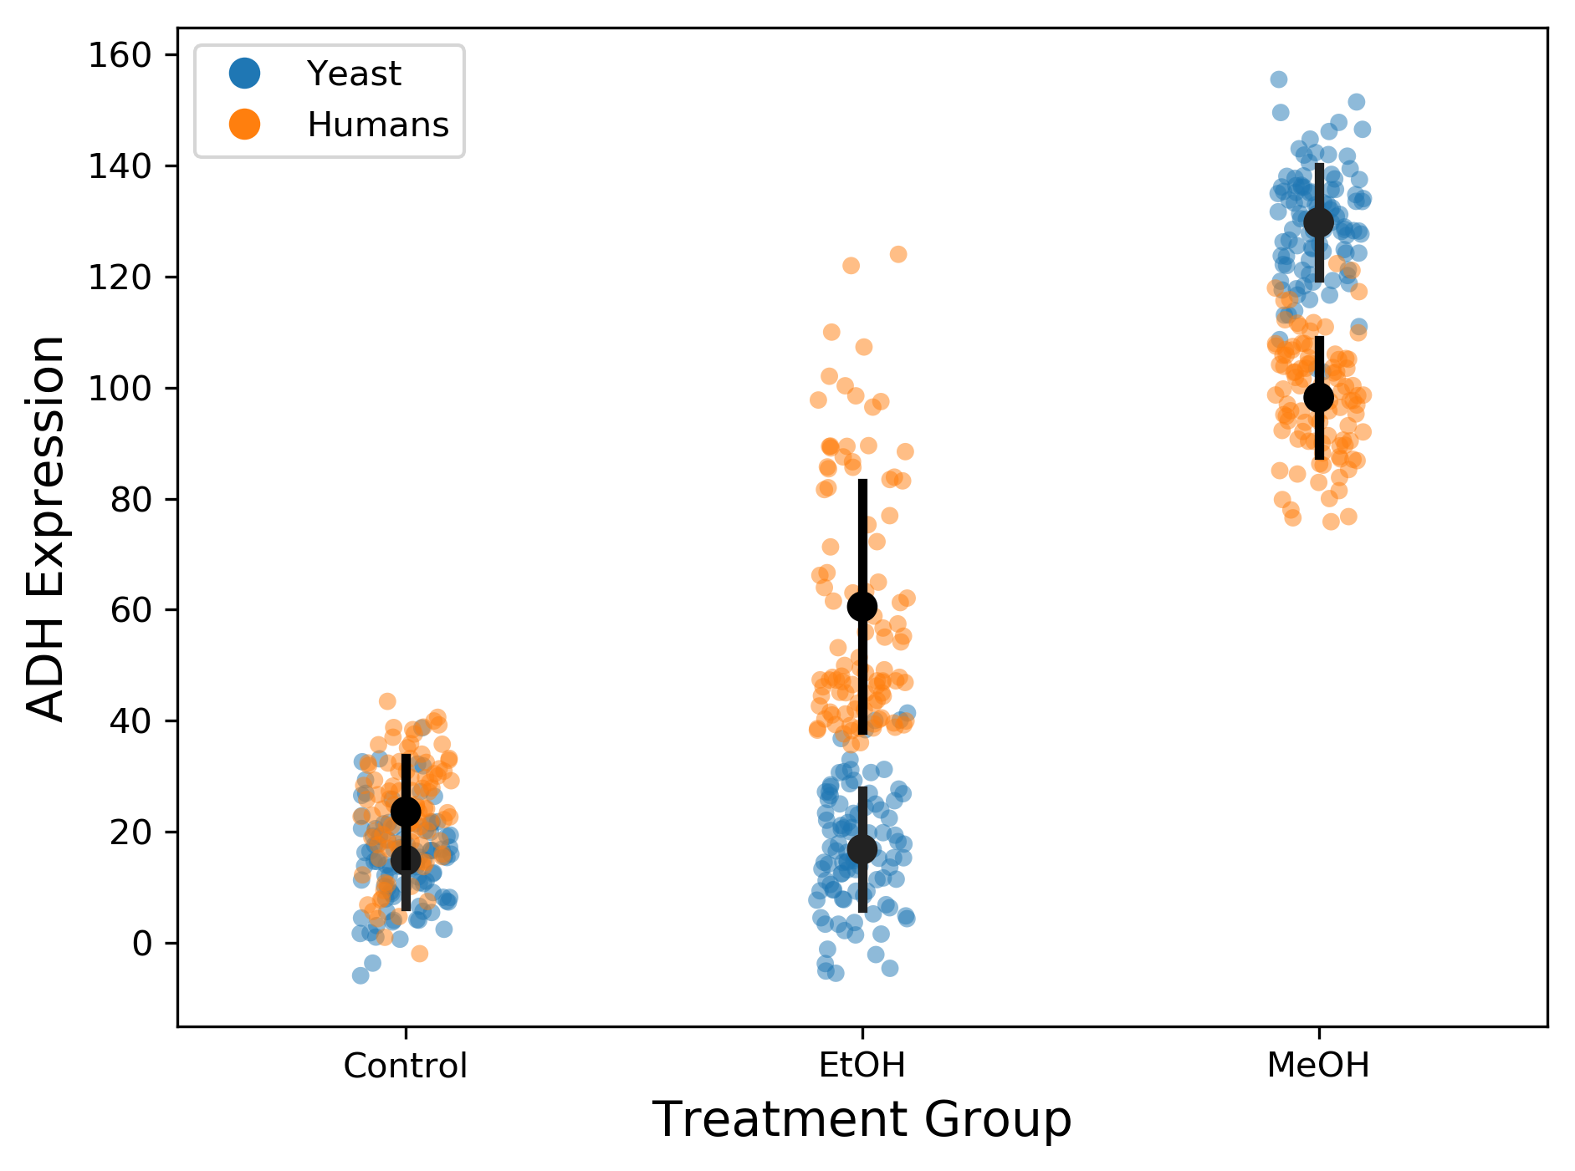
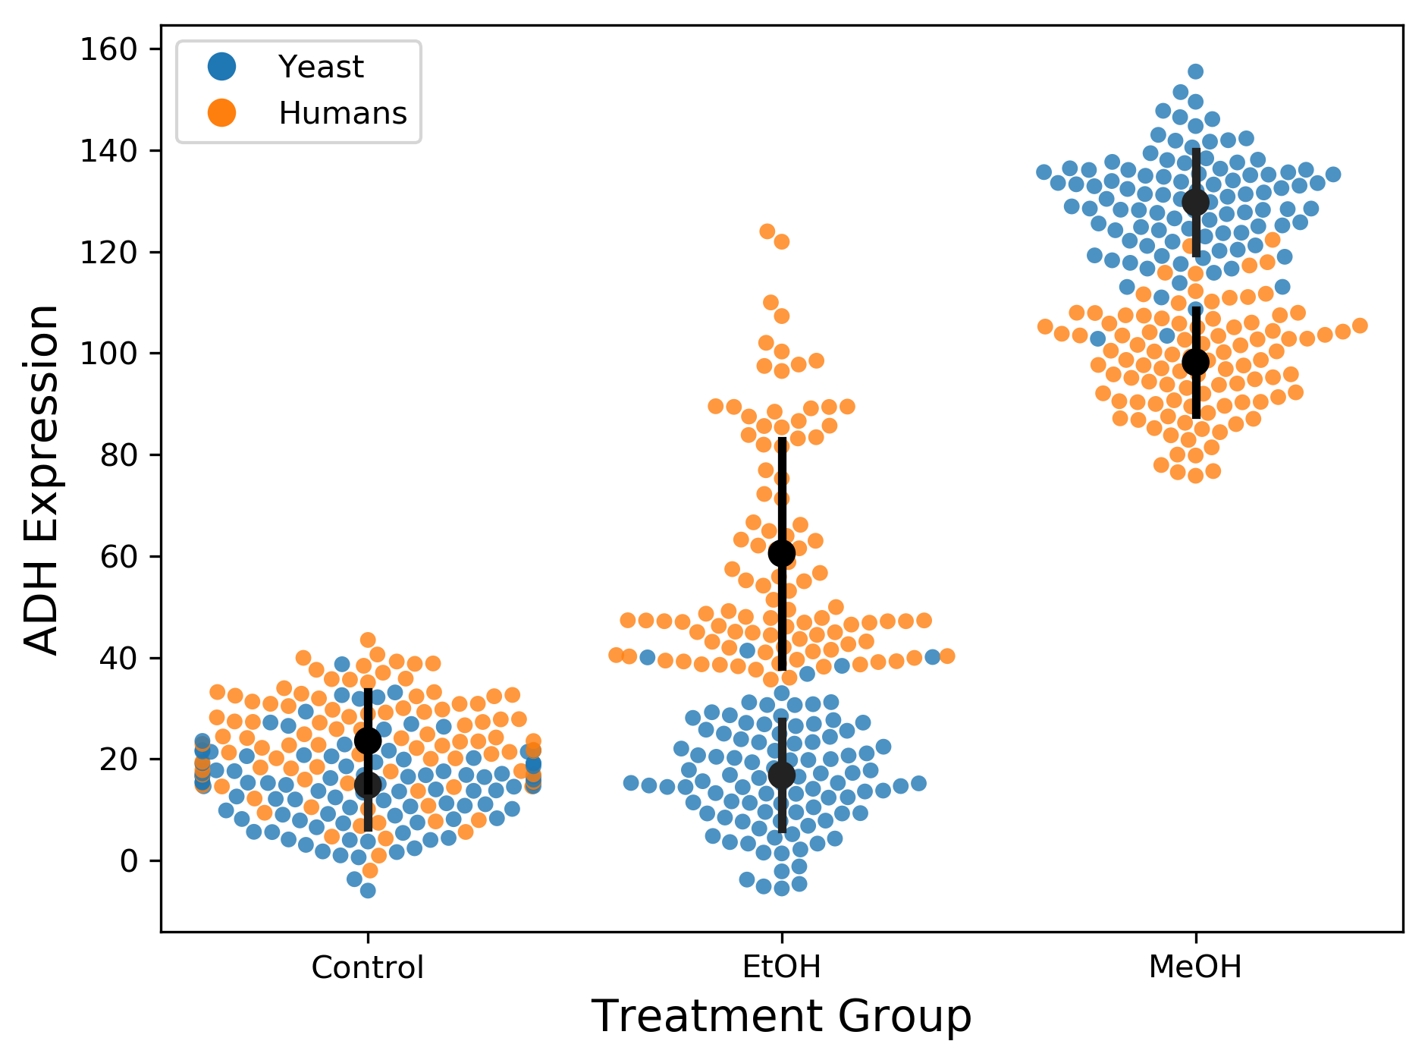
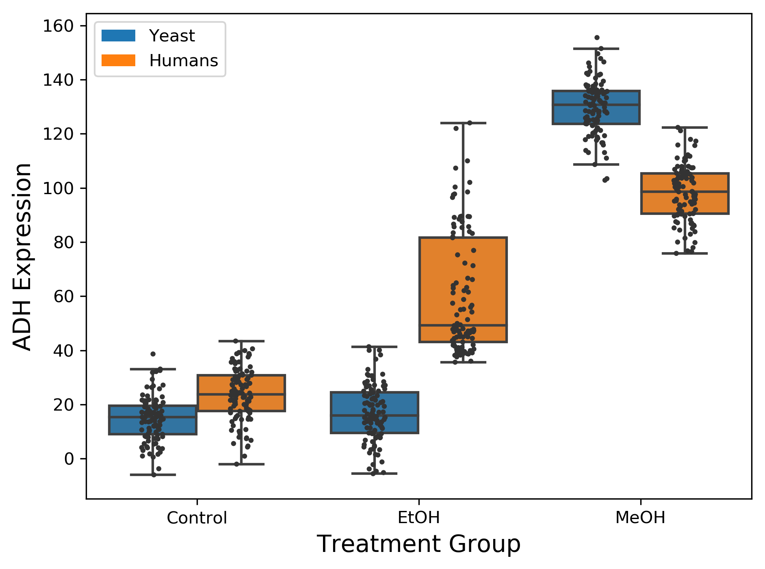

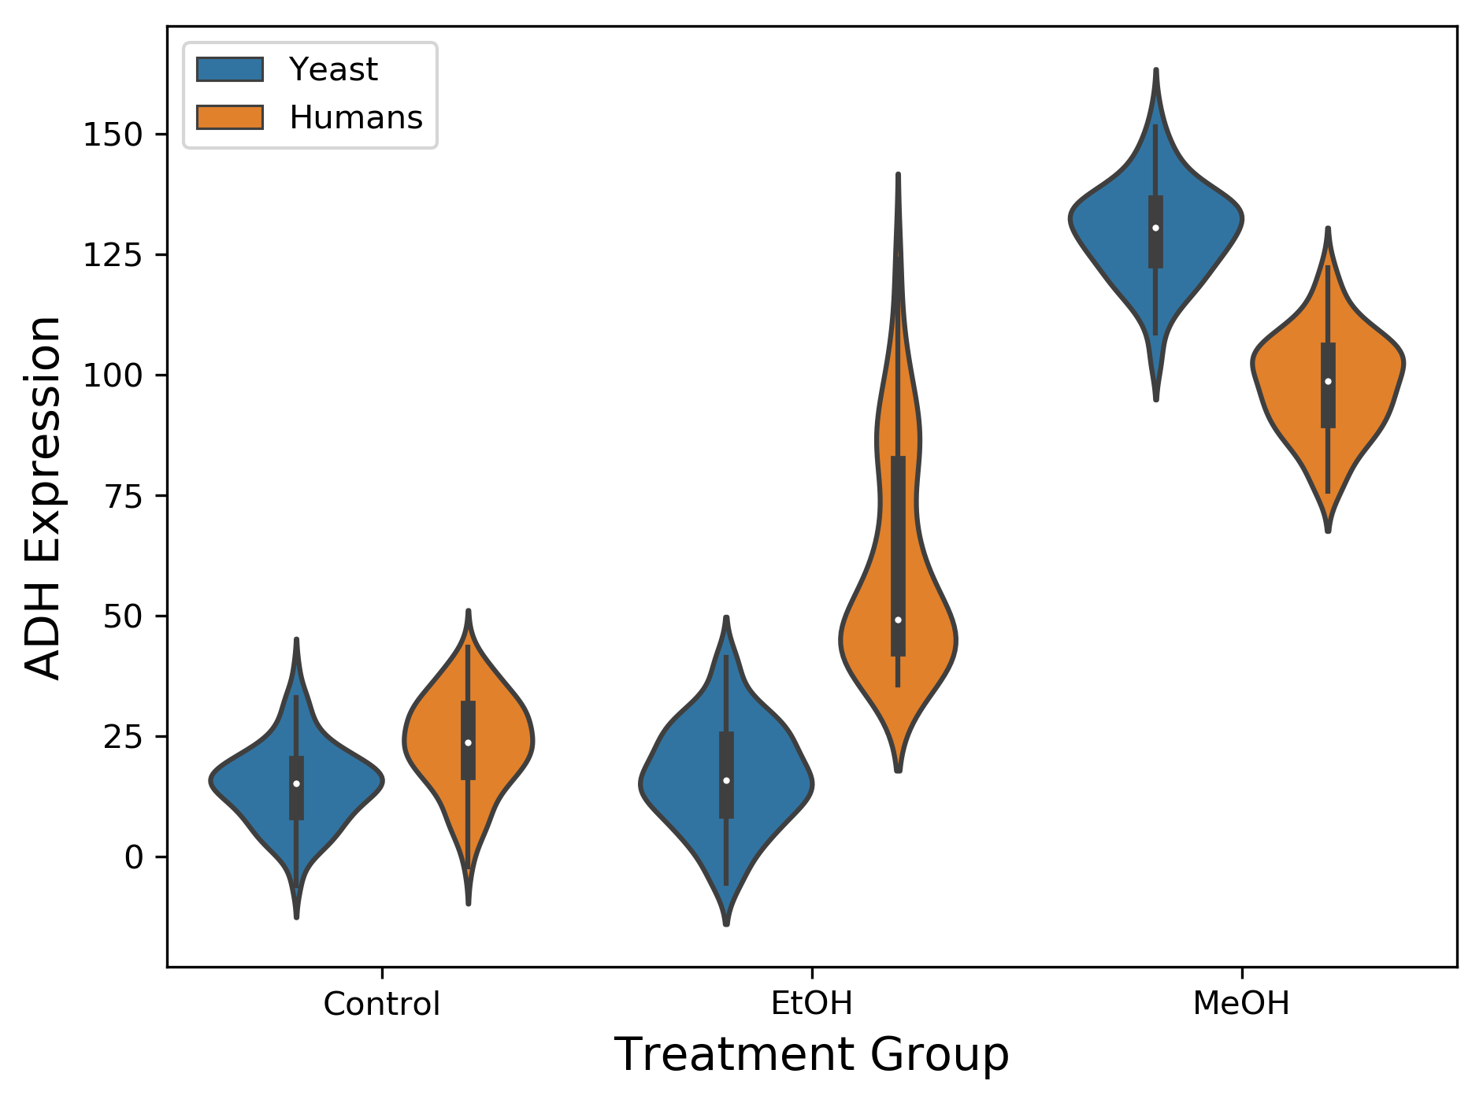
Adding a Dimension

Slide 4
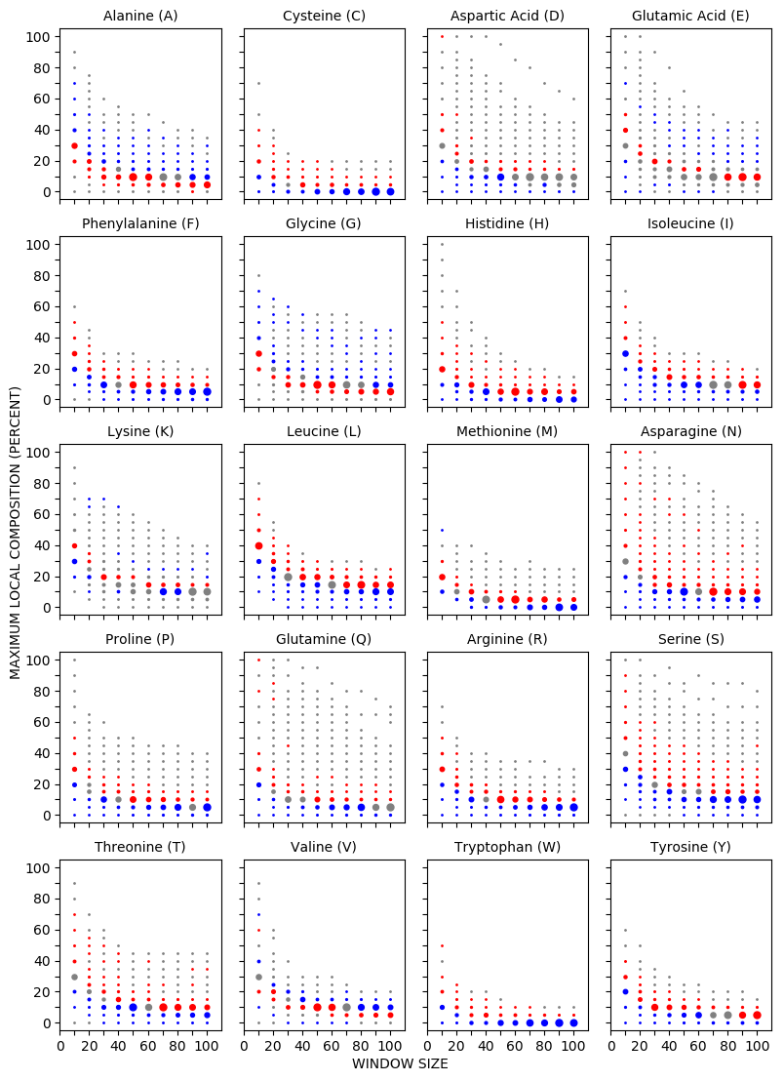
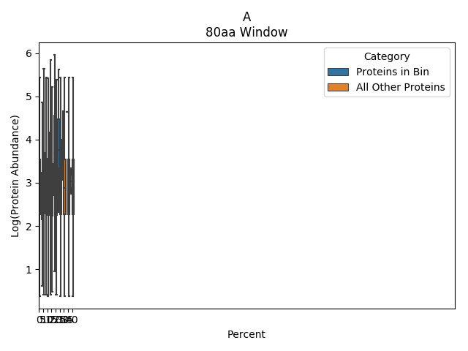
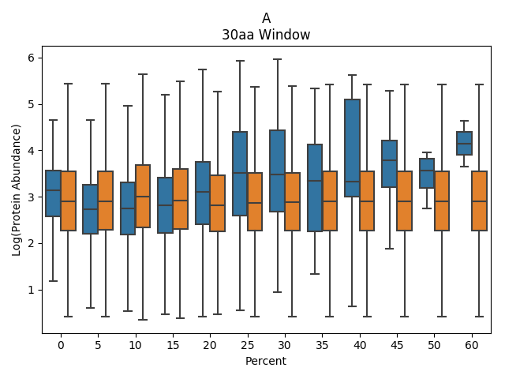
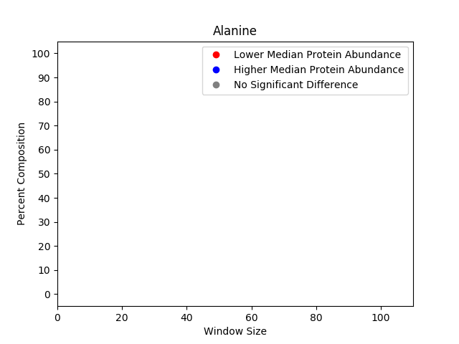
Compressing and Expanding Multi-Dimensional Data
Guiding questions:
What is the essential message you are trying to convey?
How can that message be conveyed according to the Interpretability vs. Information tradeoff?
Which combination of visual tricks can I use to optimize Interpretability vs. Information?
(separate graphs, 2D or 3D, colors, heatmaps, marker types, etc.)
Protein Abundance
Alanine (A)
100
Size of dots indicates protein sample size
80
60
Log(Protein Abundance)
Log(Protein Abundance)
MAXIMUM % COMPOSITION
40
20
0
Significantly lower median value
MAXIMUM % COMPOSITION
0
20
40
60
80
100
MAXIMUM % COMPOSITION
Significantly higher median value
WINDOW SIZE
No significant difference

Slide 5
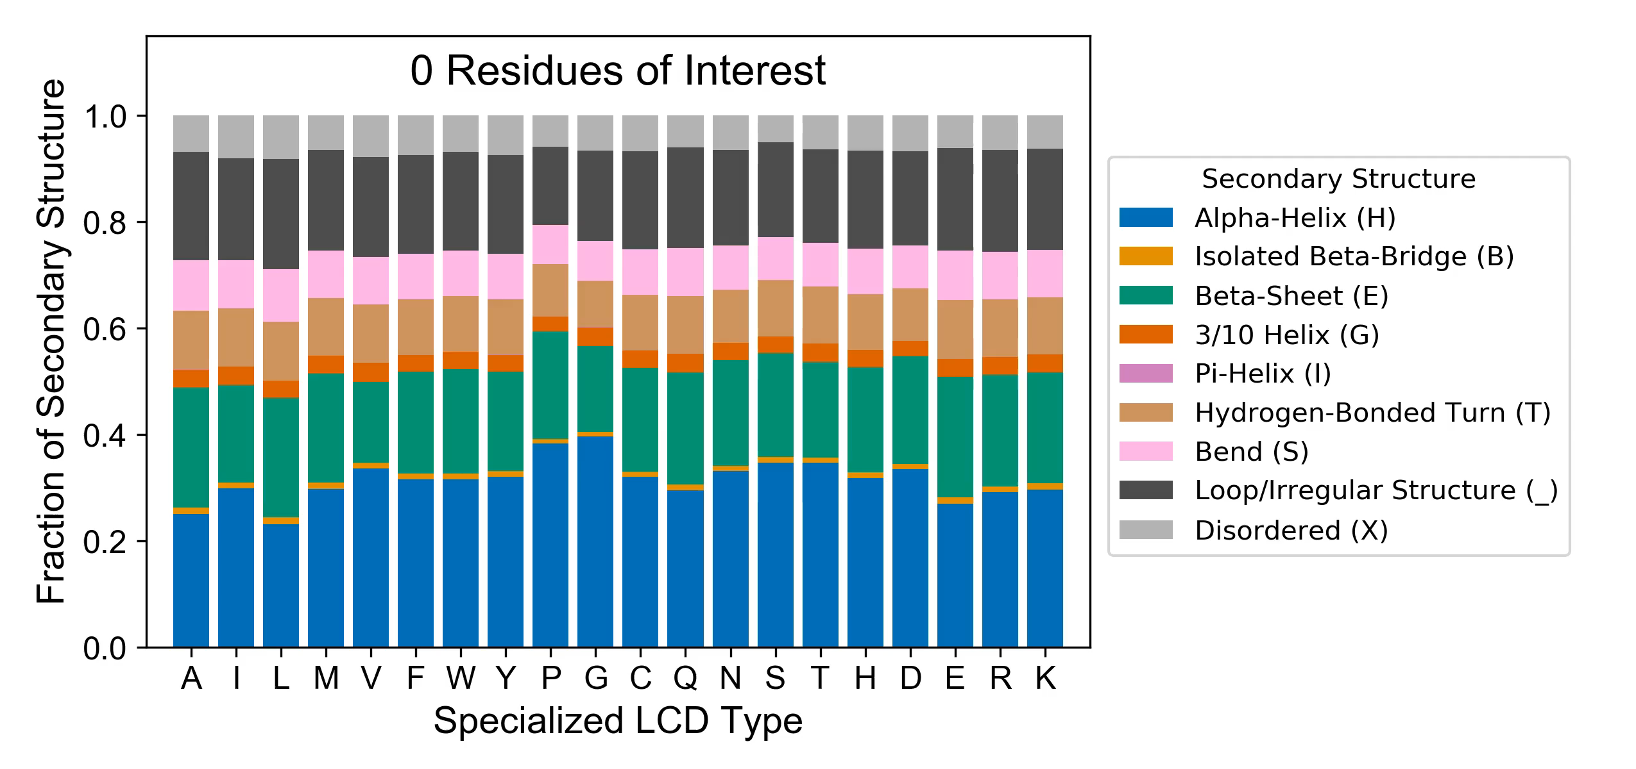
Adding a Time Dimension to Data Visualization – 4D Animated Figures

