Slide 1


Slide 2
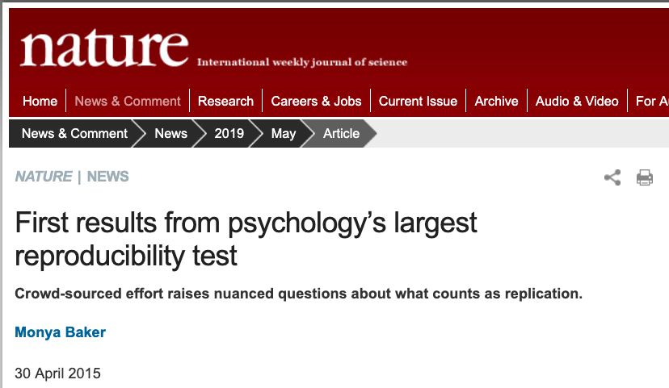
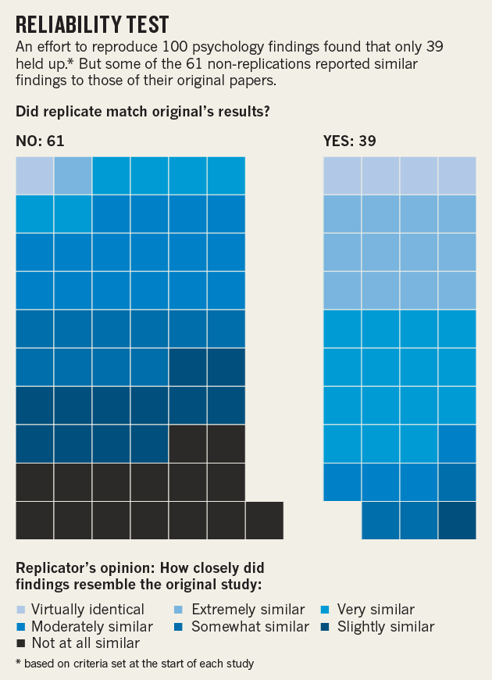
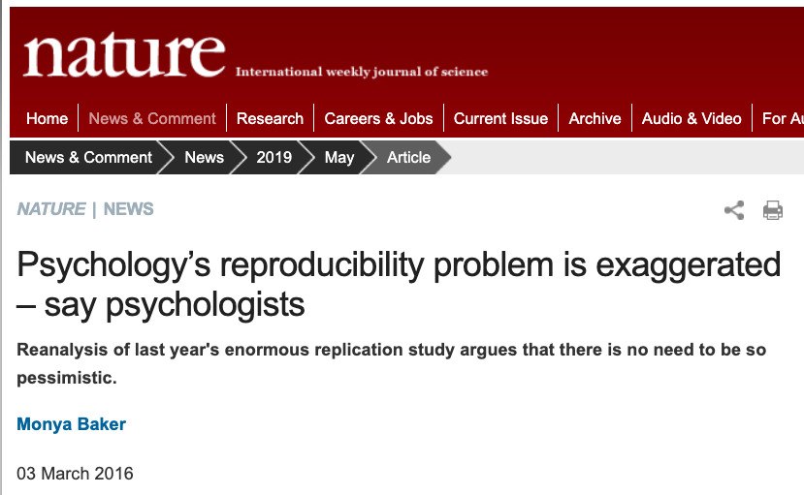

Slide 3
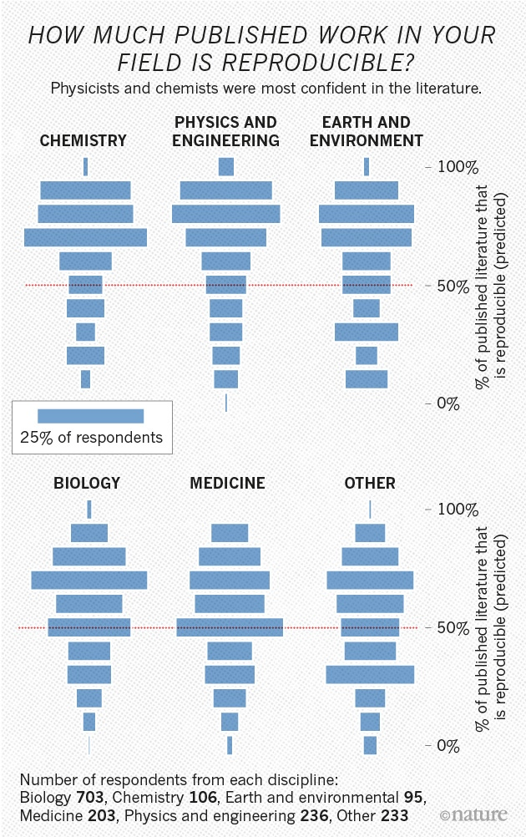
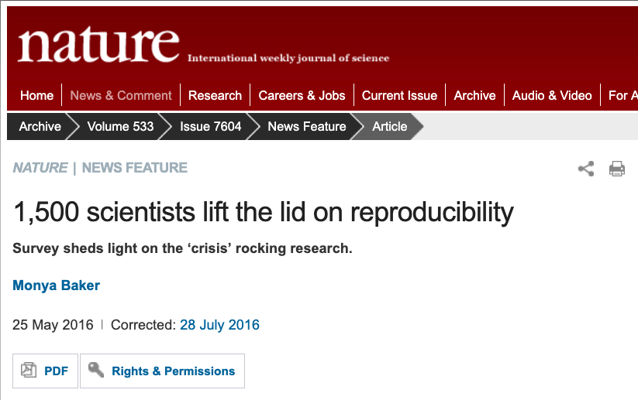
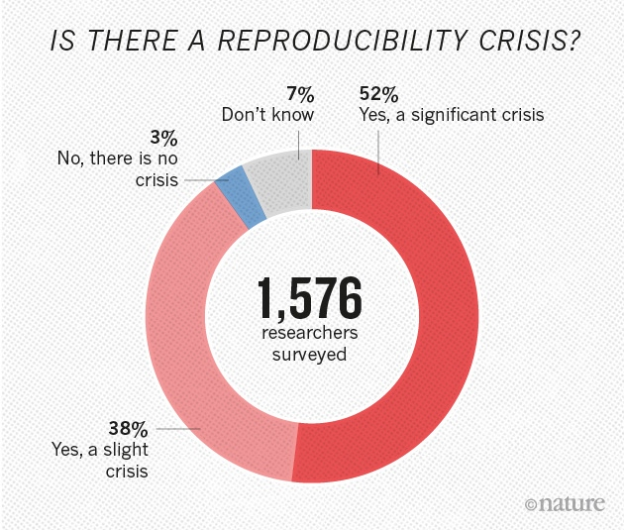

Slide 4
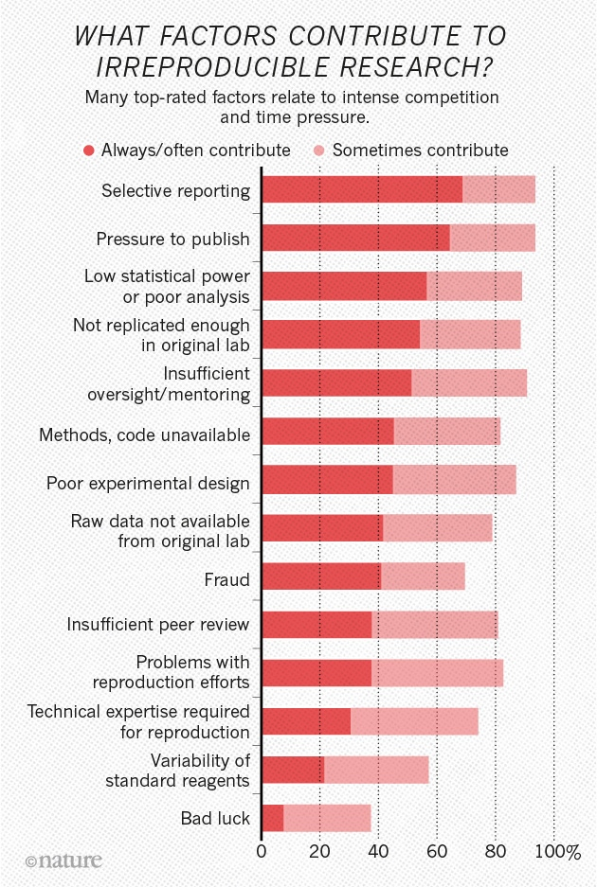
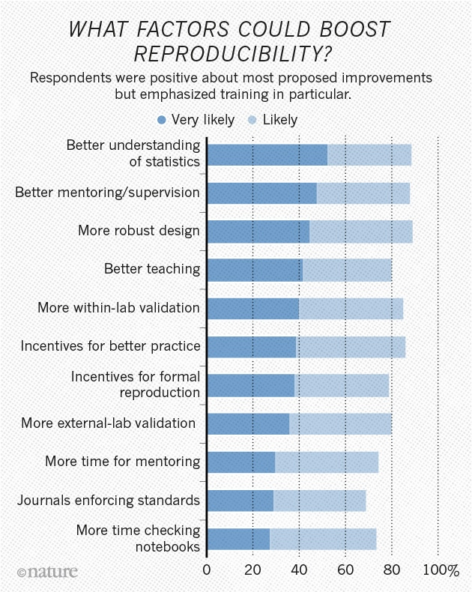

Slide 5
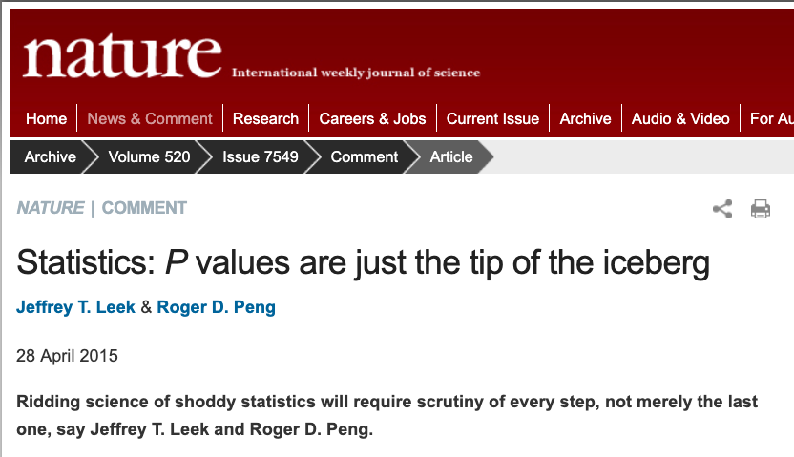
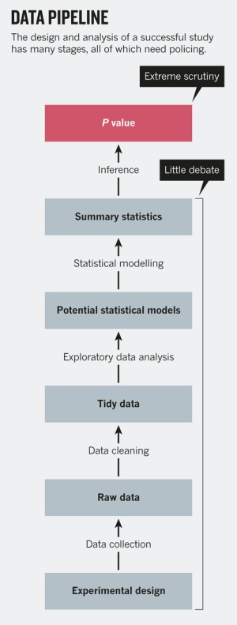
“Arguing about the P value is like focusing on a single misspelling, rather than on the faulty logic of a sentence.”
“But education is not enough. Data analysis is taught through an apprenticeship model, and different disciplines develop their own analysis subcultures.”

Slide 6
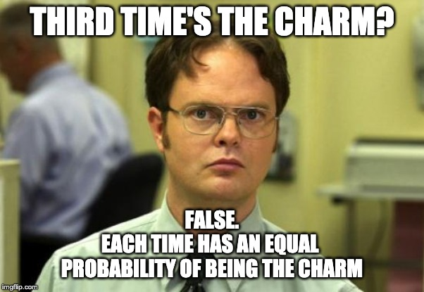
Abrasive Statistical Apprenticeship

Slide 7
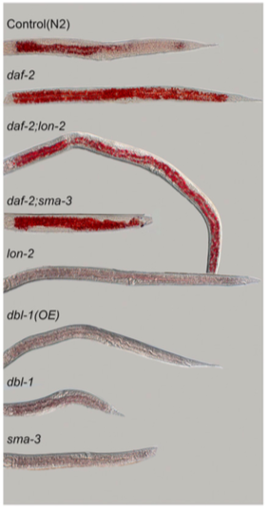
How to formulate a test
What comparison am I making/testing?
A group of observations versus a given value
Ex. Are my worm lengths > [some standard worm length]?
Two groups compared to each other
Ex. Does group A have longer worms than group B?
Multiple groups
Ex. Are there any groups (A, B, C, …) with different worm lengths?
Find evidence to reject your null hypothesis of NO DIFFERENCE
What type of data do I have?
Consult a flowchart
Clark JF, et al. G3: Genes|Genomes|Genetics. 2018;8(1):343-351.

Slide 8
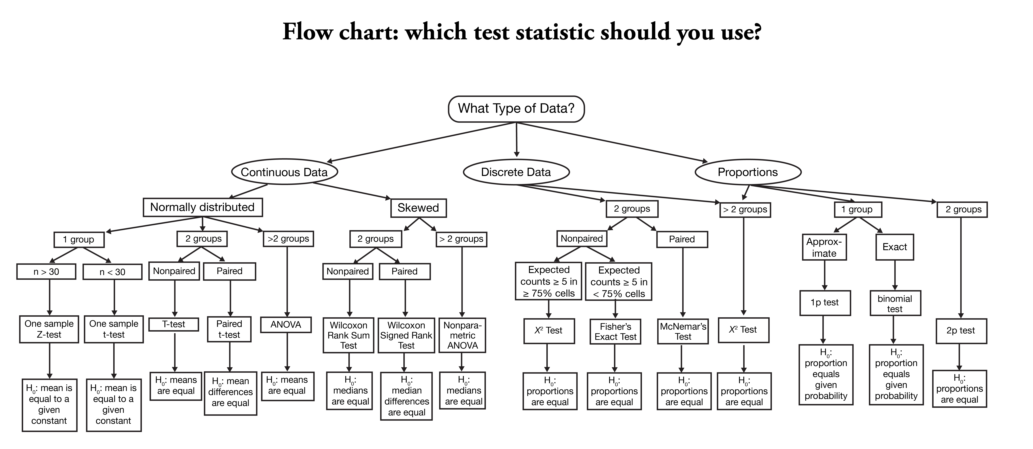

Slide 11
Tests are built in to statistical software like R
T-test: t.test
Chi-sq test: chisq.test
ANOVA: anova
Proportion test: prop.test, binom.test
And many, many more: fisher.test, wilcox.test, kruskal.test

Slide 12
Testing Non-normal groups for large sample sizes
Use the t-test
Because: The Central Limit Theorem
Statquest YouTube series with Josh Starmer: https://www.youtube.com/watch?v=YAlJCEDH2uY

