Slide 1
Evolution of Sports Analytics
Saryu Onishi
HES 3000-002, Sport Performance Analytics

Slide 2
Exercise: The Box Score Blind Spot
 | Minutes | Points | Rebounds | Assists | FG | 3PT
Player A | 38 | 24 | 4 | 2 | 9/22 | 2/8
Pair & Share:
What is something a traditional box score completely hides that modern tracking might reveals?
Shot quality and defensive pressure?
Physical workload and fatigue accumulation?
Spacing impact when off the ball?

Slide 3
Why leverage data for decision making?
Bias:
Memory & perception are unreliable
Scale:
Humans can’t track large samples
Precision:
96 mph ≠ “pretty fast”
Complexity:
Too many interacting variables
Notes:
Conclusions can be altered by emotion
Data driven insights cuts through this
Large samples: Humans can't reliably remember and process large amounts of information
Precise measurement: 96 mph not "pretty fast“
Complex interactions: Too many variables for intuition (e.g., lineup combinations)
Removing bias: Objective measurement vs. subjective impressions

Slide 4
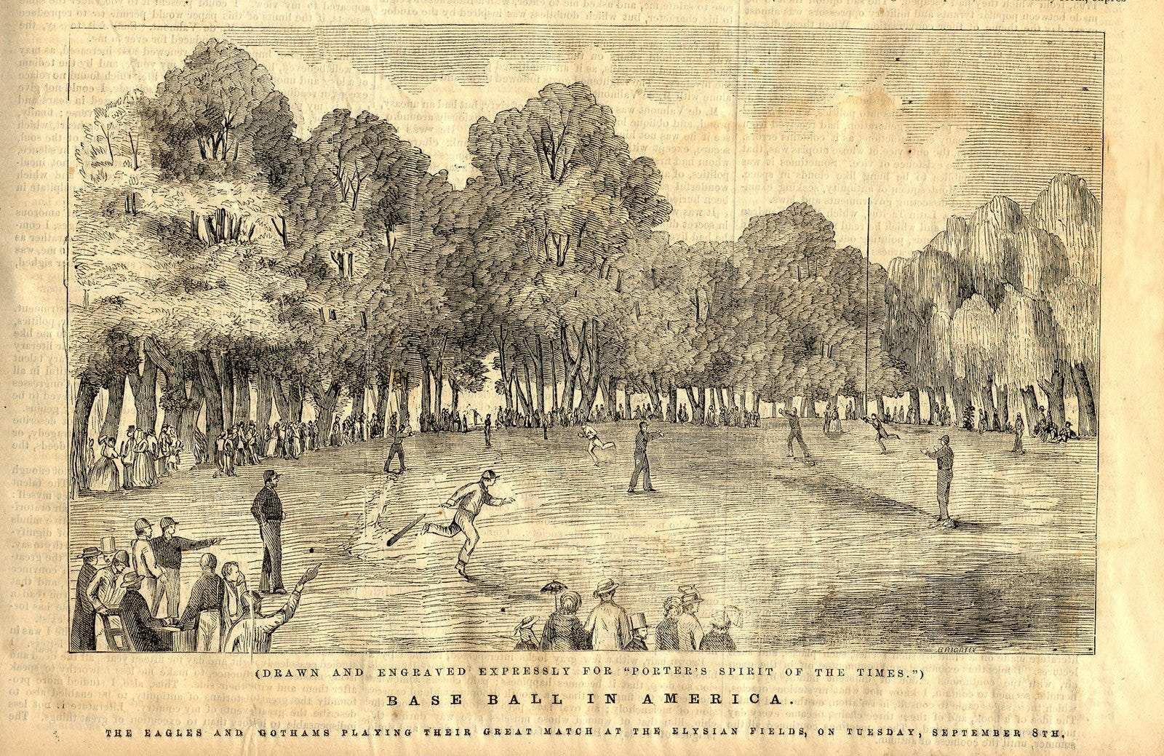
Beginning of Sports Analytics

Slide 5
Analog Measurement (and Analysis)
Mid-1800s–1960s
Sports began turning performance into recorded information.
Data collection was manual, limited, and primarily descriptive.
Scouting remained largely observational and qualitative.
Limitations:
Box scores capture the what but entirely miss the how and why (i.e., context) – think back to opening exercise
High susceptibility to confirmation bias and overgeneralization from small samples

Slide 6
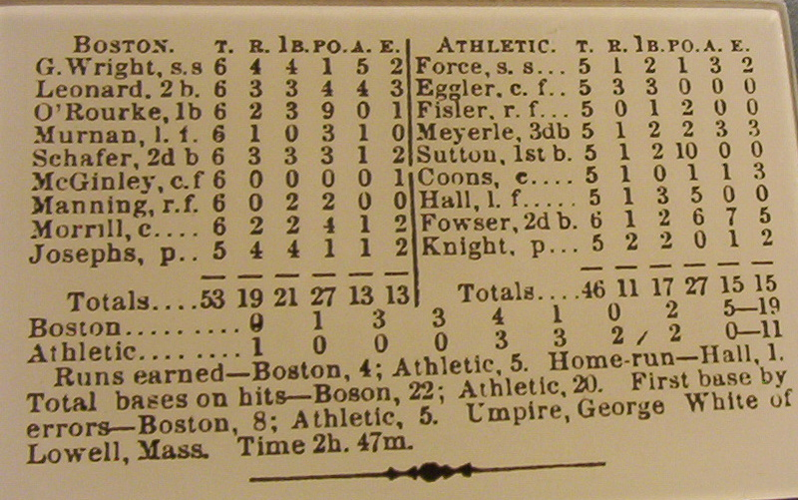
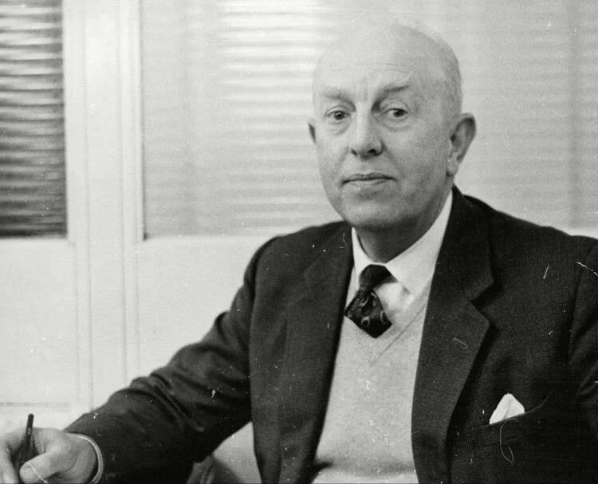
Analog Measurement (and Analysis)
Henry Chadwick:
Helped standardize the baseball box score.
Harvey Pollack:
Expanded the statistics recorded in basketball.
Charles Reep:
Manually coded actions and passing sequences in soccer.
Advocated for the long ball strategy
Notes:
“Reep fallacy” of analysing only successful outcomes

Slide 7
Challenging Conventional Wisdom
1960s–1990s
Analysts began questioning accepted beliefs and whether traditional statistics actually measured performance.
Greater emphasis on efficiency/rates, context, and contribution.
Analysis began moving from recording outcomes to evaluating decisions.

Slide 8
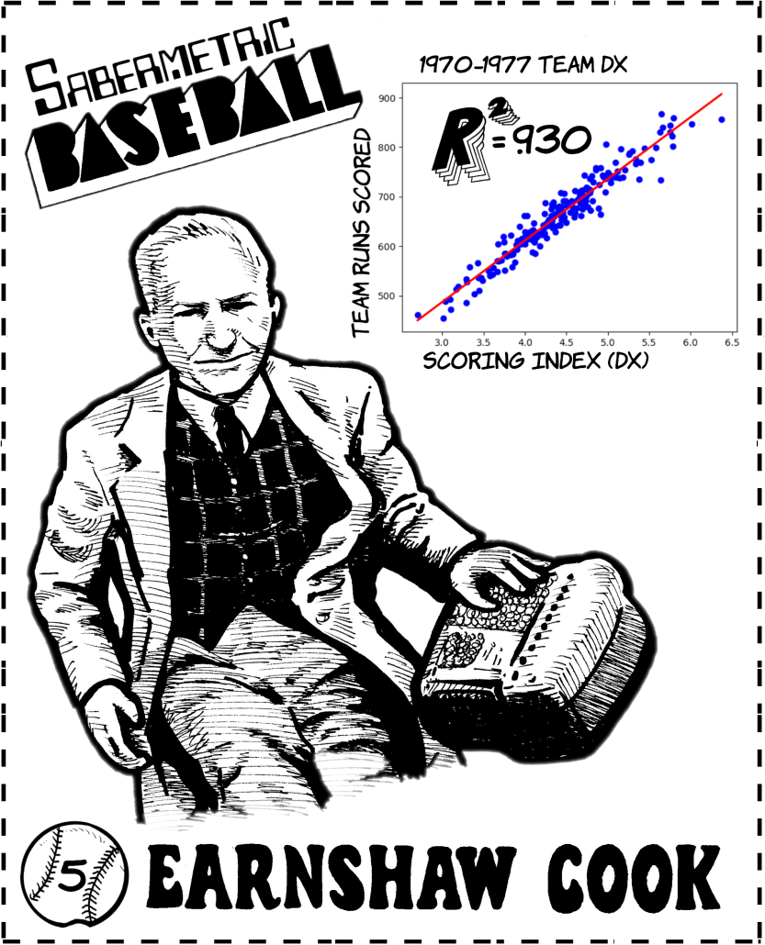

Challenging Conventional Wisdom
Earnshaw Cook:
Applied mathematical analysis to baseball strategy.
Bill James:
Challenged traditional measures and popularized sabermetrics.
Pete Palmer:
Developed methods for estimating runs and player value.

Slide 9
Why was analytics still limited?
Notes:
Data and access is main. Others include … buy in, inertia, etc

Slide 10
Digital Measurement Revolution
1990s–2000s
New technologies dramatically expanded the volume, frequency, and detail of sports data.
Optical tracking, video analysis, and spatial tracking captured performance beyond traditional statistics.
Movement and physiological responses could increasingly be measured continuously.

Slide 11
Digital Measurement Revolution
What are some examples of technologies that increased data in your sport?

Slide 12
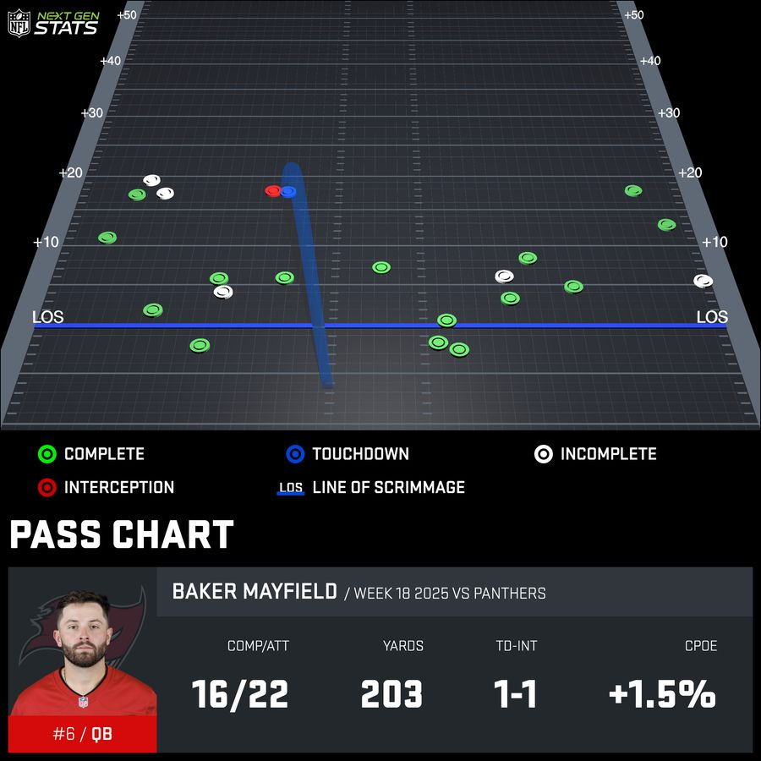
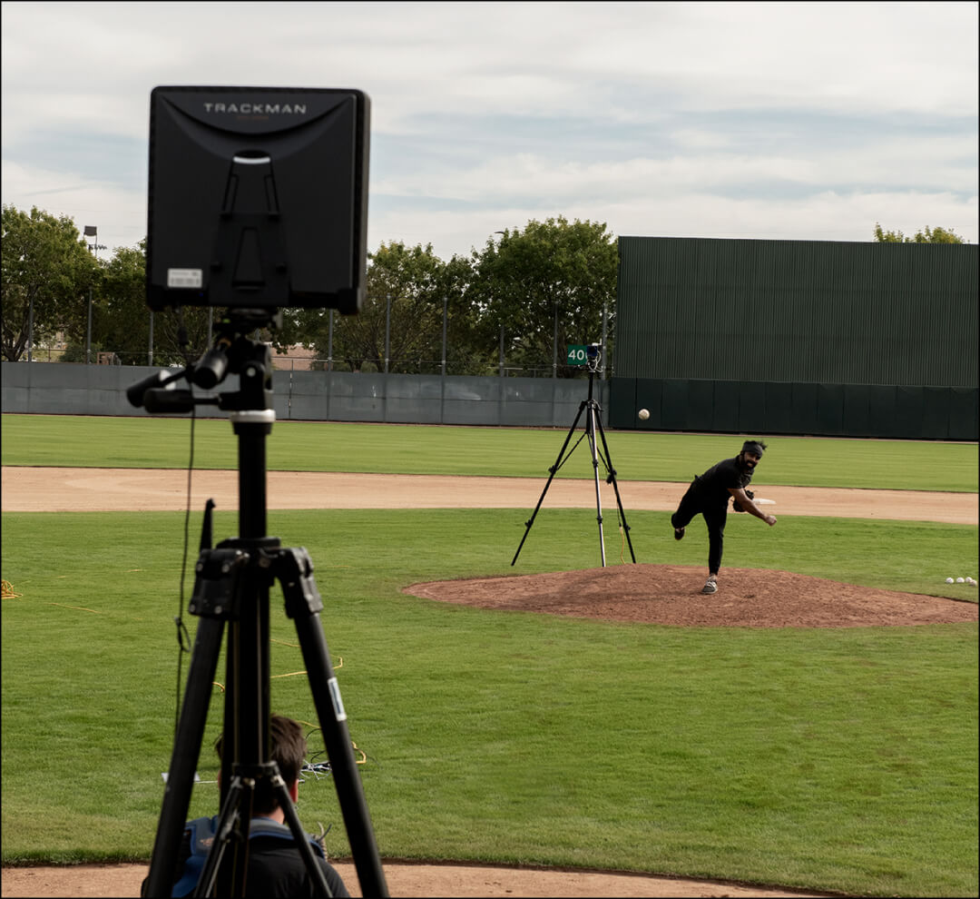

Digital Measurement Revolution
Polar: Portable heart-rate monitoring.
Garmin: Wearable GPS live distance and pace numbers.
Catapult: Spatial tracking systems for team sports
TrackMan: Radar-based ball and object tracking.

Slide 13
Modern Performance Analytics
2000s–Present
Analytics moved from isolated outsiders toward front offices, coaching staffs, and dedicated departments.
Analytics became integrated across scouting, strategy, athlete performance, and sports medicine.

Slide 14


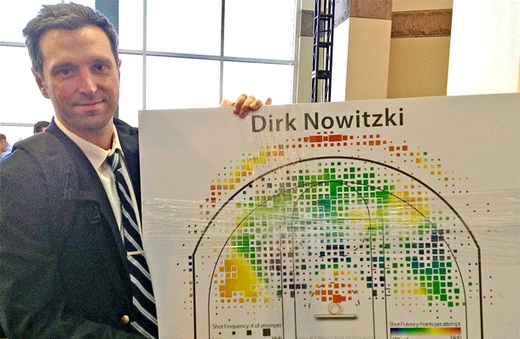
Modern Performance Analytics
Billy Beane and Paul DePodesta:
Applied sabermetric ideas to player acquisition and roster construction in Oakland.
Daryl Morey
Built an analytically driven basketball operation around efficiency, probabilities, and decision-making.
Kirk Goldsberry
Used spatial data and visualization to transform how basketball shooting and defensive performance were understood.

Slide 15
Tools of Performance Analytics
Manual
Pen, paper, tally sheets, film notation
Record and summarize a limited number of events
Computational
Spreadsheets, databases, statistical software
Store larger datasets, calculate efficiently, and compare patterns
Programmatic
R/Python, cloud computing, machine learning
Automate workflows, integrate multiple data sources, and model complex outcomes
Notes:
As data became larger and more complex, analysis has shifted from manual methods to methods that can more effectively process, visualize, and model them.

Slide 16
The Paradigm Shift:
The Traditional Mindset:
Heavy reliance on expert intuition, scouting lore, and decades of visual confirmation.
The "gut feeling" approach to training and game planning.
Analytics Approach:
Uncovering hidden patterns that human cognitive biases naturally filter out or miss.
Data doesn't replace the eye test; it calibrates and enhances it.

Slide 17

Evolution of Sports Analytics through Moneyball

Slide 18
Before Billie Bean and the A’s
1. Challenging the Traditional Measures
Batting average (BA) was traditionally treated as a central measure of offensive performance.
It captured hits but ignored other ways a player could reach base.
Bill James questioned whether conventional statistics accurately represented player value.
Measures such as on-base percentage (OBP) helped shift attention toward the production of runs rather than traditional reputation.
The first shift was not more data. It was questioning what the existing data actually measured.

Slide 19
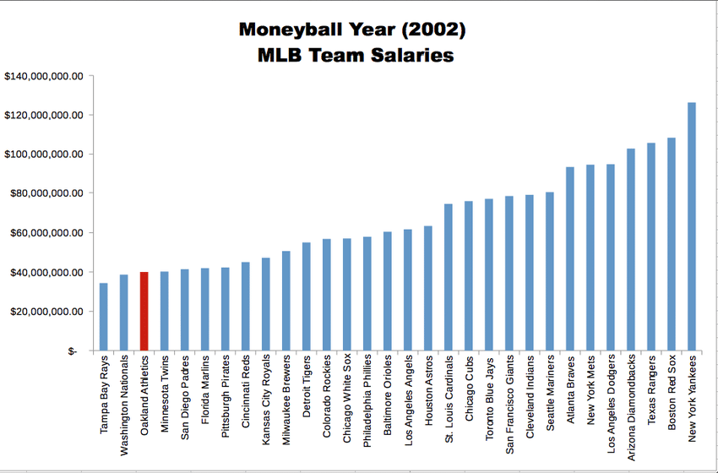
Analysis to Implementation
2. The Oakland A's Put the Philosophy to Work
The A's needed to build a competitive roster under substantial payroll constraints.
Billy Beane, Paul DePodesta, and the Oakland front office looked for skills that contributed to winning but were undervalued by the player market.
Eg: OBP

Slide 20
What Happens When Everyone Catches Up?
3. From Competitive Advantage to Widespread Adoption
A’s demonstrated analytical methods could reveal market inefficiencies.
Other organizations expanded their own analytics capabilities.
Previously undervalued skills became more widely recognized
(and the skill became appropriately priced)
Competitive advantage of OBP disappeared.

Slide 21
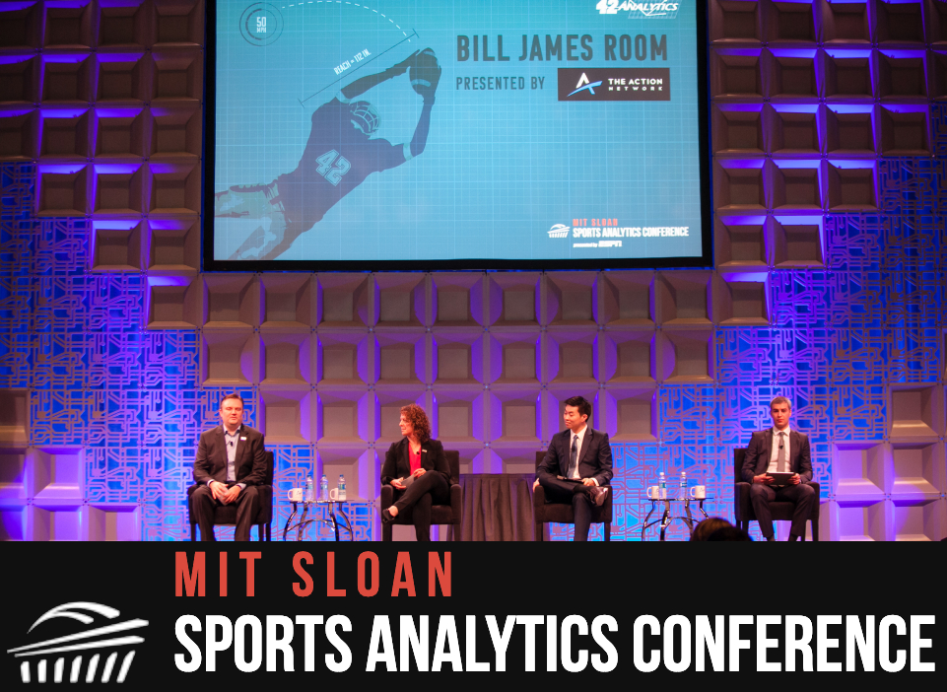
Beyond Moneyball
4. The Analytical Frontier Keeps Moving
Modern analytics extends far beyond box scores and any single “advanced” statistic.
Competitive advantage increasingly depends on asking better questions, domain expertise, and effective communication / implementation.

Slide 22
The Modern Sports Analytics Landscape
Performance analytics is now specialized into several “domains”:
Scouting & Talent Evaluation
Objective profiling, tracking performance trajectories, and building predictive models for athlete recruitment.
Athlete Tracking
Monitoring training and physical condition to manage training stress and prevent injuries.
Strategy & Tactical Optimization
Leveraging situational probabilities and spatial efficiency to guide play-calling, defensive alignment, and game plans.

Slide 23
Summary & Looking Ahead
Key Takeaway: Sport analytics continually evolves as new questions, data, technologies, and methods reshape how performance is understood and decisions are made.
Next Class: Overview of the three domains (Tracking, Scouting, Strategy) and how data changes sports decisions.
For Next Time: Think about a specific sports decision you've seen coaches make that you'd like to analyze with data.

Slide 24
Challenges & Cultural Friction
Cognitive Biases:
Overcoming the "hot hand" fallacy, outcome bias, and selective memory.
Signal vs. Noise:
Avoiding data overload. Not everything that can be measured matters, and not everything that matters can be easily measured.
The Human Element:
Analytics is only as powerful as its implementation on the ground.
Pushing past cultural resistance from traditional coaches, staff, and athletes.

Slide 25
Moneyball: The art of winning an unfair game
Revisiting Moneyball by Pardis Noorzad
What specific problem were the A’s trying to solve?
How did they use data to solve it?
How did analytics impact the scouting job?
How has baseball analytics changed since?

