Slide 1
The Three Domains: Scouting, Tracking, and Strategy
Saryu Onishi
HES 3000-002, Sport Performance Analytics
Notes:
Overview of the three domains (Tracking, Scouting, Strategy) and how data changes sports decisions.

Slide 2
Sport Analytics Begins With a Decision
For any sport analytics problem, ask:
Who will use the analysis?
What decision are they trying to make?
What information could improve that decision?
What are the consequences of being wrong?
What data might provide that information?

Slide 3
Start With a Sport Question or Decision
Write down a question or decision you are interested in analyzing.
If you don’t have one, chose one:
Should we recruit this athlete?
Which defensive lineup should we use against our next opponent?
Which part of a player’s game should be prioritized for development?
Why is the team conceding so many opportunities after losing possession?
Think about how today’s lecture applies to your topic of interest

Slide 4
Overview
Understand where sport performance analytics is applied and how each domain supports real-world decisions.
Scouting & Talent Evaluation
Athlete Tracking
Strategy & Tactical Optimization

Slide 5
Domains and the Different Decision Environments
Scouting and Talent Evaluation
Evaluating athletes, projecting future performance, and informing recruitment.
Athlete Tracking and Monitoring
Understanding training, competition demands, and athlete responses over time.
Strategy and Tactical Analysis
Understanding how games unfold and supporting decisions about how to compete.
The domains describe where analytics is applied and which decisions it supports.
Notes:
STUDENTS SHOULD BE ABLE TO IDENTIFY WHICH DOMAIN THEIR QUESTION IS IN
Is it about signing talent?
Is it about athlete’s training?
Is it about how we play the game?

Slide 6
Domain 1: Scouting & Talent Evaluation
Evaluate current ability, understand development, and estimate future fit or performance.
Common decisions
Recruit or draft an athlete
Compare potential prospects
Identify development priorities
Build a balanced roster
Common information
Performance history
Training history
Physical and technical profile
Competition context
Age

Slide 7
Evaluation Depends on the Reference Point
Consider the claim: “This athlete is an excellent shooter.”
Excellent compared with what?
Teammates?
Players at the same position?
Players of the same age?
Players in the current league?
Players at the level being considered?
A number becomes evaluative only when it has a meaningful comparison.
Notes:
One of the things to consider when investigating scouting domain

Slide 8
Evidence From Different Sources
In scouting:
Statistical performance: what the athlete has produced
Video and observation: how that performance occurred
Physical testing: the athlete’s specific capabilities
Interviews and background: the athlete’s role, experience, and environment
Notes:
Often times scouting does not rely on a single data point (it may in your project)
Which source would you trust most?
and why?

Slide 9
Domain 2: Athlete Tracking and Monitoring
Understand what athletes do and how they respond across training and competition.
Common decisions
Adjust training
Plan recovery
Prepare for competition demands
Evaluate return-to-play progression
Common information
External load
Internal load
Wellness and readiness
Performance-test results

Slide 10
Tracking Connects the Training Plan, Completed Work, and Athlete Response
What was prescribed?
The planned training or competition demand
What did the athlete complete?
Duration, distance, accelerations, impacts, repetitions
How did the athlete respond?
Heart rate, RPE, soreness, wellness, performance changes

Slide 11
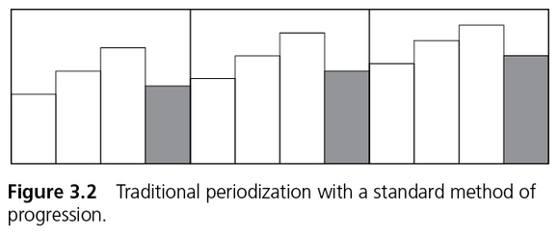
Monitoring Data Requires Interpretation
Athlete monitoring data can identify unusual patterns or changes.
A flag indicates that something may deserve attention but does not diagnose a problem.
Coaches and practitioners must interpret the information within the athlete’s broader context.
Notes:
What is the context here?
Progression cycle example

Slide 12
Domain 3: Strategy & Tactical Analysis
Understand patterns of play and support decisions about how to compete.
Common information
Events and outcomes
Spatial patterns
Situational tendencies
Probabilities and expected value
Common decisions
Select lineups or rotations
Prepare for an opponent
Choose offensive or defensive tactics
Make in-game adjustments

Slide 13
Situational Context and Game Event
The value of a shot, pass, or play depends on:
When it occurred: score, time remaining, and game situation
Where it occurred: player location and defensive pressure
Who was involved: opponent, matchup, and teammates on the court or field
Strategy analysis asks not only what happened, but when, where, and against whom.

Slide 14
Return to your question
Which domain is your decision or question in?
Scouting and talent evaluation
Athlete tracking and monitoring
Strategy and tactical analysis
What information would you want before making that decision?
Notes:
The domain tells us where the problem lives.
It does not tell us what the analysis needs to accomplish.
Within any domain, we might describe, diagnose, predict, or prescribe.

Slide 15
Developing an Analytical Question

Slide 16
Analytical Questions Serve Different Purposes
Within any domain, we might want to:
Describe what occurred
Diagnose why it may have occurred
Predict what may occur next
Prescribe what action should be taken

Slide 17
Four Types of Analytical Questions
1. Descriptive
What happened?
2. Diagnostic
Why / how did it happen?
3. Predictive
What is likely to happen?
4. Prescriptive
What should we do about it?
These are different purposes. Not a ranking

Slide 18
Descriptive Analytics
Descriptive analytics summarizes past or current data to show what occurred.
Identifies patterns and results, but it does not explain why they occurred.
Examples:
Tracking: How much high-intensity work did the athlete complete?
Scouting: What are the prospect’s current performance statistics?
Strategy: Which players created the most scoring opportunities?

Slide 19
Diagnostic Analytics
Diagnostic analytics uses data to investigate the possible reasons behind an outcome.
May identify possible explanations, but an observed relationship does not prove causation.
Examples:
Did workload increase because practice was longer or more intense?
Did the player perform differently against stronger opponents?
Did turnovers contribute to the team allowing more shots?

Slide 20
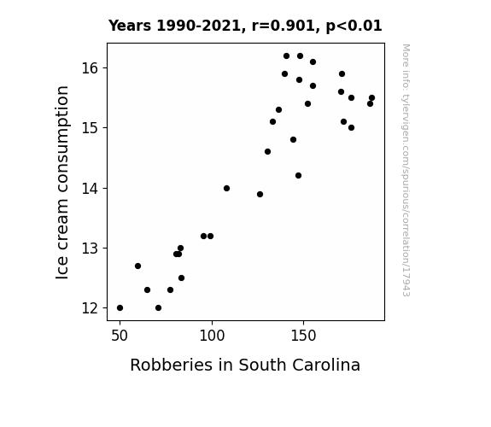
Spurious Correlation in Diagnostic Analytics
Relationship in which two or more events or variables are associated but not causally related
Relationship may be driven by coincidence or a confounding variable
Notes:
Very important, we will come back to this later

Slide 21
Predictive Analytics
Predictive analytics uses available information to estimate an unknown outcome, often in the future.
Predictions are uncertain and depend on the quality of the data and assumptions.
Examples:
How is the athlete likely to perform in the next game?
Which prospect is most likely to succeed at the next level?
What is the probability that a possession produces a score?

Slide 22
Prescriptive Analytics
Prescriptive analytics uses evidence to compare possible actions and recommend what should be done.
May guide decisions, but the final choice also depends on context, priorities, experience, and human judgment.
Examples:
Should the athlete’s training be modified?
Which prospect should the team select?
Which defensive strategy should the team use?

Slide 23
Turning a Concern Into Analytical Questions
A basketball team has lost four of its last five games.
The coach asks: “What is going on?”
Working with your group:
Identify the domain.
Write one question for each analytical purpose:
Descriptive
Diagnostic
Predictive
Prescriptive
Notes:
EXPLAIN

Slide 24
Analytics Chain in Each Domain
Domain | Descriptive | Diagnostic | Predictive | Prescriptive
Scouting | What has the player done? | Why has performance varied? | How might the player perform at the next level? | Should we recruit or draft the player?
Athlete monitoring | What work did the athlete complete? | Why did workload or readiness change? | How might the athlete respond tomorrow? | Should training be modified?
Game strategy | What happened during the game? | Why did the strategy succeed or fail? | What is likely against the next opponent? | What strategy should the team use?

Slide 25
Analytics Is a Connected Process
Description can support diagnosis, diagnosis can inform prediction, and all three can contribute to a recommendation.
Descriptive
Diagnostic
Predictive
Prescriptive

Slide 26
Real Analytical Work Is Rarely Linear
Descriptive
Predictive
Data
Data
Diagnostic
Prescriptive
Data

Slide 27
More Complex ≠ More Valuable
Much of the daily work in sport analytics involves:
Collecting, cleaning, and organizing data
Defining metrics consistently
Identifying meaningful changes and patterns
Communicating findings to decision-makers
Predictive models can be valuable, but only when they address a real decision and are supported by reliable foundational work.
Notes:
Sports analytics is not defined by how complicated the method is. It is defined by whether data are being used thoughtfully to understand a problem and support a decision. Sometimes that requires a predictive model. Often, it requires accurate reporting, appropriate context, and clear communication.

Slide 28
Summary & Looking Ahead
The three domains describe where sport analytics is applied.
Descriptive, diagnostic, predictive, and prescriptive questions describe what the analysis is intended to accomplish.
Next: Turning practitioner concerns into clear, testable analytical questions

