Slide 1
Quantifying relationships
Saryu Onishi
HES 3000-002, Sport Performance Analytics

Slide 2
What can we do beyond describing what happened?
Notes:
Mean vs. median decision-making (most frequent, and conceptually foundational)
Graph selection and matching to variable type
Describing a distribution in words
Excel selection and formula demo (quick and practical)

Slide 3
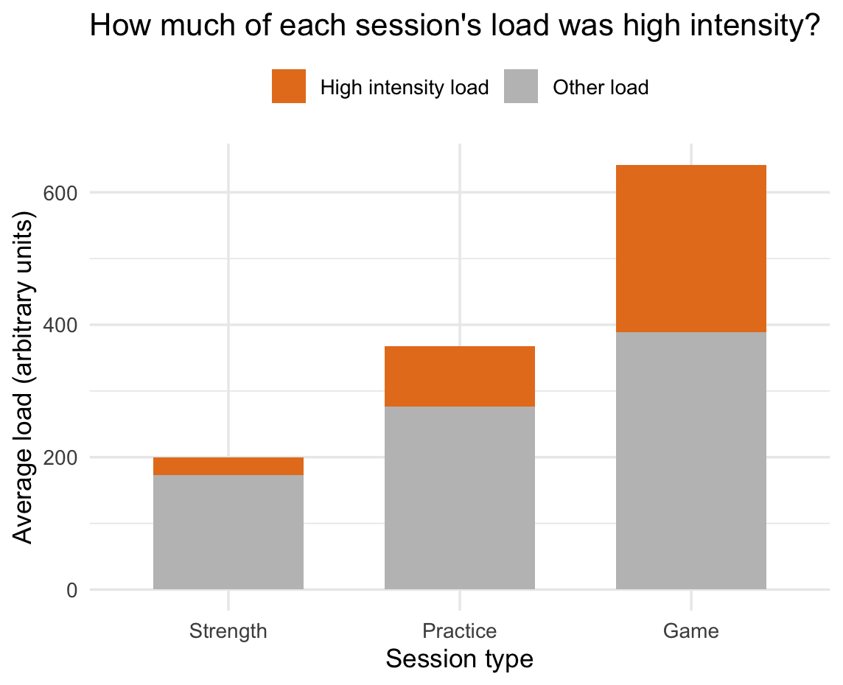
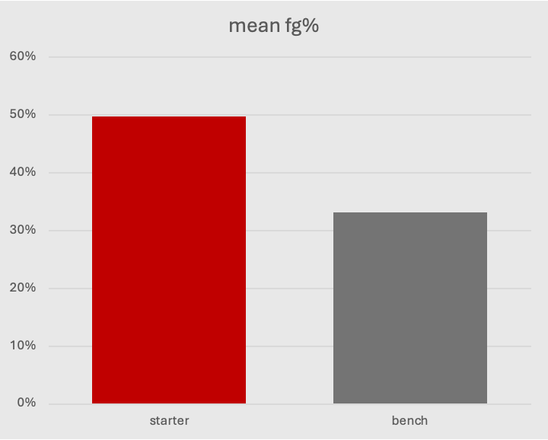
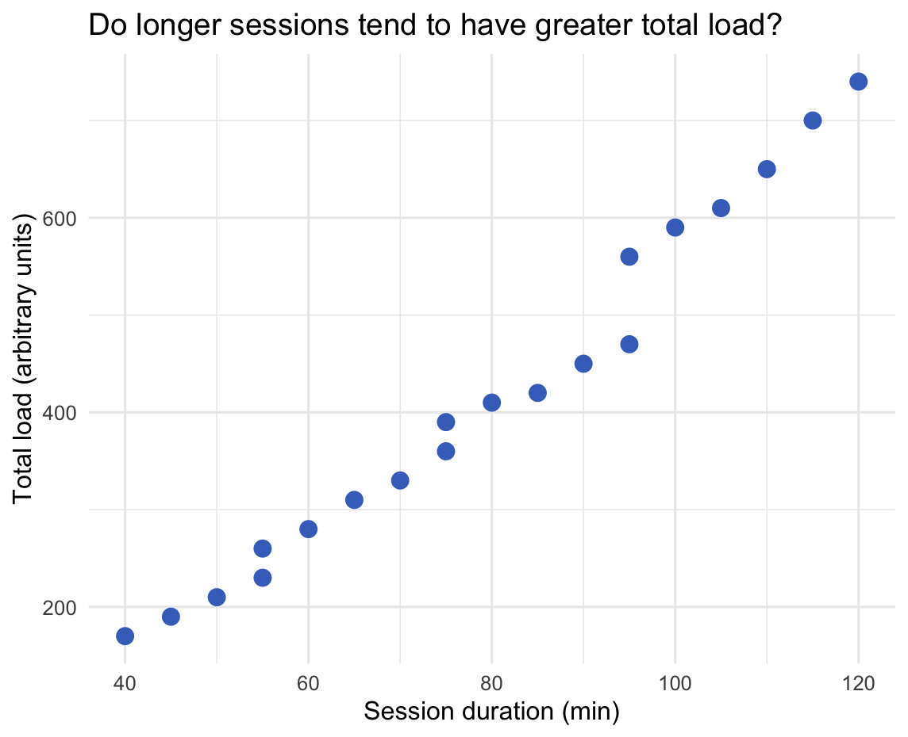
Beyond descriptive statistics
Previously: summarize variables and visualize relationships.
Today: quantify a relationship and use it to estimate an outcome.

Slide 4
Correlation Analysis
Notes:
Mean vs. median decision-making (most frequent, and conceptually foundational)
Graph selection and matching to variable type
Describing a distribution in words
Excel selection and formula demo (quick and practical)

Slide 5
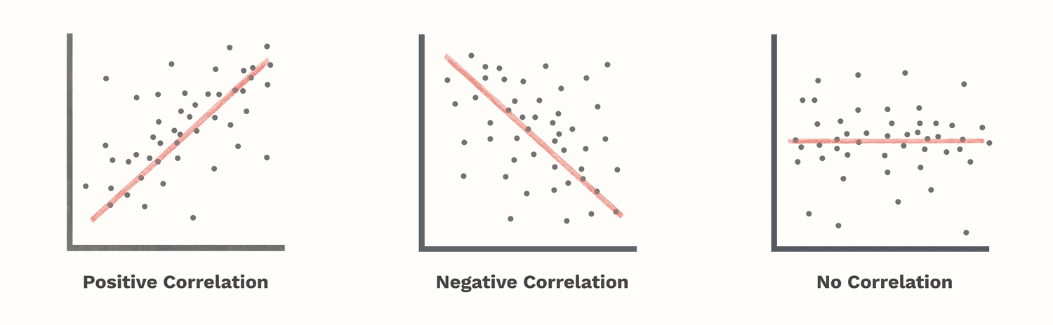
How do two variables move together?
Positive: higher values of one tend to accompany higher values of the other.
Negative: higher values of one tend to accompany lower values of the other.

Slide 6
Pearson’s correlation coefficient (r)
Measures the direction and strength of a linear relationship between two numerical variables.
Ranges from −1 to +1.
The sign describes direction.
The distance from zero describes the strength.
Correlation has no units.

Slide 7
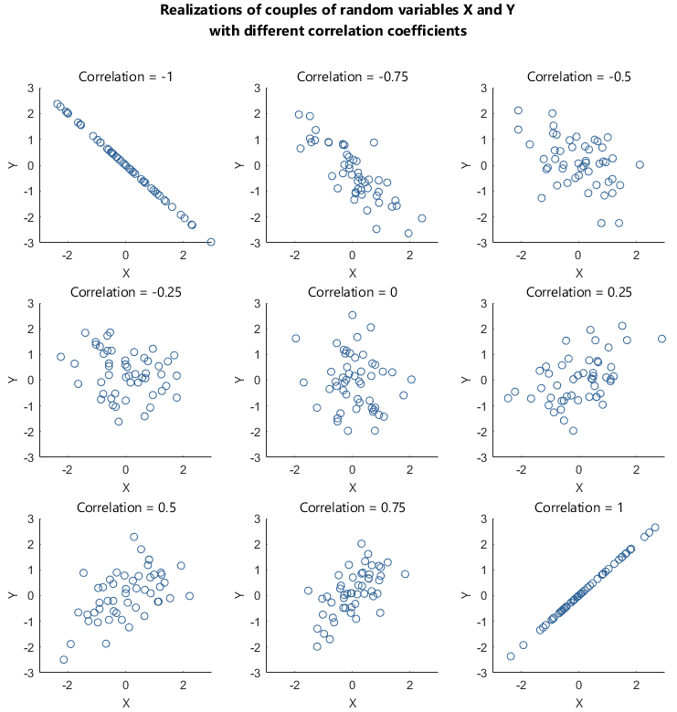
Ranking correlations
Rank the plots from weakest to strongest
Identify direction
Pearson’s r quantifies the linear pattern we see in a scatterplot.
Notes:
“We judged these patterns visually. Pearson’s correlation coefficient puts a number on their linear direction and strength, giving us a consistent way to describe and compare them.”

Slide 8
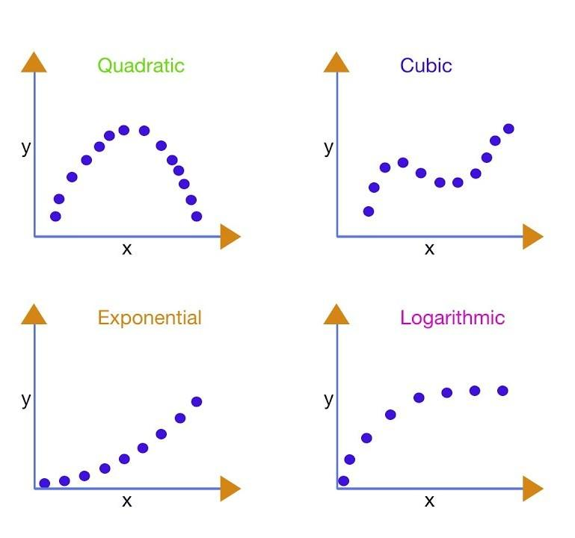
What Pearson’s r does (and doesn’t) tell us
A negative correlation is not a weak correlation.
r describes a linear relationship.
r ≈ 0 can still occur when there is a curved relationship.
Always inspect the graph alongside the number.

Slide 9
From a relationship to a line
Correlation describes the direction and strength of a linear relationship.
Simple linear regression fits a line that describes the relationship in the variables’ original units.
  This line is sometimes called “trend line” or “line of best fit”

Slide 10
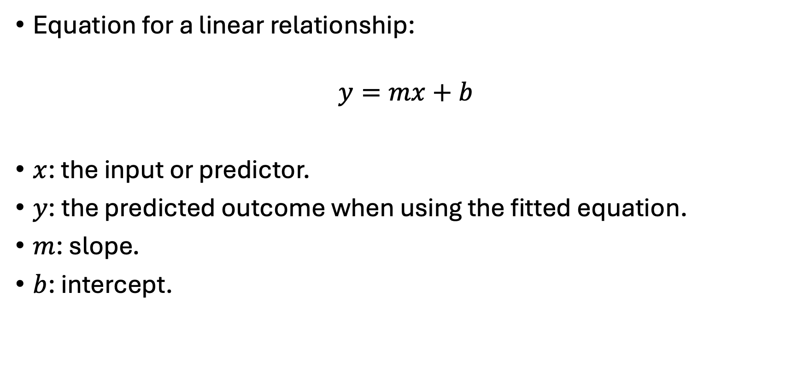
Describing linear relationships
Equation for a linear relationship:
$$y=mx+b$$
$x$: the input or predictor.
$y$: the predicted outcome when using the fitted equation.
$m$: slope.
$b$: intercept.

Slide 11
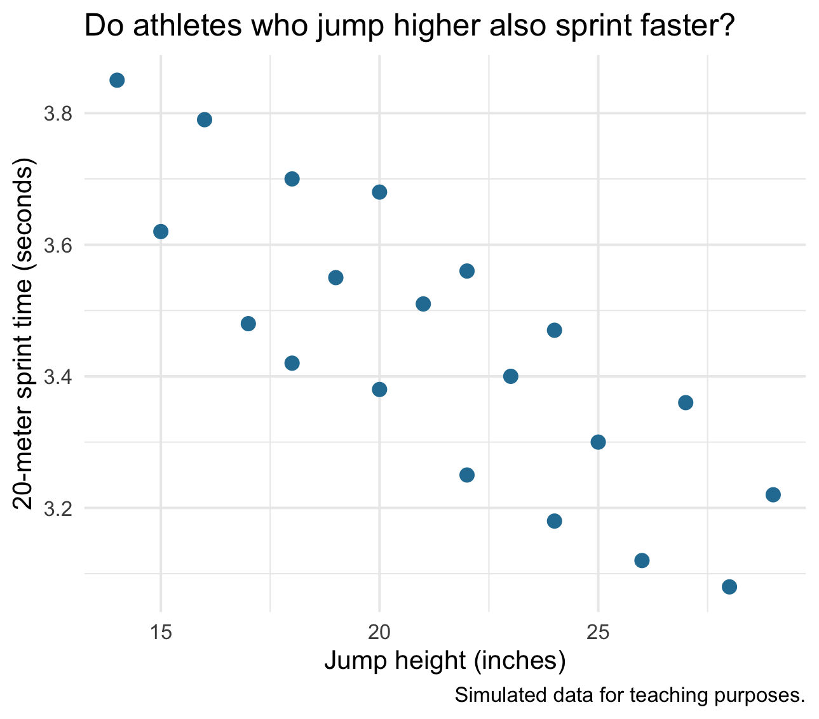
Scatter plot → r → line

Slide 12
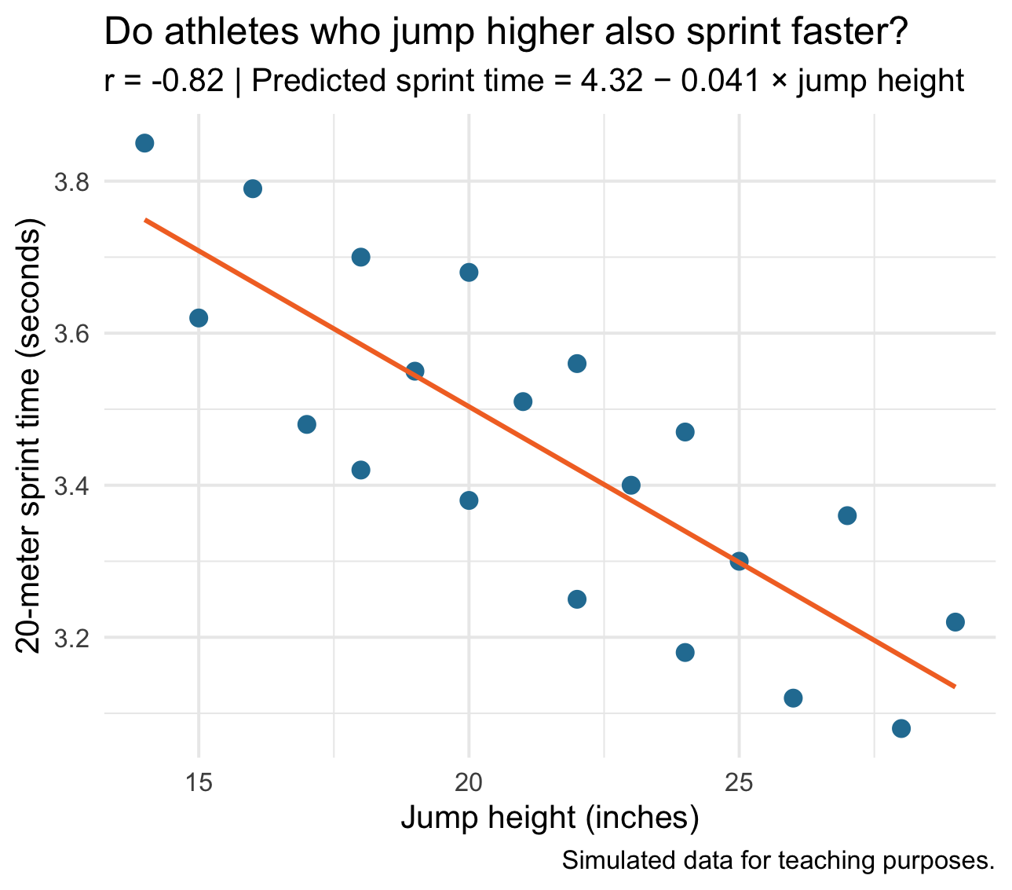
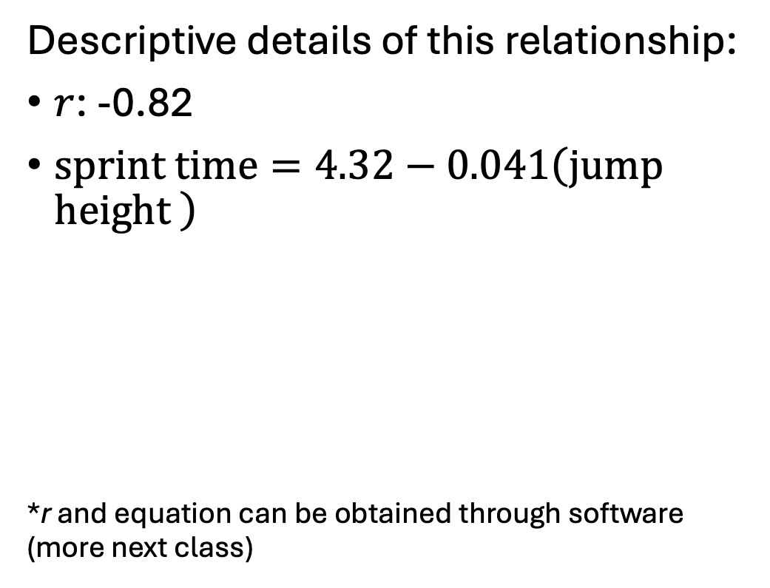
Scatter plot → r → line
Descriptive details of this relationship:
$r$: -0.82
$\text{sprint time}=4.32−0.041\left(\text{jump height }\right)$
*r and equation can be obtained through software (more next class)

Slide 13
Descriptive → Predictive Analytics
Notes:
Mean vs. median decision-making (most frequent, and conceptually foundational)
Graph selection and matching to variable type
Describing a distribution in words
Excel selection and formula demo (quick and practical)

Slide 14
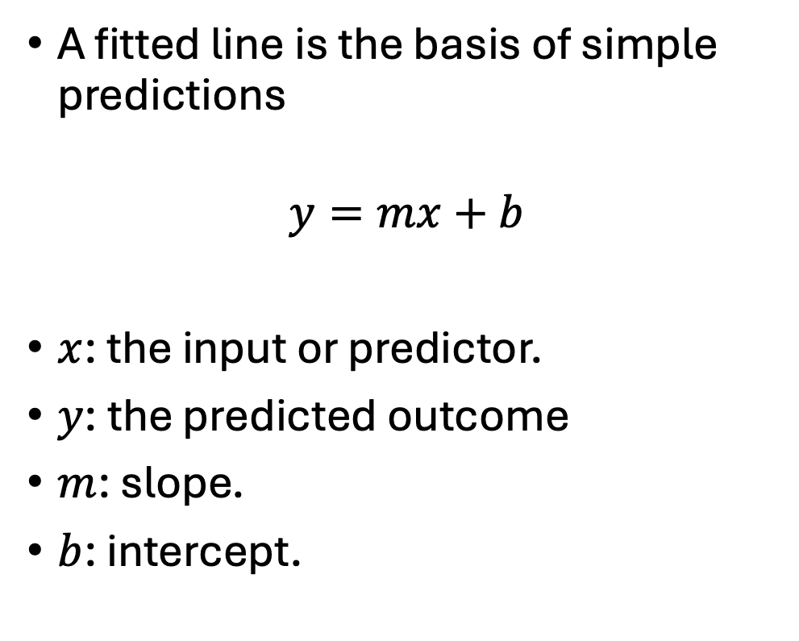
Simple linear regression
A fitted line is the basis of simple predictions
$$y=mx+b$$
$x$: the input or predictor.
$y$: the predicted outcome
$m$: slope.
$b$: intercept.

Slide 15
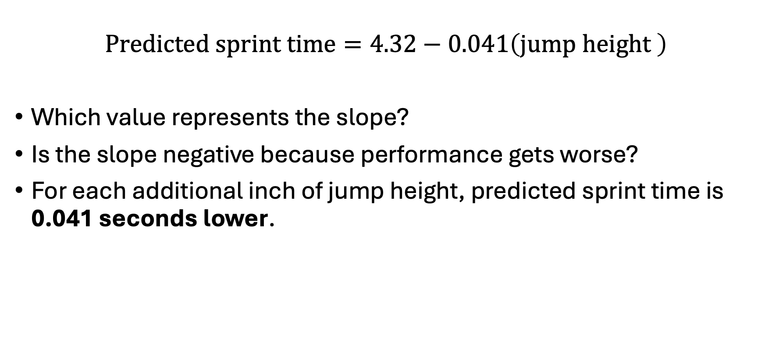
What does the slope mean?
$$\text{Predicted sprint time}=4.32−0.041\left(\text{jump height }\right)$$
Which value represents the slope?
Is the slope negative because performance gets worse?
For each additional inch of jump height, predicted sprint time is 0.041 seconds lower.

Slide 16
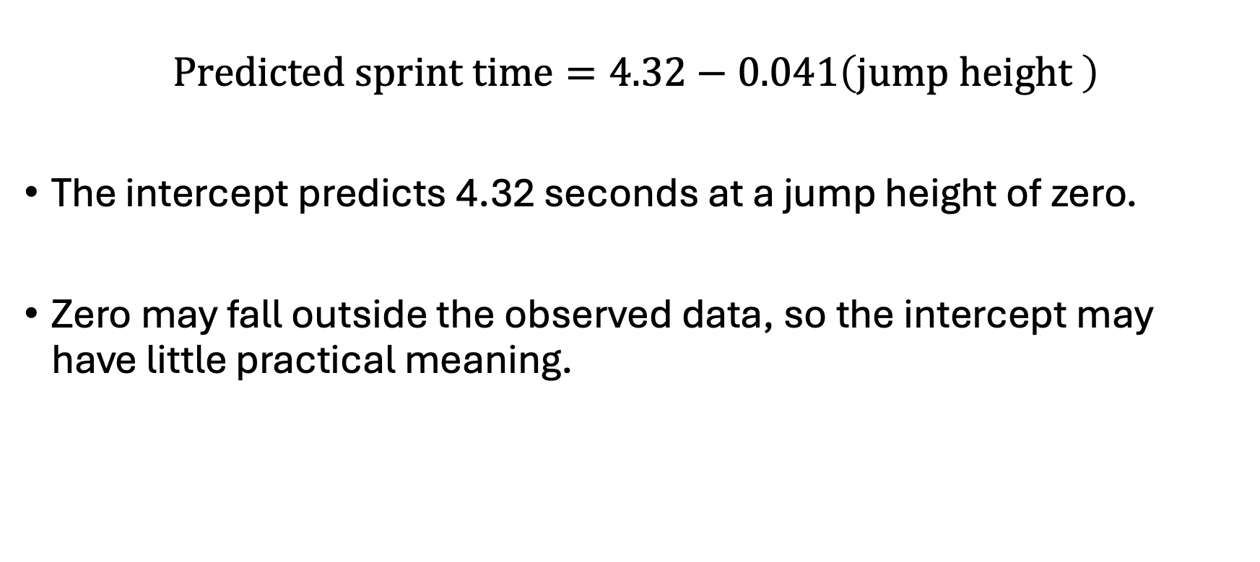
What does the intercept mean?
$$\text{Predicted sprint time}=4.32−0.041\left(\text{jump height }\right)$$
The intercept predicts 4.32 seconds at a jump height of zero.
Zero may fall outside the observed data, so the intercept may have little practical meaning.

Slide 17
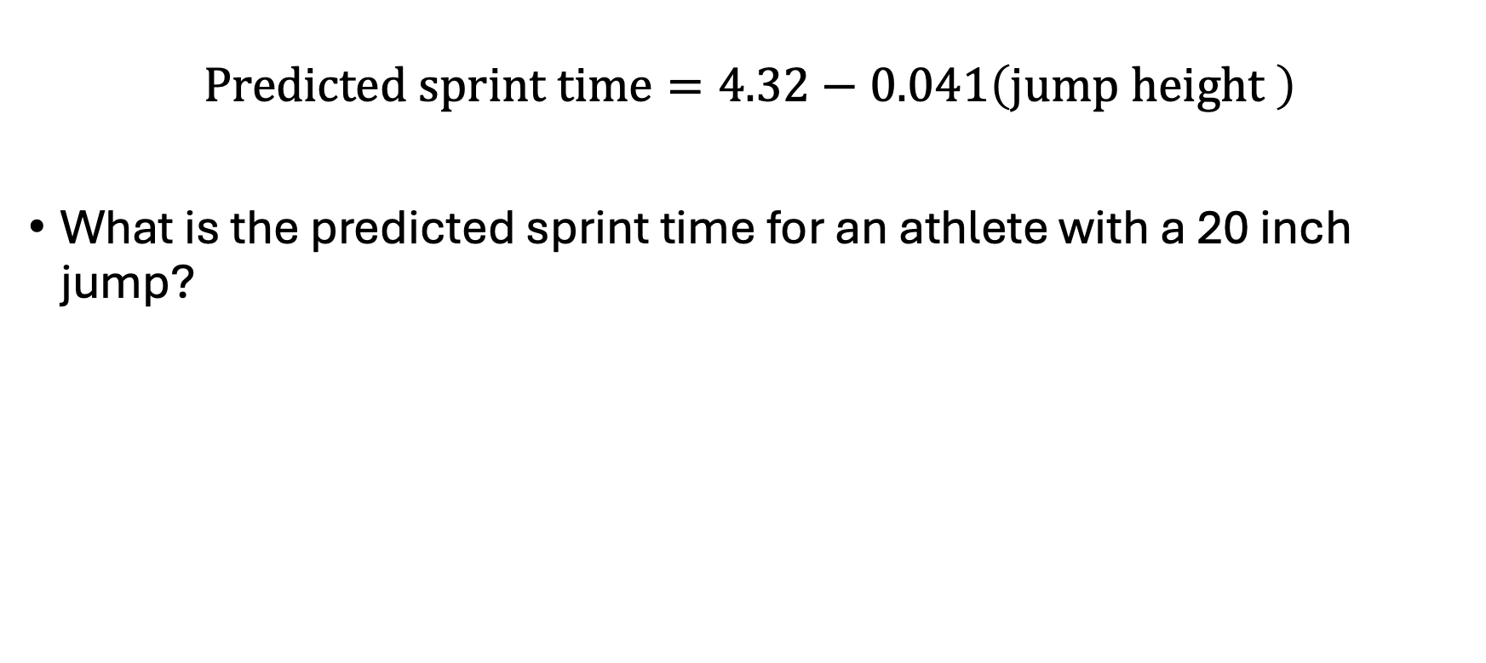
Predict an outcome
$$\text{Predicted sprint time}=4.32−0.041\left(\text{jump height }\right)$$
What is the predicted sprint time for an athlete with a 20 inch jump?

Slide 18
Prediction = best guess
Athletes with the same jump height can have different sprint times.
Actual observations fall above and below the line.
Other factors and ordinary variation remain.
The prediction missed by 0.2 seconds. Would that matter?
Notes:
The point is that usefulness depends on the task and the size of the error. You can call the observed-minus-predicted difference a residual, but leave formal error metrics for later.

Slide 19
Association, prediction, and causation
Notes:
Mean vs. median decision-making (most frequent, and conceptually foundational)
Graph selection and matching to variable type
Describing a distribution in words
Excel selection and formula demo (quick and practical)

Slide 20
Three separate claims
Athletes who jump higher tend to sprint faster.
Jump height helps us estimate sprint time.
Increasing jump height will cause sprint time to improve.
Small-group prompt:
Which claims does this scatterplot support? Which require additional evidence?
Notes:
Debrief:
The graph and \(r\) describe association.
The fitted line produces predictions; their accuracy still needs evaluation.
A causal claim requires evidence about what happens when something changes.

Slide 21
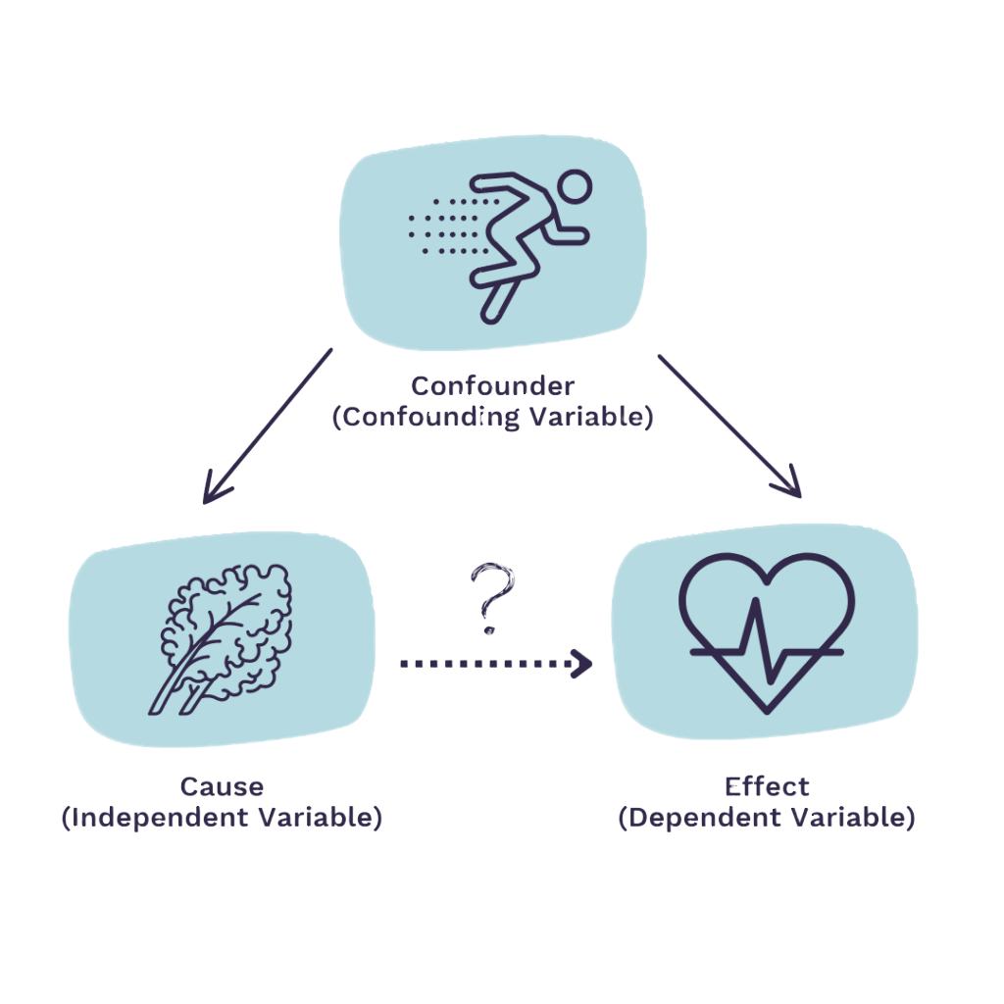
Why might variables be associated?
One variable may influence the other.
Another factor may influence both.
Group differences or sample selection may create the pattern.
Notes:
For this example, strength, training background, or sport could help explain both jumping and sprinting performance.

Slide 22
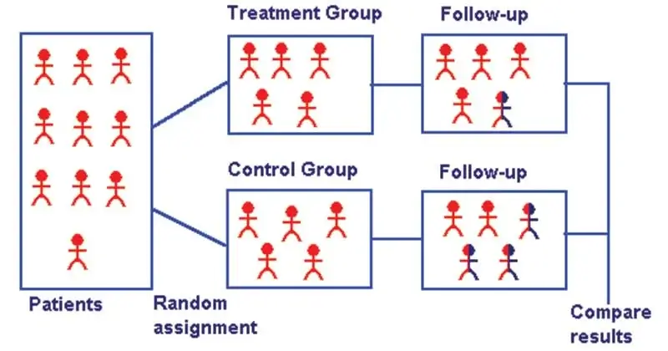
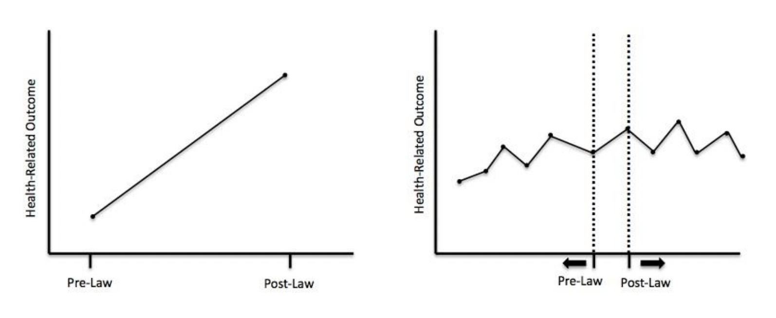
What would support a causal claim?
A correlation alone does not establish cause and effect.
Stronger evidence compares outcomes under different conditions while addressing other explanations.
In sports, rule changes or policy changes can create opportunities for these comparisons.
Notes:
Use a concrete comparison: observing jump height and sprint time versus randomly assigning athletes to a training intervention and a comparison condition. Be clear that the experiment estimates the effect of that intervention, rather than automatically proving that jump height itself causes sprint performance.

Slide 23
Applying association, prediction and causation
A coach sees that athletes who jump higher tend to sprint faster and says: “Let’s add jump training so everyone gets faster.”
Discuss in pairs
How would you respond using what we learned today?
Notes:
Give pairs a minute, then take a few responses. Guide them toward:
The data show an association between jump height and sprint time.
The line estimates sprint time, but individual outcomes vary.
This analysis alone doesn’t establish that adding jump training will improve sprint performance.
We started with a pattern on a graph. Now we can describe its strength, use an equation to estimate an outcome, and explain how far the evidence takes us. Next class, you’ll do those steps yourselves in Excel.

Slide 24
Summary
Correlation: How strongly do the variables move together in a linear pattern?
Regression: What outcome does the fitted line predict for a given input?
Causation: Does the study provide evidence that changing something changes the outcome?
Next time
In class application activity

