Slide 1
Generating and Collecting Sports Data
Saryu Onishi
HES 3000-002, Sport Performance Analytics
Notes:
Overview of the three domains (Tracking, Scouting, Strategy) and how data changes sports decisions.

Slide 2
Case Study 1
share:
Their sport concern
Their analytical question
Who would use the answer
Their ideal evidence
Their feasible data
Their biggest remaining uncertainty

Slide 3
Analytics Project
Identify a meaningful sport problem.
Develop a focused analytical question.
Determine what evidence is needed.
Find and evaluate feasible data.
Conduct an analysis that matches the question.
Interpret the results for the intended user.
Before the next checkpoint, your group should know what each row in your proposed dataset represents, who or what generated the data, and whether the variables needed for your question are actually present.

Slide 4
Where do the numbers come from?

Slide 5
How is sports data collected?

Slide 6
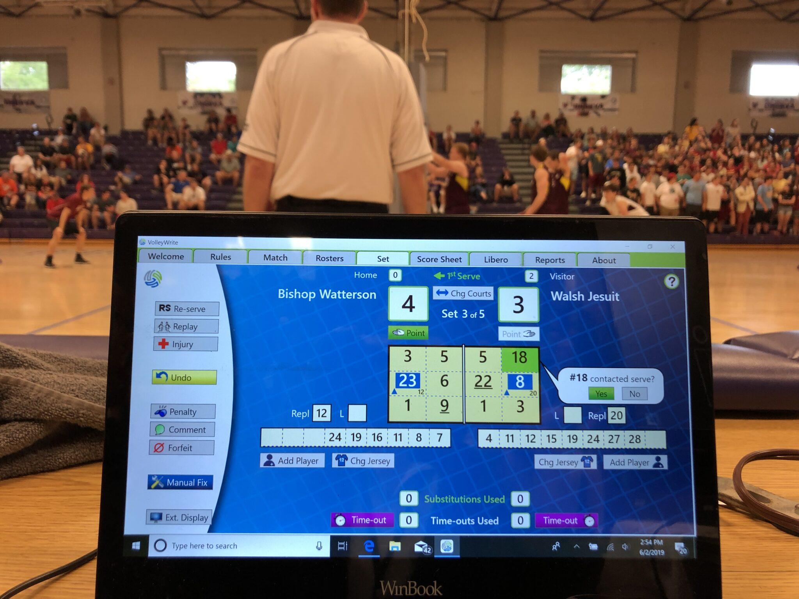
Observational
Scout with notebook, coach's tactical board, video coding
Strengths: Contextual, can capture nuanced behaviors
Limitations: Schema determines possibilities, subjective, time-intensive
Notes:
This is when observations are recorded.
This is MULTIMEDIA (reference). Raw = “FILM”, coded = stat sheet
Schema = rules, categories, framework. Eg: often tagging video means assigning specific action to an observation
Subjective = low interrater reliability

Slide 7
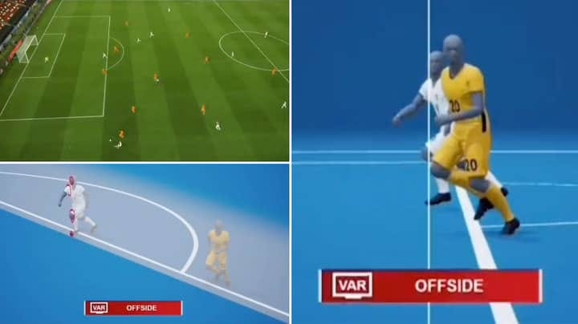
Optical tracking systems
Camera-based position tracking (Second Spectrum, Hawk-Eye)
Strengths: Spatial precision, non-invasive, every player tracked
Limitations: Expensive, venue-dependent, line-of-sight issues
Notes:
Similar to observational but utilizes a more systematic method
Major application of ML (if interested)
Mistakes can still occur

Slide 8
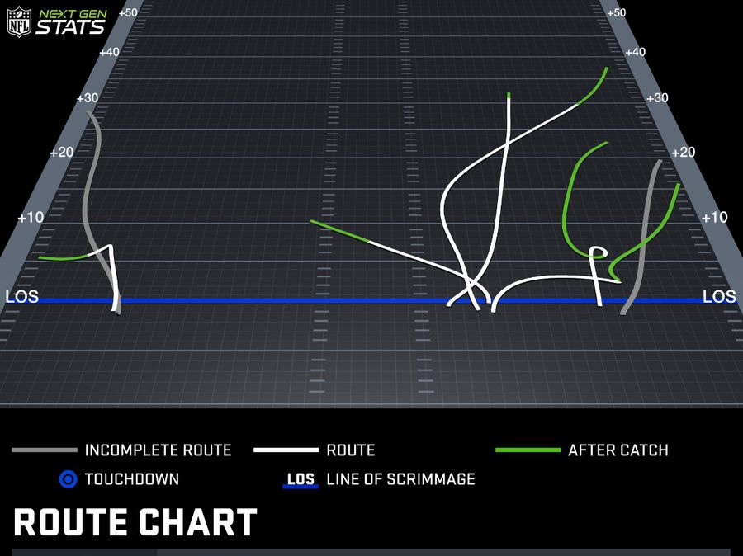
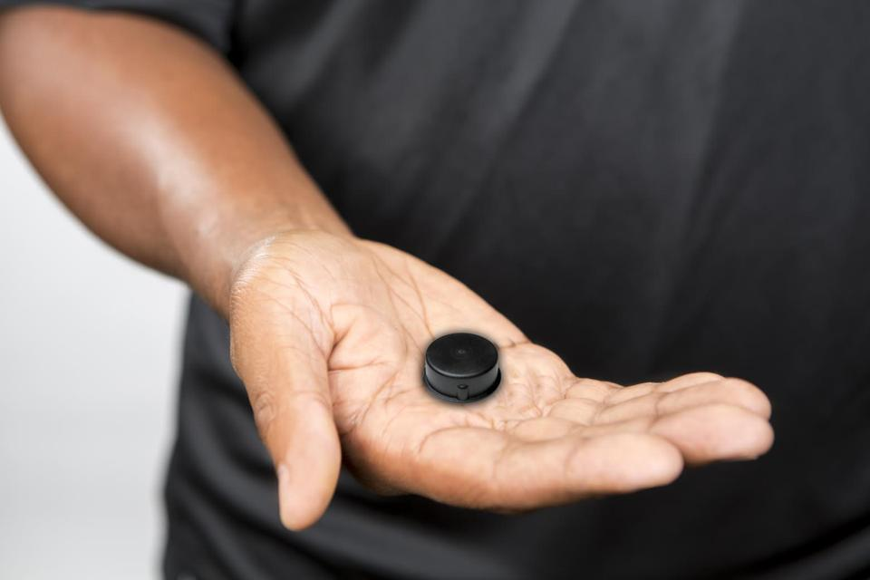
Wearable technology
GPS units, accelerometers, heart rate monitors, IMUs
Strengths: Continuous data, objective physiological metrics
Limitations: Only captures what sensors detect, requires athlete buy-in
Notes:
Wearable tech, very popular now. Can be individual or team wide data
Your apple watch, technically wearable tech
This is Ceedee lamb vs lions. Data collected via gps device

Slide 9
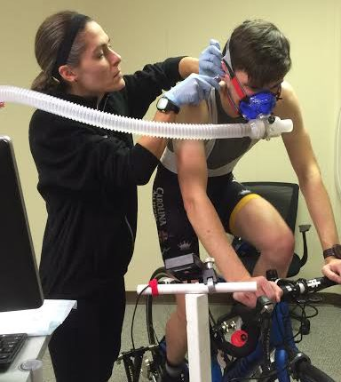
Laboratory Equipment
Force plates, motion capture, metabolic carts, isokinetic testing
Strengths: Gold-standard precision, controlled conditions
Limitations: Artificial environment, doesn't capture competition reality
Notes:
This is what we do in research.
Attempt to control all confounding factors to measure one thing.

Slide 10
Who collects Sports data?
Notes:
So who collects the data
Important to know this as it can determine access as well as analytical possibilities

Slide 11

League/Competition Providers
Leagues may provide standardize data across all teams/matches
Examples: NBA stats, FIFA match data
Pros: Consistency, benchmarking
Cons: One-size-fits-all, slow to innovate
Notes:
Obviously, many sports leagues collect data.
Not only for business but also for performance! Eg: nextgen stats
This is how they control game data. data is distributed to teams
Consistency is a major benefit
Might not get what you need from the one size fits all approach

Slide 12
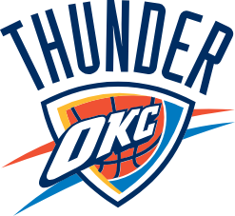

Teams (Internal data)
Teams often try to collect and analyze data to gain a competitive advantage
Examples: Proprietary load monitoring, custom tactical metrics
Pros: Tailored to needs, flexibility, privacy
Cons: No external benchmarks, siloed innovation, inaccessible for outsiders
Notes:
Because teams may have more specific needs, they collect their own data
Its all about the competitive adv
Great for the team
Difficult for anyone outside to use that

Slide 13
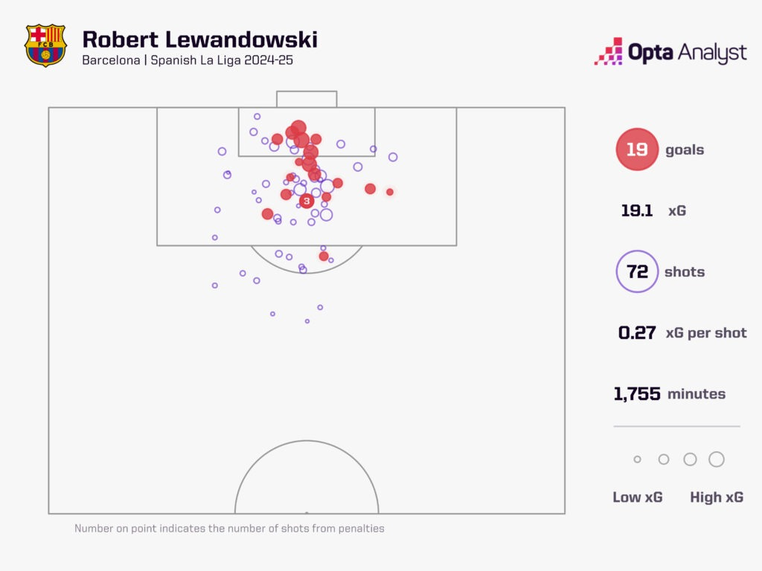
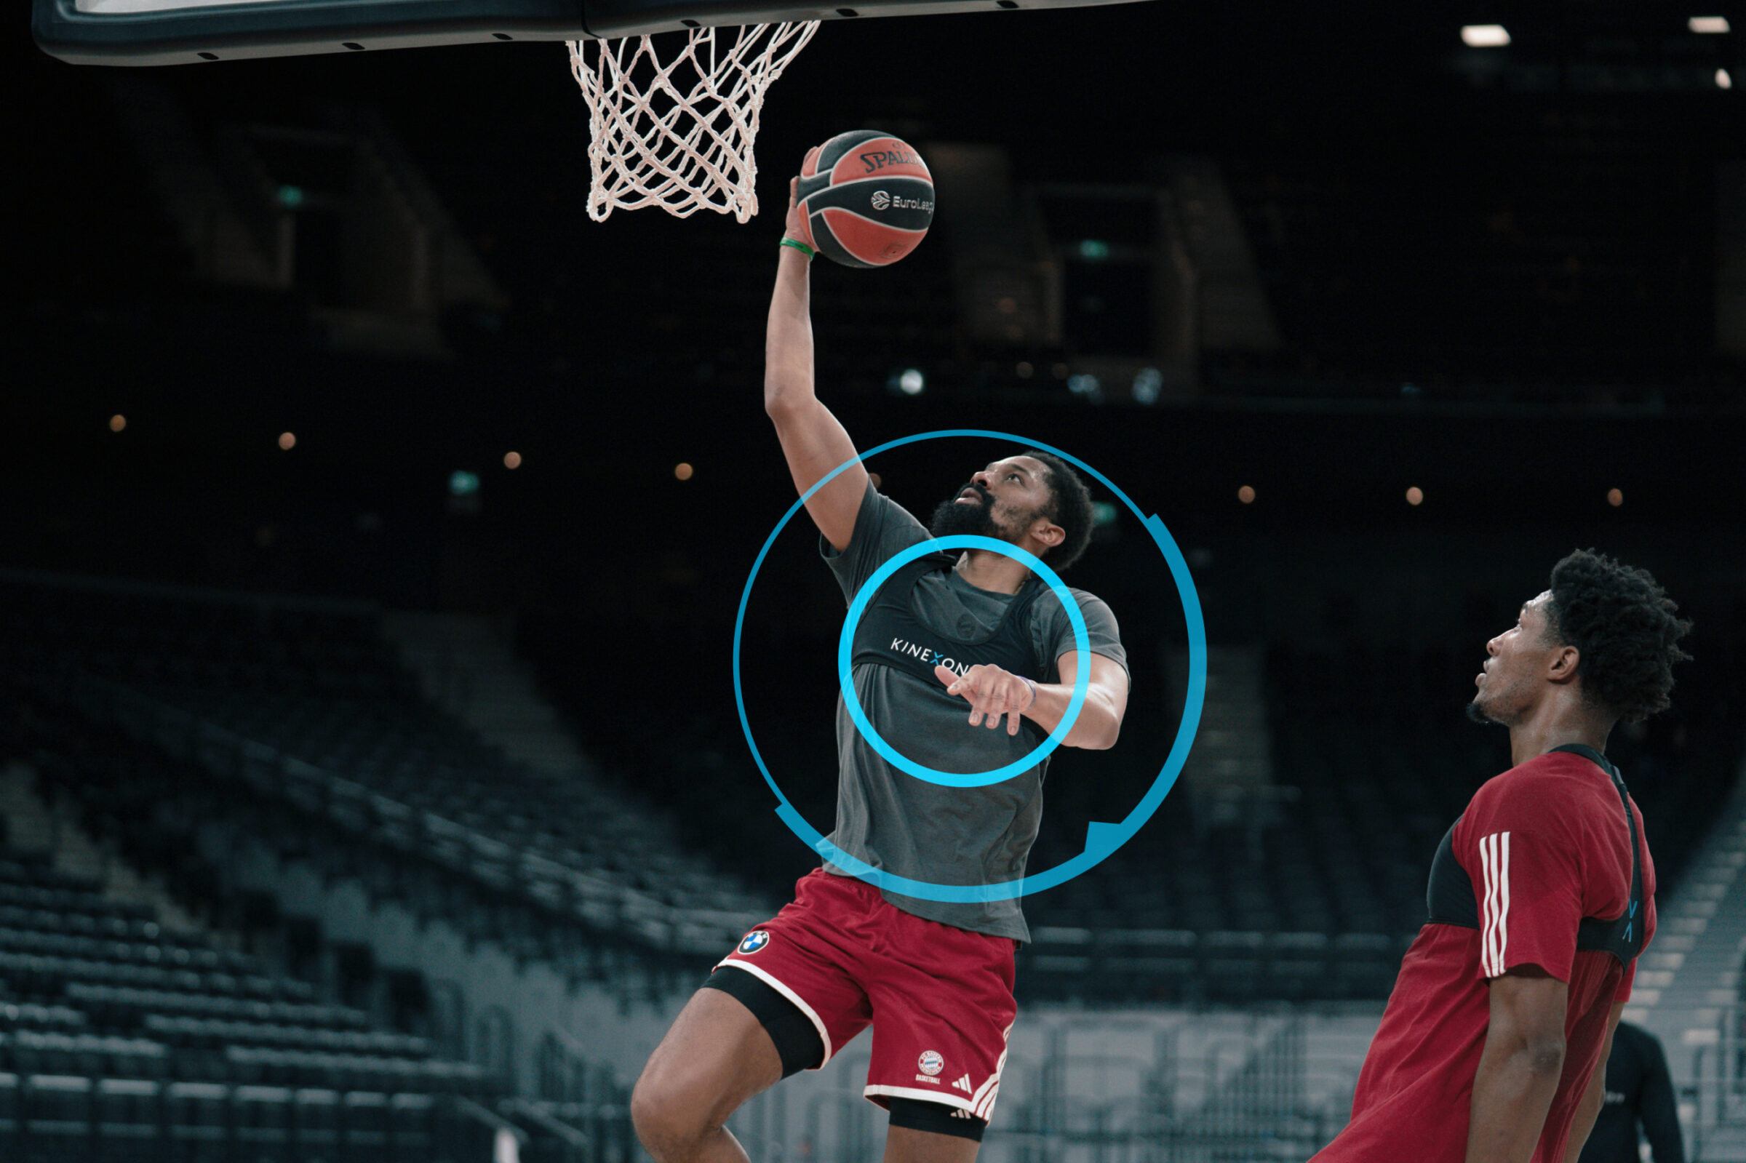
Third-Party Vendors
Some businesses sell data collection technology and data analysis software
Opta, Stats Perform, Catapult, Kinexon, etc.
Pros: Expertise, scale, cross-sport learning
Cons: Black box algorithms, vendor lock-in, no competitive advantage
Notes:
Many (leagues and teams) buy data from companies.
Its unreasobale to develop own tech to collect, or to do observational for everything
These data gets integrated into systems
This offloads responability and expertise
Offloading / outsourcing means giving up control and to some degree, competitive advantage

Slide 14
Academic/Research Institutions
Research institutions prioritize methodological rigor.
Pros: Reliable methods, scientific collaboration
Cons: Limited samples, specific contexts, slow dissemination

Slide 15

Primary Data Collection
You collect data for a specific question or use case
Pros: Full control over what and how data are collected
Cons: Time and resource intensive, access can be a challenge

Slide 17
Where does Sports Data Come From?
Human-recorded data
Examples:
Scouting grades
Notational analysis
Coach observations
Injury or participation records
Event tagging
Instrument-generated data
Examples:
GPS or local positioning systems
Optical tracking
Force plates
Heart-rate monitors
Timing systems
Notes:
Emphasize that people decide what counts, how categories are defined, and when an event is recorded.

Slide 18
Event → Dataset
A player performs a jump → force plates record force → software identifies takeoff → an equation estimates jump height → one jump-height value appears in a table.

Slide 19
Summary & Looking Ahead
The three domains describe where sport analytics is applied.
Descriptive, diagnostic, predictive, and prescriptive questions describe what the analysis is intended to accomplish.
These purposes are connected, but not every analysis requires all four.
The most valuable analysis is the one that provides credible evidence for a meaningful decision.
Next: Turning practitioner concerns into clear, testable analytical questions

