Slide 1
Proportions and relationships
Saryu Onishi
HES 3000-002, Sport Performance Analytics

Slide 2
Case study 2
Notes:
Mean vs. median decision-making (most frequent, and conceptually foundational)
Graph selection and matching to variable type
Describing a distribution in words
Excel selection and formula demo (quick and practical)

Slide 3
Workflow
Open and inspect
Identify the observation and variables
Prepare the values
Choose and make a graph
Summarize
Interpret

Slide 4
What am I looking at?
What does one row represent?
What does each column represent?
Which columns are numeric or categorical?
Are there blank cells, labels mixed with values, or units in the cells?
Recall: data characteristics slides.

Slide 5
Which values answer the question?
Defined by your research question
  Eg: study of offensive performance? → field goal percentage?
Recall: unit of observation and data structure.
Notes:
In Excel, select or prepare the values you’ll actually analyze.

Slide 6
Inspecting data
game_id | team_id | opponent_team_id | athlete_id | field_goals_made | field_goals_attempted | fg%
401858379 | 201 | 38 | 5329888 | 0 | 2 | 0%
401851568 | 201 | 8 | 5329888 | 2 | 2 | 100%
401851564 | 201 | 245 | 5329888 | 3 | 4 | 75%
401851560 | 201 | 2579 | 5329888 | 0 | 0 | 0%
401808287 | 201 | 251 | 5329888 | 1 | 3 | 33%
401808280 | 201 | 142 | 5329888 | 2 | 5 | 40%
401808269 | 201 | 99 | 5329888 | 1 | 3 | 33%
401808262 | 201 | 2 | 5329888 | 0 | 0 | 0%
401808256 | 201 | 245 | 5329888 | 0 | 1 | 0%
401808247 | 201 | 2633 | 5329888 | 0 | 1 | 0%
401808239 | 201 | 61 | 5329888 | 3 | 3 | 100%
401808225 | 201 | 238 | 5329888 | 0 | 1 | 0%
401808216 | 201 | 96 | 5329888 | 2 | 4 | 50%
401808214 | 201 | 251 | 5329888 | 4 | 10 | 40%
401808206 | 201 | 8 | 5329888 | 1 | 1 | 100%
401808196 | 201 | 142 | 5329888 | 3 | 5 | 60%
401808191 | 201 | 2579 | 5329888 | 1 | 2 | 50%
401808184 | 201 | 333 | 5329888 | 2 | 3 | 67%
401808172 | 201 | 57 | 5329888 | 4 | 4 | 100%
401808166 | 201 | 245 | 5329888 | 1 | 1 | 100%
401808154 | 201 | 344 | 5329888 | 0 | 2 | 0%
401808151 | 201 | 145 | 5329888 | 0 | 1 | 0%
401826782 | 201 | 2400 | 5329888 | 2 | 3 | 67%
401858385 | 201 | 277 | 5144388 | 0 | 1 | 0%
401858385 | 201 | 277 | 5101844 | 3 | 3 | 100%
401858383 | 201 | 239 | 5144388 | 2 | 4 | 50%
401858383 | 201 | 239 | 5101844 | 2 | 2 | 100%
Describing one row is a descriptive. Do not need to report metrics.
  “each row represents a single athlete’s performance in one game of the 2026 season”
  “a summary of a team’s performance last season”
Understanding the data is critical for all future steps.
  Data type affects which summaries and graphs make sense. (mode vs mean, color vs position)
  Is the data valid? (can fg% be 0 if fg attempted is 0?)
*sample rows from the full dataset

Slide 7
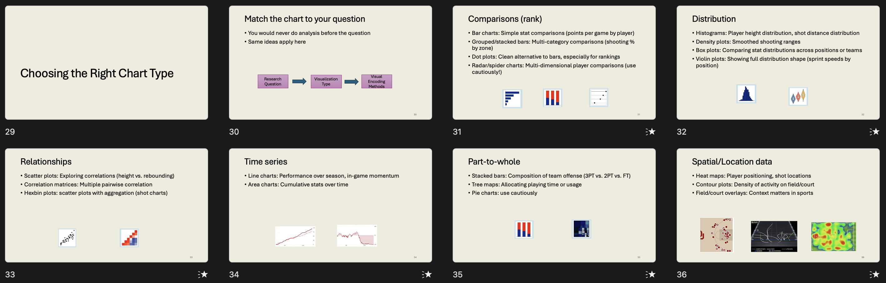
Which graph answers this question?
one numeric variable → distribution → histogram.
Recall: chart choice follows the question.

Slide 8
Making the histogram
Recall: long format.
game_id | team_id | opponent_team_id | athlete_id | field_goals_made | field_goals_attempted | fg%
401858379 | 201 | 38 | 5329888 | 0 | 2 | 0%
401851568 | 201 | 8 | 5329888 | 2 | 2 | 100%
401851564 | 201 | 245 | 5329888 | 3 | 4 | 75%
401851560 | 201 | 2579 | 5329888 | 0 | 0 | 0%
401808287 | 201 | 251 | 5329888 | 1 | 3 | 33%
401808280 | 201 | 142 | 5329888 | 2 | 5 | 40%
401808269 | 201 | 99 | 5329888 | 1 | 3 | 33%
401808262 | 201 | 2 | 5329888 | 0 | 0 | 0%
401808256 | 201 | 245 | 5329888 | 0 | 1 | 0%
401808247 | 201 | 2633 | 5329888 | 0 | 1 | 0%
401808239 | 201 | 61 | 5329888 | 3 | 3 | 100%
401808225 | 201 | 238 | 5329888 | 0 | 1 | 0%
401808216 | 201 | 96 | 5329888 | 2 | 4 | 50%
401808214 | 201 | 251 | 5329888 | 4 | 10 | 40%
401808206 | 201 | 8 | 5329888 | 1 | 1 | 100%
401808196 | 201 | 142 | 5329888 | 3 | 5 | 60%
401808191 | 201 | 2579 | 5329888 | 1 | 2 | 50%
401808184 | 201 | 333 | 5329888 | 2 | 3 | 67%
401808172 | 201 | 57 | 5329888 | 4 | 4 | 100%
401808166 | 201 | 245 | 5329888 | 1 | 1 | 100%
401808154 | 201 | 344 | 5329888 | 0 | 2 | 0%
401808151 | 201 | 145 | 5329888 | 0 | 1 | 0%
401826782 | 201 | 2400 | 5329888 | 2 | 3 | 67%
401858385 | 201 | 277 | 5144388 | 0 | 1 | 0%
401858385 | 201 | 277 | 5101844 | 3 | 3 | 100%
401858383 | 201 | 239 | 5144388 | 2 | 4 | 50%
401858383 | 201 | 239 | 5101844 | 2 | 2 | 100%
 | value
mean | 42.1%
median | 42.9%
min | 0.0%
max | 100.0%
range | 100.0%
sd | 28.4%
Which table should we use for histogram?
What format is this? (long or wide)
*sample rows from the full dataset
Notes:
Make the histogram live in Excel.

Slide 9
Making the histogram
one observation per row and values in one column
Recall: long format data for visualization and analysis
Notes:
Make the histogram live in Excel.

Slide 10
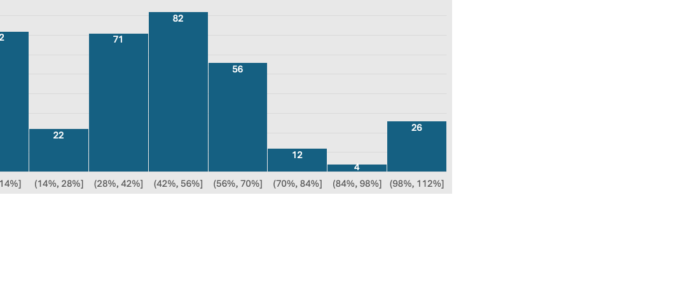
What does the distribution tell us?
Describe the shape, range/spread, clusters, unusual values.
Would the mean or median better describe a typical value here, and why?
Notes:
Calculate the relevant statistics live and write a brief interpretation.

Slide 11
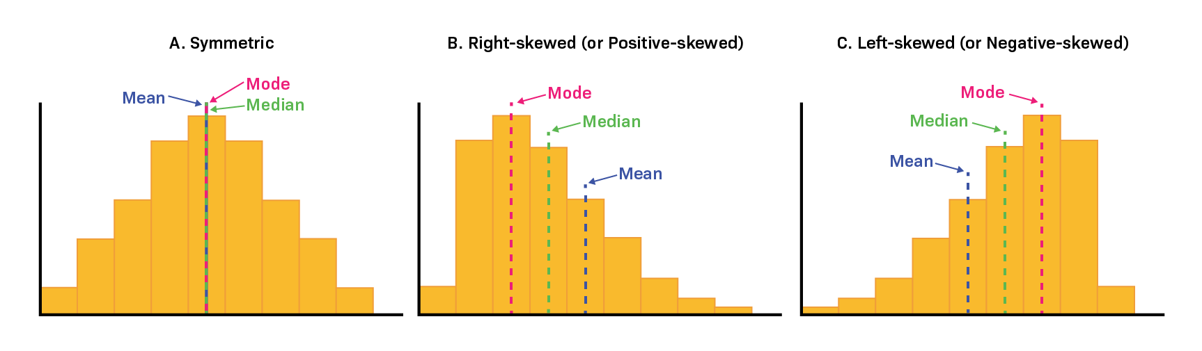
What does the distribution tell us?
Recall: center and spread lecture.

Slide 12
Bonus: What changes when we compare groups?
game_id | team_id | opponent_team_id | athlete_id | minutes | fg% | points | starter
401858379 | 201 | 38 | 5329888 | 8 | 0% | 0 | FALSE
401851568 | 201 | 8 | 5329888 | 12 | 100% | 4 | FALSE
401851564 | 201 | 245 | 5329888 | 17 | 75% | 6 | FALSE
401851560 | 201 | 2579 | 5329888 | 1 | 0% | 0 | FALSE
401808287 | 201 | 251 | 5329888 | 12 | 33% | 4 | FALSE
401808280 | 201 | 142 | 5329888 | 13 | 40% | 7 | FALSE
401808269 | 201 | 99 | 5329888 | 14 | 33% | 4 | FALSE
401808262 | 201 | 2 | 5329888 | 7 | 0% | 1 | FALSE
401808256 | 201 | 245 | 5329888 | 8 | 0% | 2 | FALSE
401808247 | 201 | 2633 | 5329888 | 13 | 0% | 0 | FALSE
401808239 | 201 | 61 | 5329888 | 18 | 100% | 7 | FALSE
401808225 | 201 | 238 | 5329888 | 14 | 0% | 0 | FALSE
401808216 | 201 | 96 | 5329888 | 16 | 50% | 4 | FALSE
401808214 | 201 | 251 | 5329888 | 29 | 40% | 9 | FALSE
401808206 | 201 | 8 | 5329888 | 12 | 100% | 2 | FALSE
401808196 | 201 | 142 | 5329888 | 26 | 60% | 9 | FALSE
401808191 | 201 | 2579 | 5329888 | 17 | 50% | 5 | FALSE
401808184 | 201 | 333 | 5329888 | 19 | 67% | 5 | FALSE
401808172 | 201 | 57 | 5329888 | 18 | 100% | 17 | FALSE
401808166 | 201 | 245 | 5329888 | 9 | 100% | 2 | FALSE
401808154 | 201 | 344 | 5329888 | 12 | 0% | 0 | FALSE
401808151 | 201 | 145 | 5329888 | 6 | 0% | 0 | FALSE
401826782 | 201 | 2400 | 5329888 | 18 | 67% | 6 | FALSE
401858385 | 201 | 277 | 5144388 | 3 | 0% | 0 | FALSE
401858385 | 201 | 277 | 5101844 | 16 | 100% | 6 | FALSE
401858383 | 201 | 239 | 5144388 | 10 | 50% | 5 | FALSE
401858383 | 201 | 239 | 5101844 | 17 | 100% | 4 | FALSE
To compare groups, addition information is needed
*sample rows from the full dataset
Notes:
Keep this brief; it’s bonus work, so you don’t need to teach every Excel route to it.

Slide 13
Bonus: What changes when we compare groups?
game_id | team_id | opponent_team_id | athlete_id | minutes | fg% | points | starter
401858379 | 201 | 38 | 5329888 | 8 | 0% | 0 | FALSE
401851568 | 201 | 8 | 5329888 | 12 | 100% | 4 | FALSE
401851564 | 201 | 245 | 5329888 | 17 | 75% | 6 | FALSE
401851560 | 201 | 2579 | 5329888 | 1 | 0% | 0 | FALSE
401808287 | 201 | 251 | 5329888 | 12 | 33% | 4 | FALSE
401808280 | 201 | 142 | 5329888 | 13 | 40% | 7 | FALSE
401808269 | 201 | 99 | 5329888 | 14 | 33% | 4 | FALSE
401808262 | 201 | 2 | 5329888 | 7 | 0% | 1 | FALSE
401808256 | 201 | 245 | 5329888 | 8 | 0% | 2 | FALSE
401808247 | 201 | 2633 | 5329888 | 13 | 0% | 0 | FALSE
401808239 | 201 | 61 | 5329888 | 18 | 100% | 7 | FALSE
401808225 | 201 | 238 | 5329888 | 14 | 0% | 0 | FALSE
401808216 | 201 | 96 | 5329888 | 16 | 50% | 4 | FALSE
401808214 | 201 | 251 | 5329888 | 29 | 40% | 9 | FALSE
401808206 | 201 | 8 | 5329888 | 12 | 100% | 2 | FALSE
401808196 | 201 | 142 | 5329888 | 26 | 60% | 9 | FALSE
401808191 | 201 | 2579 | 5329888 | 17 | 50% | 5 | FALSE
401808184 | 201 | 333 | 5329888 | 19 | 67% | 5 | FALSE
401808172 | 201 | 57 | 5329888 | 18 | 100% | 17 | FALSE
401808166 | 201 | 245 | 5329888 | 9 | 100% | 2 | FALSE
401808154 | 201 | 344 | 5329888 | 12 | 0% | 0 | FALSE
401808151 | 201 | 145 | 5329888 | 6 | 0% | 0 | FALSE
401826782 | 201 | 2400 | 5329888 | 18 | 67% | 6 | FALSE
401858385 | 201 | 277 | 5144388 | 3 | 0% | 0 | FALSE
401858385 | 201 | 277 | 5101844 | 16 | 100% | 6 | FALSE
401858383 | 201 | 239 | 5144388 | 10 | 50% | 5 | FALSE
401858383 | 201 | 239 | 5101844 | 17 | 100% | 4 | FALSE
To compare groups, addition information is needed
Typically, categorical information
  Eg: starter status
status | n | mean fg%
starter | 185 | 50%
bench | 160 | 33%
*sample rows from the full dataset
Notes:
Keep this brief; it’s bonus work, so you don’t need to teach every Excel route to it.

Slide 14
Bonus: What changes when we compare groups?
 | n | mean fg%
Full team | 345 | 42.1%
status | n | mean fg%
starter | 185 | 50%
bench | 160 | 33%
What does this tell us?
Notes:
Keep this brief; it’s bonus work, so you don’t need to teach every Excel route to it.

Slide 15
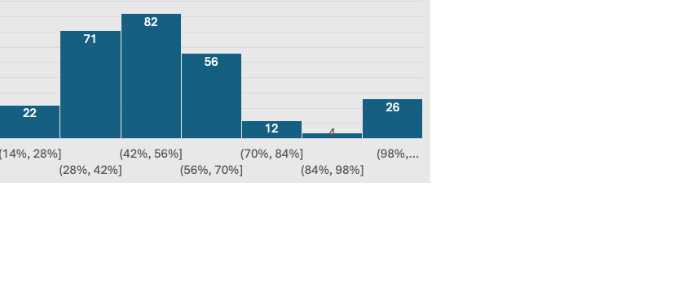
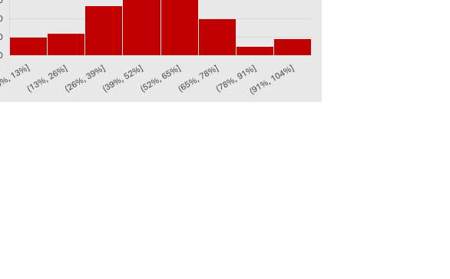
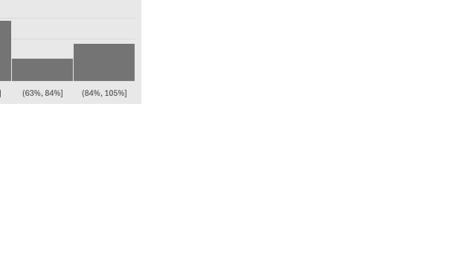
Bonus: What changes when we compare groups?
What else does this reveal?
Notes:
Keep this brief; it’s bonus work, so you don’t need to teach every Excel route to it.

Slide 16
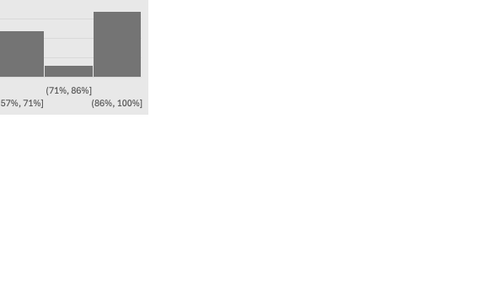
Bonus: What changes when we compare groups?
What else does this reveal?
Notes:
Keep this brief; it’s bonus work, so you don’t need to teach every Excel route to it.

Slide 17
Bonus: What changes when we compare groups?
Requires additional columns?
Do overall averages hides meaningful differences?
Notes:
Keep this brief; it’s bonus work, so you don’t need to teach every Excel route to it.

Slide 18
Proportions and relationships
Notes:
Section 1: Central tendency
What is typical?

Slide 19
Proportions in sports
Question:
What proportion of recorded sessions were games, practices, or strength sessions?
What proportion of successful shots were off short pass sequences (< 3 passes)?
what proportion of the team improved in their agility test?

Slide 20
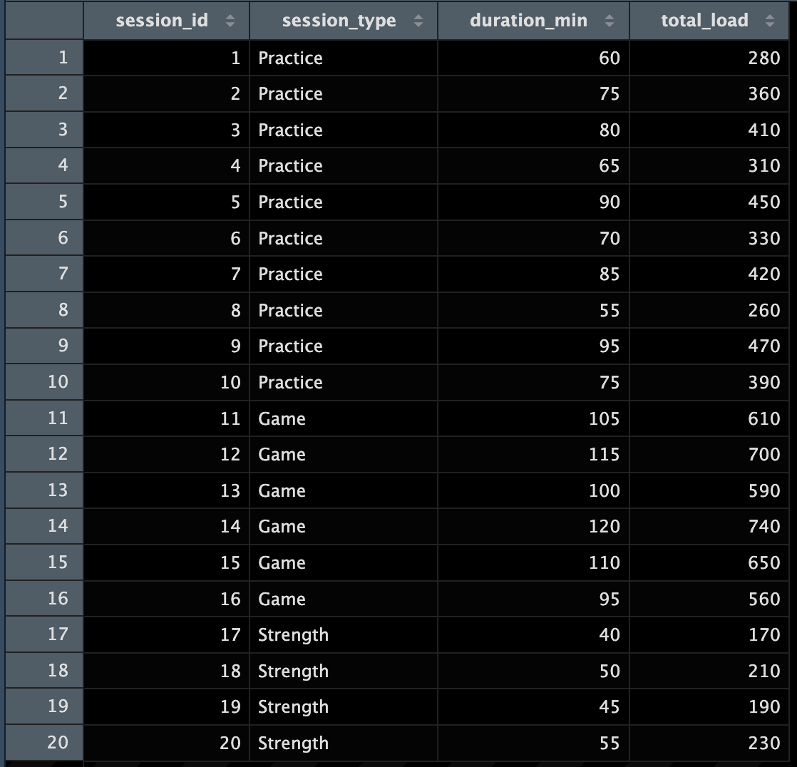
Proportions in sports
A proportion describes a part of a defined whole.
Proportion = number in a category ÷ total number
Before calculating:
  What does one row represent?
  What counts as the whole?
  If we wanted to know the proportion of sessions were games, practices, or strength sessions and our data have one row per athlete per session, would counting rows tell us the number of sessions?

Slide 21
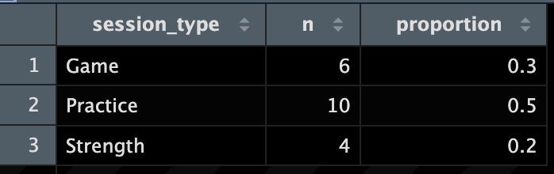
Calculating proportions

Slide 22
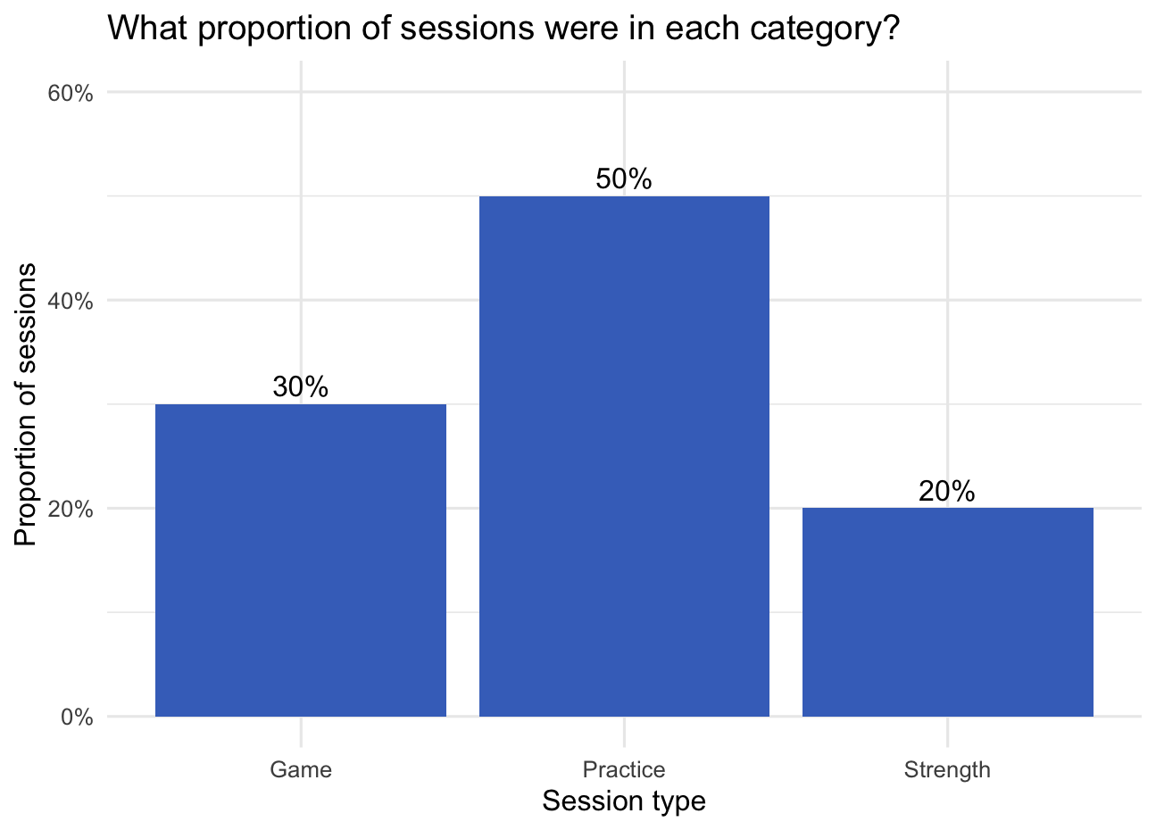
Choosing a chart for proportions
Question: Which session type was most common?
Use a bar chart to compare categories.
  categories on one axis and counts or percentages on the other.
  Label whether the bars show counts or percentages.

Slide 23
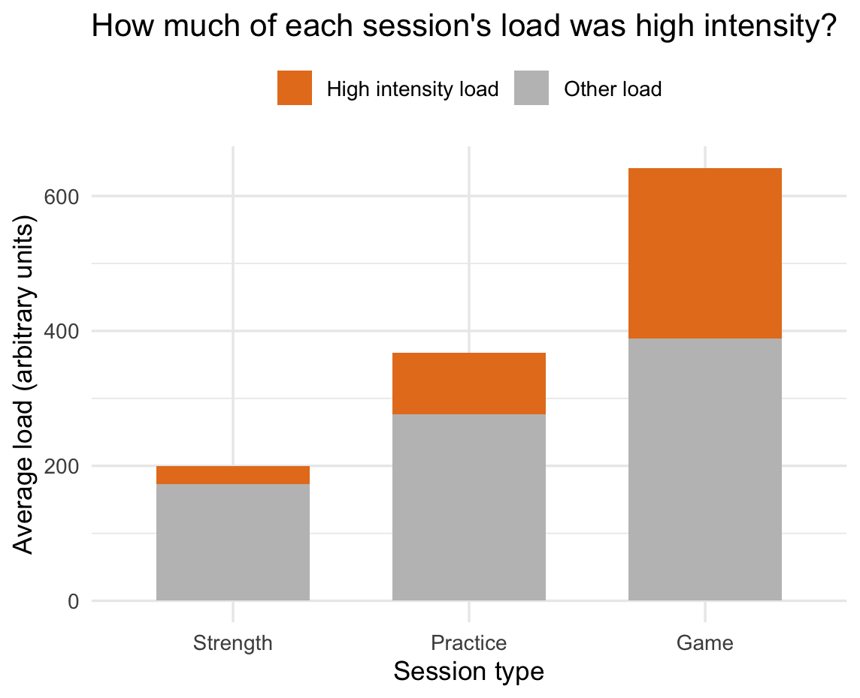
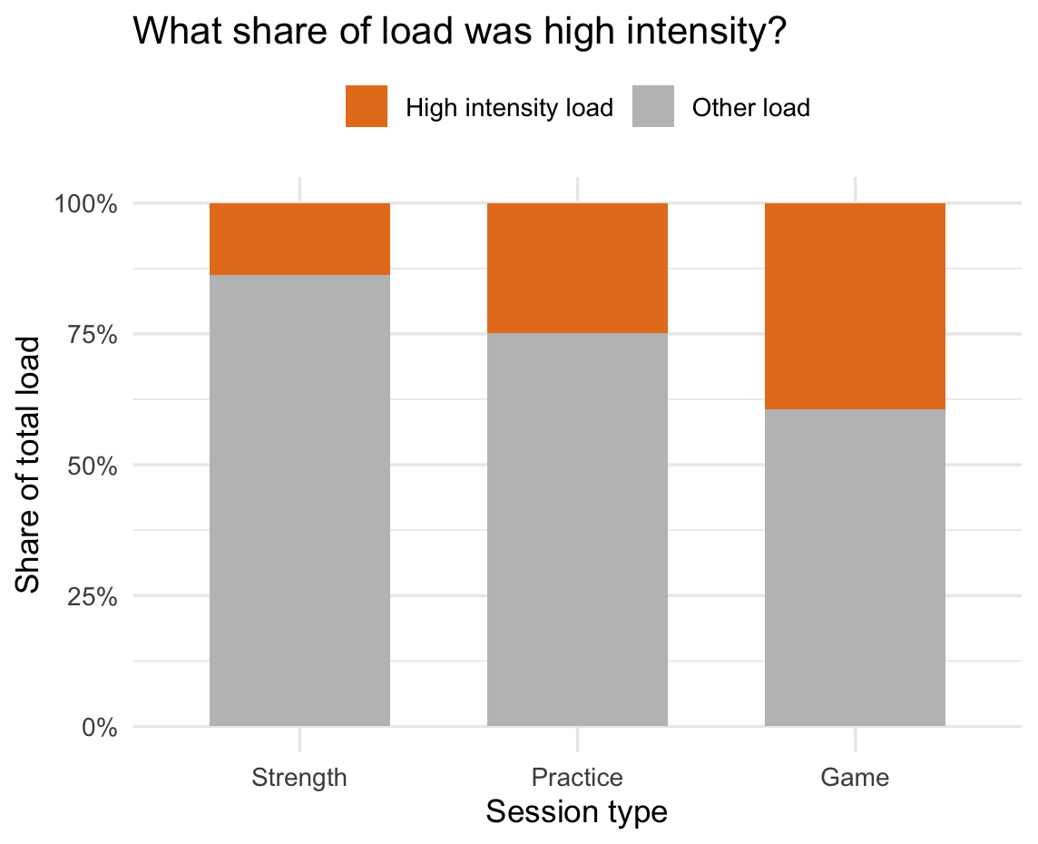
Choosing a chart for proportions
Question: How is the load within each session type divided between high intensity and other load?
*Each bar represents the average total load per session. Each section show high intensity and other load.
Which chart makes total load easier to compare? Which makes high intensity share easier to compare?

Slide 24
Choosing a chart for proportions
Question: How is the load within each session type divided between high intensity and other load?
Stacked bar chart when the parts add up to a meaningful total.
100% stacked bar chart if the question is about the proportion only.

Slide 25
Data for relationships
We need two numeric variables measured on the same observation.

Slide 26
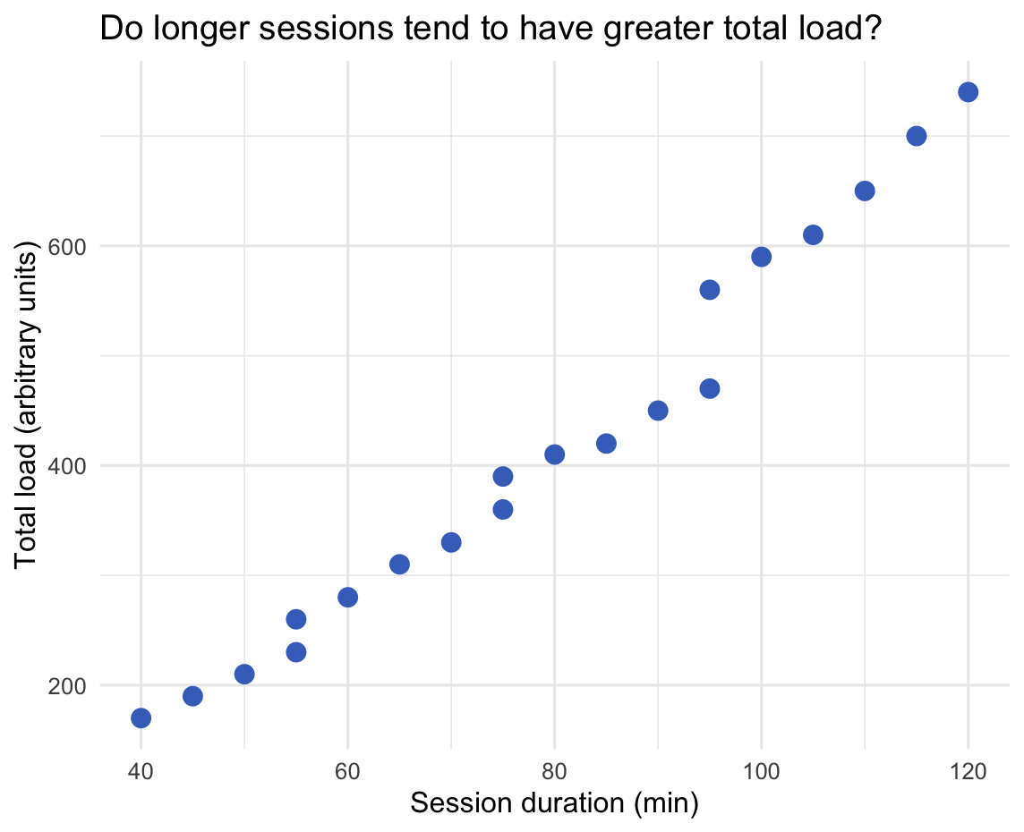
Visualizing relationships
Scatterplots:
Explanatory variable on the x-axis and the outcome on the y-axis.
  x-axis = duration
  y-axis = total load
Each point represents one session (or one athlete-session, depending on your data).

Slide 27
Reading a scatterplot
What pattern do you see?
Direction:
  Do higher values of one variable tend to occur with higher or lower values of the other?
Shape:
  Is the pattern roughly straight, curved, or unclear?
Spread:
  How closely do the points follow the pattern?
Unusual points or groups:
  Is anything worth a closer look?
Notes:
In these data, sessions with longer durations tended to ______.

Slide 28
Interpreting graphs
Observation:
Longer sessions tended to have greater total load.
Questions the graph alone cannot answer:
Were those sessions more intense, or simply longer?
Does duration itself explain the pattern?
Would the same pattern appear within each session type?

Slide 29
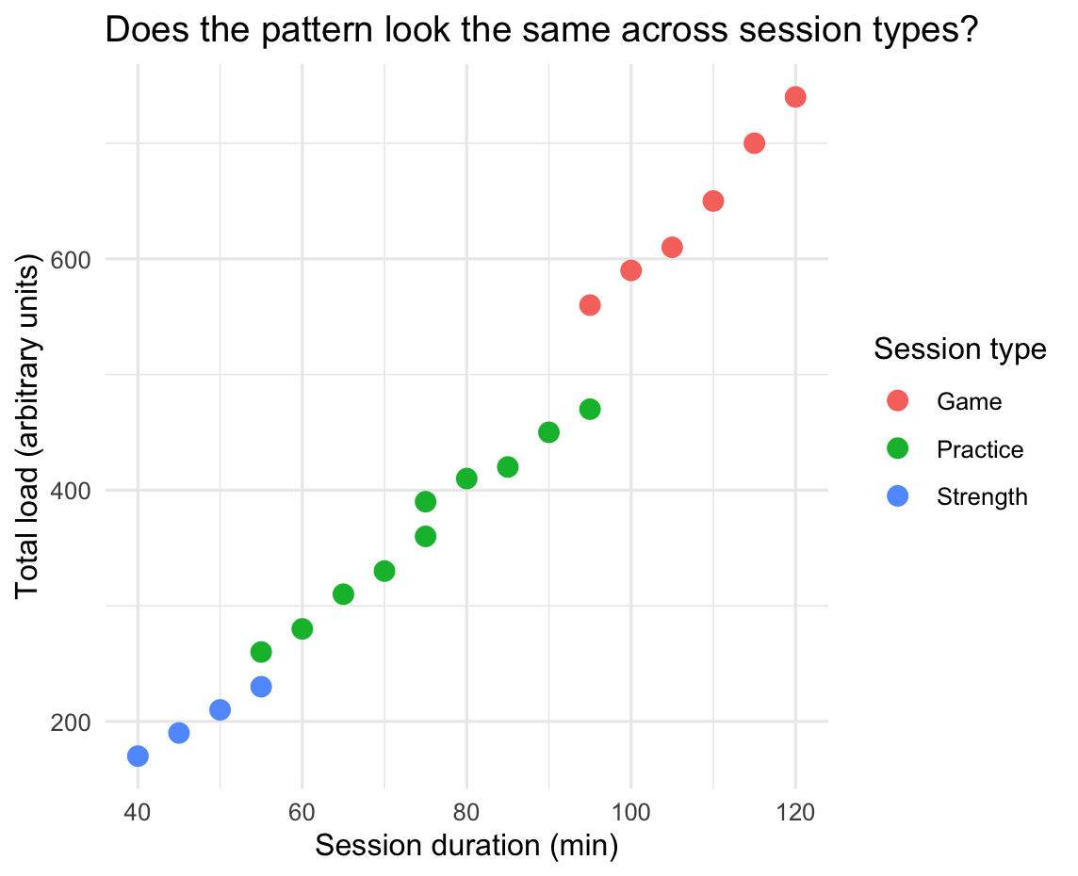
Comparing groups

Slide 30
Summary
Workflow: Start with the question, inspect the data, choose a graph, then interpret it.
Proportions: Define the whole before calculating or graphing its parts.
Relationships: Use a scatterplot to see how two numeric variables vary together. Describe the pattern before explaining it.
Next time
Exam review: Bring questions from the lectures and case studies.

