Slide 1
Center, spread, and distributions
Saryu Onishi
HES 3000-002, Sport Performance Analytics

Slide 2
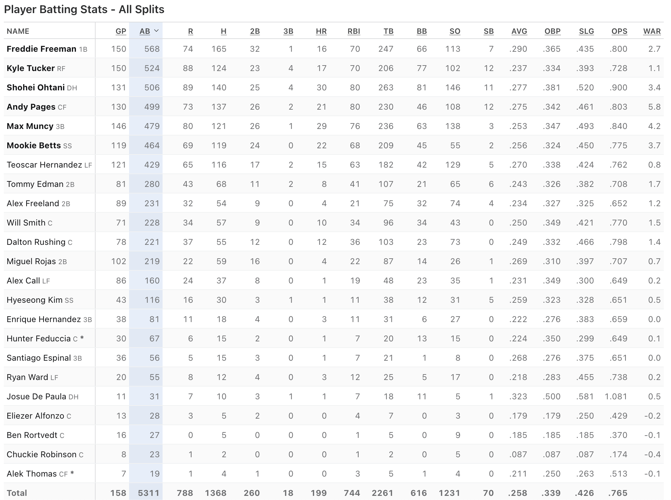
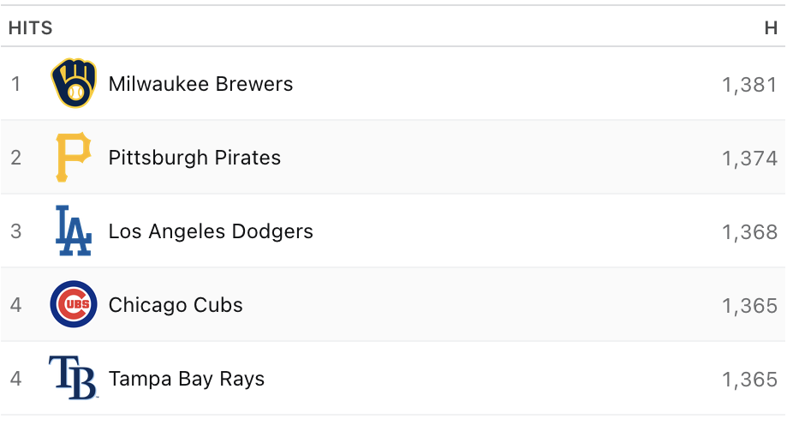
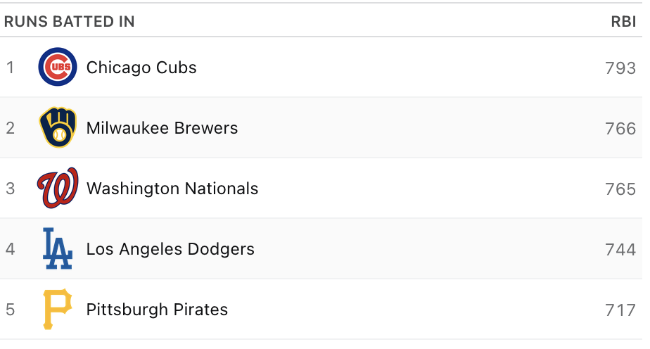
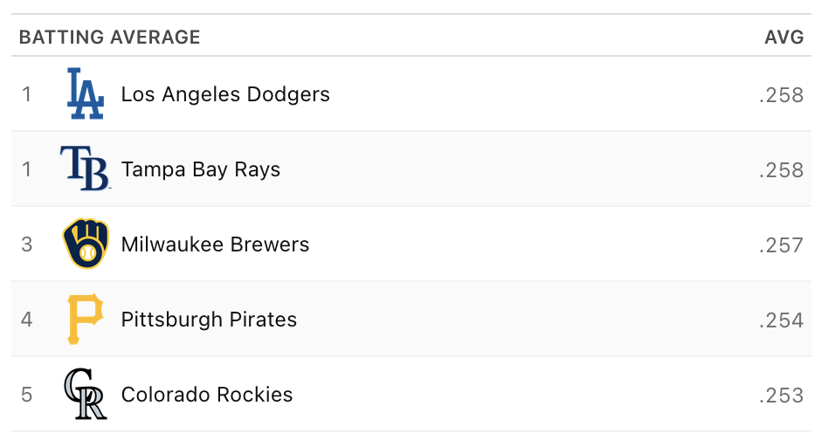
levels of granularity
How do we get from team level stats to league level stats?

Slide 3
Summarizing your data
A single number can answer different questions:
Question | Method | Example
How much happened? | Sum | Total points scored
How much per game? | Rate | Points per game
What is typical? | Center | Mean or median points in a game
How much does it vary? | Spread | Range or standard deviation

Slide 4
What is “typical”?
Notes:
Section 1: Central tendency
What is typical?

Slide 5
Measures of central tendency
A method of describing a data set with a single figure
Main methods:
  Mean
  Median
  Mode
Most appropriate method depends on the data and question
  Scale of measurement
  Outliers and data distribution
Notes:
What do we mean by “typical”?
Central tendency attempts to describe where most values in a dataset tend to cluster.
Mean, median, and mode: same goal, different behavior
Different measures of central tendency respond differently to skew and extreme values.

Slide 6
Mean, Median and Mode
Mean: arithmetic mean
  Determined by the sum of the values in the distribution divided by the number of values.
  Misleading if outliers or asymmetries are present
Median: the middle value
  the data point below which half of the values lie
  Ignores magnitude, focused on order
Mode: most frequent value
  Rarely used for interval or ratio data
Notes:
Sensitivity to outliers
Some measures shift dramatically with extreme values, others are more resistant.
When the average is misleading
A single “typical” value can fail to represent most observations.
What central tendency hides
Central tendency tells us nothing about spread, shape, or subgroups.

Slide 7
Mean, Median and Mode
Mean: arithmetic mean
  =AVERAGE(range)
Median: the middle value
  =MEDIAN(range)
Mode: most frequent value
  =MODE.SNGL(range)
Notes:
Sensitivity to outliers
Some measures shift dramatically with extreme values, others are more resistant.
When the average is misleading
A single “typical” value can fail to represent most observations.
What central tendency hides
Central tendency tells us nothing about spread, shape, or subgroups.

Slide 8
How much does it vary?
Notes:
Section 2: Variability

Slide 9
Measures of variability
The degree of spread or distribution of the data.
Can be used to show consistency or meaningful differences.
Methods:
  Range
  IQR
  Variance
  Standard Deviation
Notes:
Why variability matters
Variability describes how much observations differ, not just where they center.
Variability as information, not noise
High variability can signal inconsistency, risk, or meaningful differences.
Same mean, different variability
Datasets with identical averages can imply very different interpretations.
What variability still does not show
Variability alone does not reveal structure, trends, or relationships.

Slide 10
Range
Range: distance between the smallest and largest values.
  Sensitive to outliers
IQR: spread of the middle 50% of the data.
  Less sensitive to outliers
Standard Deviation: square root of variance
  Typical deviation from the mean
  Same units as the data
Notes:
Range, IQR, and standard deviation
Different variability measures capture different aspects of spread.
Range is the simplest lens. It shows the extremes, which is useful for sanity checks and identifying possible outliers, but it tells you nothing about how the rest of the data behave.
IQR focuses on the middle of the distribution. It’s more robust to outliers and gives a sense of where most athletes sit, but it intentionally ignores the tails.
These two are useful for data validation. Next 2 are used for interpretation
Variance and SD describe how values typically deviate from the mean. This is usually the most informative for applied work because it connects naturally to ideas like consistency, typical error, and thresholds. SD is easier to interpret than variance, which is why we usually report SD.

Slide 11
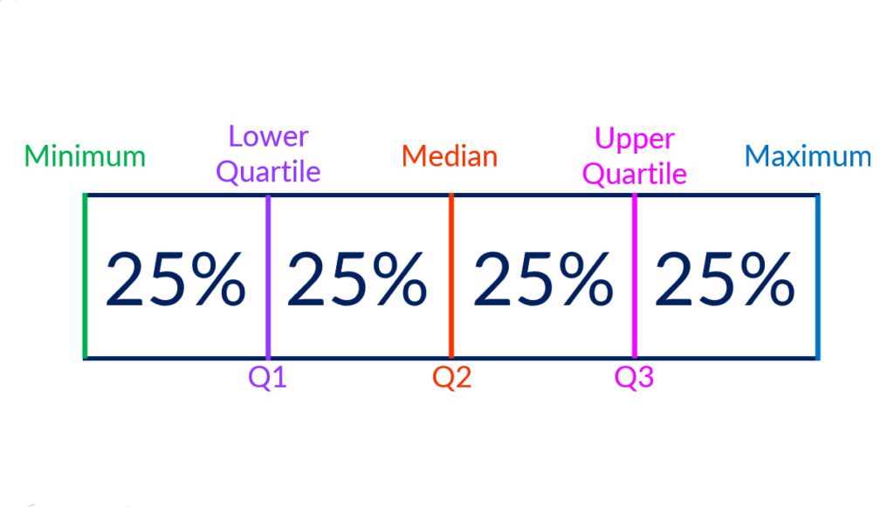
Range and IQR
range
Interquartile
range
Notes:
Range, IQR, and standard deviation
Different variability measures capture different aspects of spread.
Range is the simplest lens. It shows the extremes, which is useful for sanity checks and identifying possible outliers, but it tells you nothing about how the rest of the data behave.
IQR focuses on the middle of the distribution. It’s more robust to outliers and gives a sense of where most athletes sit, but it intentionally ignores the tails.
These two are useful for data validation. Next 2 are used for interpretation
Variance and SD describe how values typically deviate from the mean. This is usually the most informative for applied work because it connects naturally to ideas like consistency, typical error, and thresholds. SD is easier to interpret than variance, which is why we usually report SD.

Slide 12
Standard Deviation
Range: distance between the smallest and largest values.
  Sensitive to outliers
IQR: spread of the middle 50% of the data.
  Removes outliers
Standard Deviation: Typical deviation from the mean
  square root of variance
  Same units as the data
  =STDEV.S(range)
Notes:
Range, IQR, and standard deviation
Different variability measures capture different aspects of spread.
Range is the simplest lens. It shows the extremes, which is useful for sanity checks and identifying possible outliers, but it tells you nothing about how the rest of the data behave.
IQR focuses on the middle of the distribution. It’s more robust to outliers and gives a sense of where most athletes sit, but it intentionally ignores the tails.
These two are useful for data validation. Next 2 are used for interpretation
Variance and SD describe how values typically deviate from the mean. This is usually the most informative for applied work because it connects naturally to ideas like consistency, typical error, and thresholds. SD is easier to interpret than variance, which is why we usually report SD.

Slide 13
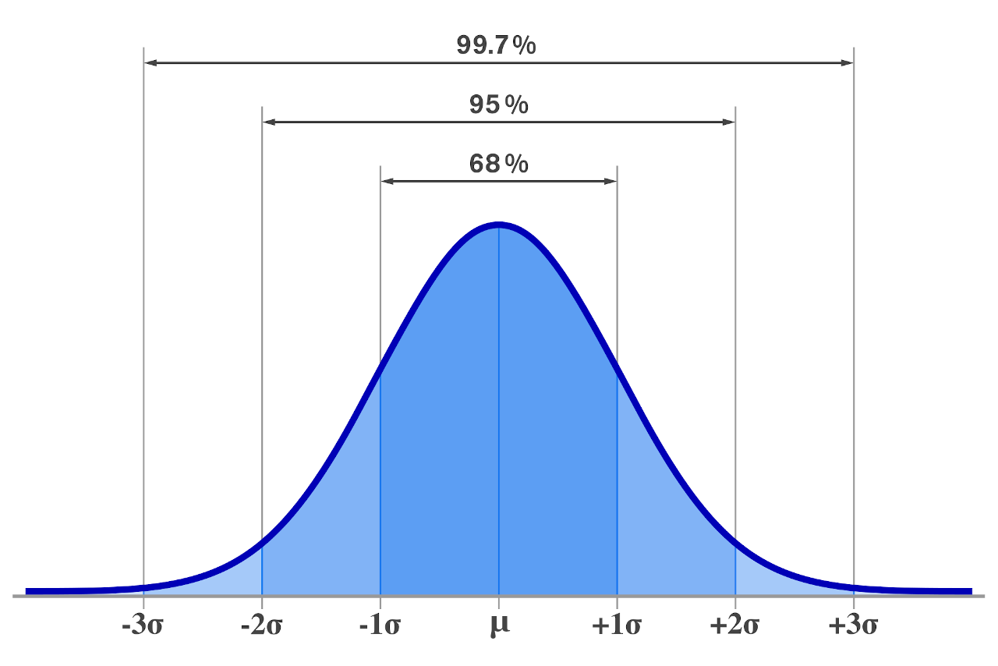
Standard Deviation
Deviation
mean
Notes:
Range, IQR, and standard deviation
Different variability measures capture different aspects of spread.
Range is the simplest lens. It shows the extremes, which is useful for sanity checks and identifying possible outliers, but it tells you nothing about how the rest of the data behave.
IQR focuses on the middle of the distribution. It’s more robust to outliers and gives a sense of where most athletes sit, but it intentionally ignores the tails.
These two are useful for data validation. Next 2 are used for interpretation
Variance and SD describe how values typically deviate from the mean. This is usually the most informative for applied work because it connects naturally to ideas like consistency, typical error, and thresholds. SD is easier to interpret than variance, which is why we usually report SD.

Slide 14
Distribution in data
Notes:
Section 2: Variability

Slide 15
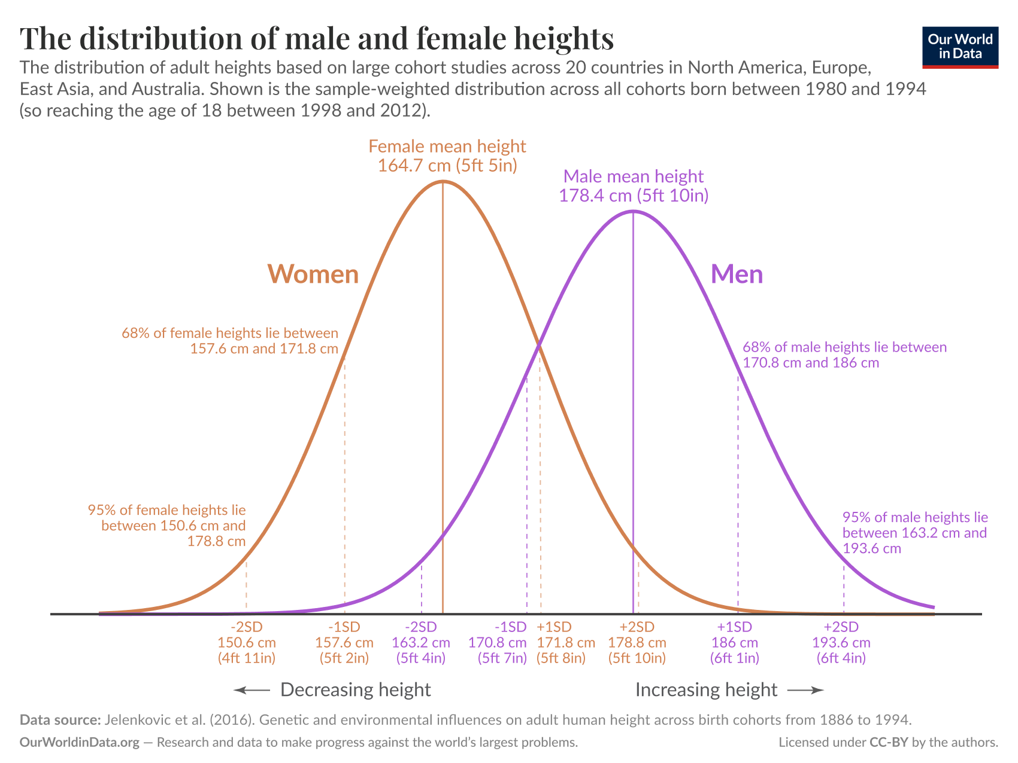
Understanding Distributions
The Normal Distribution (Bell Curve):
  Many biological and physical traits roughly approximate a normal distribution

Slide 16
Understanding Distributions
The Normal Distribution (Bell Curve):
  Many biological and physical traits roughly approximate a normal distribution
  Defined by mean and standard deviation (symmetric).

Slide 17
Distribution in Sports
Data in sports often not-normal
  Pooling athletes can create skew because athletes have different roles and opportunities.
  Measurements within one athlete may be more symmetric
Notes:
Measurements within one athlete may be more symmetric, especially under similar conditions, but we should check the plot rather than assume a normal distribution.

Slide 18
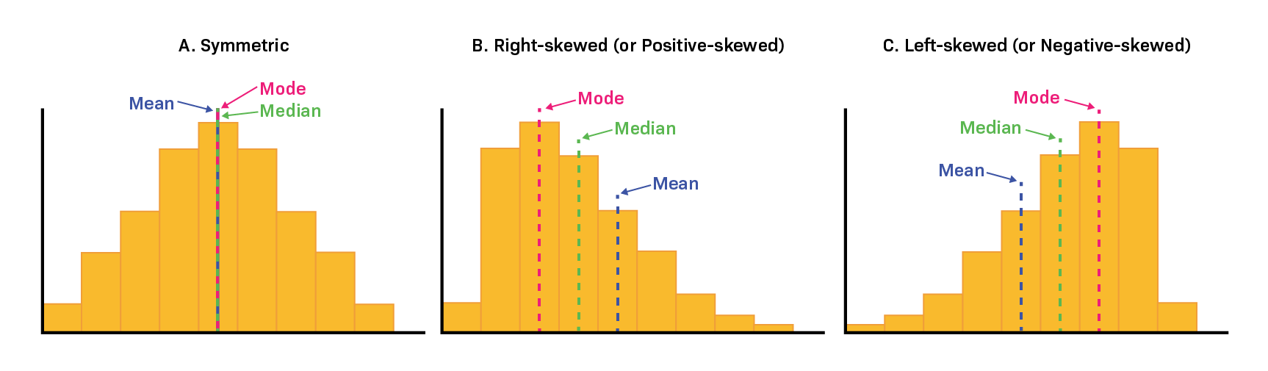
Skew in Data
Right-Skewed (Positive Skew):
  Most players have low counts, but a few superstars skew the tail high.
Left-Skewed (Negative Skew):
  Values clustered near the maximum ceiling, with a few poor performances trailing off.
Notes:
Right-Skewed (Positive Skew):
Most players have low counts, but a few superstars skew the tail high.
Examples: Goals scored per match, career home runs, yellow cards.
Left-Skewed (Negative Skew):
Values clustered near the maximum ceiling, with a few poor performances trailing off.
Examples: Passing completion percentages for elite quarterbacks, free-throw percentages.

Slide 19
Measuring the center in non-normal data
Notes:
Section 2: Variability

Slide 20
The center in symmetric data
Notes:
Mean: arithmetic mean
Determined by the sum of the values in the distribution divided by the number of values.
Misleading if outliers or asymmetries are present
Median: the middle value
the data point below which half of the values lie
Ignores magnitude, focused on order
Mode: most frequent value
Rarely used for interval or ratio data

Slide 21
The center in asymmetric data
Common in sports
Notes:
Mean: arithmetic mean
Determined by the sum of the values in the distribution divided by the number of values.
Misleading if outliers or asymmetries are present
Median: the middle value
the data point below which half of the values lie
Ignores magnitude, focused on order
Mode: most frequent value
Rarely used for interval or ratio data

Slide 22
Does distribution change appropriate method?
Would you / should you change the averaging method based on distribution?
Notes:
Mean: arithmetic mean
Determined by the sum of the values in the distribution divided by the number of values.
Misleading if outliers or asymmetries are present
Median: the middle value
the data point below which half of the values lie
Ignores magnitude, focused on order
Mode: most frequent value
Rarely used for interval or ratio data

Slide 23
Grouped summary
Notes:
Section 2: Variability

Slide 24
Grouped summary statistics
Why Segment Your Data?
Looking at team / league average often masks the truth because different positions have entirely different physical and tactical requirements.
Example:
  Grouping all positions may make total high-speed distance look "average."
  Segmenting by position may reveal that certain groups log massive high-speed workloads.
Notes:
We’ve talked about comparing players by position. Here’s a case where grouping changes the conclusion entirely.

Slide 25
Grouping can change the conclusion
Who is the better shooter?
 | 2pt made | 2pt att | 3pt made | 3pt att
Player A | 12 | 16 | 1 | 4
Player B | 4 | 4 | 8 | 16
 | 2pt% | 3pt%
Player A | 75% | 25%
Player B | 100% | 50%
Notes:
mistaken expectation that aggregate data will reflect the same relationships found within subgroups such as categories, classes, or individuals that comprise the aggregate.
In this example, summarizing (aggregating) the two types of shots leading to the devaluing of the 3 point shot
- Since Larry Bird took far more two-point shots, his overall percentage is dominated by two-point efficiency. Reggie Miller took many more three-point shots, so his overall percentage is more influenced by three-point efficiency. Because three-pointers are harder shots, that weighting pulls Miller’s overall percentage down

Slide 26
Different grouping can flip the conclusion
Who is the better shooter?
FG% = (2pt made + 3pts made) ÷ (2pt attempted + 3pts attempted)
Player B
 | 2pt% | 3pt% | FG%
Player A | 75% | 25% | 65%
Player B | 100% | 50% | 60%
Player A
How can this be??
Notes:
mistaken expectation that aggregate data will reflect the same relationships found within subgroups such as categories, classes, or individuals that comprise the aggregate.
In this example, summarizing (aggregating) the two types of shots leading to the devaluing of the 3 point shot
- Since Larry Bird took far more two-point shots, his overall percentage is dominated by two-point efficiency. Reggie Miller took many more three-point shots, so his overall percentage is more influenced by three-point efficiency. Because three-pointers are harder shots, that weighting pulls Miller’s overall percentage down

Slide 27
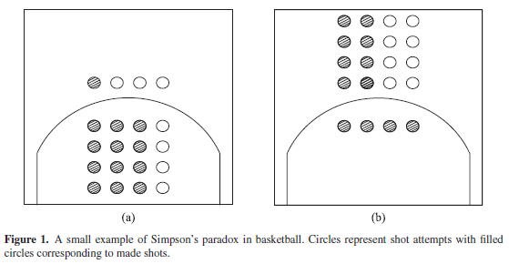
Simpson’s paradox
A pattern that appears within each group may reverse when the groups are combined, because the groups contribute different amounts to the overall result.
 | 2pt% | 3pt% | FG%
Player A | 75% | 25% | 65%
Player B | 100% | 50% | 60%
Notes:
mistaken expectation that aggregate data will reflect the same relationships found within subgroups such as categories, classes, or individuals that comprise the aggregate.
In this example, summarizing (aggregating) the two types of shots leading to the devaluing of the 3 point shot
- Since Larry Bird took far more two-point shots, his overall percentage is dominated by two-point efficiency. Reggie Miller took many more three-point shots, so his overall percentage is more influenced by three-point efficiency. Because three-pointers are harder shots, that weighting pulls Miller’s overall percentage down

Slide 28
Visualizing Distributions and Groups
Numbers tell part of the story, but visual shapes reveal the full picture.
Bar graphs, scatter plots and line graphs can show averages and averages over time
Histograms, density plots, and boxplots are useful for spotting positional differences and skewness.

Slide 29
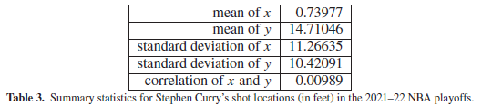
Summary statistics cuts out nuance
Steph Curry’s 2021-2022 NBA Playoff shot locations
Mean, standard deviation and correlation of shot locations.

Slide 30
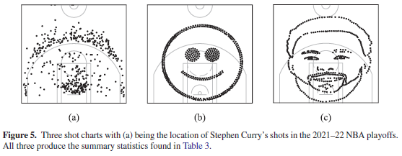
Visuals show the details
Steph Curry’s 2021-2022 NBA Playoff shot locations
Simple summary statistics can obscure actual data distribution (shot location).

Slide 31
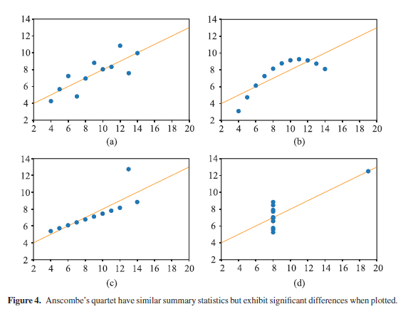
Anscombe’s quartet
Notes:
This is the real Anscombe’s quartet, in case you ever come across it outside of this class

Slide 32
In-Class Case Study: Describing Your Project Data
Notes:
Section 3: What summaries reveal vs. what they hide

Slide 33
In-Class Case Study
Before conducting analysis, it is good to find out what your data actually looks like. In this activity, you will describe one important numeric variable using measures of center, spread, and distribution.
Notes:
– Which summary statistics are invalid for Position, and why?
– What is the mode of Position?
– For JumpHeight_cm, which is more representative of a “typical” athlete: mean or median?
– Which variability measure is most affected by Athlete A10?
– Which variability measure is least affected by Athlete A10?
– If you were validating the data, which variability measure would you look at first?
– If you were describing performance consistency, which would you report?
– If you could report one number for “typical performance” and one number for “spread” to a coach, what would you choose and why?

Slide 34
In-Class Case Study
Part 1: Choose what to describe
Identify what one row of your dataset represents: a player, a player-game, a team-game, a training session, or something else.
Choose one numeric variable that matters.
Record the variable’s units and the number of observations with a usable value.
If you do not have data, use a provided class dataset and complete the same steps. Note which dataset you used.

Slide 35
In-Class Case Study
Part 2: Summarize the variable
Calculate:
  Mean and median
  Minimum and maximum
  Range
  Standard deviation
Make one plot that shows the distribution

Slide 36
In-Class Case Study
Part 3: Interpret what you found
Write three or four sentences that address these questions:
  What would you tell someone is a typical value? Would you use the mean or median, and why?
  How much do observations vary? Use at least one measure of spread in your answer.
  What does the distribution show that the summary statistics alone might hide? Consider unusual values, skew, gaps, or clusters.

Slide 37
In-Class Case Study
Bonus:
Compare the variable across a relevant group, such as position, team, season, or competition level.
  Report the number of observations in each group and compare both center and spread.
  Describe what you observe without assuming the group difference has a particular cause.

Slide 39
Issues with summary statistics
Notes:
Section 3: What summaries reveal vs. what they hide

Slide 40
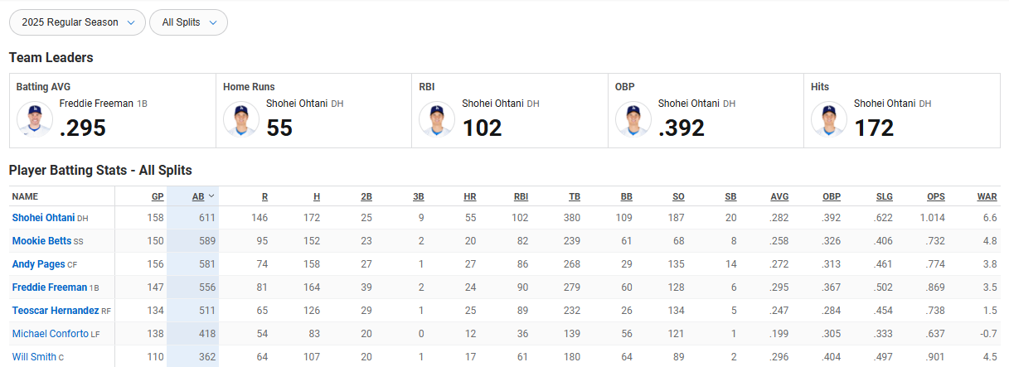
What they reveal
Quick snapshot of your data
Identify typical values and variation
Compare groups or time periods
Notes:
Correct but incomplete: Summary statistics can be mathematically correct while still misleading.
Aggregation changes the story: Summarizing across time, people, or groups can obscure important patterns.
Masking subgroups and structure: A single summary can hide clusters, trends, or outliers.

Slide 41
What They Hide
Outliers masked by averages
Distribution shape (skew, bimodality)
Individual stories lost in aggregation

Slide 42
Importance of Visualization
Visuals show the shapes of distributions, indicate where differences or relationships might be present and highlight any outliers
Common methods:
  Histograms
  Bar graph
  Box plot
  Scatter plot
Notes:
Same statistics, different data
Multiple datasets can share identical summary statistics but have very different structures.
Why visualization is necessary
Plots reveal patterns that summary statistics alone cannot detect.
Mention why pie charts are not ideal – stacked bar is better

Slide 43
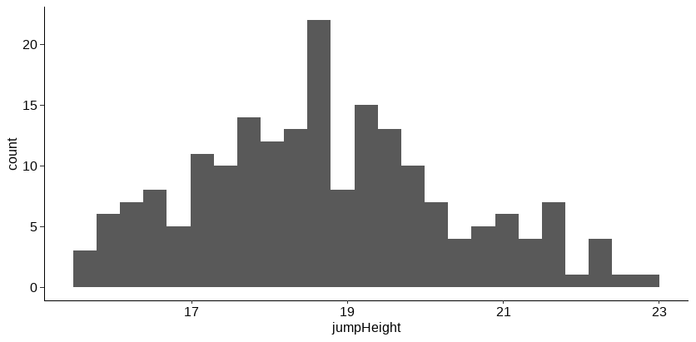
Visualization of distribution
Histogram, density plots show data distribution

Slide 44
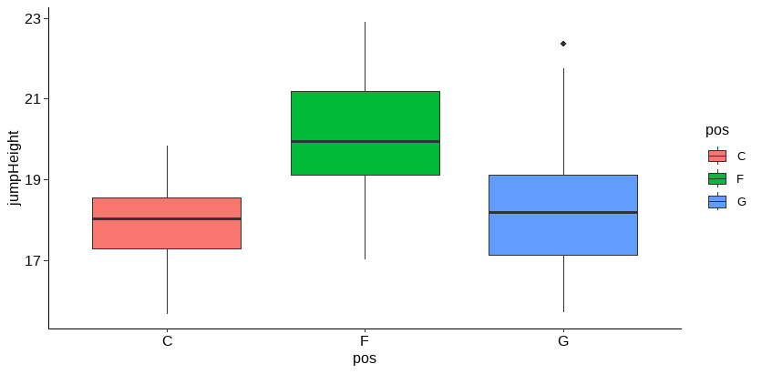
Visualization of averages
Box plots compare distributions across groups; bar charts can compare means

Slide 45
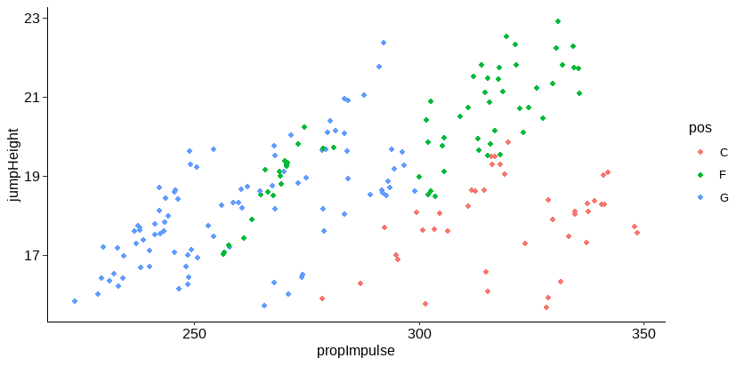
Visualization of relationships
Scatter plot can represent relationships in two-dimensional data
*show structure, not causation

Slide 46
Visualization of change over time
Line plots represent change over time
Anscombe’s quartet – applied:
  Both players have :
    average weight of about 100 kg
    Standard deviation of about 3
  Who (if any) would you flag?

