Slide 1
Special Topics in Health and Exercise Science: Sports Performance Analytics
HES 3000-002
Saryu Onishi

Slide 2
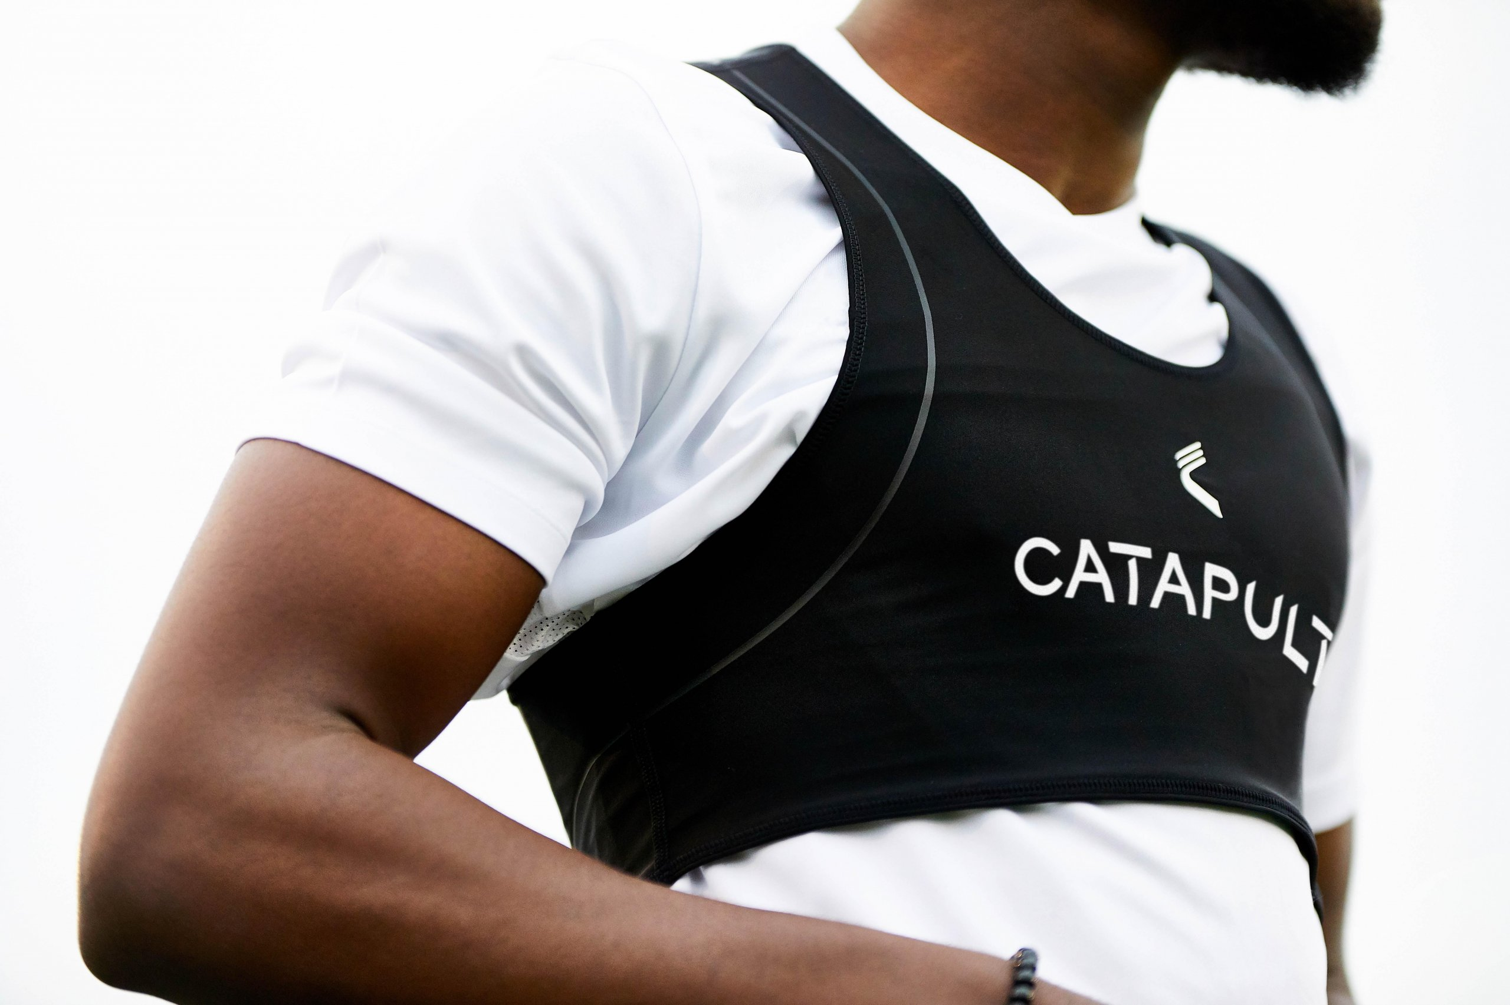
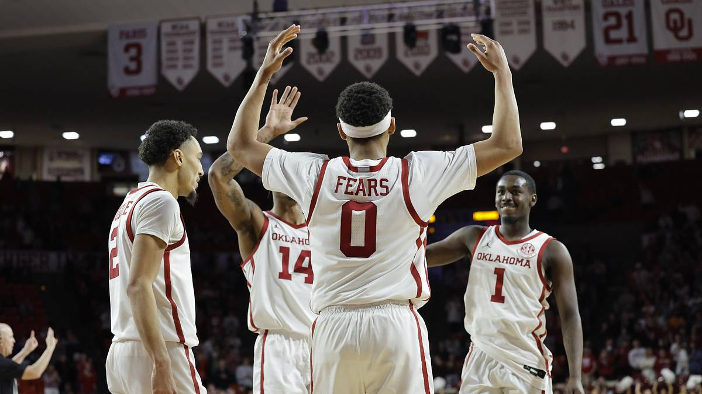


About me
Graduate Instructor
HES 3000-002: Sports Performance Analytics
HES 3883: Principals of Endurance Training
HES 2131, 2913, 2823
Background & Research
Endurance sports and physiology
Performance Analytics
Athlete monitoring and training load management
Notes:
What do you love about teaching the course? How long have you been teaching? What is your favorite thing about teaching?
Why did you choose to study and work in your discipline? What do you love about the discipline? How you see the discipline affecting the world and vice versa?
What is your research agenda and how does it relate to the course? (if applicable)
Personal details that you feel comfortable sharing, such as place of birth, family details, hobbies and interests, future plans.

Slide 3
Why Performance Analytics?
Bring together physiology, data and real decisions
Improve performance by:
understanding how athletes respond to training.
flag concerning patterns before they become larger performance or health problems.
guide better decisions with information.
Notes:
What do you love about teaching the course? How long have you been teaching? What is your favorite thing about teaching?
Why did you choose to study and work in your discipline? What do you love about the discipline? How you see the discipline affecting the world and vice versa?
What is your research agenda and how does it relate to the course? (if applicable)
Personal details that you feel comfortable sharing, such as place of birth, family details, hobbies and interests, future plans.

Slide 4
Tell me about yourself!
In your index cards:
Name
Year + Major
Favorite sport / team
One thing you’re hoping to learning in this class
Notes:
To help me remember you

Slide 5
Components of Performance Analytics
Performance analytics is not a single skillet
What skills do we need?
Sports Performance Analytics
Notes:
What do you love about teaching the course? How long have you been teaching? What is your favorite thing about teaching?
Why did you choose to study and work in your discipline? What do you love about the discipline? How you see the discipline affecting the world and vice versa?
What is your research agenda and how does it relate to the course? (if applicable)
Personal details that you feel comfortable sharing, such as place of birth, family details, hobbies and interests, future plans.

Slide 6
Components of Performance Analytics
Performance analytics is not a single skillet
Statistics and modelling
Data management
Measurement and collection of data
Visualization and communication
Sports Performance Analytics
Sport/performance knowledge
Decision-making and evaluating success
What skill is the most important?
Notes:
Its not about the stats

Slide 7
Working Definition for This Course
Sports Performance Analytics:
Management of structured performance data
Application of analytic models
Inform decision makers
Gaining a competitive advantage
Notes:
Ultimately: statistics to identify trends in athletic performance.

Slide 8
Skills to Build during this semester
Analytics foundations:
What sport analytics is and formulating good questions we can answer
Data:
Sources, structure, quality, validity, reliability, and ethics
Describe data:
Center, spread, distributions, and athlete profiling
Visualize data:
Showing patterns clearly and honestly
Explore relationships:
Association, regression, and interpretation
Making decisions:
Thresholds, probabilities, models, and communication
Application:
Example applications + semester-long group project
Notes:
This is general structure
Personal story: Similar class immediately started with case studies
Interesting but did not equipt me with the knowledge of how its done
My aim is to go over the steps and then later discuss how this is applied irl

Slide 9
The Scope of this Course
We are interested in questions related to:
Scouting, recruiting, and roster decisions
Athlete performance and training
Strategy and competition
We are not working on sports business problems
Ticketing
Marketing and sponsorship
Operations

Slide 10
Brainstorming Activity
List a few example of data or analytics being used in sports.
In pairs
Give each person an opportunity to share.
Select one or two ideas to discuss further.
For each selected idea, consider:
What information was being collected or presented?
What was it being used for? To understand? To decide?
Did you find it useful, convincing, or questionable?

Slide 11
Brainstorming Activity
The examples generated today involve different:
Sports and competitive settings
Types of data
Analytical approaches
Audiences and decisions
Throughout the semester, we will develop a systematic method to understand and/or investigate.

Slide 12
Syllabus

Slide 13
Assessments
12 quizzes:
Review the previous week's material; the two lowest scores are dropped.
In-class activities:
Apply concepts to sports problems and earn participation credit.
> 80% completion = 10 pts, 60-79% completion = 5 pts, < 60% completion = 0.
4 case studies:
Interpret data, evaluate methods, visualize findings, and reflect on analytical choices.
2 exam:
Demonstrate your understanding of concepts, applications, and the final project.
Notes:
Quizzes: due each Sunday
In-class activities:
Case studies:
Journal article presentation
Analytics project: think about a topic as we go through content
Exams: requires lockdown browser

Slide 14
Assessments
Evaluation | Points
Quizzes (10) | 100
Attendance | 10
Case study (4) | 100
Final project | 100
Exams (2) | 200
Total | 510
Notes:
Point disctibution
Available in syllabus

Slide 15
Course policies
Attendance
In-class activities count toward attendance and cannot be made up.
Grade rounding at the end of the semester is only applied if full attendance points is earned.*
Deadlines:
Late quizzes and exams are not accepted.
Other late work loses 10% per day unless arranged in advance.
AI:
*Check syllabus for full details
Notes:
Groups: If there are issues, please speak to me asap

Slide 16
Resources
Canvas
All materials used in this course will be available on Canvas
Class-wide communications will be done via Canvas Announcements
Communication
Email: saryu@ou.edu (DO NOT message me on Canvas)
Office: SJSC 103 on Tuesdays at 1:30-2:30 or by appointment
Help me help you - please reach out if you need something from me!
Reasonable accommodation policy
All accommodations are facilitated through the Accessibility and Disability Resource Center.
If you require accommodations, contact adrc@ou.edu or (405)2325-3852.
Notes:
I do not get a sense of your understanding until the exams. Hence it is critical for you to reach out if you need help. If the slides look wrong or need clarification on anything, PLEASE email me or let me know in class. This is the only way I can help you

Slide 17
Looking Ahead
Next Class: Evolution of sports analytics
Before Next Class:
Read the syllabus
Get familiar with Moneyball, by Michael Lewis

Slide 18
Welcome!
Modern sports generate enormous amounts of data.
Having data is not the same as knowing:
What it means
What matters
What to do next
This course is about turning sports data into knowledge and insights that can guide decisions.

Slide 19
What Will We Do in This Course?
Translate sports intuition into answerable analytical problems.
Extract and summarize information from performance data.
Make comparisons, analyze patterns / trends and build basic statistical models.
Visualize and communicate findings for sport performance audiences.
Evaluate assumptions, limitations, bias, and uncertainty in analytical claims.

