Slide 1
Scouting and Talent Evaluation
Saryu Onishi
HES 3000-002, Sport Performance Analytics

Slide 2
Draft season
60 prospects. 20 metrics each. A week to decide. What do you do?
  write down your first 3 steps
  Get in groups of 3, share with each other
prospect_id | draft_class | position | conference | age | height_in | wingspan_in | vertical_in | sprint_s | ppg | reb_pg | three_pt_pct
P001 | 2021 | Wing | Power | 22 | 80.2 | 84.9 | 38.3 | 3.29 | 15.5 | 4.2 | 0.429
P002 | 2021 | Wing | Mid-major | 20 | 77.4 | 81.7 | 36.5 | 3.08 | 22.3 | 7.9 | 0.361
P003 | 2021 | Guard | Power | 20 | 71 | 74.1 | 35 | 3.26 | 10.3 | 5.4 | 0.396
P004 | 2021 | Guard | Power | 21 | 72.7 | 75.9 | 33.9 | 3.21 | 12.7 | 3.8 | 0.382
P005 | 2021 | Wing | Mid-major | 22 | 81.4 | 85.5 | 27.6 | 3.31 | 22 | 6.4 | 0.386
P006 | 2021 | Guard | Power | 21 | 76.9 | 81.7 | 38.3 | 3.22 | 14.6 | 1.7 | 0.327
P007 | 2021 | Wing | Power | 20 | 78.6 | 83.8 | 32.9 | 3.24 | 14.2 | 4.7 | 0.329
P008 | 2021 | Big | Mid-major | 21 | 83.5 | 87.6 | 27.6 | 3.4 | 14.6 | 7.7 | 0.313
P009 | 2021 | Guard | Low-major | 20 | 72.2 | 76.1 | 36.4 | 3.27 | 12 | 3.4 | 0.351
P010 | 2021 | Wing | Mid-major | 20 | 79 | 82.9 | 31.3 | 3.32 | 6.3 | 1.5 | 0.306
P011 | 2021 | Guard | Power | 21 | 75.2 | 79.3 | 33.6 | 3.14 | 8.3 | 3.8 | 0.378
P012 | 2021 | Wing | Mid-major | 23 | 77.5 | 81.6 | 36.1 | 3.24 | 17 | 3.1 | 0.319

Slide 3
Getting specific
“Sort by the best stat” → which stat?
“Best” → compared to whom?
“Good enough” → good enough for what?
“Look at everything” → how do I combine it?
Outline:
KPI → Group → Method → Composite

Slide 4
1. Which KPIs matter?

Slide 5
Which KPIs matter?
Not every number is useful
Some are signal (tell us something real about future success)
Some are noise (random, redundant, or irrelevant)
KPI filters: Relevant? Distinct?
*KPI = Key Performance Indicator

Slide 6


Start with the outcome
You can’t pick predictors until you define “success”
  Eg: minutes played in years 1-3, win shares, still in the league after 4 years, role (starter or bench)
Different outcomes → different “best” KPI
How would you define success for …
  NFL Player
  NHL Player
  WNBA Player
Notes:
This is the fundamental piece in scouting.
In OBP example, success was defined as getting on base!

Slide 7
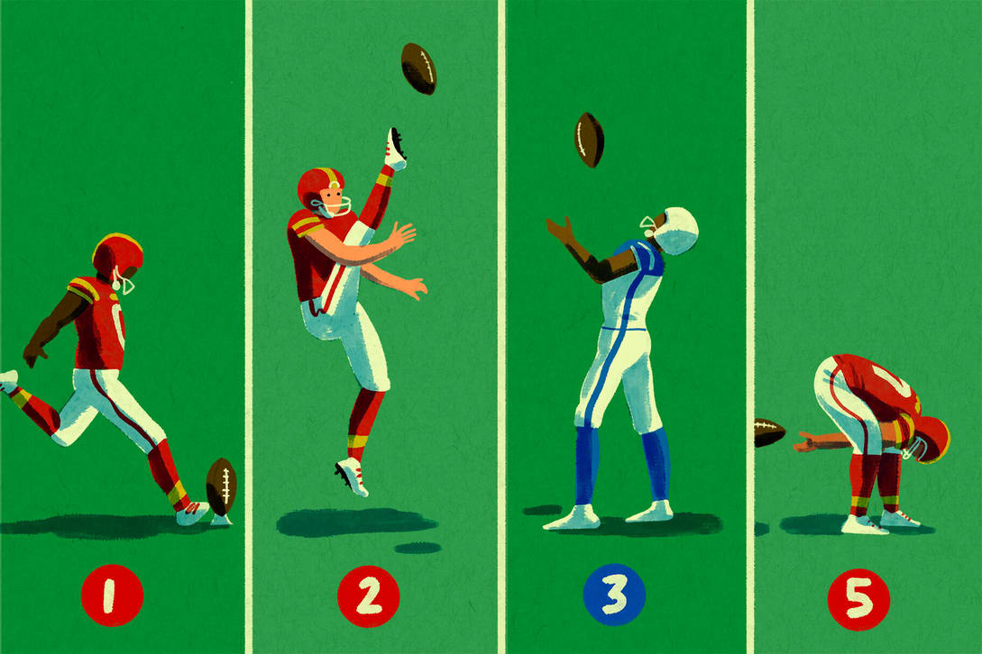
Define success
Would these qualities change if the question was
  NFL QB vs WR vs DB?
  NHL Goalie vs Center vs Wing?
  WBNA PG vs F vs C?
Would these qualities change if the question was
  NFL QB for the Bears vs the Broncos?

Slide 8
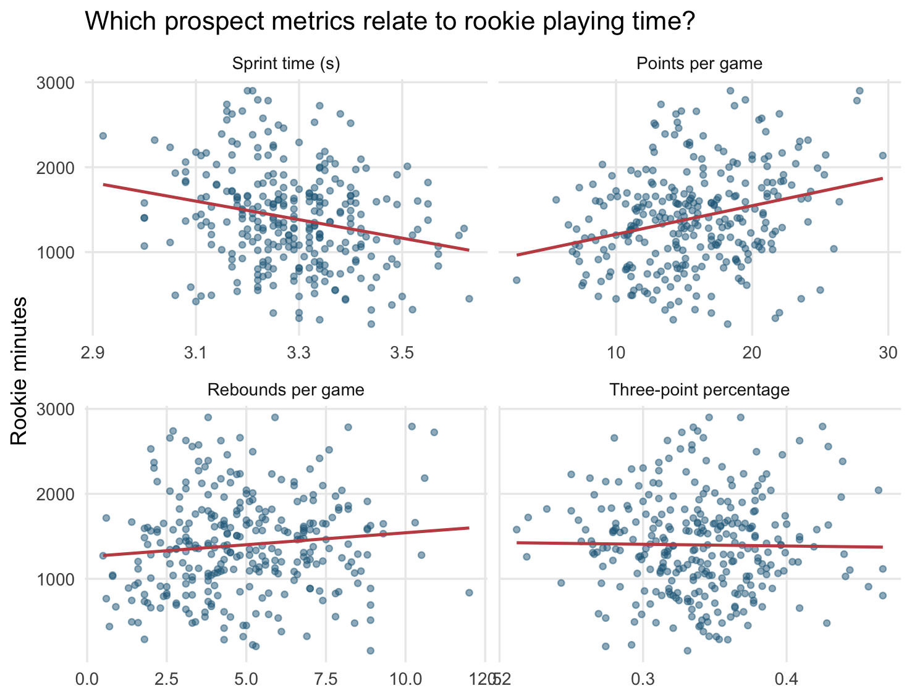
Filter 1: Is it relevant?
How to you find relevant KPIs?
  Correlate the combine KPIs with the success indicators
  A weak correlation can mean the metric is unrelated or just noisy.

Slide 9
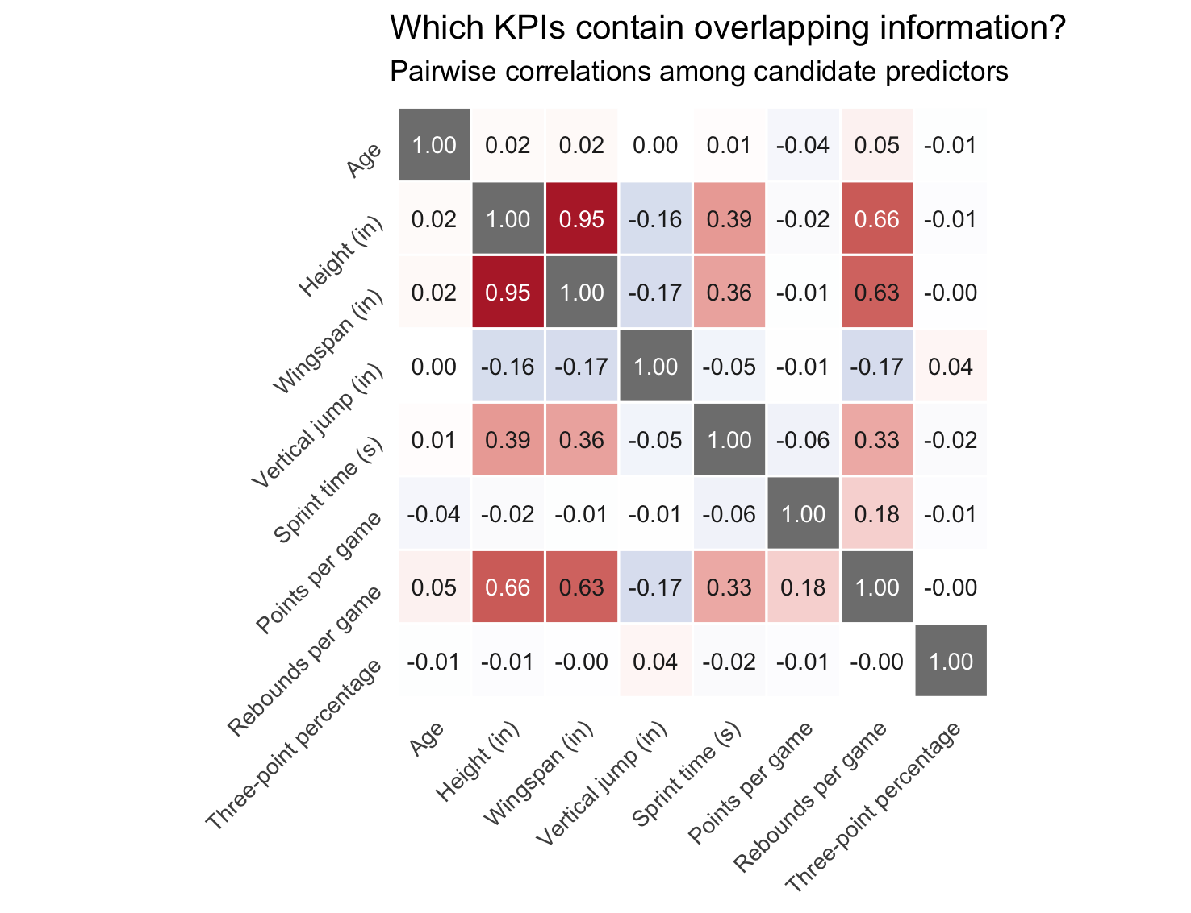
Filter 2: Is it distinct?
Correlate KPIs with each other
  If two metrics at r ≈ 0.9 are telling us roughly the same thing
  Redundant metrics double-count one quality

Slide 10
Putting the filters together
Table: 6-8 example metrics × (Relevant? Distinct? Plot looks linear?)
Keep / Drop / Investigate

Slide 11
Common traps
Chance:
  The more metrics you screen, the greater the chance that some appear relevant by luck.
Survivors:
  Looking only at drafted players can distort relationships and limits what we can conclude about all prospects.
Correlation ≠ causation, and circularity:
  Outcome can reflect team decisions, not only individual performance
Look before you correlate:
  linear correlation analysis will only test linear relationships

Slide 12
Quick check
A metric has r ≈ 0 with minutes, but the quartile plot shows a clear rise then plateau. What do you conclude?
Two metrics correlate at r = 0.95. What should you do?
Why might rookie minutes be an imperfect measure of success?

Slide 13
Known KPIs – use or drop?
Many metrics are already known to be important:
  tradition, past research, what other teams share
These are a sensible starting point
  if every team uses the same KPIs, it is not a competitive advantage
Edge can come from:
  Checking whether a known KPI holds up in your data
  Finding what the standard KPI list misses
  Matching metrics to your team’s needs (needs aren’t the same across teams)

Slide 14
Real Analytics is Collaborative
Analysts rarely make decisions start to finish. Coaching staff may:
Describe outcome
  “I need someone who can defend multiple positions and play heavy minutes early.”
  Use analytics to find metrics who fits this
Prescribe KPI
  “I want ppg, vertical, and three-point %.”

Slide 15
2. Compared to whom?

Slide 16
Compared with whom?
A number means nothing alone:
  Is a 58 mL/kg/min VO2max good?
Compared to...
  the whole draft class?
  Position group?
  Conference?
  Current pros?
The group you pick changes the answer
Notes:
“Is a 38-inch vertical good?” Let them realize they need context.

Slide 17
Choosing a comparison group
Whole draft class: simple, but mixes roles
Same position: fairer for position-specific traits
Same conference or level of competition: provide a more similar competition context
Same age or class year: accounts for development

Slide 18
Choosing a comparison group
Trade-off: more specific = more relevant, but smaller sample
Lecture 3: Asking Testable Analytical Questions
Too Broad
Whole draft class
Position Group*
Focused
Too Narrow
Same College
* Most appropriate comparison depends on context

Slide 19
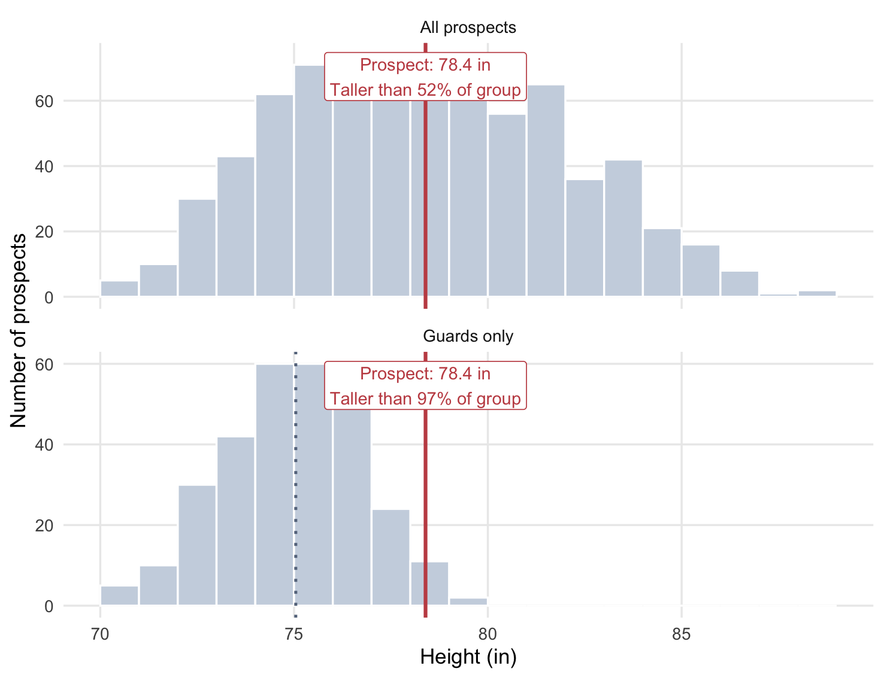
The comparison group changes the interpretation.
Selecting the appropriate comparison group is important
One athlete can look average in one group, and elite in a sub-group

Slide 20
Questions about Comparisons
Relative question: how good is athlete A compared to their draft class?
  Relative group: Players in their draft class
Benchmark question: how good is athlete A compared to what our league requires?
  Benchmark group: current or past players at that position
A prospect can be the best in their class and still below the bar

Slide 21
Summary
Define success
Choose relevant, distinct KPIs
Choose the comparison group
Relative comparisons vs benchmark comparison
Return to answers for opening activity
  Which step would you add or change?
Up Next: How do we express the comparison, and how do we combine metrics?

