Slide 1
Performance Profile → Scouting Decision
Saryu Onishi
HES 3000-002, Sport Performance Analytics

Slide 2
Plan
Time | Topic | Teaching approach
0–8 min | Revisit the opening decision | Ask whether the athlete profiles changed students’ original selections.
8–20 min | Performance is multidimensional | Discuss role, team needs, trade-offs, and minimum requirements.
20–30 min | Building a weighted score | Demonstrate a simple score using consistently oriented percentiles.
30–48 min | Scouting committee activity | Groups receive different recruitment briefs, select weights, and choose an athlete.
48–57 min | Challenge the decision | Change the weights and compare selections across groups.
57–60 min | Exit recommendation | Students recommend an athlete and identify one uncertainty that could change their decision.

Slide 3
What are we recruiting this athlete to do?
Divide into groups:
  Team A needs a perimeter shooter.
  Team B needs a primary ball handler.
  Team C needs an athletic developmental prospect.
Which athlete did you select?

Slide 4
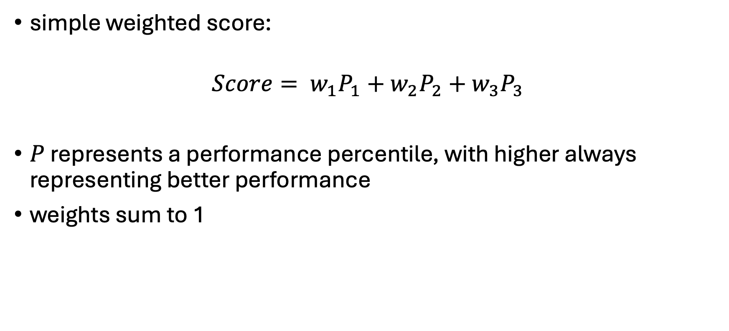
weighted score
simple weighted score:
$$Score= w_{1}P_{1}+w_{2}P_{2}+w_{3}P_{3}$$
$P$ represents a performance percentile, with higher always representing better performance
weights sum to 1

Slide 5
Choosing the weights
The most valuable discussion is how to choose the weights:
  Role and team needs: What qualities does the athlete need to contribute?
  Sport knowledge: What do coaches and scouts consider relevant, and why?
  Evidence: Do these measures help predict the outcome we care about?
  Measurement quality: Is the apparent strength based on reliable testing and enough observations?

Slide 6
Revisiting activity
Their recruitment goal.
Their selected metrics and weights.
Their preferred athlete.
Whether that choice changes under equal weights or a plausible alternative.
One additional piece of information they would request before recruiting.

Slide 7
Minimum standard?
minimum requirements. A weighted average allows strengths to compensate for weaknesses, but that may be inappropriate for some roles. A team might require a minimum shooting standard before comparing the remaining candidates

