Slide 1
Data Visualization
Saryu Onishi
HES 3000-002, Sport Performance Analytics

Slide 2
Quiz 4
Why does “garbage in, garbage out” matter in sports analytics?
Statistical models automatically remove measurement errors
Large datasets do not require quality checks
Sophisticated analyses cannot fully compensate for flawed input data
Only manually entered data contain errors

Slide 3
Quiz 4
Why does “garbage in, garbage out” matter in sports analytics?
Statistical models automatically remove measurement errors
Large datasets do not require quality checks
Sophisticated analyses cannot fully compensate for flawed input data
Only manually entered data contain errors

Slide 4
Why visualization matters in sports analytics

Slide 5
Why visualization matters in sports analytics
Pattern recognition and speed
Communication and decision support
Notes:
Sports data visualization is described as an increasingly important research direction
Visual processing happens faster than numerical processing—critical for time-sensitive sports decisions

Slide 6
Who played the most minutes?
Player | Pos | GP | GS | Mins
T. Baribo | F | 29 | 20 | 1876
B. Damiani | F | 33 | 23 | 2040
M. Uhre | F | 29 | 16 | 1325
I. Vassilev | M | 31 | 21 | 1973
D. Jean Jacques | M | 31 | 26 | 2361
K. Wagner | D | 32 | 30 | 2769
Q. Sullivan | M | 28 | 24 | 1967
N. Harriel | D | 25 | 23 | 2098
M. Iloski | F | 9 | 7 | 600
D. Gazdag | M | 6 | 6 | 498
J. Lukic | M | 32 | 30 | 2620
O. Makhanya | D | 29 | 23 | 2145
A. Bedoya | M | 24 | 9 | 739
J. Glesnes | D | 31 | 30 | 2626
F. Westfield | D | 25 | 18 | 1724
I. Glavinovich | D | 4 | 3 | 257
M. Anderson | F | 3 | 1 | 98
J. Bueno | M | 20 | 11 | 903
N. Pierre | D | 1 | 0 | 20
D. Vazquez | M | 1 | 0 | 19
O. Mbaizo | D | 9 | 6 | 481
C. Sullivan | M | 11 | 1 | 214
J. Rafanello | M | 15 | 2 | 274
S. Olivas | F | 3 | 0 | 45
B. Bender | M | 7 | 4 | 320
A. Rick | G | 14 | 13 | 1232
E. Davis | F | 1 | 0 | 2
A. Blake | G | 21 | 21 | 1828
C. Donovan | F | 20 | 6 | 540
Notes:
Who played the most minutes?

Slide 7
Gradient to represent magnitude

Slide 8
Order to organize values

Slide 9
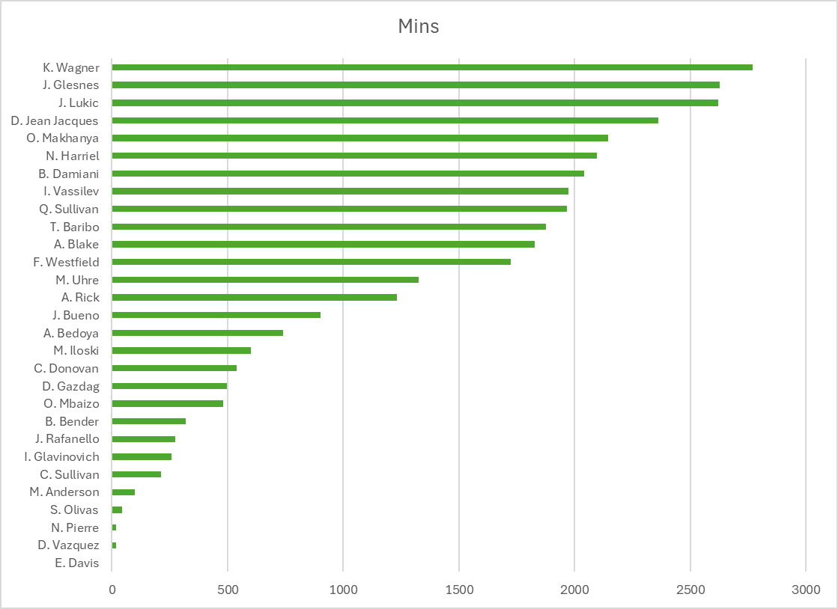
Visual representation of values

Slide 10
Why visualization matters in sports analytics
Pattern recognition and speed
Communication and decision support
Notes:
Sports data visualization is described as an increasingly important research direction
Visual processing happens faster than numerical processing—critical for time-sensitive sports decisions

Slide 11
Who played >1500 minutes last season?
Player | Pos | GP | GS | Mins
T. Baribo | F | 29 | 20 | 1876
B. Damiani | F | 33 | 23 | 2040
M. Uhre | F | 29 | 16 | 1325
I. Vassilev | M | 31 | 21 | 1973
D. Jean Jacques | M | 31 | 26 | 2361
K. Wagner | D | 32 | 30 | 2769
Q. Sullivan | M | 28 | 24 | 1967
N. Harriel | D | 25 | 23 | 2098
M. Iloski | F | 9 | 7 | 600
D. Gazdag | M | 6 | 6 | 498
J. Lukic | M | 32 | 30 | 2620
O. Makhanya | D | 29 | 23 | 2145
A. Bedoya | M | 24 | 9 | 739
J. Glesnes | D | 31 | 30 | 2626
F. Westfield | D | 25 | 18 | 1724
I. Glavinovich | D | 4 | 3 | 257
M. Anderson | F | 3 | 1 | 98
J. Bueno | M | 20 | 11 | 903
N. Pierre | D | 1 | 0 | 20
D. Vazquez | M | 1 | 0 | 19
O. Mbaizo | D | 9 | 6 | 481
C. Sullivan | M | 11 | 1 | 214
J. Rafanello | M | 15 | 2 | 274
S. Olivas | F | 3 | 0 | 45
B. Bender | M | 7 | 4 | 320
A. Rick | G | 14 | 13 | 1232
E. Davis | F | 1 | 0 | 2
A. Blake | G | 21 | 21 | 1828
C. Donovan | F | 20 | 6 | 540
Notes:
We need to flag athletes who played more than 1500 minutes

Slide 12
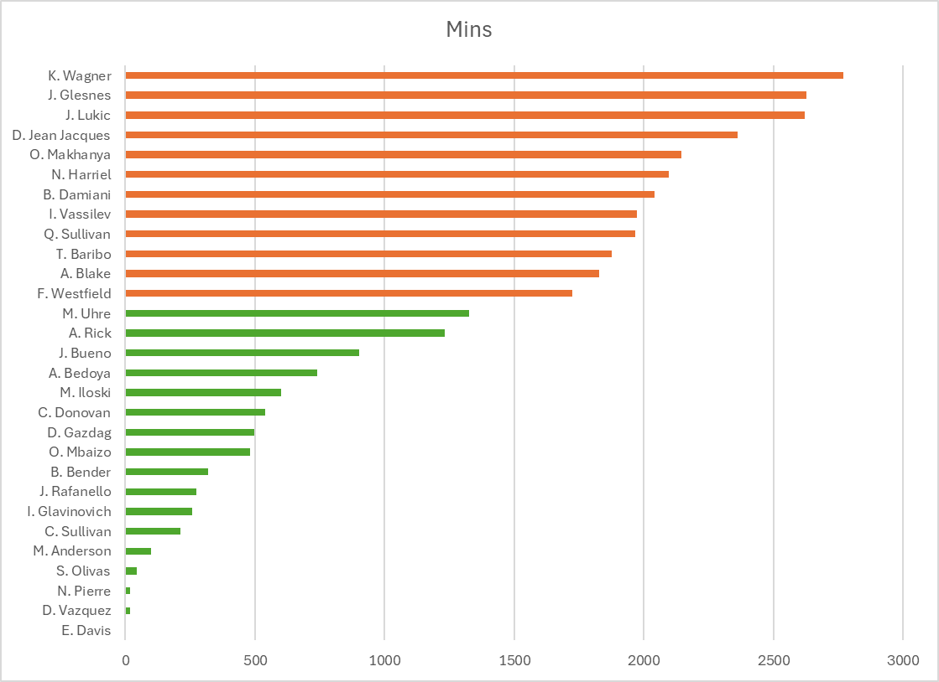
Color, order, graphs

Slide 13
Why visualization matters
Each version contained the same basic data. What changed was how the data were visually encoded.
Tables are useful for looking up exact values.
Charts are useful for seeing patterns.
Ordering improves comparison.
Color and reference lines add meaning.
Different visual choices support different decisions.

Slide 14
Directing attention

Slide 15
Visual encoding
Visual encoding maps data values to visual properties.
Attributes such as position, length, color, size and shape communicate different information.
vertical position = player name
bar length = minutes
reference line = decision threshold
color = above or below threshold

Slide 16
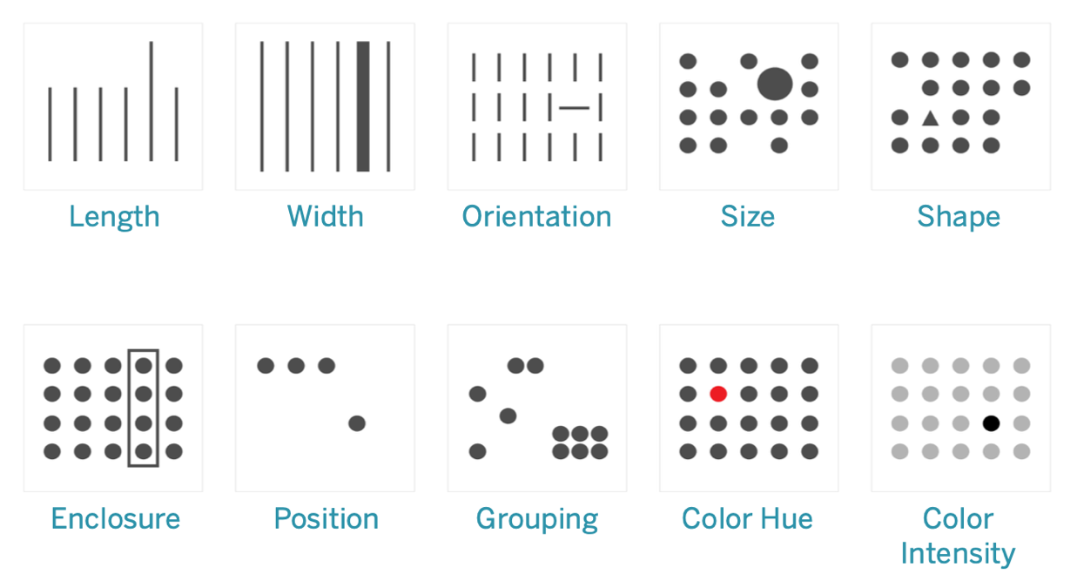
Pre-attentive attributes
Visual properties that the human brain processes almost instantly and subconsciously
Notes:
Visual properties your brain processes in <200-250 milliseconds You see them instantly without conscious effort
Happens before you "think" about what you're looking at
Critical for dashboards, in-game analytics, quick decision-making
Spatial:
length,
width,
orientation,
enclosure
position,
grouping,
Size
Shape
Color:
hue
intensity
Motion

Slide 17
Pre-attentive attributes
Visual properties that the human brain processes almost instantly and subconsciously
spatial
size and shape
color
Notes:
Visual properties your brain processes in <200-250 milliseconds You see them instantly without conscious effort
Happens before you "think" about what you're looking at
Critical for dashboards, in-game analytics, quick decision-making
Spatial:
length,
width,
orientation,
enclosure
position,
grouping,
Size
Shape
Color:
hue
intensity
Motion

Slide 18
Attention versus importance
Visual emphasis tells the audience where to look.
The most visually prominent element appears important.
Emphasis should reflect the analytical question.
Unnecessary emphasis can distort interpretation.

Slide 19
Accuracy in visualizations

Slide 20
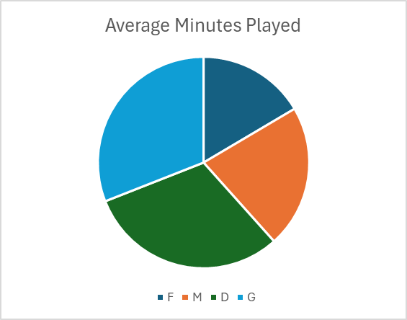
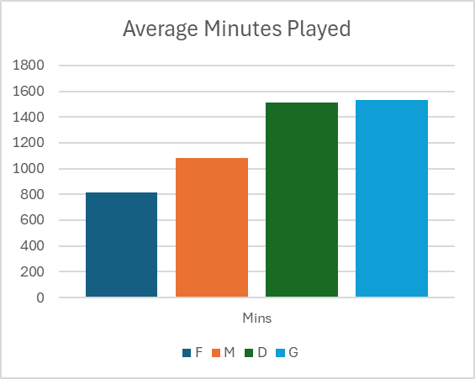
Making comparisons easy
Which position accumulated more minutes?
Approximately how many more minutes?

Slide 21
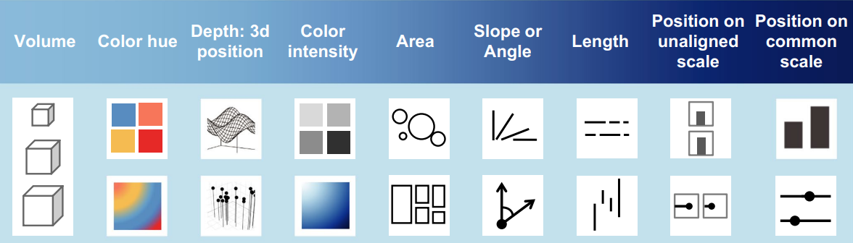
Accuracy of visual encodings

Slide 22
Accuracy of visual encodings

Slide 23
Selecting attributes

Slide 24
Selecting attributes
Which visual properties would appropriately represent:
  Position
  Minutes played
  Team
  Average sprint speed
Data type | Appropriate visual properties
Numerical | Position, length, size, color intensity
Nominal | Position, color hue, shape
Ordinal | Position, light-to-dark color, size

Slide 25
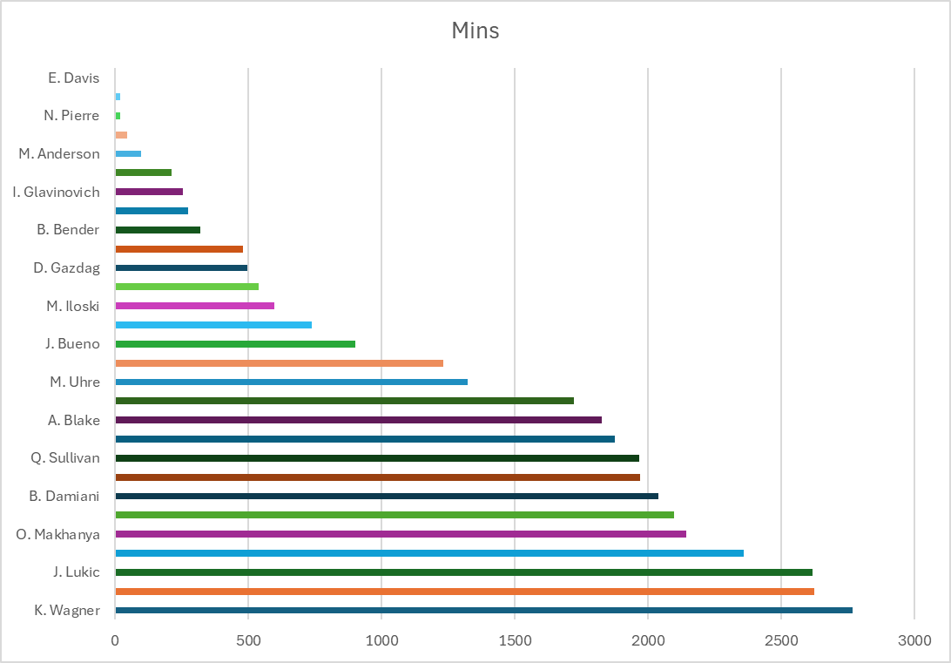
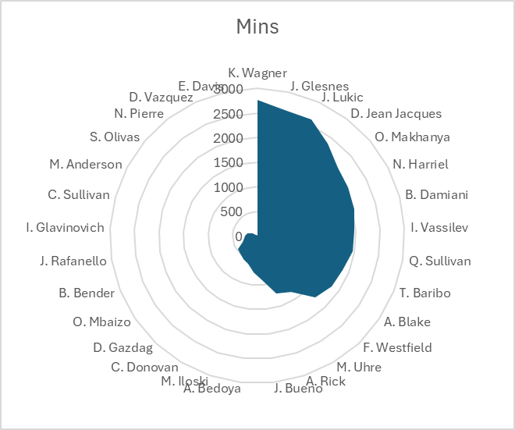
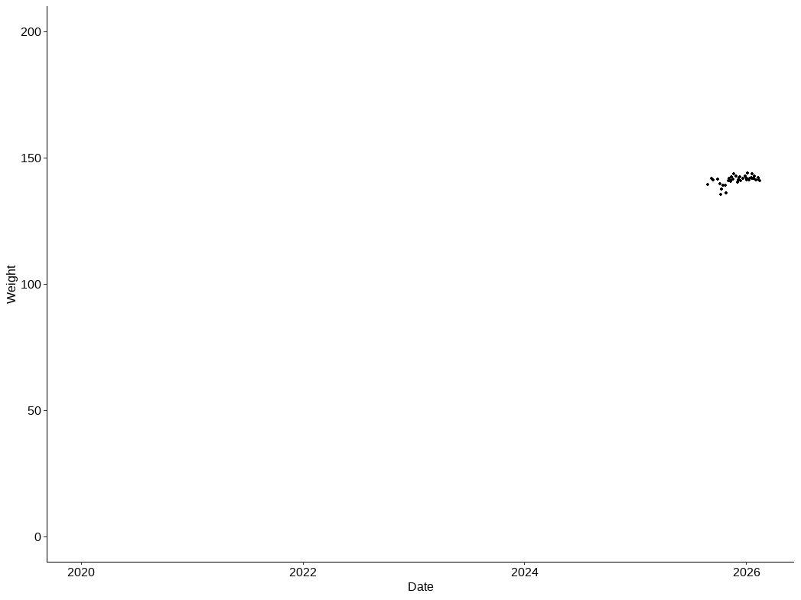
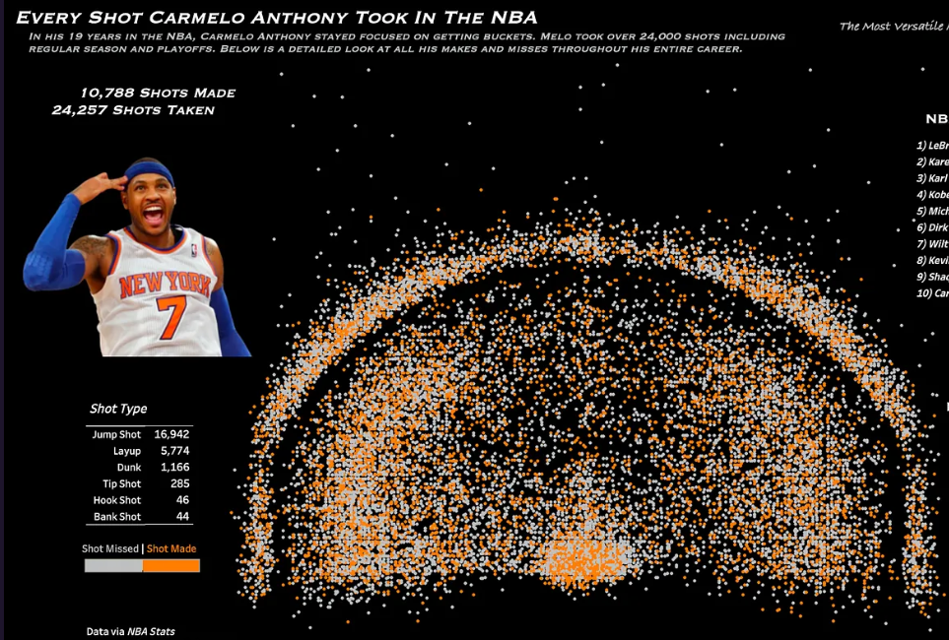
Bad choices

Slide 26
Visualizing distributions

Slide 27
Match the chart to your question
You would never do analysis before the question
Same ideas apply here
Research Question
Visualization Type
Visual Encoding Methods
Notes:
Chart types section → 10-15 slides (show the chart type + sports application for each)

Slide 28
What is a distribution?
A distribution describes:
  Where values are concentrated
  Variance of data
  Whether unusual values are present
  Where data point exists relative to others
  distribution requires multiple observations of the same variable.

Slide 29
How should we encode a distribution?
Position represents the measured value.
Height or area can represent frequency.
Color can distinguish groups.
Individual points can represent observations.
Reference lines can identify averages or thresholds.

Slide 30
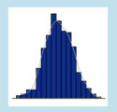

distribution
Histograms: Player height distribution, shot distance distribution
Box plots: Comparing stat distributions across positions or teams
Violin plots: Showing full distribution shape (sprint speeds by position)

Slide 31
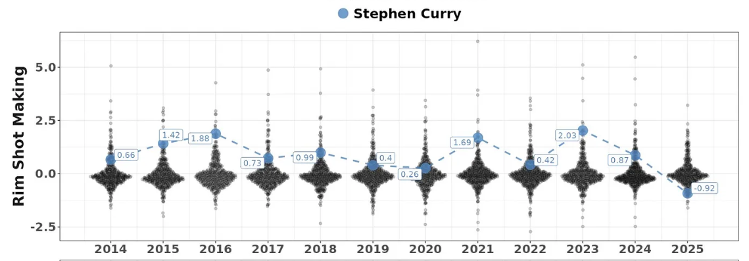
distribution
Violin plots: Showing full distribution shape

Slide 32
Summary & Looking Ahead
Next: Measures of center, spread, and distributions.

Slide 33
A distribution question
Which athlete is more consistent across repeated jump tests?
# A tibble: 4 × 27
hawkinID `2025-08-26` `2025-09-02` `2025-09-08` `2025-09-15` `2025-10-06` `2025-10-13` `2025-10-20` `2025-10-27`
<chr> <dbl> <dbl> <dbl> <dbl> <dbl> <dbl> <dbl> <dbl>
1 c3BJUw8svk… 22.3 20.9 20.4 21.8 21.5 19.8 21.5 20
2 Yo5NGQPILQ… 19.9 18.6 19.1 19.8 20.1 18.5 19.5 19.7
3 fElzfrCrDL… 19.6 18.9 19.7 20.1 18.8 20.4 20.1 19.1
4 zEXfMoEuCY… 17 NA 17.1 19.2 18.5 17.3 18.6 19.1
# ℹ 18 more variables: `2025-11-03` <dbl>, `2025-11-11` <dbl>, `2025-11-20` <dbl>, `2025-11-23` <dbl>,
# `2025-12-04` <dbl>, `2025-12-10` <dbl>, `2025-12-13` <dbl>, `2025-12-16` <dbl>, `2025-12-22` <dbl>,
# `2025-12-29` <dbl>, `2026-01-03` <dbl>, `2026-01-17` <dbl>, `2026-01-27` <dbl>, `2026-01-31` <dbl>,
# `2026-02-14` <dbl>, `2026-02-21` <dbl>, `2026-02-24` <dbl>, `2026-03-03` <dbl>
Who performed better?
Who was more consistent?

