Slide 1
Validity and Ethics in Sports Analytics
Saryu Onishi
HES 3000-002, Sport Performance Analytics
Notes:
Some people seem to have done some level of analysis already
Overwhelming, difficult to know what variable applies
Be careful about jumping to conclusions and/or doing analysis to confirm your view point

Slide 2
Quiz 3
Notes:
Difficulty finding data for question was most common
Overwhelming, difficult to know what variable applies
Some people seem to have done some level of analysis already
Be careful about jumping to conclusions and/or doing analysis to confirm your view point

Slide 3
Illusion of precision
Media framing implies that GPS vests, force plates, and optical tracking systems give us an infallible, objective window into an athlete's soul and body.
systems may produce numbers with multiple decimal places, but precision does not guarantee accuracy.

Slide 4
Messy data
Sport data are affected by:
  Device limitations
  Inconsistent procedures
  Human error
  Athlete behavior
  Environmental conditions
  Missing observations
  Changing definitions or technologies
Before analyzing performance, we must understand how the data were produced.

Slide 5
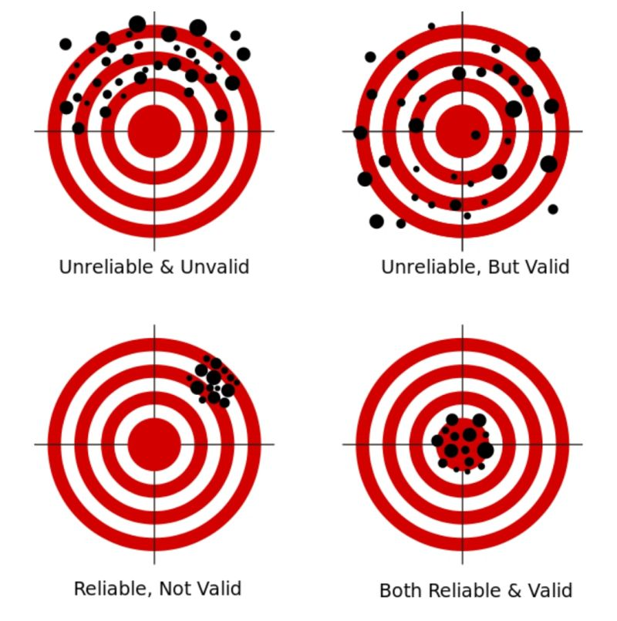
Trust in the measurement
Concept | Primary question
Reliability | Can the measurement be reproduced consistently?
Validity | Does the measurement represent what we intend to measure?

Slide 6
Can measurements be reproduced consistently?
A reliable measurement produces similar results when the underlying performance has not meaningfully changed
Potential sources of inconsistency include:
  Device measurement error
  Device-to-device differences
  Rater or analyst differences
  Inconsistent testing procedures
  Normal biological variation

Slide 7
Types of reliability
Test–retest reliability
  Does the same athlete produce similar results when the test is repeated under similar conditions?
Inter-device reliability
  Do two units of the same device produce similar measurements?
Interrater reliability
  Do different observers produce similar measurements?
Intrarater reliability
  Does the same observer produce similar measurements when repeating the process?

Slide 8
Example
An athlete completes the same jump test three times under similar conditions:
  Trial 1: 41.2 cm
  Trial 2: 41.0 cm
  Trial 3: 41.3 cm
The results appear highly reliable.
But that does not tell us whether the device is measuring jump height correctly.

Slide 9
Are we measuring what we intend to measure?
A valid measurement accurately represents the concept or outcome we want to study.
Examples:
  Does the device accurately measure distance traveled?
  Does “player load” represent overall physical stress?
  Does AVG represent offensive contribution?
Validity depends on both the technology and the claim being made.

Slide 10
Types of Validity
Criterion validity
  Does the measurement agree with an accepted reference method?
Construct validity
  Does the measurement behave as expected based on the underlying concept?
Ecological validity
  Does the measurement represent performance in the real sporting environment?
A laboratory test may be accurate under controlled conditions but less informative during competition.

Slide 11
Reliable but Not Valid
Imagine a bathroom scale that always reports weight 5 kg too high.
It gives consistent measurements → reliable
It does not give accurate measurements → not valid.
In sport, a metric may consistently measure something without measuring what coaches think it measures.
  Is this a problem?

Slide 12
What Does the Metric Actually Mean?
Consider “player load.”
A device may calculate player load consistently, but:
  Does it measure total physiological stress?
  Does it account for collisions?
  Does it capture psychological fatigue?
  Can values be compared across devices or manufacturers?
  Does the same value mean the same thing for every athlete?
The name of a metric can imply more than the measurement actually establishes.

Slide 13
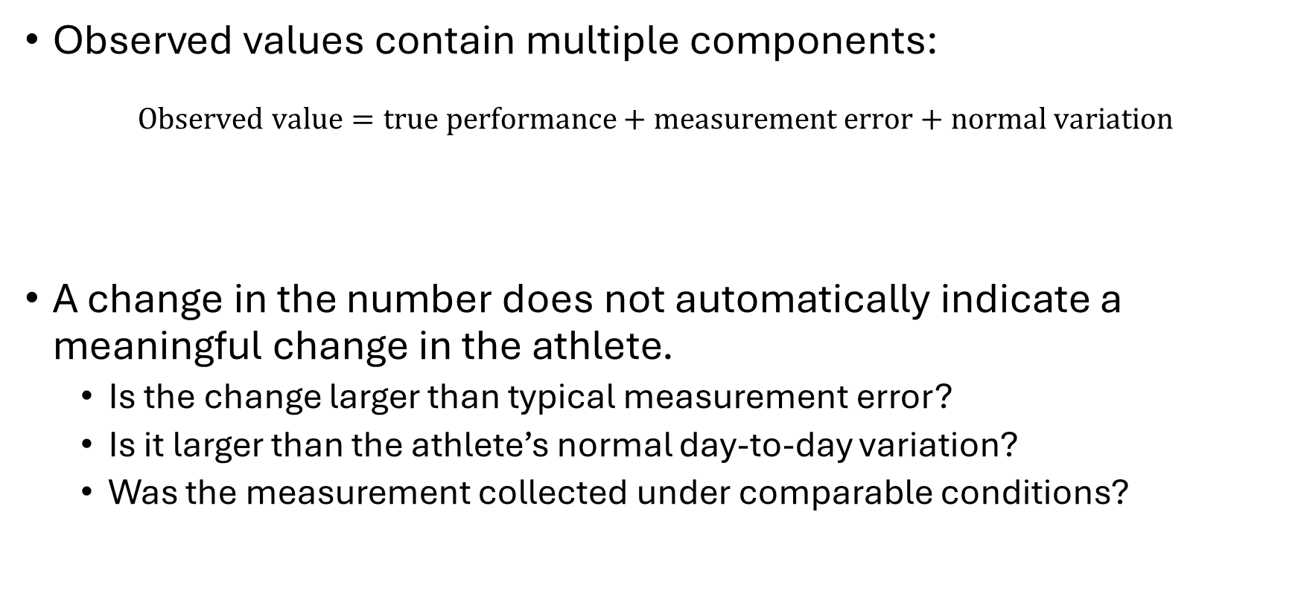
Measurement Error Is Not Athlete Change
Observed values contain multiple components:
$$\text{Observed value}=\text{true performance}+\text{measurement error}+\text{normal variation}$$
A change in the number does not automatically indicate a meaningful change in the athlete.
  Is the change larger than typical measurement error?
  Is it larger than the athlete’s normal day-to-day variation?
  Was the measurement collected under comparable conditions?

Slide 14
Sensor Audit
Think of a wearable or performance-monitoring device you have used. What is one factor that could produce misleading or unusable data?
Possible categories:
  Device placement
  Poor contact
  Environment
  Athlete behavior

Slide 15
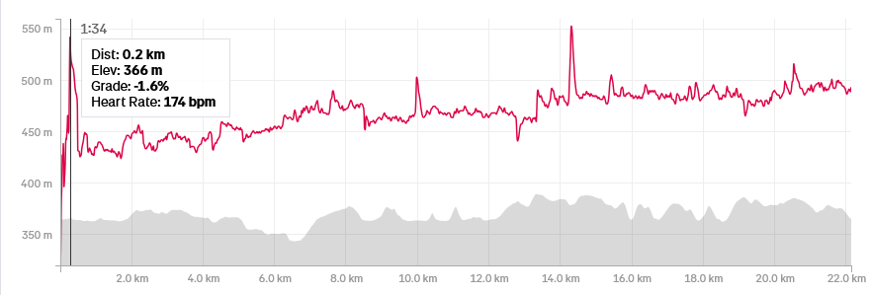
Sensor Audit Example
Poor contact or improper placement of a heart-rate chest strap can produce:
  Missing observations
  Sudden heart-rate spikes
  Delayed responses
  Data that appear real but are physiologically unlikely

Slide 16
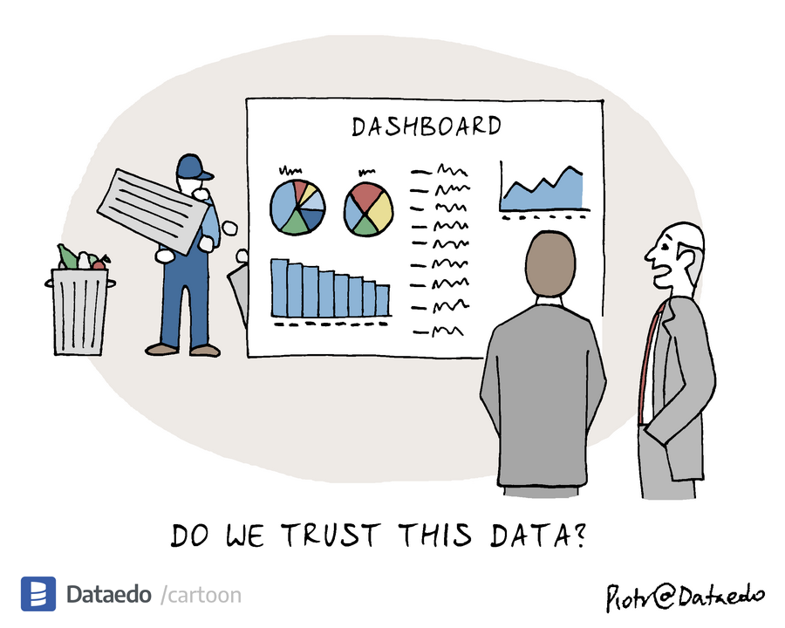
Garbage In, Garbage Out
Your analysis is only as good as your data source
Stats and models cannot fix flawed data
Notes:
There is a saying that originates from the world of computer sience , garbage in garbage out
Stats and models cannot fix flawed data
Your analysis is only as good as your data source
Example:
Wrong tagging, errors in device

Slide 17
Ethics in sports performance analytics
Athlete data may influence:
  Playing time
  Team selection
  Scholarships
  Contracts
  Injury management
  Return-to-play decisions
  How coaches perceive an athlete

Slide 18
consent and ownership
Athlete monitoring raises several questions:
  Do athletes understand what is being collected?
  Can they meaningfully refuse?
  Who owns the data?
  Who can access it?
  How long will it be stored?
  Can it be used for purposes beyond the original reason for collection?
  What happens when an athlete leaves the team?
Participation is not necessarily the same as informed consent.

Slide 19
weaponization of data
Data collected to support athletes can also be used against them.
  Using wellness responses to question commitment
  Using monitoring data during contract negotiations
  Punishing athletes for reporting fatigue or pain
  Sharing data outside its original purpose
If athletes believe honesty will be punished, they may stop providing honest data.
  This produces both an ethical failure and a data-quality failure.

Slide 20
The resource divide
Funding determines ability to collect data
  Tracking technology
  Staff and technical expertise
  Time for quality control
Better-resourced organizations do not simply have more data. They often have more opportunities to make the data usable.
How does this affect:
  The quality of analytics?
  Outcomes in each domain?

Slide 21
How Does the Resource Divide Affect Analytics?
Lower-resource programs may face:
  Smaller datasets
  Less complete dataset
  Less staff time for cleaning and interpretation
Domain | Possible consequence
Athlete monitoring | Less ability to individualize training or detect meaningful changes
Scouting | Greater reliance on visible athletes and traditional networks
Strategy | Less detailed opponent and game analysis

Slide 22
The invisible athlete
If you can't afford the metrics, do you officially cease to exist to modern recruiters?

Slide 23
Finding the invisible athlete
Simpler, not more complex metrics, can sometimes reveal the diamond in the rough

Slide 24
Protect your analysis from bad data
Start with the question
Before analyzing any dataset, ask yourself:
  Who collected this and why?
  What technology/method was used?
  Has this technology/method been validated?
  Has the methodology been consistent over time?
  What's NOT being measured?
Be aware of the data quality red flags

Slide 25
Summary & Looking Ahead
Next:

Slide 26
Ethics and Data Quality
Low-quality data
Less honest reporting
Low-quality analysis
Athlete distrust
Worse decisions

