Slide 1
Evolution of Sports Analytics
Saryu Onishi
HES 3000-002, Sport Performance Analytics

Slide 2
Exercise: The Box Score Blind Spot
 | Minutes | Points | Rebounds | Assists | FG | 3PT
Player A | 38 | 24 | 4 | 2 | 9/22 | 2/8
Pair & Share (5 mins): What is something a traditional box score completely hides that modern tracking might reveals?
What did the box score miss?
Shot quality and defensive pressure?
Physical workload and fatigue accumulation?
Spacing impact when off the ball?

Slide 3
The Paradigm Shift: Eye Test vs. Data
The Traditional Mindset:
Heavy reliance on expert intuition, scouting lore, and decades of visual confirmation.
The "gut feeling" approach to training and game planning.
The Modern Reality:
Data doesn't replace the eye test; it calibrates and enhances it.
Uncovering hidden patterns that human cognitive biases naturally filter out or miss.

Slide 4
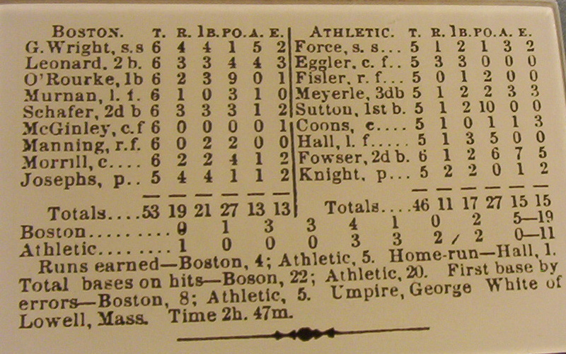
Analog Measurement and Analysis
1859: Henry Chadwick
Invented the modern box score by quantifying hits, runs, and errors
Foundational for systematics talent evaluation.
1950: Charles Reep
Manually recorded all passes and shots of 2500+ games across 45 years
Concluded that most goals came from three or fewer passes, leading to the "Long Ball" Gameplay Strategy (note: he was wrong)

Slide 5
The Traditional Era (Pre-1970s)
Characteristics:
Performance was evaluated through observation, memory, and counting
Heavily reliant on basic box scores (BA, PPG, completion percentages).
Anecdotal scouting reports and qualitative grading systems.
Limitations:
Box scores capture the what but entirely miss the how and why (i.e., context).
High susceptibility to confirmation bias and small-sample-size theater.

Slide 6
Pioneers of Sports Analytics
1950s: Paul Brown
First to use game film for scouting and opponent analysis. (amongst many other innovations)
Developed a system for evaluating college players that became the blueprint for the modern NFL Draft.
1977: Bill James
He coined the term "Sabermetrics" and published the Baseball Abstract.
Challenged conventional metrics that valued the wrong skills, working largely outside the establishment.
1984: Davey Johnson
used a computer to run simulations for gameplay strategy, optimizing lineups and understanding opponent tendencies

Slide 7
The Statistical Awakening (1970s–2000s)
Characteristics:
Independent pioneers digging beneath standard box scores to find true indicators of success (e.g., Bill James and Sabermetrics).
Shift toward efficiency ratings and adjusted metrics rather than raw counting stats.
The Moneyball Effect:
Popularized the framework of exploiting market inefficiencies.
Proved that analytical frameworks could compete with (and often beat) massive financial budgets.

Slide 8
Why was analytics still limited?
Data availability

Slide 9
Tracking and wearable technology
What are some examples of technologies that increased analytics in your sport?

Slide 10
Tracking and wearable technology
1978: Seppo Säynäjäkangas (Polar)
filed the first wireless heart rate monitor patent
marking the beginning of portable physiological monitoring in sports
2003: Gary Burrell & Min Kao (Garmin)
Brought GPS technology to the masses.
2003: Trackman
Began as a golf start up aimed at measuring ball ballistics
Opened a baseball division in 2008
2006: Catapult
Commercialized team oriented wearable GPS technology based on research by founders and Australian Institute of Sport (AIS)
Enabled coaches to track player distances and movement data across team

Slide 11
The Tracking & Wearables Revolution (2010s - )
Characteristics:
Proliferation of optical tracking cameras (SportVU, Hawk-Eye) and internal/external physical load monitors (GPS, Catapult, accelerometers).
Real-time tracking of spatial data, player velocity, and biomechanical stress.
The Shift:
Moving from macro-level game summaries to micro-level movement data.
Quantifying fatigue and workload before soft-tissue injuries manifest.

Slide 12
Three Pillars of Sport Performance Analytics
Scouting & Talent Evaluation
Objective profiling, tracking performance trajectories, and building predictive models for athlete recruitment.
Athlete Tracking (Physical & Spatial)
Monitoring external load (distance, acceleration) and internal load (heart rate, RPE) to manage training stress and prevent injuries.
Strategy & Tactical Optimization
Leveraging situational probabilities and spatial efficiency to guide play-calling, defensive alignment, and game plans.

Slide 13
Challenges & Cultural Friction
Cognitive Biases:
Overcoming the "hot hand" fallacy, outcome bias, and selective memory.
Signal vs. Noise:
Avoiding data overload. Not everything that can be measured matters, and not everything that matters can be easily measured.
The Human Element:
Analytics is only as powerful as its implementation on the ground.
Pushing past cultural resistance from traditional coaches, staff, and athletes.

Slide 14
Moneyball: The art of winning an unfair game
Revisiting Moneyball by Pardis Noorzad
What specific problem were the A’s trying to solve?
How did they use data to solve it?
How did analytics impact the scouting job?
How has baseball analytics changed since?

