Slide 1
KiCad
Introduction to Printed Circuit Board design
with KiCad 4.0
CoSin 2016
Gregor Riepl

Slide 2
About KiCad
PCB CAD Tool
Open Source (GPL 3)
Multiplatform (Windows, OSX, Linux, *BSD, …)
Started in 1992
Officially endorsed by CERN
Many professional features
Suitable for very simple and very complex projects

Slide 3
Overview
kicad
eeschema
cvpcb
pcbnew
gerbview
pcb calculator
part editor
footprint editor

Slide 4
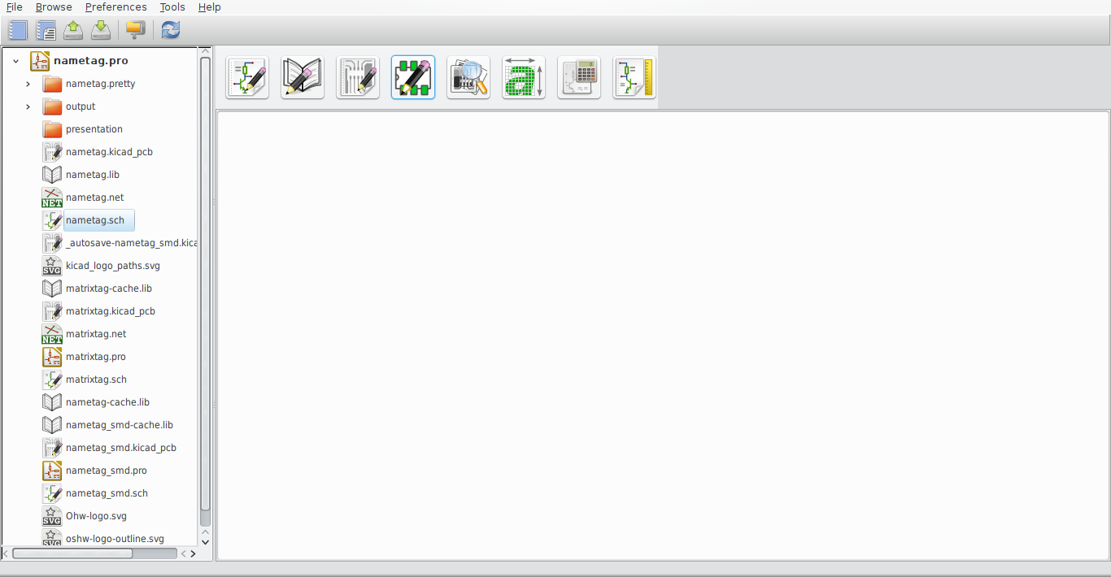
kicad

Slide 5
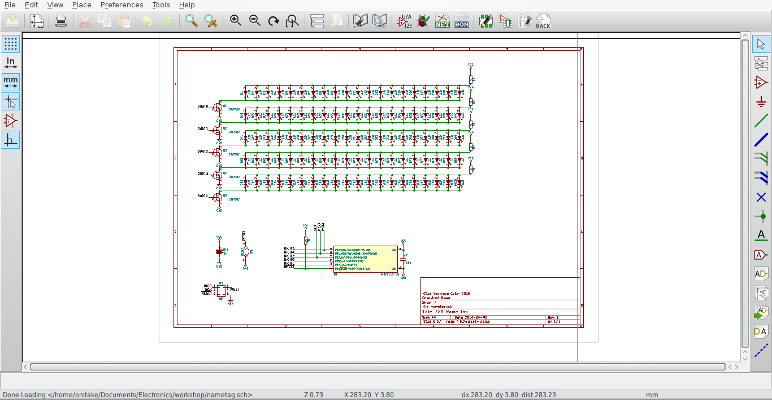
eeschema

Slide 6
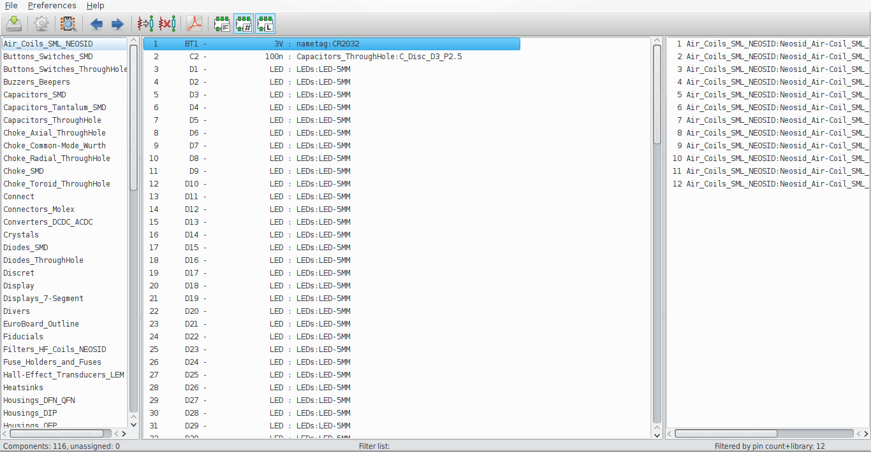
cvpcb

Slide 7
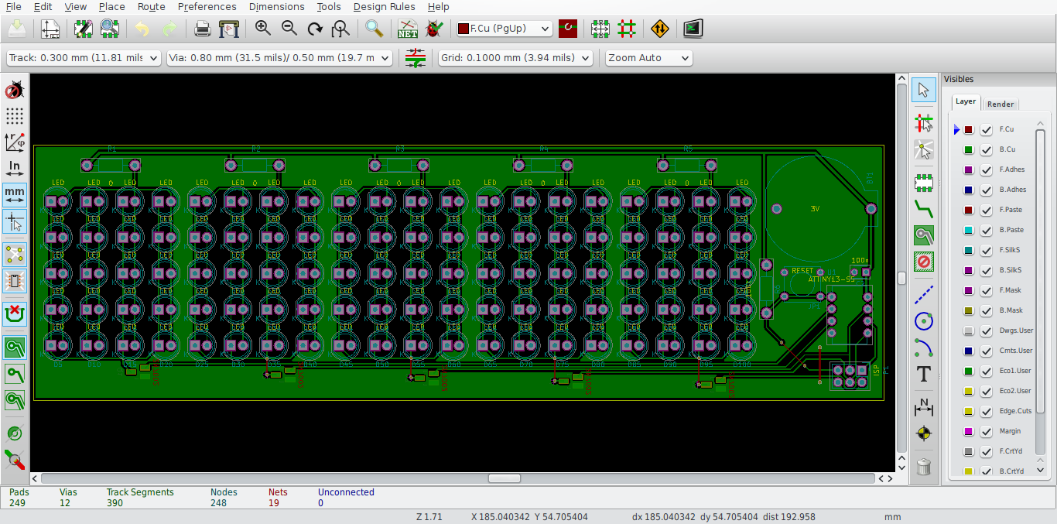
pcbnew

Slide 8
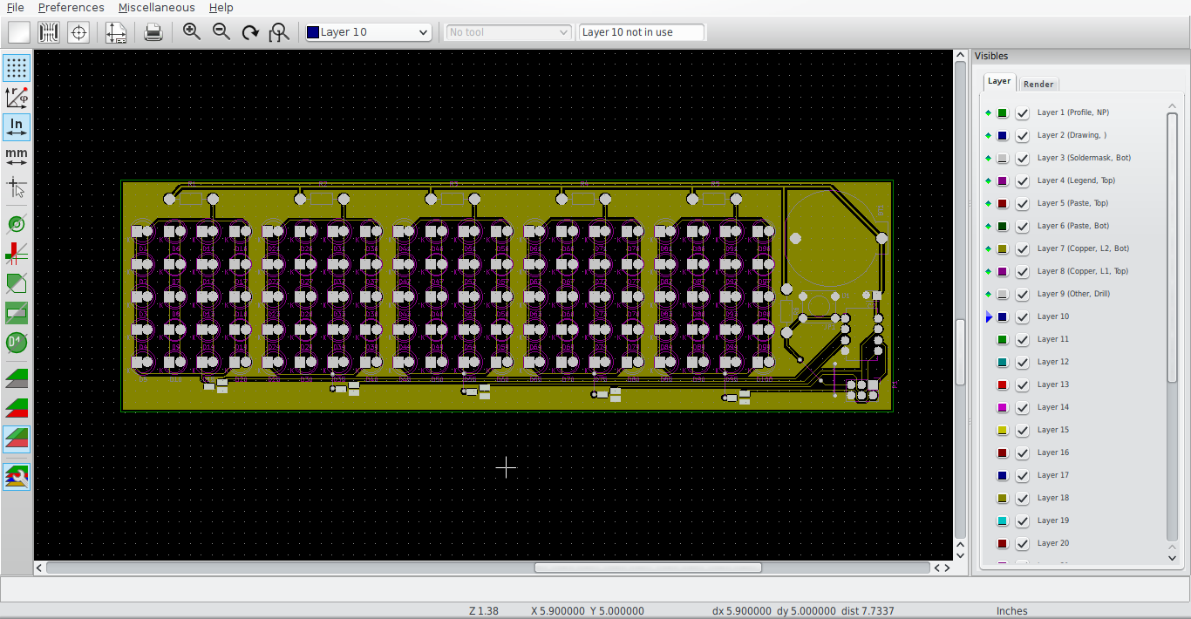
gerbview

Slide 9
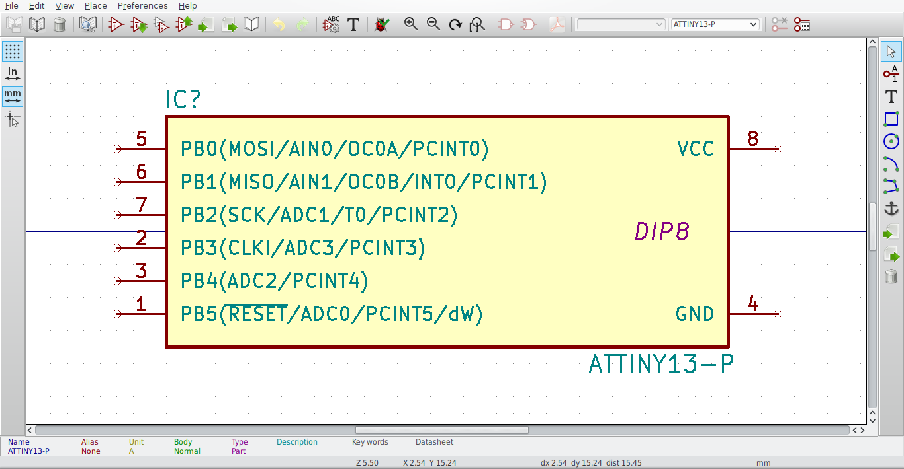
part editor

Slide 10
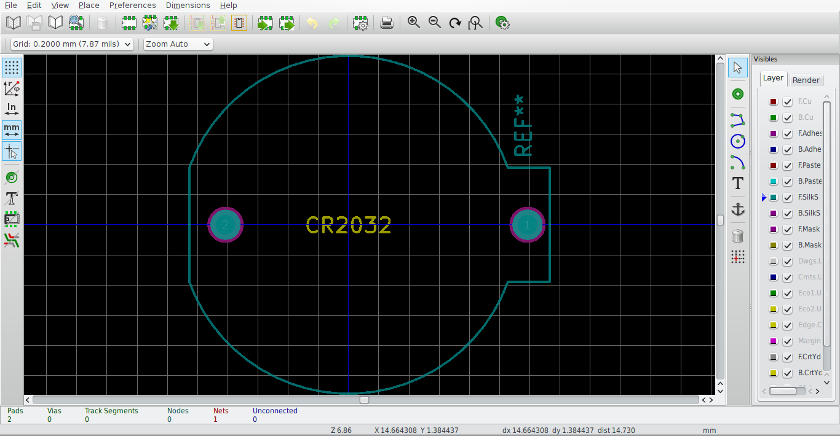
footprint editor

Slide 11
Workflow
Schema design
Footprint assignment
Netlist export / import
PCB design
Gerber / PDF export
Verification
Production

Slide 12
Schema design
Layout decision
Part sourcing
Part design / editing / library import
Part placement
Tracing / labeling
Fine tuning
Annotation
ERC

Slide 13
Parts
KiCad has a large part library
kicadlib.org has many more
Creating custom parts is easy

Slide 14
Netlists
netlists = interface between eeschema and pcbnew
Export after schema is complete
Then import into pcbnew
Backward annotation is not possible

Slide 15
PCB design
Design rules / Net classes
Layout decision / edge cuts
Part placement
Power / ground planes
Routing
DRC

Slide 16
Output
Use Gerber for CAM
Use PDF for DIY
Each layer is a separate file
Gerber layers can be checked in gerbview
PDF export best mirrored, better exposure (focus)

Slide 17
Questions?
Answers!

Slide 18
More
http://kicad-pcb.org
http://press.cern/press-releases/2011/07/cern-launches-open-hardware-initiative
http://www.kicadlib.org/
https://github.com/onitake/pcb-workshop

