Slide 1
HOTSPOT
Progress Report 1

Slide 2
Public services
Facebook Graph API
  Fetching data through official Facebook SDK library for python
  Returns “places” that are not even in Europe? → Ignore places that are not within area
  There are places that clearly have a Facebook page but they don’t show up?
  We do not get well distributed data → partly solved by cluster abstraction

Slide 3
Public services
Google Places API
  At the moment just used in a function that’s not integrated in the algorithm yet
  Fetching data through the googleplaces python library by slimkrazy
  Searching for individual locations found before over Facebook Graph API to get more data
  Usage of the library may change in the near future, as the query limit seems quite restricting

Slide 4
API Interface
Request: GET
Response: Geo-JSON, JSON
Functions
  “/api/hotspots/” → returns filtered hotspots sorted by score
    Request: “geo_lat”, “geo_long”, “filter”
    Response: Geo-JSON
  “/api/hotspot/” → returns detailed information about hotspot
    Request: “uuid”
    Response: JSON

Slide 5
Cluster Abstraction
Map divided into “Clusters”
Each cluster will updated its hotspots when
  the cluster is created
  a certain timespan has passed (e.g. 2 hours)
  a certain number of request has been made for this cluster (e.g. 2000)
Update thread triggered after request
Fetch “cached” clusters from database

Slide 6
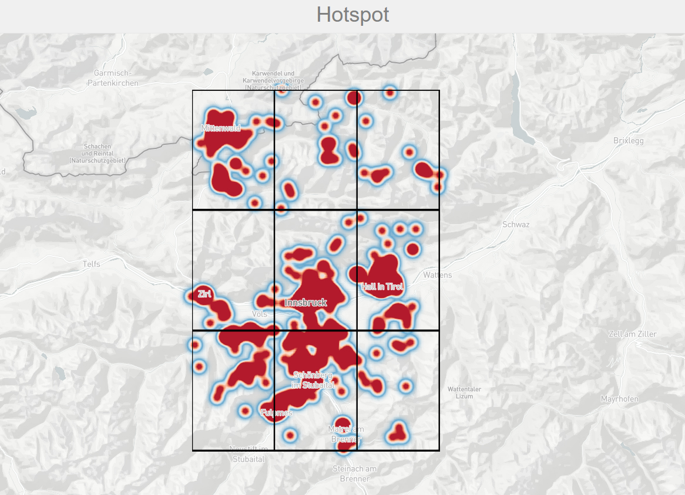
Clusters

Slide 7
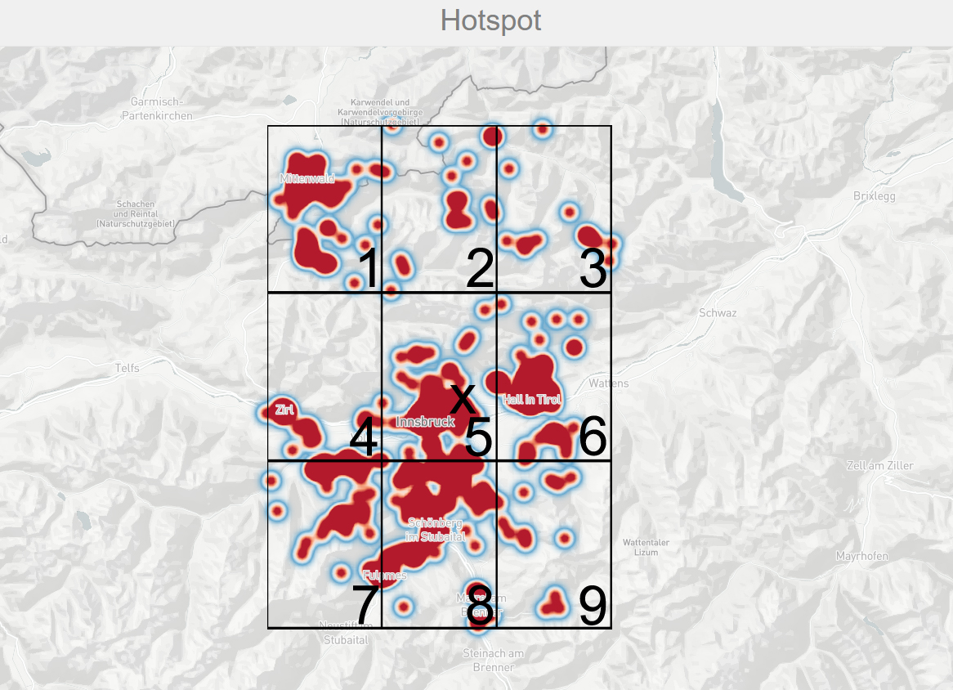
Clusters

Slide 8
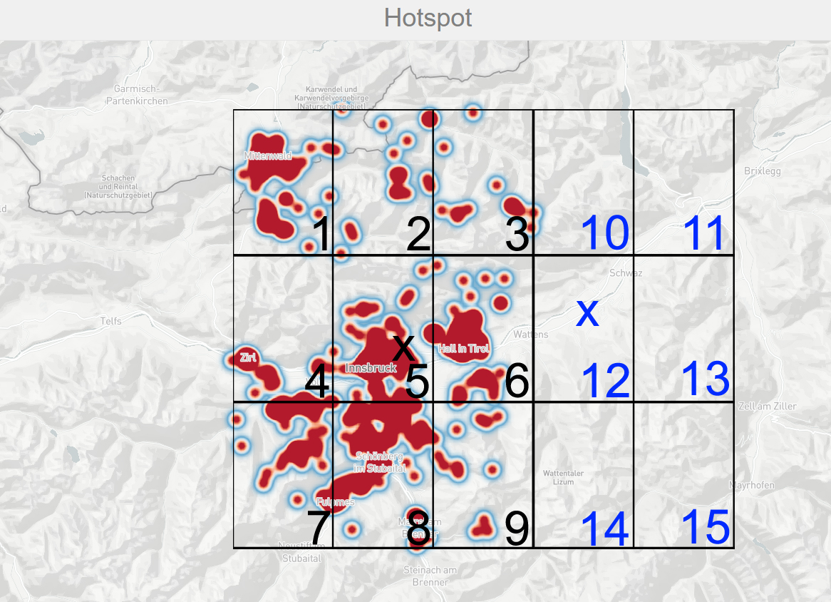
Clusters

Slide 9
first short live demo

Slide 10
thank you for your attention
Questions?

