Slide 1
HOTSPOT
Progress Report 2

Slide 2
Yelp Fusion API as second source
Yelp Fusion API
  Fetching data through an unofficial Python implementation of the Yelp API by gfairchild
  Completely independent fetches with the ability to set up new hotspots
  Simple matching prevents (or should prevent) the creation of duplicates
  Combined and normalized scoring system fully integrated and visualized

Slide 3
Yelp Fusion API as second source
Facebook
Yelp
Hotspot pool
1 merged total score and plausibility

Slide 4
Short Recap: Cluster Abstraction
Map divided into “Clusters”
Each cluster will updated its own hotspots
Update thread triggered after request → fixed number of worker threads, threads pull cluster update jobs from work queue

Slide 5
Cluster Abstraction
new API function called “hotspots area”
parameters:
  South East point of map view (lat, long)
  North West point of map view (lat, long)
  Filter → String containing multiple types of hotspots
get center cluster → find neighbor clusters for the map view

Slide 6
Cluster Abstraction
each cluster returns a list of hotspots
  The number of fetched hotspots depends on size of map view!
    Wide map → less hotspots per cluster
    Narrow map → many hotspots per cluster
  hotspots per cluster are sorted by score

Slide 7
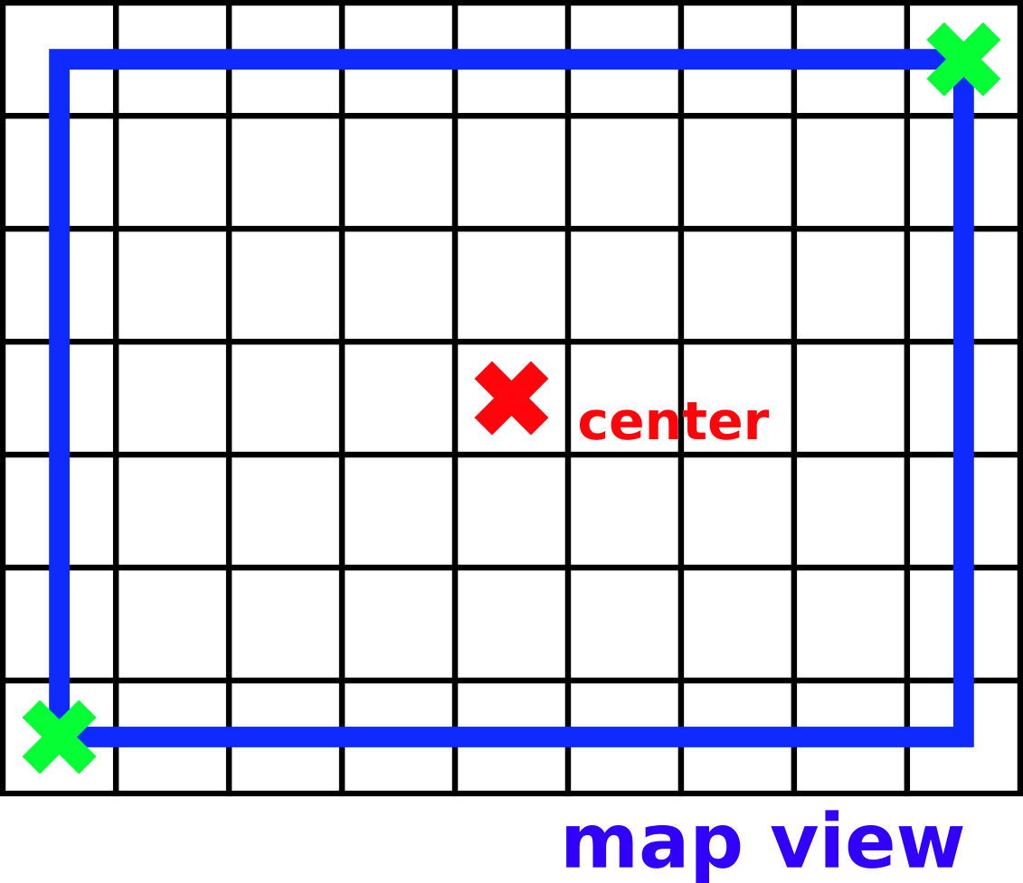
Cluster Abstraction

Slide 8
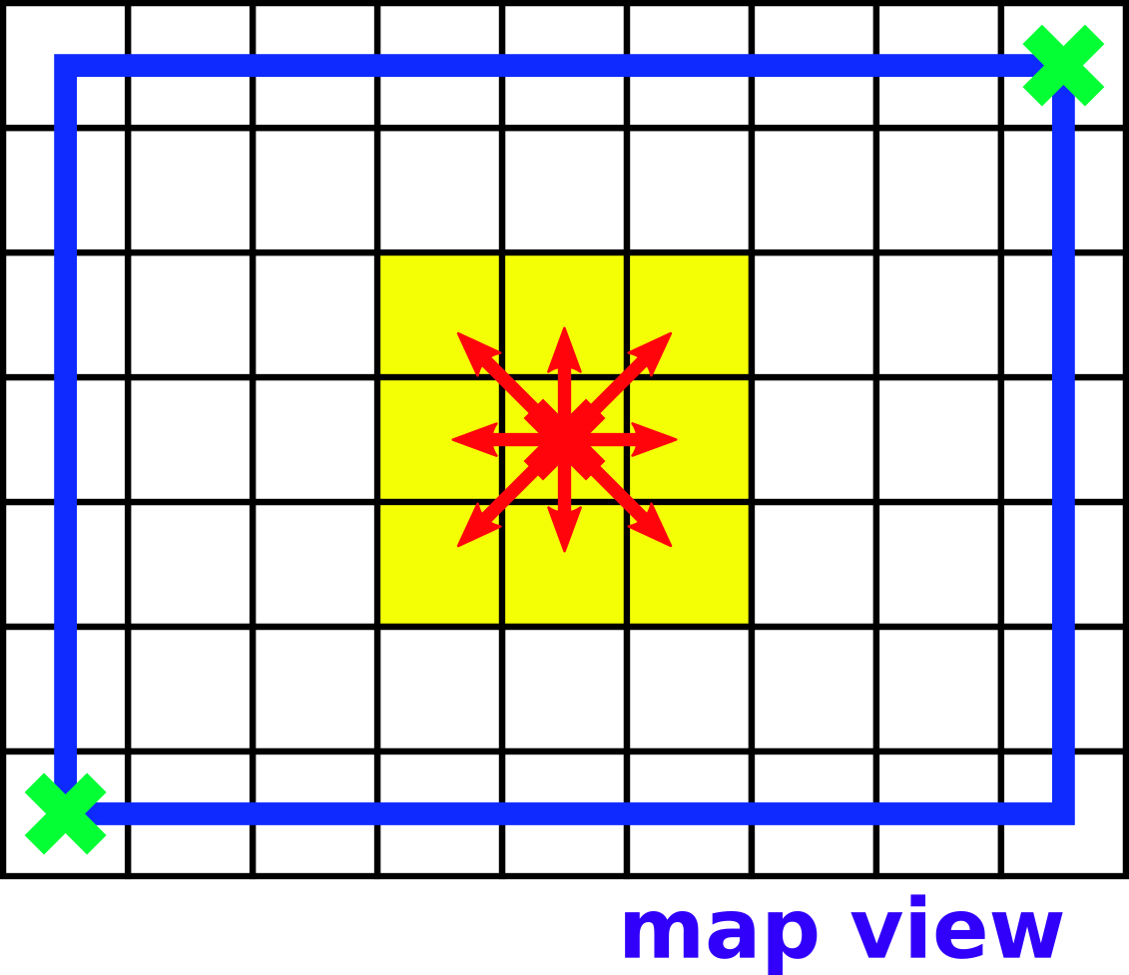
Cluster Abstraction

Slide 9
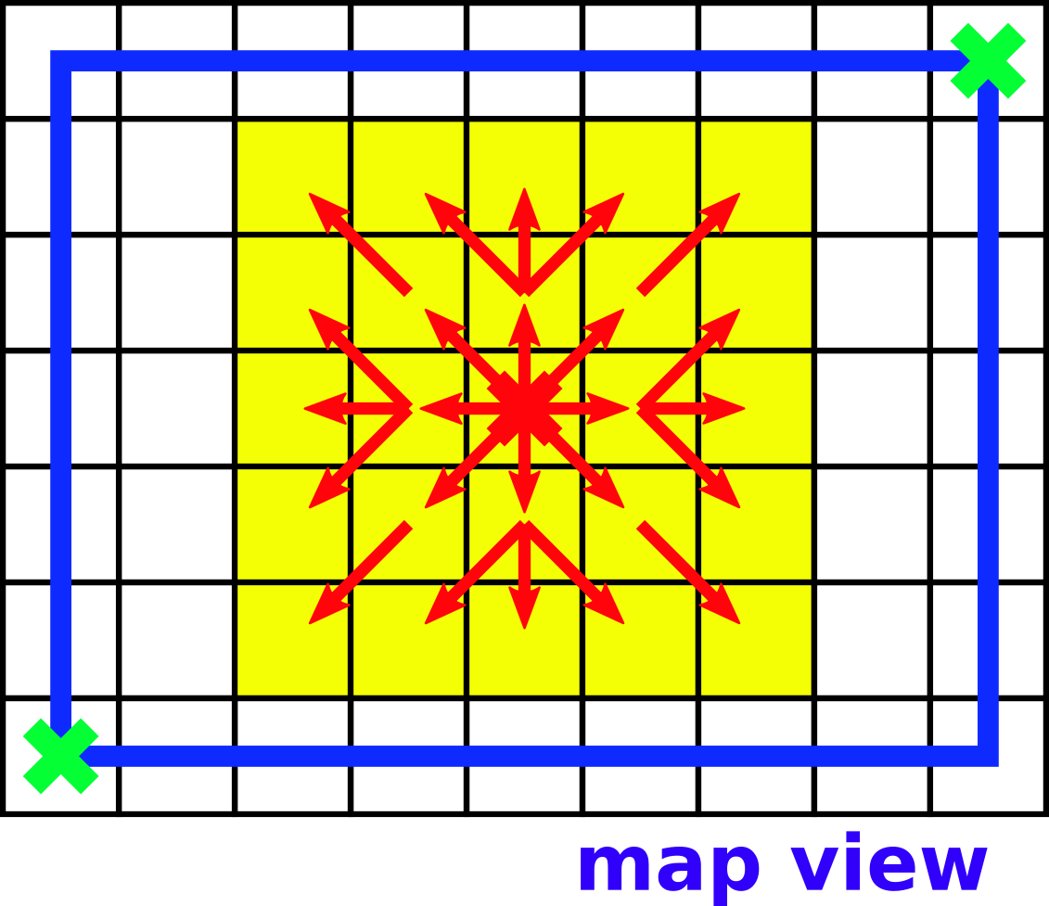
Cluster Abstraction

Slide 10
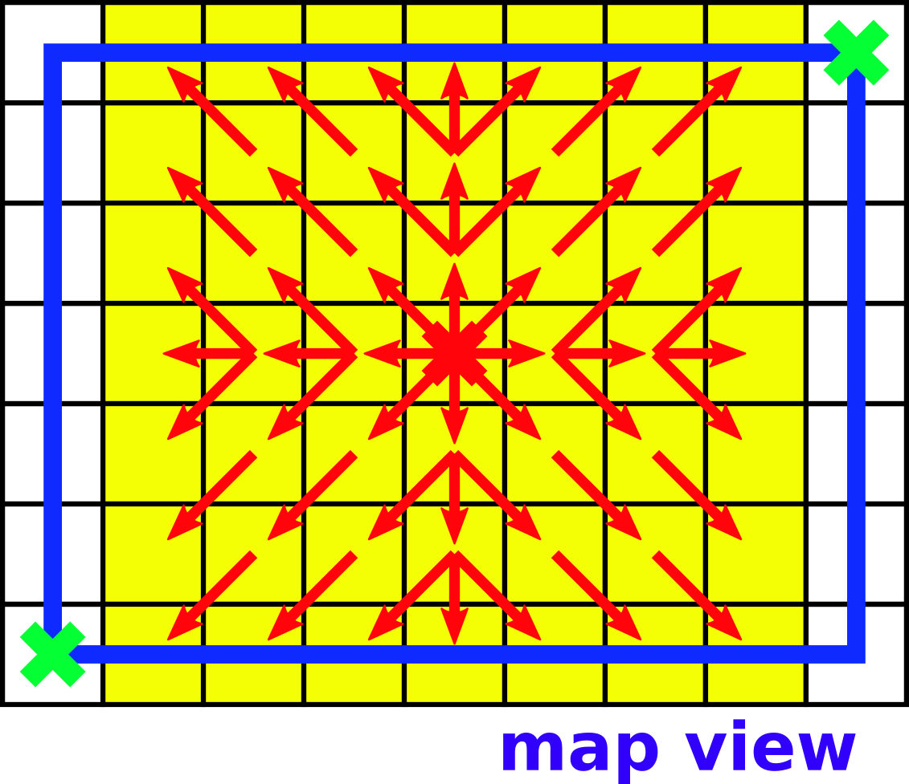
Cluster Abstraction

Slide 11
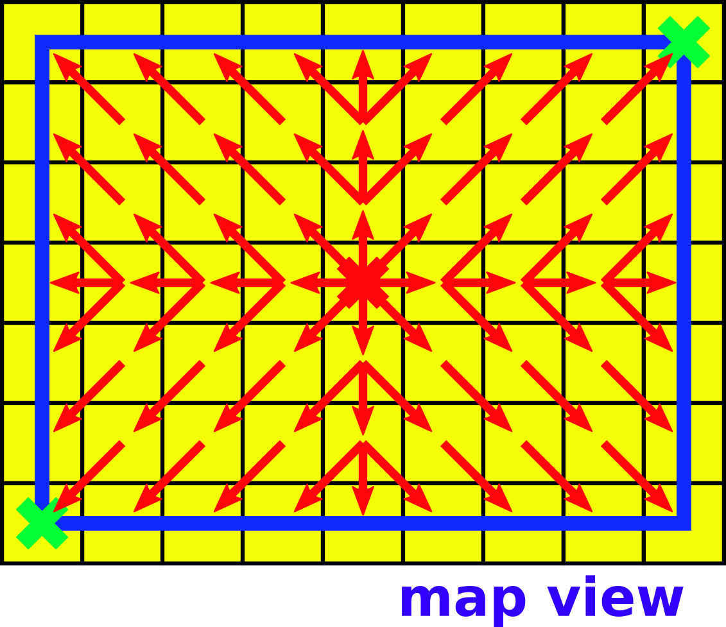
Cluster Abstraction

Slide 12
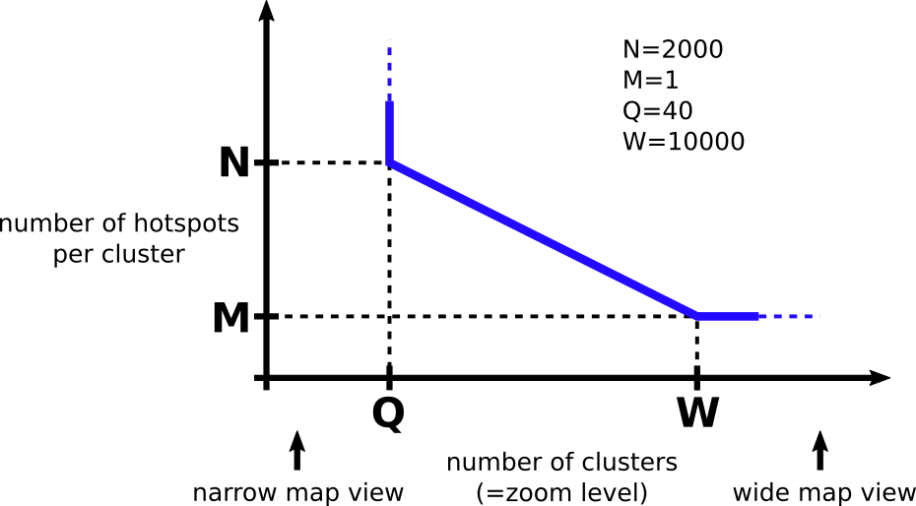
Cluster Abstraction

Slide 13
Cluster Abstraction
Server now updates clusters dynamically
  movement on the map is detected by server
  fetching new hotspots at any location all the time possible
  because of the strong limitation of other web services, we only consider Austria → ~2000 clusters

Slide 14
Ratelimit
API calls are limited
  1000 calls per hour
  “normal” users can move the map about 1000 times per hour before limitation hit them
Client can change update rate in JavaScript → limited number of requests per user to protect the performance of the service

Slide 15
Integrated Interface
Design Goals
  minimal
  clean
  professional
  coherent
Detailed explanation in live demo

Slide 16
How to access the application?
It’s a website, so you can access it …
  on a Windows PC using Chrome, Firefox or Edge
  on a Mac using Chrome, Firefox or Safari
  on a Linux PC using Chrome or Firefox
  on an Android tablet or mobile device using Chrome or Firefox
  on an iOS tablet or mobile device using Chrome, Firefox or Safari
  on a Windows 10 tablet or mobile device using Edge

Slide 17
short live demo

Slide 18
thank you for your attention
Questions?

