Slide 1
HOTSPOT
Alin Andersen, Simon Feuerstein, Daniel Gogl,
Daniel Proksch, Robert Schaffenrath

Slide 2
What is the purpose of HOTSPOT?
mainly intended for tourists, who already are in an unknown city
Tourists in general only have limited time to spend
Hotspot can help to find the most interesting locations to visit
those locations called Hotspots are presented in a clear, easy to interprete heatmap
Hotspots can be filtered by category (e.g. food, shopping)

Slide 3
Web Services?
Mapbox API
Facebook API
Yelp API

Slide 4
Final improvements
removed /changed some things
  dynamic fixed number of hotspots returned per cluster depending on zoom level
  improved formula for merging scores
  finalized and cleaned up the code
Implemented caching for better user experience
  Server side improvements for accessing hotspots
  Client side caching improves smoother transitions

Slide 5
Production server
Web service is currently running on a real production server → hosted by contabo
Nginx + Gunicorn, Ubuntu
  receives HTTP requests, which are then forwarded through an unix socket to Gunicorn
  Gunicorn runs the python virtual enviroment with the Django Web-Framework
MariaDB (MySQL) for persistent data storage
  Django is communicating with MariaDB over TCP
HTTPS certificate → lets encrypt (https://letsencrypt.org/)

Slide 6
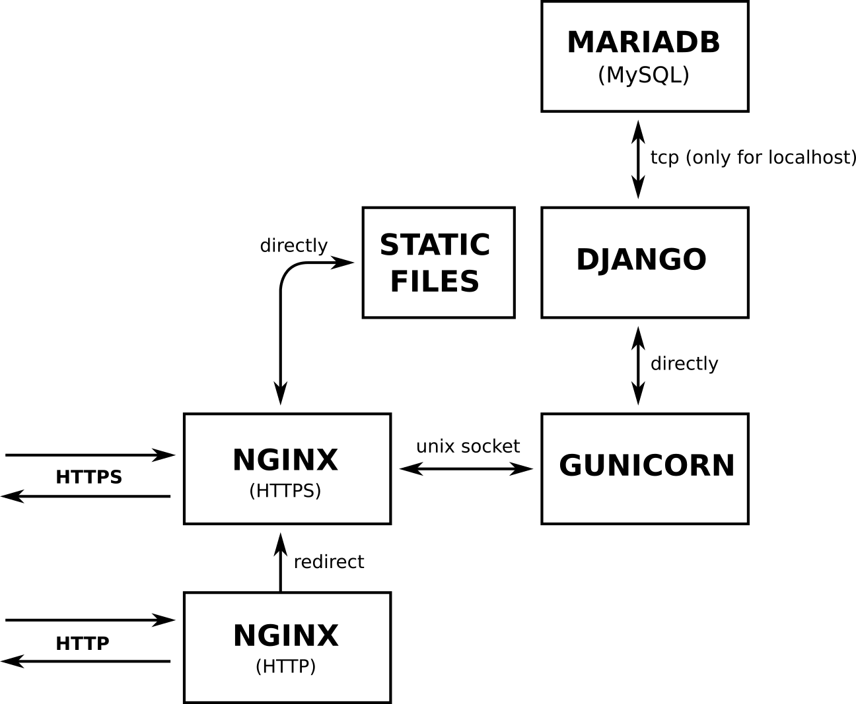
Production server

Slide 7
Live demo
(live demo)

Slide 8
END
THANK YOU FOR
YOUR ATTENTION!
Check out our project:
https://alin.space
https://gitlab.com/onixion/hotspot.git

