Slide 1
HOTSPOT

Slide 2
team rocket
Alin PoRcic
Daniel GOgl
Robert SChaffenrath
Daniel ProKsch
Simon Elias FeuersTein

Slide 3
the problem
Many tourists visit cities for a short time only
Due to the sheer amount of possible points of interest, time management can become a hard problem
They want to find locations in the city that offer a high number of points of interest, shops and restaurants
How can tourists find the most interesting places?

Slide 4
our solution
Provide a “heatmap” overlay visualizing the most interesting areas of the city
The overlay is generated from so-called “hotspots” including restaurants, shops, bars and other points of interest
The locations are weighted by factors from multiple sources
Depending on the zoom the user either can evaluate the aggregated value of interest or specific hotspots to visit

Slide 5
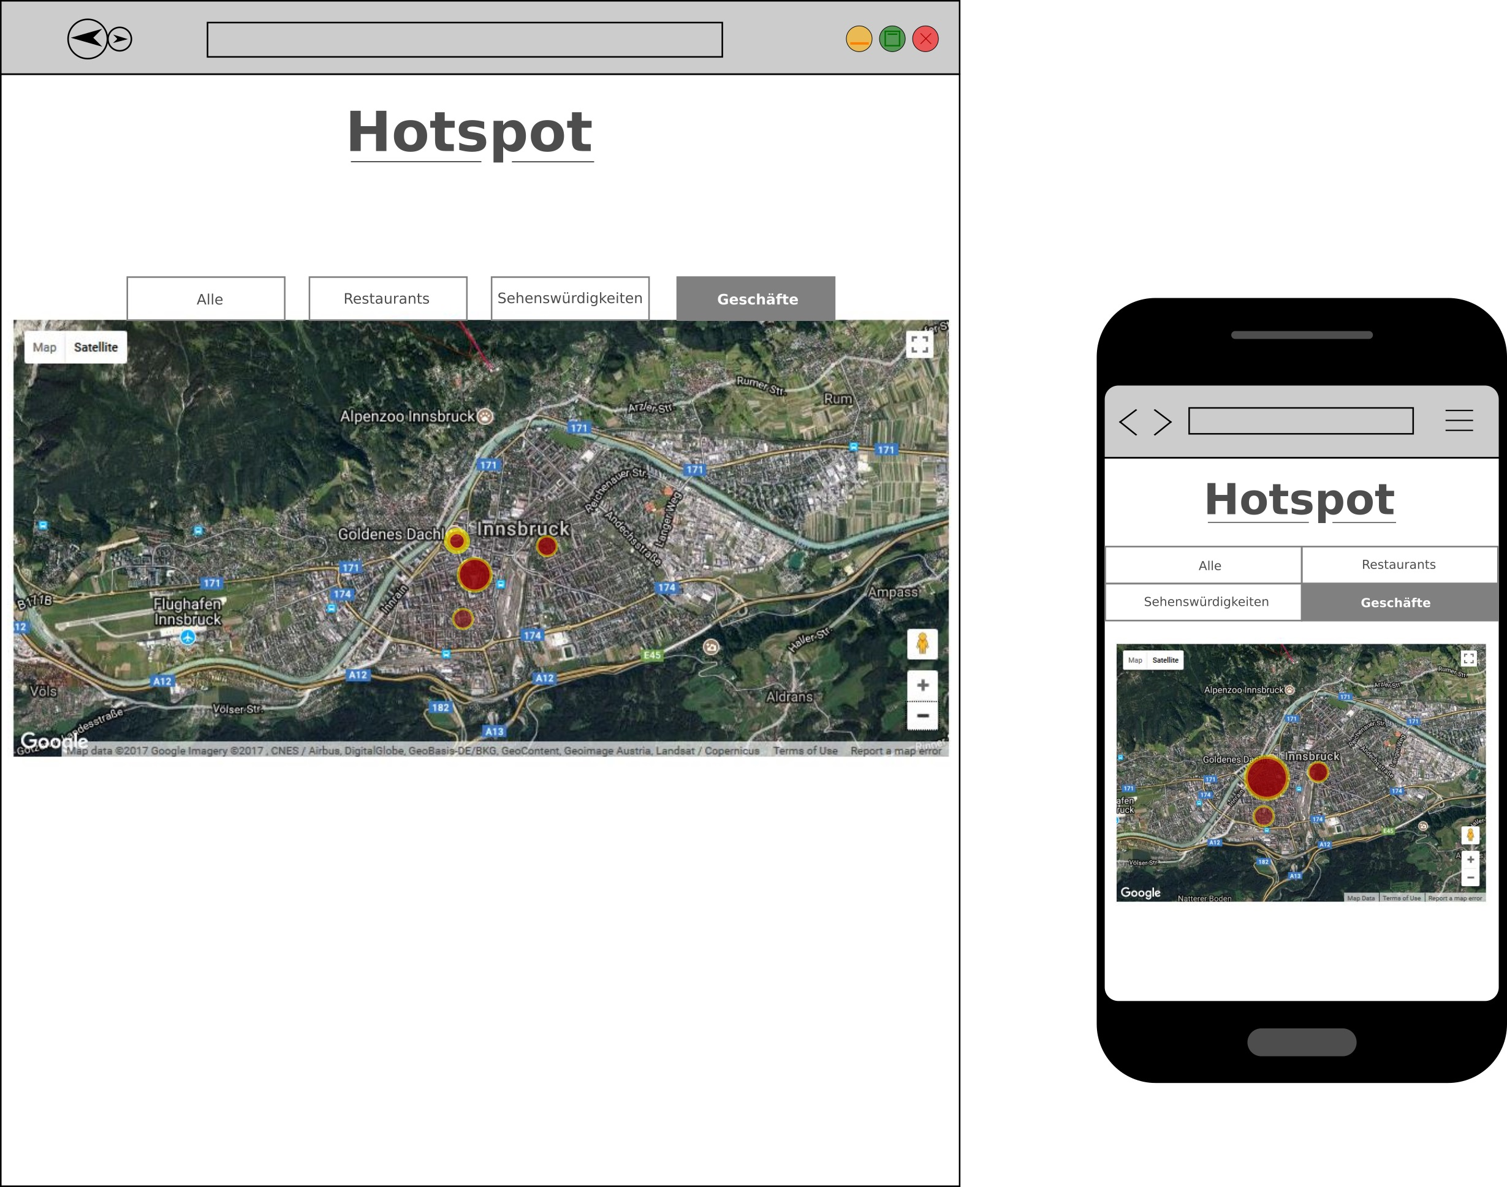
concept

Slide 6
technologies
Python 3
Django Web-Framework [https://www.djangoproject.com/]
Django Rest-Framework [http://www.django-rest-framework.org/]
Bower
Apache
MySQL
HTML/CSS3, JavaScript
jQuery
Bootstrap

Slide 7
web service APIs
Google Maps API
TripAdvisor API
Google Analytics API
IP API
Maybe more...

Slide 8
thank you for your attention
Questions?

