Slide 1
Mist
What it is and how it works

Slide 2
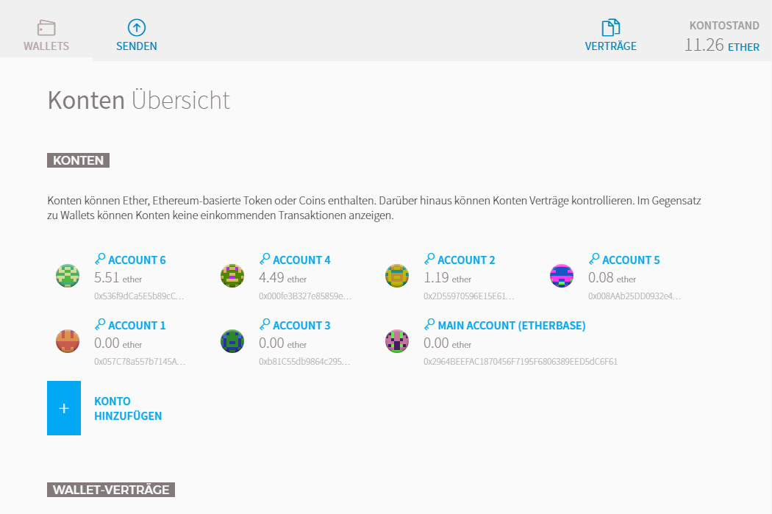
A Wallet
Manage Accounts
Send/Receive Ether
Deploy Contracts
Use Contracts

Slide 3
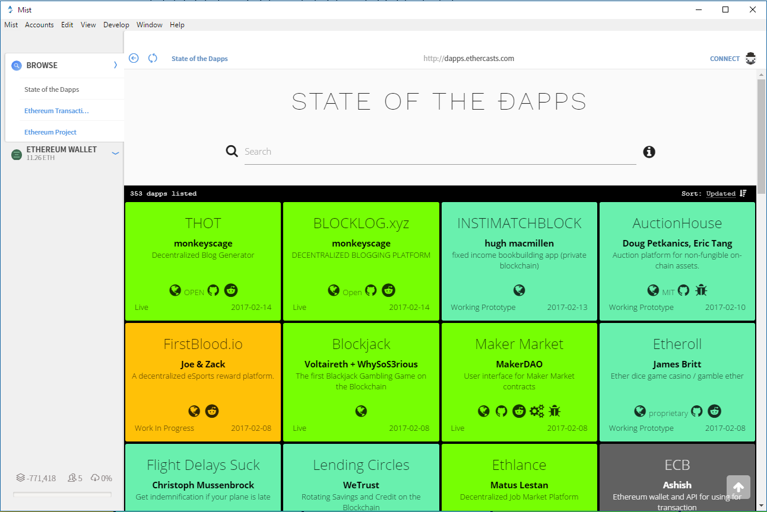
A Browser
Use „Web“-Dapps
Have a geth node running
Securely use one account to „browse“ a Dapp

Slide 4
Lets look at it together
Hands on!

