Slide 1
Hands-on Coding
Implement a Multi-Signature Wallet from Scratch

Slide 2
What it is?
A Multi-Signature-Wallet requires more than one address to confirm an operation
Example: I want to transfer 1000 ether from the wallet to an address.
I start the operation
I ask someone else to confirm the operation
N-People have to confirm the operation

Slide 3
Example
https://github.com/ethereum/dapp-bin/blob/master/wallet/wallet.sol
Gav Wood wrote a great example
Multi-Owned
Multi-Signature
With Daily Limit
Now available as a standard Wallet-Contract from Mist

Slide 4
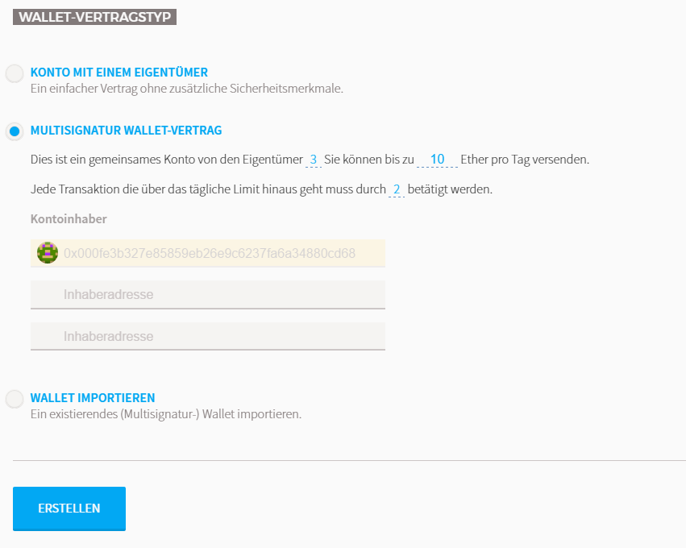
Multi-Signature Wallet in MIST

Slide 5
What we are writing
A Wallet
With many owners
And at least floor(num_owners)/2 confirmations
We are going to have a Frontend
Lists your own latest transactions
Lists the confirmations you have to give (and you can click a button to confirm)
You can request a new transaction (with a reason)

Slide 6
Truffle
http://truffleframework.com/
„Truffle is the most popular development framework for Ethereum with a mission to make your life a whole lot easier. “
Built-in smart contract compilation, linking, deployment and binary management.
Automated contract testing for rapid develpoment.
Scriptable deployment & migrations framework.
Network management for deploying to both public & private networks.
And many more

Slide 7
So, what?
If you know the Node Package Manager, Yeoman, Grunt, Gulp, etc. Then you know how to use truffle
Npm install [–g] truffle
Truffle init
Truffle compile
Truffle migrate
Puts the contract on the chain

Slide 8
Test RPC
https://github.com/ethereumjs/testrpc
testrpc is a Node.js based Ethereum client for testing and development.
Much faster
You know it from the previous lecture

Slide 9
WebPack and Bootstrap
https://webpack.js.org/
webpack is a module bundler for modern JavaScript applications.
We will use it for our frontend
„Truffle init webpack“ initializes a standard-webpack project pre-configured with truffle

Slide 10
Debugging and Testing?
Is not as hard as before anymore
Ethereum Studio has a built in Debugger
Step-By-Step Debugging
Scenarios

Slide 11
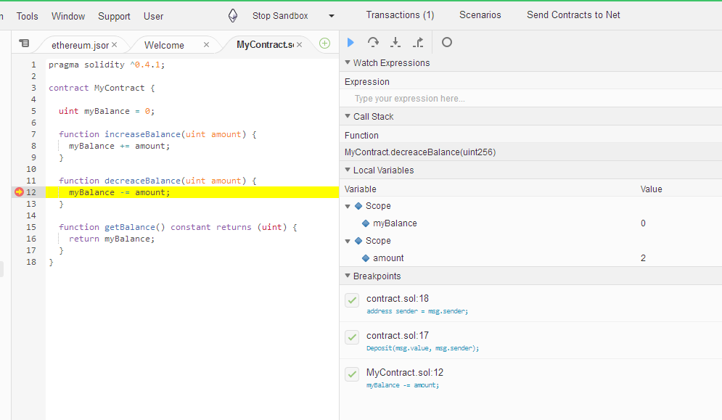
Debugging with Ethereum Studio (Ether.Camp)

Slide 12
Testing?
Truffle internal tests
„truffle test“
Fast with Ethereumjs-testrpc
„Scenarios“ with Ethereum Studio
https://github.com/ether-camp/ethereum-testing-reference
Ether.Camp testing reference

Slide 13
Let‘s start
GOGOGO!

