Slide 1
Project Presentation: Portable Piano with Enhanced Features
Team15:
Lingyu Qi 520370910124
Haoyun Zhou 520370910128
Marco Souza 520370910011

Slide 2
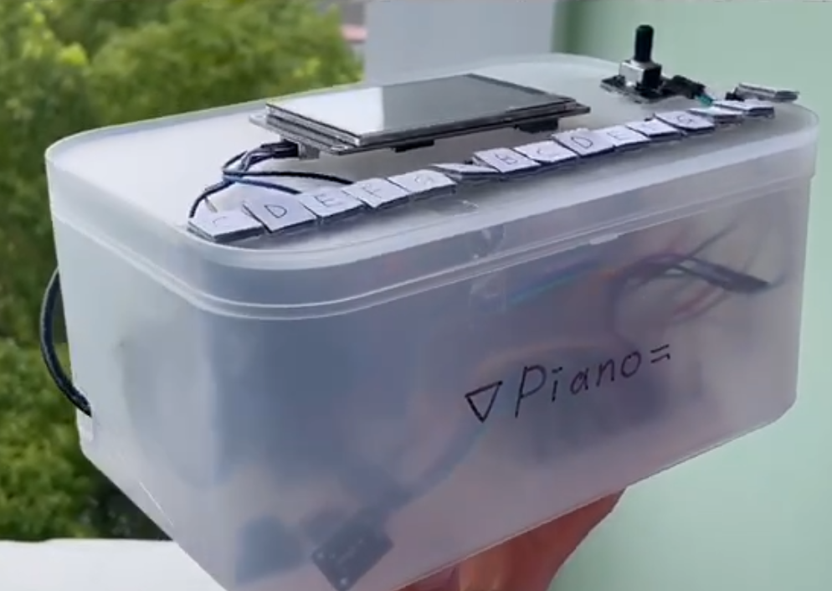
Functions
Small in size and portable
Produces sound using buzzers
Pitch adjustment knob to adjust the overall pitch
Facilitates singing practice
Touching buttons as hitting keys
A screen providing valuable feedback to the user

Slide 3
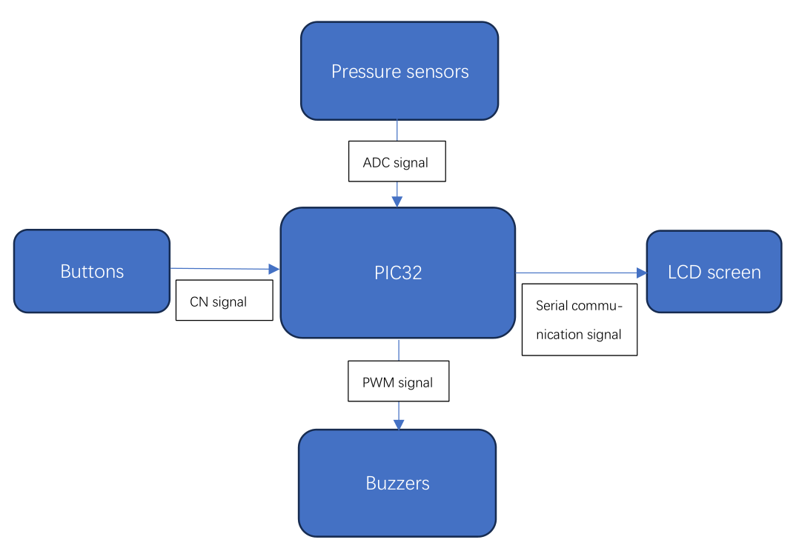
Functional Block Diagram
Buttons
Digital signal
Knob
ADC

Slide 4
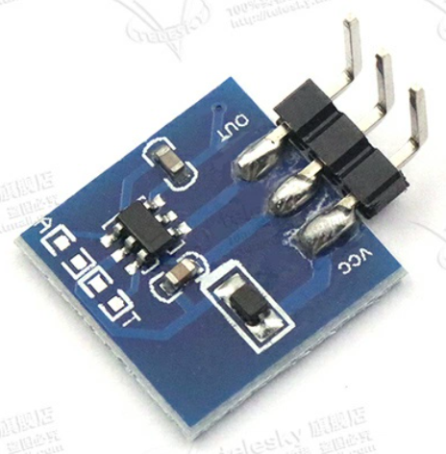
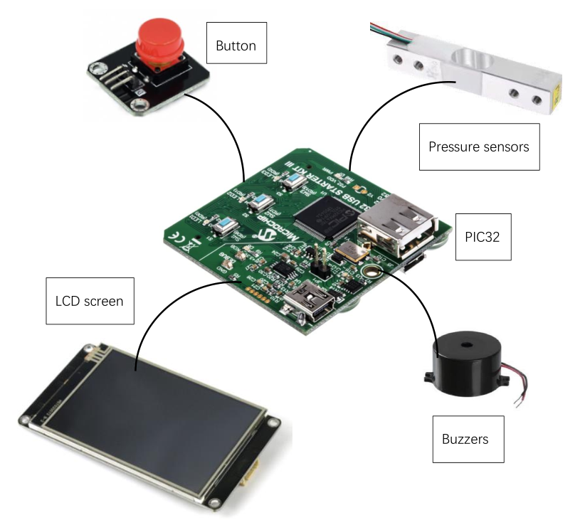
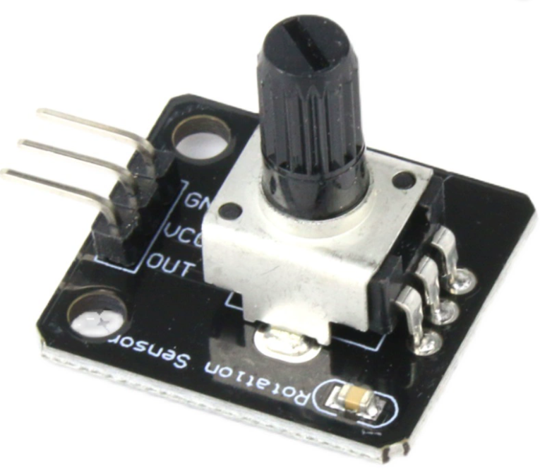
Components Level Diagram
Knob
Buttons

Slide 5
Thank you!

