Slide 1
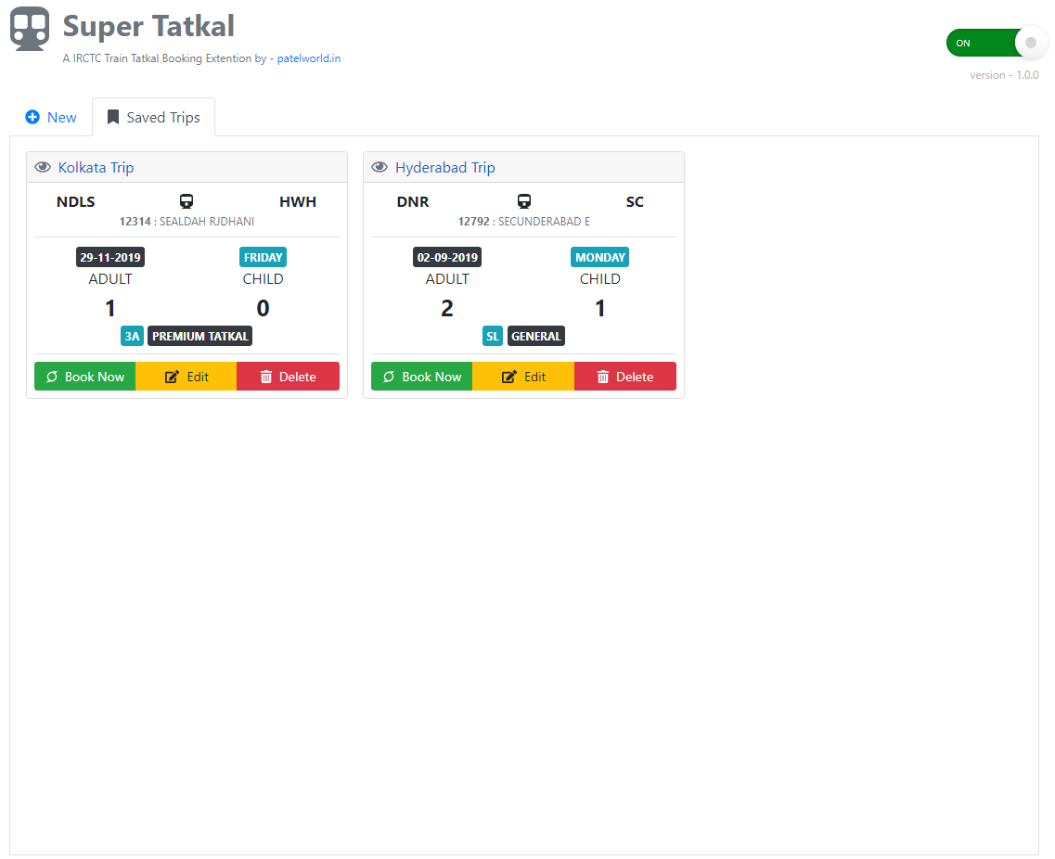
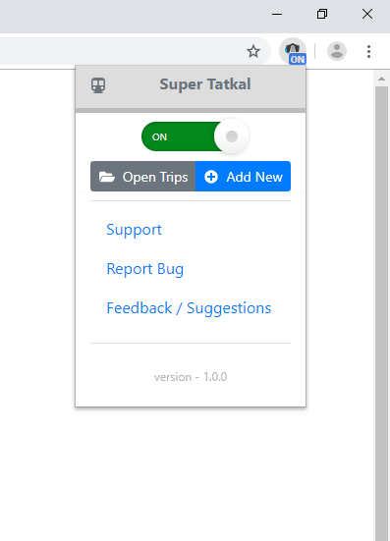
These buttons works
when Extension mode is
ON
Feel free to contact
Open Old Trip / Add New Trip

