Slide 1
Deep Learning-ResNext_Cifar10 dataset
By
Gnaneeshwar
Manikandan M
Onkar Ankelope
Venkat Raghavan
Rajkumar N

Slide 2
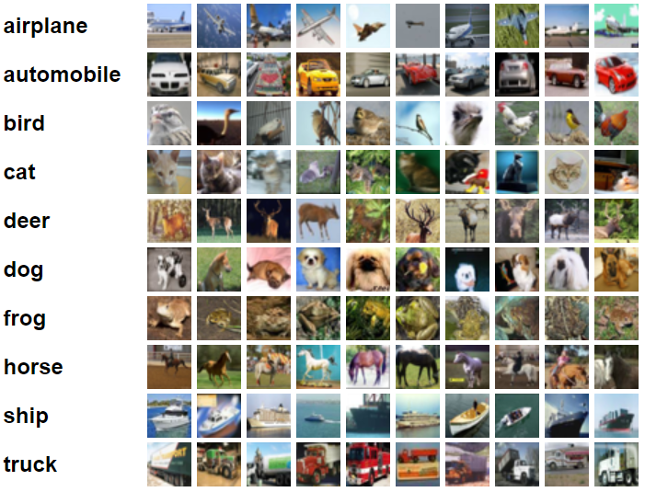
Cifar10 Description Dataset
The image has 10 classes
Each classes have 6000 images
Image size – 32 x 32
There are 50000 train images and 10000 test images

Slide 3
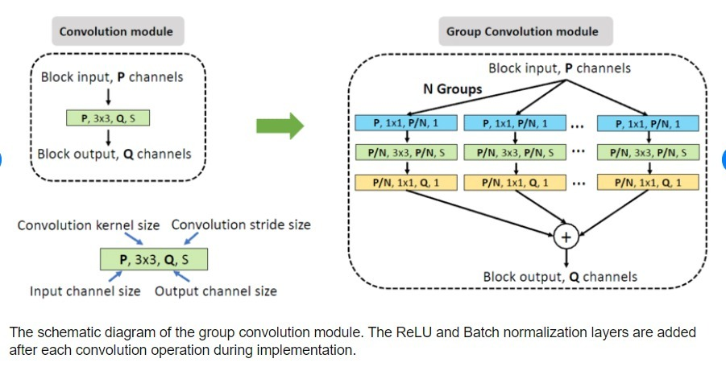
Group Convolution

Slide 4
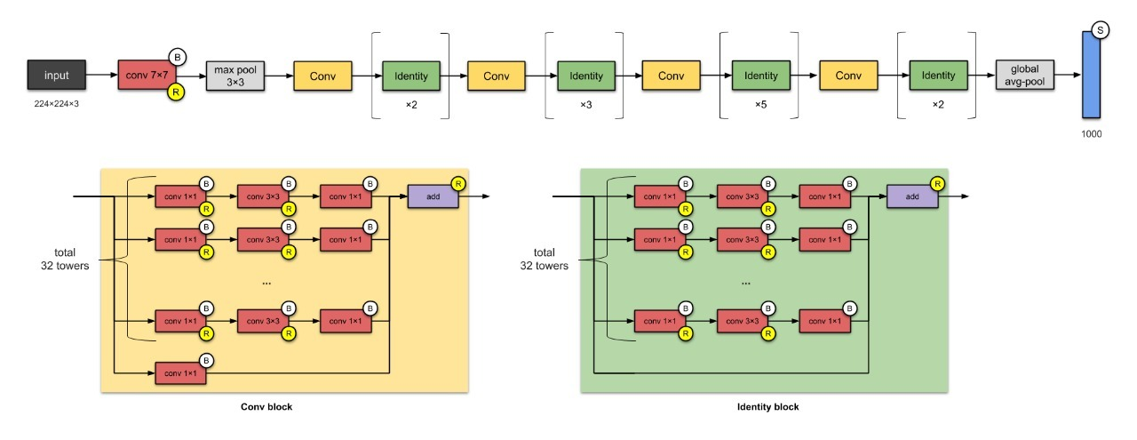
Group Convolution

Slide 5
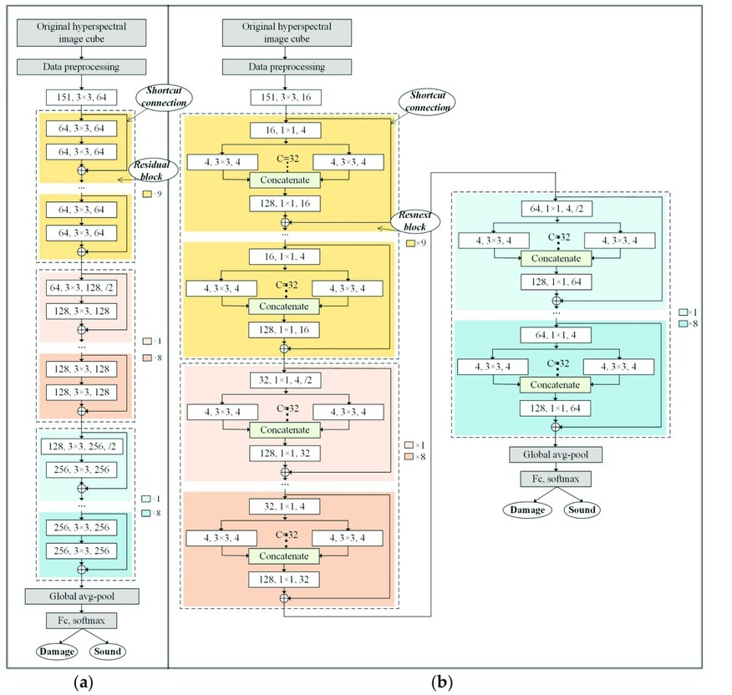
(a)Resnet Architecture
(b)ResNeXt Architecture

Slide 6
Data Loaders
trainset = torchvision.datasets.CIFAR10(root='./data', train=True, download=True, transform=transform_train)
trainloader = torch.utils.data.DataLoader(trainset, batch_size=128, shuffle=True, num_workers=2)
testset = torchvision.datasets.CIFAR10(root='./data', train=False, download=True, transform=transform_test)
testloader = torch.utils.data.DataLoader(testset, batch_size=100, shuffle=False, num_workers=2)

Slide 7
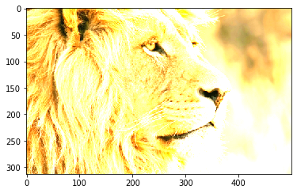
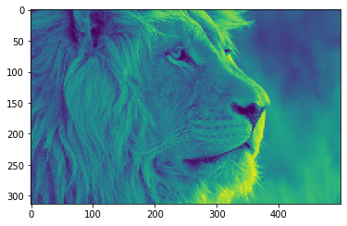
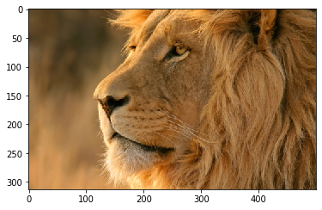
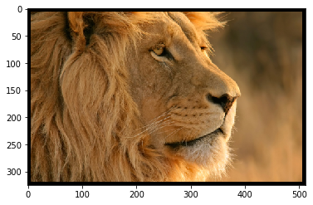
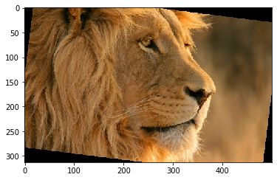
Applying different Data Augmentation techniques

Slide 8
Model Details
Cardinality-2,Bottleneck width-64
Parametes-9,128,778
Loss-Cross Entropy Loss
Checkpoint path size -35MB
Training Batch size -128
Test Batch size-100

Slide 9
Baseline models and their accuracy charts

Slide 10
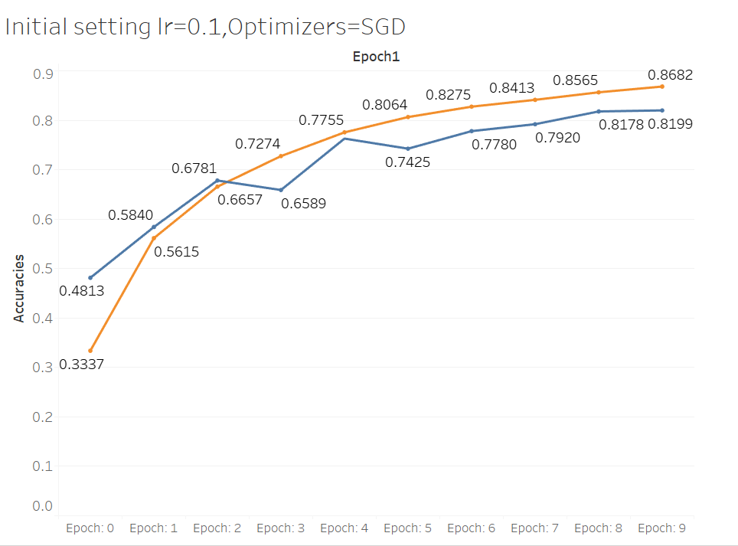
Training logs first run with Epochs=10

Slide 11
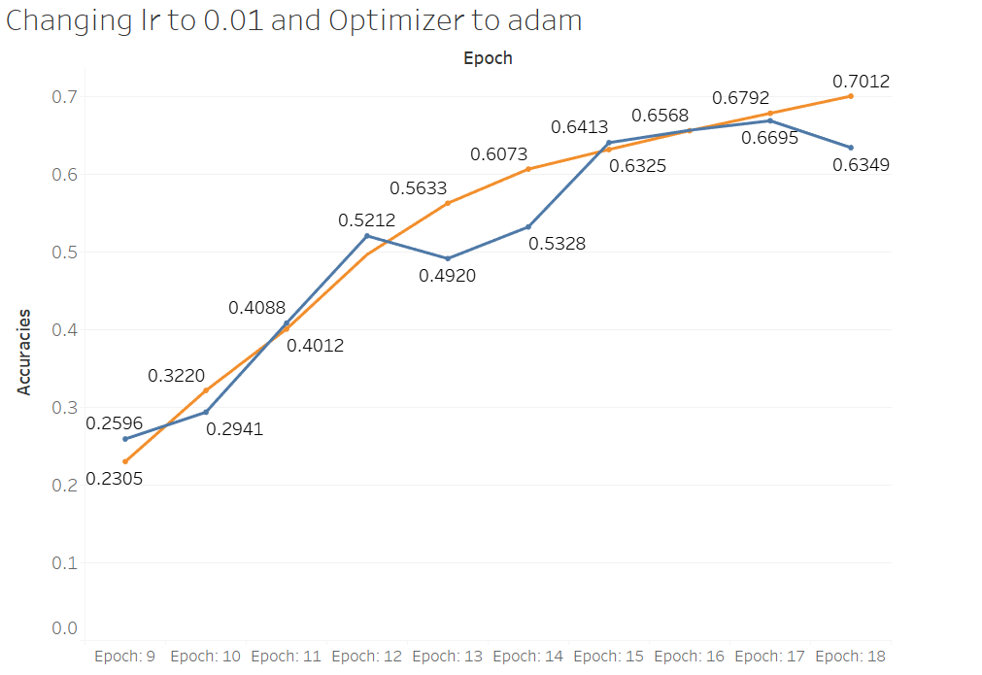
Training logs second run with Epochs=10

Slide 12
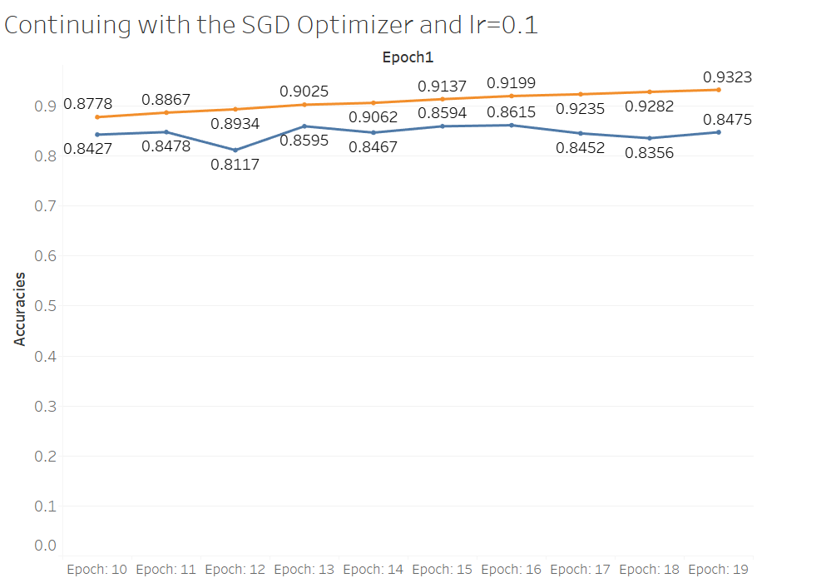
Training logs Second run with different setting and Epochs=10

Slide 13
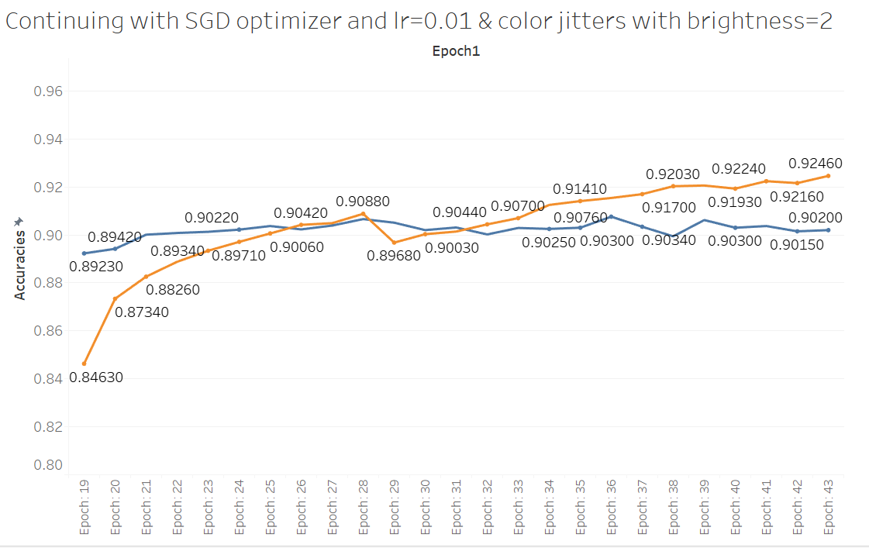
Training logs third run with Epochs=25 after data augmentation

Slide 14
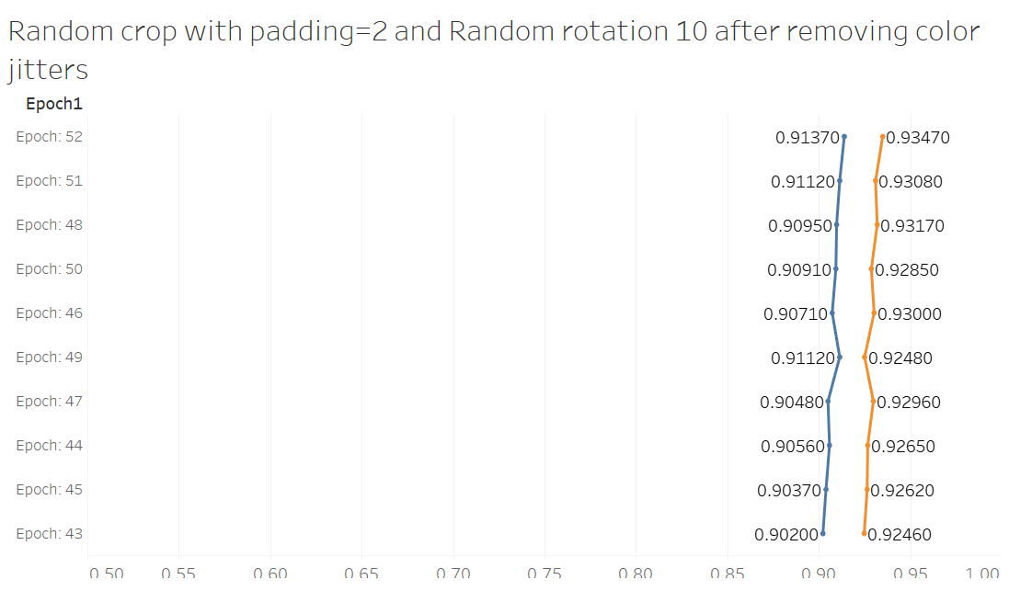
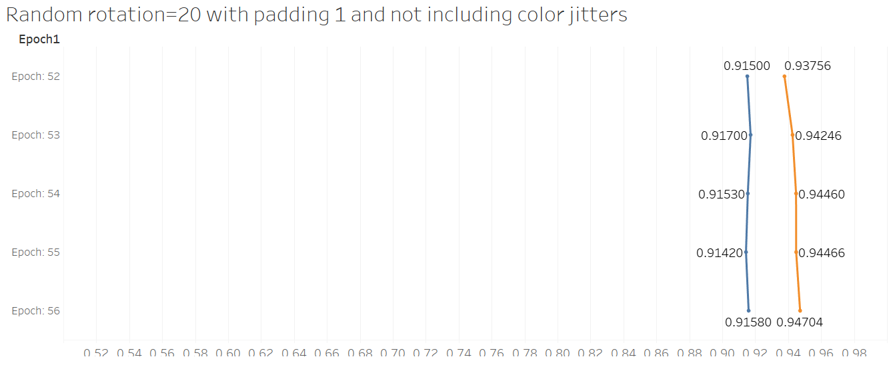
Training logs-Final runs with different data augmentation settings

Slide 15
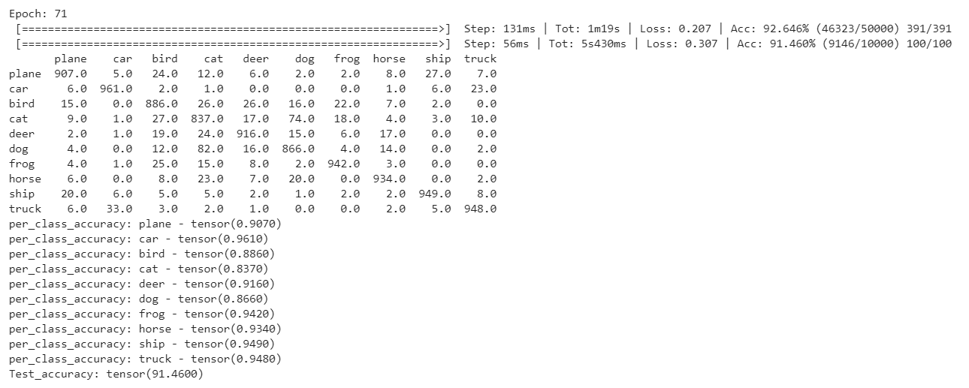
Per class Accuracy and Confusion matrix(Best Accuracy 91.46)

Slide 16
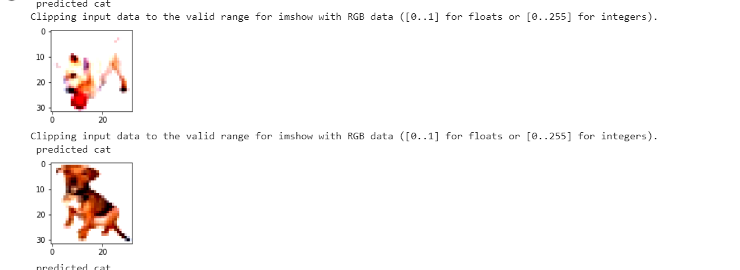
Diagnostic Analysis for model’s failure in each classes
Around 74 images were classified as dogs which were actually cats with a misclassification rate of 7.4%
Around 82 images were classified as cats which were actually dogs with a misclassification rate of 8.2%

Slide 17
Diagnostic analysis for model’s failure in each class
From the confusion matrix we can see that classes like cat , bird and dog were getting misclassified.
We can analyse the individual classes after data augmentation separately for each test and train data for these classes and choose the best data augmentation parameter that is common for these classes and which can improve accuracy as well for all 3 classes and check whether the accuracy can be improved by applying the same transformations that were applied to all these 3 classes

Slide 18
REFERENCES
1. https://github.com/kuangliu/pytorch-cifar

