Slide 1
Mpower
Case study
Onkar vaidya (IITR)

Slide 2
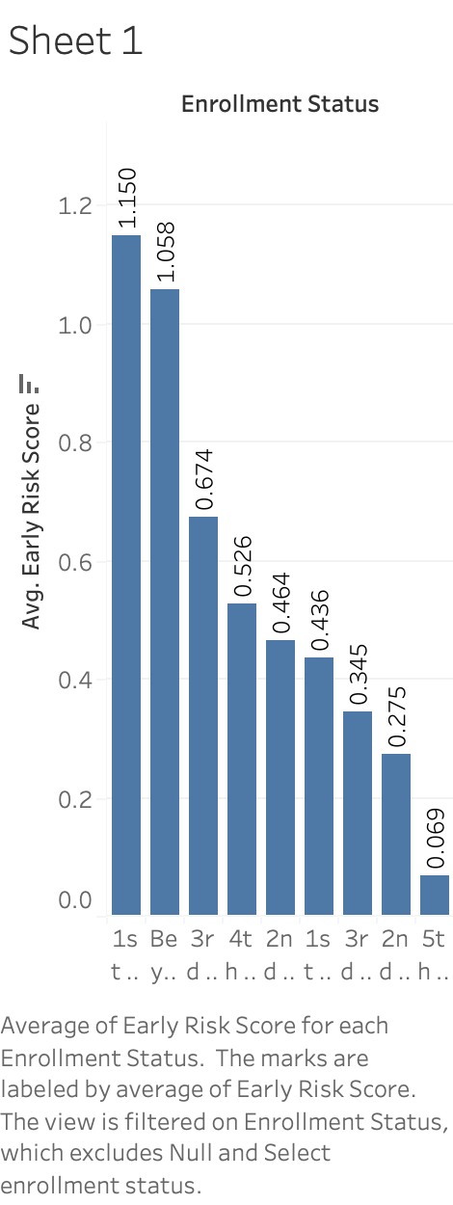
Describe your observations of the data provided
Credit risk score is High for 1 st year student while low for 5th year undergraduate because there is less time for 5th year student will start his job or income to repay the loan.

Slide 3
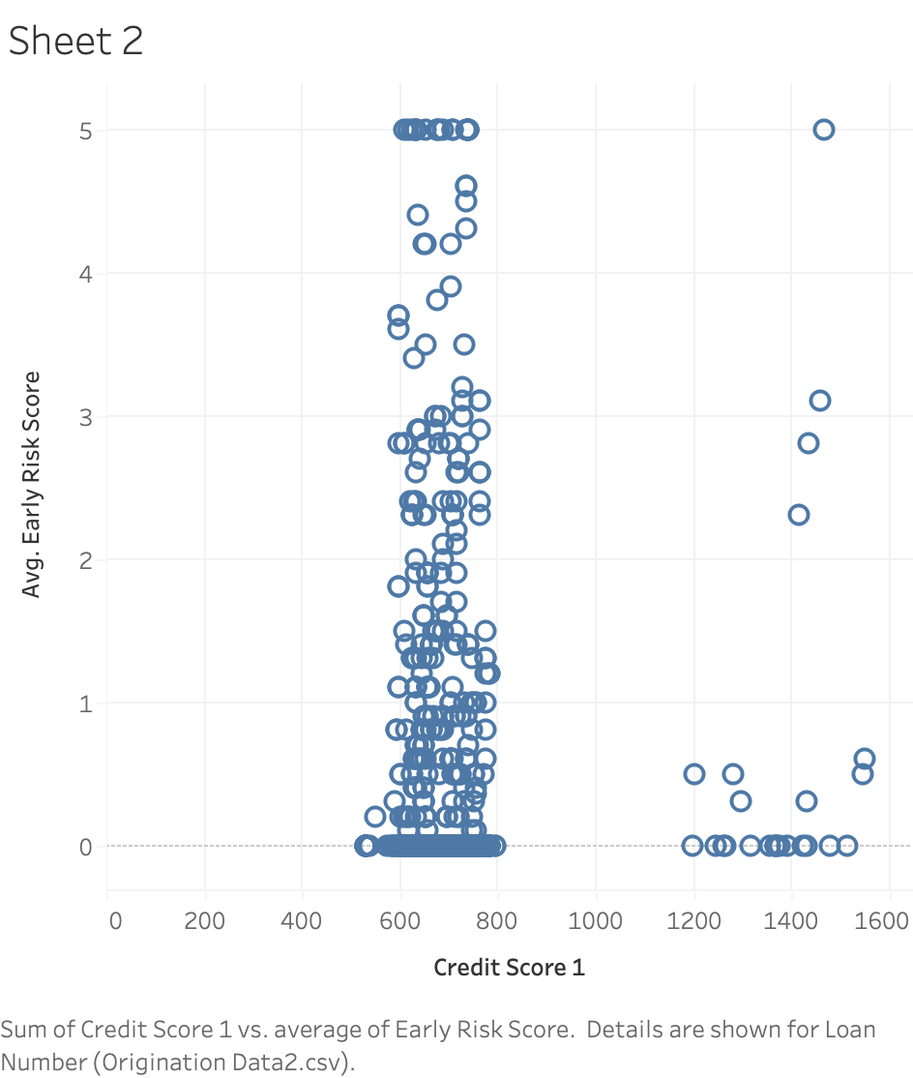
Credit score vs Early risk score
Credit Score is always been good indicator for Early risk score as high credit score indicates low Loan risk. But due to some missing data in credit score and lack of other variables in data we cannot comment on early risk score just by looking Credit score.

Slide 4
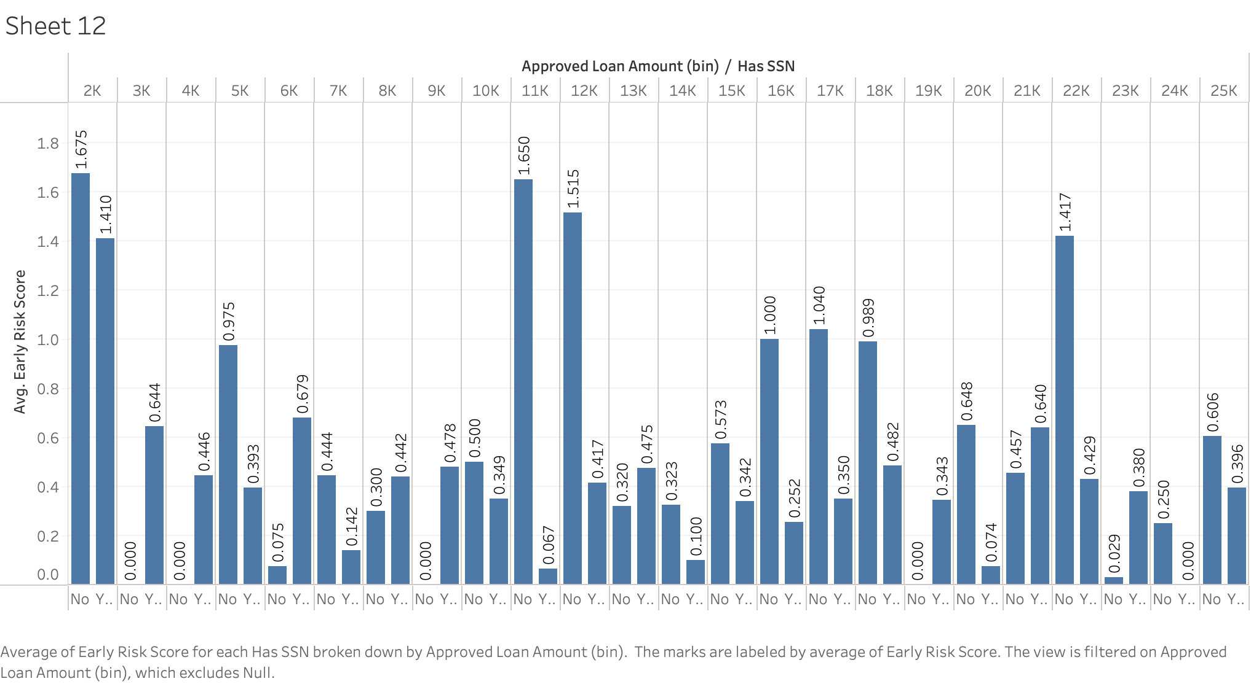
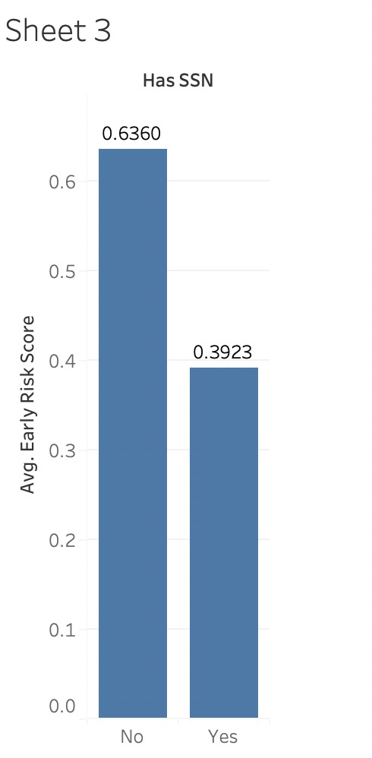
SSN factor
One of the key indicators of this data is SSN. The students Having social security number makes easy for us to track the financial condition of student which makes difficult for students to avoiding repaying of loan and reduces loan risk.

Slide 5
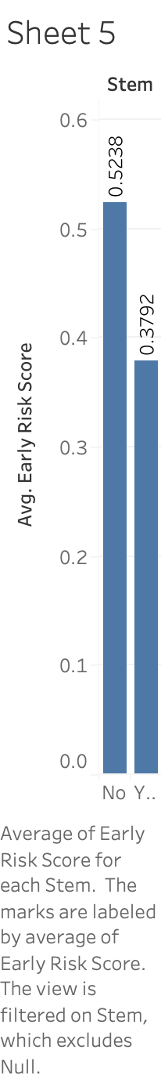
Stem vs Early risk score
Students choosing Science, technology, engineering and mathematics as their graduation subject has low risk as indicated in graph. Which also indicates the types of job available in USA.

Slide 6
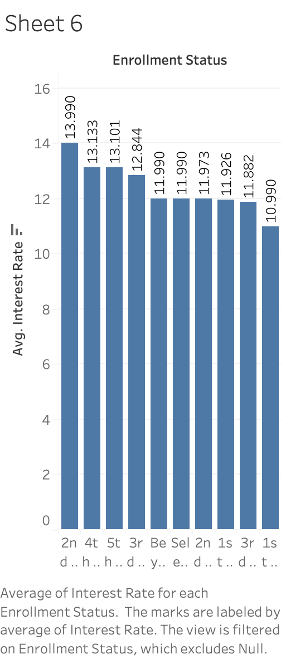
Avg interest rate and early risk score
In this graph we tried to find out avg interest rate for each year as compared to avg risk score. Which shows as interest increases risk score also increase.

Slide 7
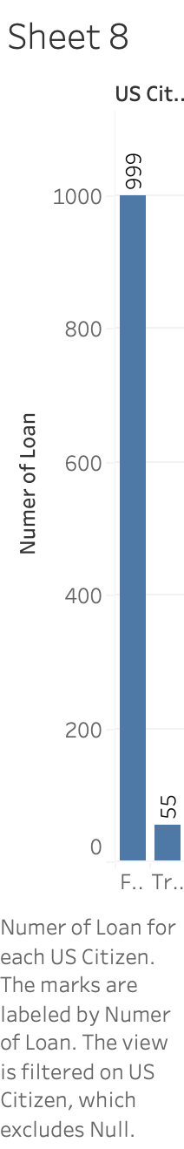
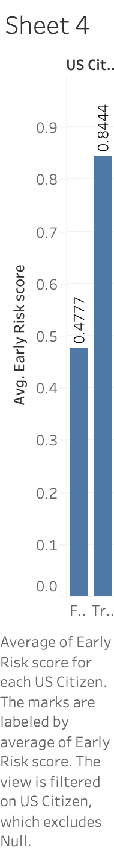
US citizen factor
We can see in the ‘sheet 8’ graph where number of students from USA applying for loan are very less than students from other countries.
Although Avg early risk score is high for USA resident student than students from other country.

Slide 8
Analyses & Conclusions
The students Having social security number makes easy for us to track the financial condition of student which makes difficult for students to avoiding repaying of loan and reduces loan risk.
Avg early risk score is high for USA resident student than students from other country.
If Interest rate become higher then most of the time loan also becomes higher.

Slide 9
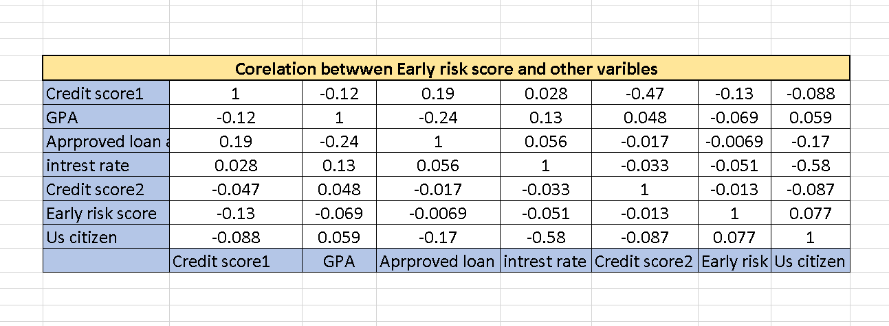
Analyses & Conclusions

Slide 10
Recommendations for the business
As students having SSN have low early risk score , Business must emphasis on having SSN while documenting a loan.
We can add more variables to find early risk score to increase its accuracy such as students parents loan history, college education quality etc.

