Slide 1


Usability testing and verification
Under guidance : Prof. Dr. Swati Chandna Sandesh Athreya
TEAM 8:
Onkar Bharat Phatangare (11013949)
Harini Sankar (11015308)
Karan Waghere(11015304)

Slide 2

Covid Blogger
Stay Connected. Stay Healthy.

Slide 3
01
02
INTRODUCTION
MOTIVATION & GOALS
03
04
UX PROCESS
CONCLUSION
The Use Case
Why this Use Case?
Process to design the use case
Results and Feedback

Slide 4
INTRODUCTION
01
Currently, a great war is going on which is between the world and covid-19 virus. People are facing issues and trying to overcome the situation. The main aim of our project is to provide platform for posting blogs related to their experiences in current pandemic. This will help many users to be updated with latest news and situation. User can easily login, post a blog or upload an image.

Slide 5

02
MOTIVATION AND GOALS
4

Slide 6
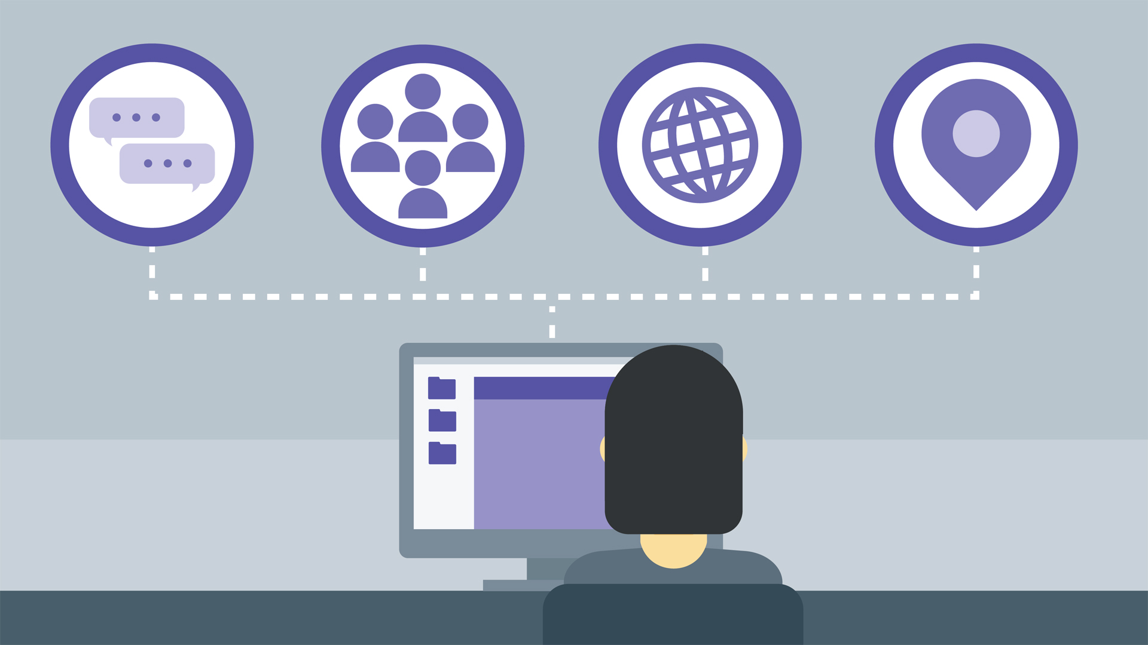

The need for single source to get updates regarding current pandemic
Decrease in face to face communication

Slide 7

03
THE UX PROCESS

Slide 8
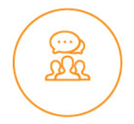




EMPATHIZE
DEFINE
IDEATE
PROTOTYPE
TEST

Slide 9
EMPATHIZE

Slide 10

REQUIREMENTS GATHERING
Most users wanted to see 3 main features – track cases, Videos, Blog
Many of them wanted to have easy login

Slide 11
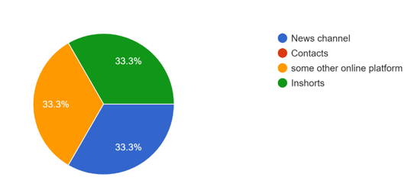
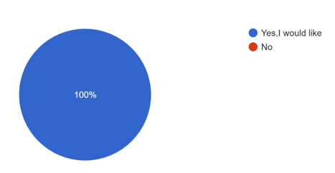
SURVEY ANALYSIS
From where do you get the updates of covid currently?
Would you like to have a covid case tracking?

Slide 12
COMPETITIVE ANALYSIS
Banner Health
Covid Blogger
Live updates
Blogging
Doctor Services
Registration Needed
Covid case tracking
Billing

Slide 13

DEFINE

Slide 14

USER PERSONA
RESPONSIBILITIES
PAIN POINTS
Health activist at ICP health service Ltd.
Lack of interaction between people in pandemic
MOTIVATION
NEEDS
John Walker
Connect people in pandemic to share their experiences.
Single platform for covid fir blogging, tracking cases and updates
Health Activist

Slide 15
IDEATE

Slide 16
SWOT ANALYSIS
STRENGTHS
WEAKNESSES
User-centric design
Lack of mobile support
Effective calls to actions
Better blog functionality
Useful & relevant content
OPPORTUNITIES
THREATS
New design trends to better convey messages
Change of customer needs
Emergence of new competitors
More effective marketing tactics

Slide 17
PROTOTYPE

Slide 18
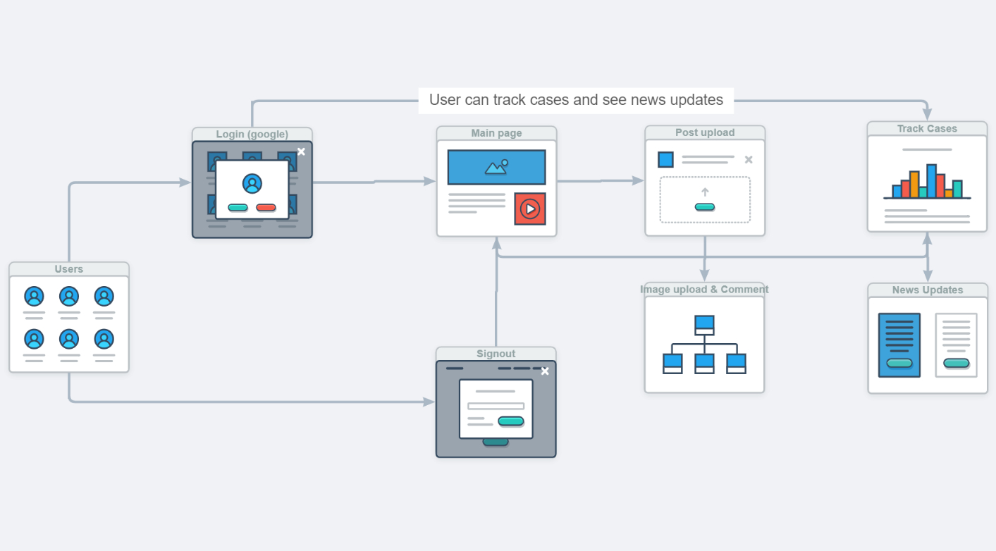
USER FLOW DIAGRAM

Slide 19
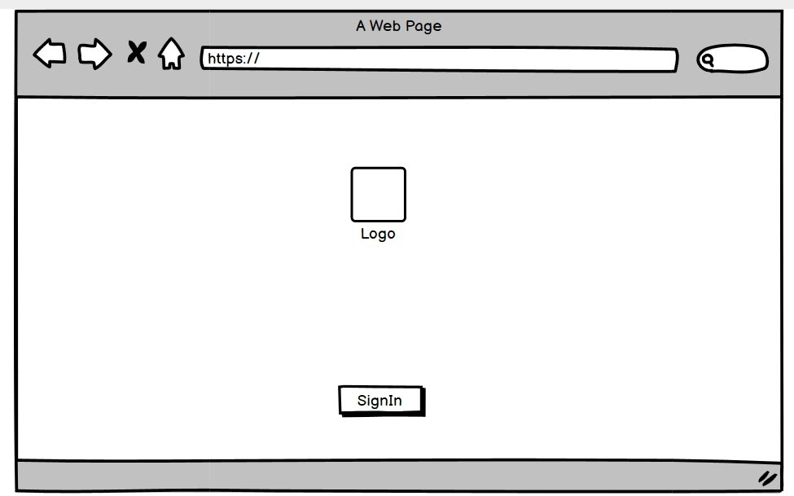
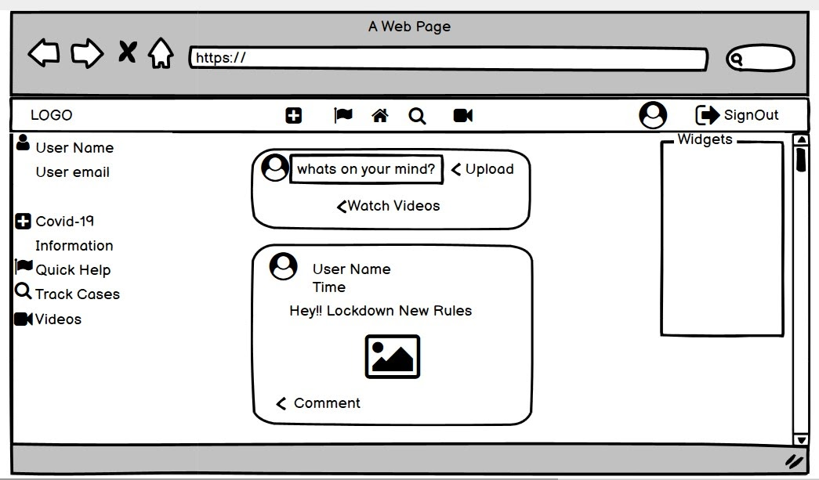
Low-fidelity prototype

Slide 20
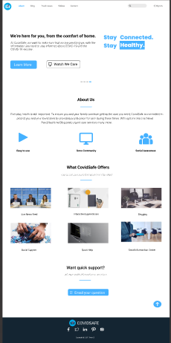
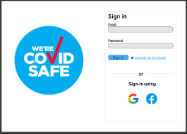
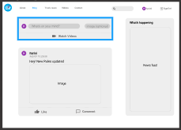
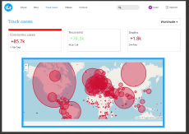
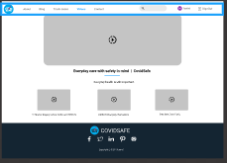
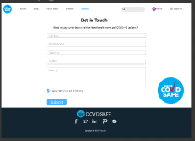
WIREFRAMES

Slide 21
COLOUR THEORY
Vivid Blue
Silver
Black
10%
60%
30%

Slide 22

TEST

Slide 23
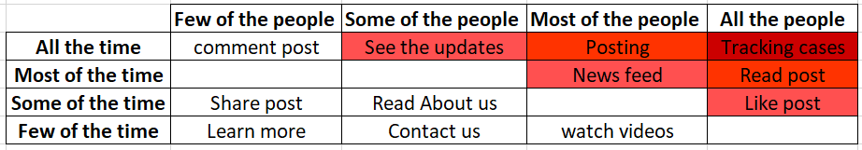
RED ROUTES

Slide 24

RECRUITING USERS
Convenient with online application.
Socially active.
Curiosity.
Honest with their blog
Cascade the information to others who aren’t using the application.

Slide 25
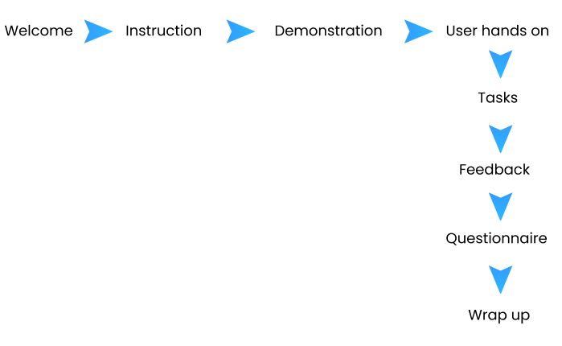
TEST PLAN
Users:4
Testing Environment: Remote
Moderator: Karan
Observers:Harini,onkar
Channel: Zoom meetings

Slide 26

USABILITY TRIAL RESULTS
Think Out Loud Process was followed
5 scenarios were given to the user – completed successfully
Scenario 1 (1 mins) – Navigate to main page
Scenario 2 (2 mins)- Make user upload post
Scenario 3 (1 mins) - getting covid case count
Scenario 4 (2 mins) - watching out videos
Scenario 5 (2 mins) - contact team

Slide 27
USABILITY TRIAL(TEASER)

Slide 28
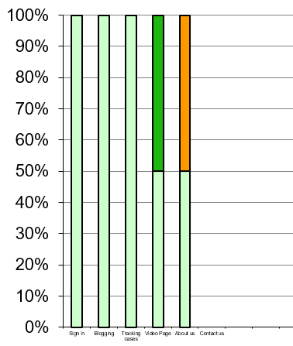
Task performance Chart

Slide 29
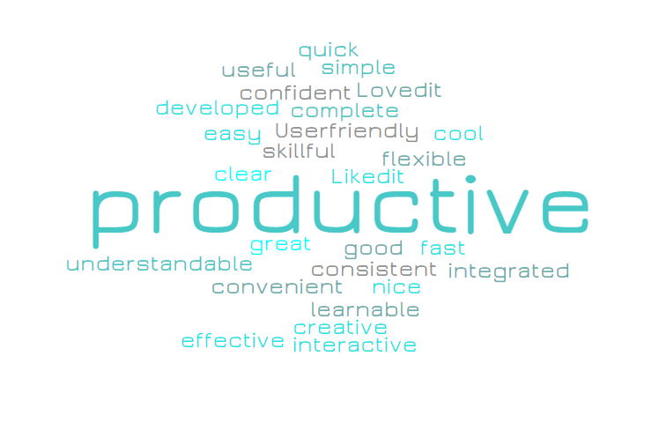
WORD CLOUD

Slide 30

04
CONCLUSION

Slide 31

Adopting the Design Thinking principles, the prototype was designed and tested.
With a mostly positive feedback from the end user, an intuitive and responsive UI design was developed..
The Design Thinking process was instrumental in bringing out the developed design.

Slide 32
IMPLEMENTATION

Slide 33

Thank you!
Do you have any questions?

