Slide 1
Introduction to JS
(JS) is a scripting language used to create dynamic and interactive web content.
It is one of the core technologies of web development, alongside HTML and CSS.
JS can be used on both the client-side (in the browser) and the server-side (with Runtime Environments like Node.js).

Slide 2
Console Output
var, let, const
Alert
Prompt

Slide 3
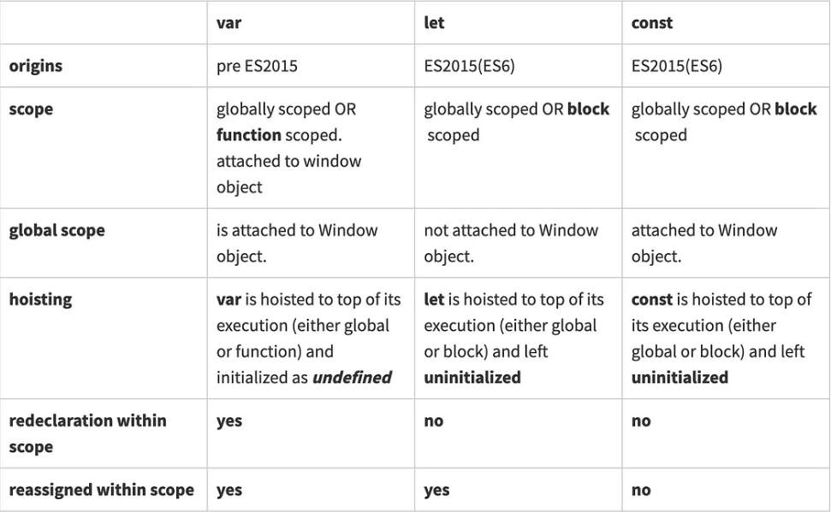
var, let, const

Slide 4
Data Types
Primitive Types:
Number: For integers and floating-point numbers. let age = 25;
String: For text, enclosed in quotes. let name = “Onkar";
Boolean: true or false. let isValid = true;
Undefined: Default value of an uninitialized variable. let x;
Null: Represents intentional absence of value. let result = null;
Symbol: Unique and immutable value. let sym = Symbol("id");
BigInt: For very large integers. let bigNum = 12345678901234567890n;

Slide 5
2. Object Types:
Object: Key-value pairs.
let person = { name: "John", age: 30 };
Array: Ordered list of values.
let fruits = ["Apple", "Banana“, 11];
Function: Reusable block of code.
function greet() { return "Hello"; }

Slide 6
Operators in JS

Slide 7
Strings and String Methods
A string is a sequence of characters used to represent text.
Strings are enclosed in quotes: single ('), double ("), or backticks (`).
Example:
let name = "John";
let greeting = 'Hello!’;
let template = `My name is ${name}`;

Slide 8
Common String Methods
length: Returns the length of the string.
let str = "Hello"; console.log(str.length); // Output: 5
toUpperCase(): Converts the string to uppercase.
console.log(str.toUpperCase()); // Output: HELLO
toLowerCase(): Converts the string to lowercase.
console.log(str.toLowerCase()); // Output: hello
charAt(index): Returns the character at the specified index.
console.log(str.charAt(1)); // Output: e
indexOf(substring): Returns the index of the first occurrence of the substring.
console.log(str.indexOf("l")); // Output: 2

Slide 9
slice(start, end): Extracts a part of the string from start to end (end not included).
console.log(str.slice(0, 2)); // Output: He
replace(search, new): Replaces the first occurrence of a substring with a new value.
console.log(str.replace("Hello", "Hi")); // Output: Hi
split(separator): Splits the string into an array based on the separator.
let words = str.split(" "); // Splits by space
trim(): Removes whitespace from both ends of the string.
let strWithSpaces = " Hello "; console.log(strWithSpaces.trim()); // Output: Hello
includes(substring): Checks if the string contains the substring.
console.log(str.includes("ell")); // Output: true

Slide 10
Arrays
Array is a data structure used to store multiple values in a single variable.
Arrays are ordered collections, which means each item in the array has a numerical index
starting from 0.
Creating Arrays
Literal Syntax: Using square brackets [].
let fruits = ["Apple", "Banana", "Cherry"];
Constructor Syntax: Using the Array constructor.
let numbers = new Array(1, 2, 3, 4);

Slide 11
Common Array Methods
length: Returns the number of elements in the array.
console.log(fruits.length); // Output: 3
push(item): Adds one or more items to the end of the array.
fruits.push("Orange"); console.log(fruits); // Output: ["Apple", "Banana", "Cherry", "Orange"]
pop(): Removes the last item from the array and returns it.
let last = fruits.pop(); console.log(last); // Output: Orange console.log(fruits);
// Output: ["Apple", "Banana", "Cherry"]
shift(): Removes the first item from the array and returns it.
let first = fruits.shift(); console.log(first); // Output: Apple console.log(fruits); // Output: ["Banana", "Cherry"]
unshift(item): Adds one or more items to the beginning of the array.
fruits.unshift("Strawberry"); console.log(fruits); // Output: ["Strawberry", "Banana", "Cherry"]

Slide 12
concat(array): Merges two or more arrays into a new array.
let moreFruits = ["Kiwi", "Mango"]; let allFruits = fruits.concat(moreFruits); console.log(allFruits); // Output: ["Strawberry", "Banana", "Cherry", "Kiwi", "Mango"]
slice(start, end): Returns a shallow copy of a portion of the array.
let sliced = allFruits.slice(1, 4); console.log(sliced); // Output: ["Banana", "Cherry", "Kiwi"]
splice(start, deleteCount, item1, item2, ...): Changes the contents of an array by removing or replacing existing elements and/or adding new elements.
allFruits.splice(2, 1, "Pineapple"); console.log(allFruits); // Output: ["Strawberry", "Banana", "Pineapple", "Kiwi", "Mango"]
forEach(callback): Executes a provided function once for each array element.
allFruits.forEach(fruit => console.log(fruit)); // Output: // Strawberry // Banana // Pineapple // Kiwi // Mango
map(callback): Creates a new array with the results of calling a provided function on every element.
let lengths = allFruits.map(fruit => fruit.length); console.log(lengths); // Output: [10, 6, 9, 4, 5]

Slide 13
filter(callback): Creates a new array with all elements that pass the test implemented by the provided function.
let shortFruits = allFruits.filter(fruit => fruit.length < 6); console.log(shortFruits); // Output: ["Kiwi", "Mango"]
find(callback): Returns the first element that satisfies the provided testing function.
let found = allFruits.find(fruit => fruit.startsWith("P")); console.log(found); // Output: Pineapple
reduce(callback, initialValue): Executes a reducer function on each element of the array, resulting in a single output value.
let totalLength = allFruits.reduce((accumulator, fruit) => accumulator + fruit.length, 0); console.log(totalLength); // Output: 34
includes(item): Checks if an array contains a certain item.
console.log(allFruits.includes("Banana")); // Output: true
sort(): Sorts the elements of an array in place.
let numbers = [3, 1, 4, 1, 5]; numbers.sort(); // Sorts numbers in ascending order console.log(numbers); // Output: [1, 1, 3, 4, 5]
reverse(): Reverses the elements of an array in place.
allFruits.reverse(); console.log(allFruits); // Output: ["Mango", "Kiwi", "Pineapple", "Banana", "Strawberry"]

Slide 14
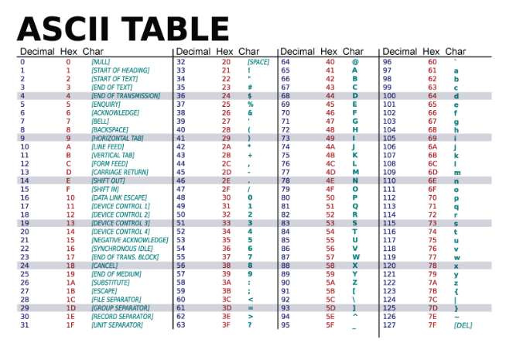

Slide 15
Loops
Loops are used to execute a block of code repeatedly until a specified condition is met. JavaScript provides several types of loops, each suited for different scenarios.
1. for Loop
The for loop executes a block of code a specific number of times.
Syntax:
for (initialization; condition; increment) { // Code to be executed }
Example:
for (let i = 0; i < 5; i++) { console.log(i); // Output: 0 1 2 3 4 }
Initialization: Runs once before the loop starts.
Condition: Evaluated before each iteration; the loop continues while true.
Increment: Executed after each iteration.

Slide 16
2. while Loop
The while loop executes a block of code as long as a specified condition is true.
Syntax:
while (condition) { // Code to be executed }
Example:
let count = 0; while (count < 5) { console.log(count); // Output: 0 1 2 3 4 count++; }
3. do...while Loop
The do...while loop executes a block of code once before checking the condition,
and then repeats the loop as long as the condition is true.
Syntax:
do { // Code to be executed } while (condition);
Example:
let num = 0; do {
console.log(num); // Output: 0 1 2 3 4
num++;
} while (num < 5);

Slide 17
4. for...in Loop
The for...in loop iterates over the enumerable properties of an object.
Syntax:
for (let key in object) { // Code to be executed }
Example:
let person = { name: "Alice", age: 25 }; for (let key in person) { console.log(key + ": " + person[key]); }
5. for...of Loop
The for...of loop iterates over iterable objects (e.g., arrays, strings).
Syntax:
for (let item of iterable) { // Code to be executed }
Example:
let numbers = [1, 2, 3, 4, 5]; for (let number of numbers) { console.log(number); // Output: 1 2 3 4 5 }

Slide 18
Conditionals
Conditionals are used to perform different actions based on different conditions.
1. if Statement
The if statement executes a block of code only if the specified condition is true.
if (condition) { // Code to be executed if the condition is true }
Example:
let age = 18; if (age >= 18) { console.log("You are an adult."); }
2. if...else Statement
The if...else statement executes one block of code if the condition is true,
and another block if the condition is false.
if (condition) { // Code to be executed if the condition is true }
else { // Code to be executed if the condition is false }
let age = 16; if (age >= 18) { console.log("You are an adult."); } else { console.log("You are a minor."); }

Slide 19
3. else if Statement
The else if statement allows you to specify multiple conditions. If the first condition is false,
it checks the next one.
if (condition1) { // Code to be executed if condition1 is true }
else if (condition2)
{ // Code}
else { // Code}
let age = 15; if (age >= 18) { console.log("You are an adult."); }
else if (age >= 13) { console.log("You are a teenager."); }
else { console.log("You are a child."); }
4. Ternary Operator (? :)
The ternary operator is a shorthand for the if...else statement. It allows you to evaluate a condition
and return one of two values based on whether the condition is true or false.
condition ? valueIfTrue : valueIfFalse;
let age = 20; let status = age >= 18 ? "Adult" : "Minor"; console.log(status);

Slide 20
6. break and continue Statements
break: Exits the nearest loop immediately.
for (let i = 0; i < 5; i++) { if (i === 3) break; console.log(i); // Output: 0 1 2 }
continue: Skips the current iteration and continues with the next iteration of the loop.
for (let i = 0; i < 5; i++) { if (i === 3) continue; console.log(i); // Output: 0 1 2 4 }

Slide 21
5. switch Statement
switch (expression) {
case value1: // Code to be executed if expression equals value1 break;
case value2: // Code to be executed if expression equals value2 break;
default: // Code to be executed if expression does not match any case
}
let day = "Monday";
switch (day) {
case "Monday":
console.log("Start of the week");
break;
case "Friday":
console.log("End of the work week");
break;
default:
console.log("It's another day");
}

Slide 22
Functions
1. Function Declaration
A function declaration defines a named function using the function keyword.
Syntax:
function functionName(parameters) { // Code to be executed }
Example:
function greet(name) { return `Hello, ${name}!`; } console.log(greet(“Onkar"));
2. Function Expressions
A function expression allows you to assign a function to a variable. It can be anonymous (without a name).
Syntax:
const functionName = function(parameters) { // Code to be executed };
Example:
const add = function(a, b) { return a + b; }; console.log(add(2, 3));

Slide 23
3. Arrow Functions
Introduced in ES6, arrow functions provide a shorter syntax for writing functions
and also handle the this keyword differently.
Syntax:
const functionName = (parameters) => { // Code to be executed };
If there’s only one parameter, the parentheses can be omitted,
and if the function has only one expression, the return and braces can be omitted.
Example:
const multiply = (a, b) => a * b; console.log(multiply(2, 3));
4. Parameters and Arguments
Parameters: Variables listed in the function definition.
Arguments: Values passed to the function when it is invoked.
Example:
function greet(name) {
// `name` is a parameter return `Hello, ${name}`;
}
greet("Bob");

Slide 24
6. try...catch for Error Handling
try {
// Code that may throw an error
} catch (error) {
// Code to handle the error
}
Throw keyword: to explicitly throw an error
-----------------------------------------------------
This keyword: refers to the current object
const person = { firstName: "John", lastName : "Doe", id : 5566, fullName : function() { return this.firstName + " " + this.lastName; } };
function getRectArea(width, height) {
if (isNaN(width) || isNaN(height)) {
throw new Error('Parameter is not a number!!!!');
}
return console.log("Area: ", height*width)
}
try {
getRectArea(3, 5);
} catch (e) {
console.error(e);
}

