Slide 1
HTML
HTML (HyperText Markup Language) is the standard language used to create web pages.
It defines the structure and layout of a web page by using a variety of tags and elements.
Each element in HTML tells the browser how to display the content on the screen.

Slide 2
Key Concepts:
HyperText: Refers to text that contains links to other texts or resources. It's the foundation of web navigation.
Markup Language: HTML uses "tags" to markup content, specifying how it should be formatted or displayed.

Slide 3
Basic HTML Document Structure:
Every HTML document follows a basic structure:
<!DOCTYPE html>
<html>
<head>
<title>Page Title</title>
</head>
<body>
<h1>This is a heading</h1>
<p>This is a paragraph.</p>
</body>
</html>

Slide 4
<!DOCTYPE html>: This declares the document type and version of HTML.
<html>: The root element that wraps all content on the page.
<head>: Contains metadata about the HTML document (like the title, character set, etc.).
<title>: The title of the web page, shown in the browser tab.
<body>: Contains the actual content of the webpage, like headings, paragraphs, links, images, etc.
<head> & <body> tags are children of HTML tag.
HTML is the parent of all tags.
Most of the HTML elements have opening & closing tag with content in between opening & closing tags.
Some HTML tags have no content. These are called Empty elements e.g. <br> We can either use .htm or .html extension.
You can use “inspect element” or “view page source” option from Chrome to look into a website’s HTML Code.

Slide 5
HTML Tags and Elements:
Tags are used to define elements, usually enclosed in angle brackets (e.g., <p> for a paragraph).
Most tags have an opening tag (e.g., <p>) and a closing tag (e.g., </p>), with the content in between.

Slide 6
Common HTML Tags:
Headings: <h1> to <h6> define headings, with <h1> being the largest.
Paragraphs: <p> defines a paragraph.
Links: <a href="url"> creates a hyperlink.
Images: <img src="image.jpg" alt="description"> displays an image.

Slide 7
HTML Headings
Headings in HTML are used to define the structure and hierarchy of content on a web page.
There are six levels of headings, ranging from
<h1> (the most important) to <h6> (the least important).

Slide 8
HTML Paragraphs
In HTML, paragraphs are defined using the
<p> tag. A paragraph is a block of text that is displayed as a single, distinct section in the document.

Slide 9
HTML Typography
Headings (<h1> to <h6>):
As explained earlier, headings define the hierarchy of your content,
from <h1> (largest and most important) to <h6> (smallest and least important).
Paragraphs (<p>):
<p> defines paragraphs, separating blocks of text into distinct sections.
Bold Text (<b> or <strong>):
<b> makes the text bold but doesn’t imply any importance.
<strong> makes the text bold and implies that it is important.

Slide 10
Italic Text (<i> or <em>):<i> makes the text italicized, often used for emphasis or quotes.<em> italicizes the text and adds emphasis, indicating the importance of the text.
<p>This is an <i>italicized</i> word.</p>
<p>This is an <em>emphasized</em> word.</p>
Underline Text (<u>):<u> underlines the text, which can be useful for highlighting certain words or phrases.
<p>This is an <u>underlined</u> word.</p>
Strikethrough (<s> or <del>):<s> creates strikethrough text (used to represent something that is no longer accurate).<del> indicates text that has been dead, often used in documents to indicate edits.

Slide 11
HTML Links
HTML links, or hyperlinks, allow users to navigate between
different pages on the web or to other resources, such as files, images, or sections
of the same page.
Links are created using the <a> (anchor) tag.
<a href="URL">Link Text</a>

Slide 12
Images in HTML
In HTML, images are embedded using the <img> tag. Unlike other elements,
the <img> tag is self-closing, meaning it doesn't have a closing tag.
Images can greatly enhance a webpage by providing visual context, product photos, graphics, or illustrations.
<img src="image-url" alt="description">

Slide 13
HTML is a case insensitive language. <H1> and <h1> tags are the same.
The <br> tag is used to create line breaks in an HTML document.
BIG AND SMALL TAGS
We can make text a bit larger and a bit smaller using <big> and <small> tags respectively.
<big>He110 world</big>
< small>He11o world</small>
HR TAG
<hr> tag in HTML is used to create a horizontal ruler often used to separate the content.
SUBSCRIPT & SUPERSCRIPT
We can add subscript and superscripts in HTML as follows:
this <sub> is </sub> subscript.
this is <sup> is </sup> superscript.
PRE TAG
HTML always ignores extra spaces and newlines. In order to display a piece of text as is,
we use pre tag.
< pre>
This is written.
using pre
tag
</pre>

Slide 14
HTML Attributes
HTML attributes provide additional information about HTML elements.
They are always included in the opening tag of the element and typically come in name/value pairs,
where the attribute name is followed by an equals sign and the value is enclosed in quotes.
<tagname attribute="value">Content</tagname>
<a href="https://www.example.com">Visit Example</a>
<img src="image.jpg" alt="A description of the image">

Slide 15
style:
Inline CSS can be applied to an element using the style attribute
<p style="color: blue; font-size: 16px;">This is a styled paragraph.</p>
id:
Provides a unique identifier for an HTML element, allowing it to be targeted with CSS or JavaScript. <div id="header">This is the header section.</div>
class:
Assigns one or more class names to an element. Classes can be used to group elements for styling and scripting purposes. <p class="intro">This is an introductory paragraph.</p>
target:
Used with the <a> tag to specify where to open the linked document. The most common value is _blank, which opens the link in a new tab or window.
<a href="https://www.example.com" target="_blank">Open in a new tab</a>

Slide 16
HTML Lists
Unordered List (<ul>)
An unordered list is a list of items marked with bullet points. It is commonly used when the order of items is not important.
<ul>
<li>Item 1</li>
<li>Item 2</li>
<li>Item 3</li>
</ul>

Slide 17
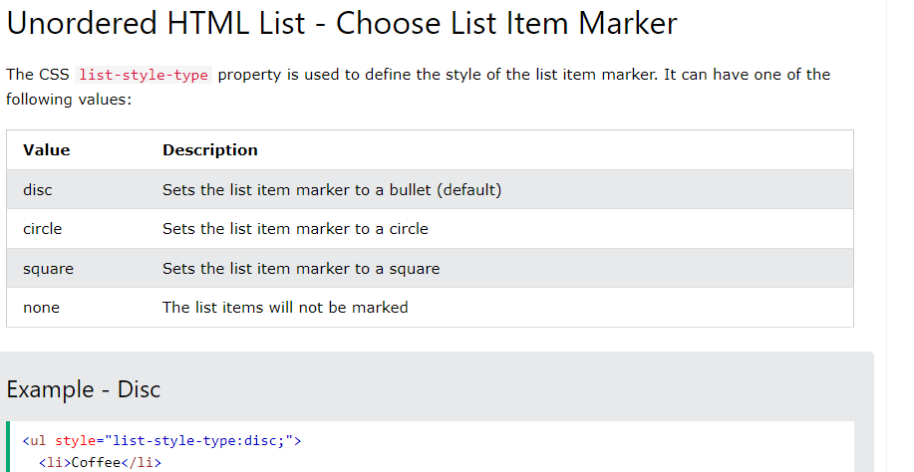

Slide 18
Ordered List (<ol>)
An ordered list is a list of items marked with numbers or letters, useful when the sequence of items matters.
Basic Structure:
<ol>
<li>First item</li>
<li>Second item</li>
<li>Third item</li>
</ol>

Slide 19
Changing List Numbering:
You can use the type attribute to change the style of numbering for an ordered list.
type="1" (default): Numbers (1, 2, 3)
type="A": Uppercase letters (A, B, C)
type="a": Lowercase letters (a, b, c)
type="I": Uppercase Roman numerals (I, II, III)
type="i": Lowercase Roman numerals (i, ii, iii)

Slide 20
List Attributes
start: Defines the starting number for an ordered list.
<ol start="5">
<li>Item 5</li>
<li>Item 6</li>
</ol>
reversed: Reverses the numbering of an ordered list.
<ol reversed>
<li>Third item</li>
<li>Second item</li>
<li>First item</li>
</ol>

