Slide 1

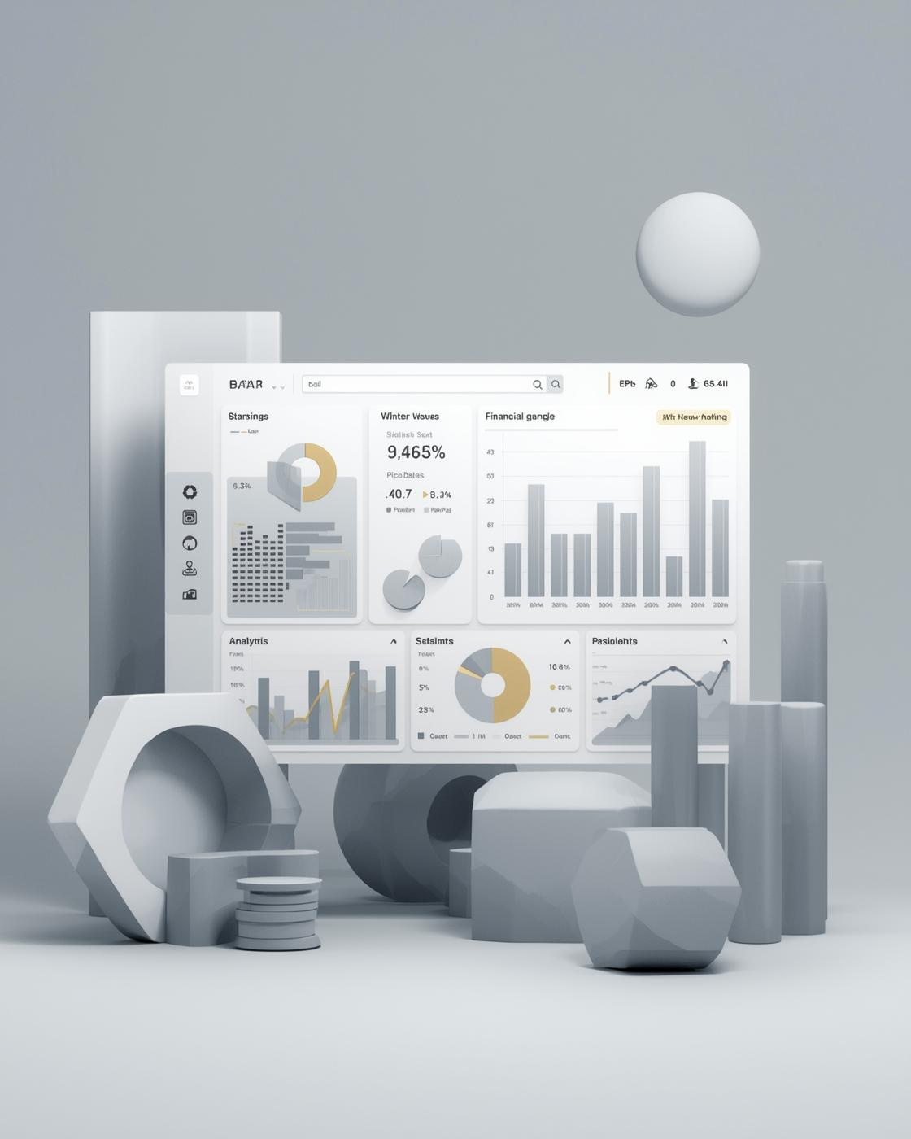
BANK ANALYTICS

Slide 2
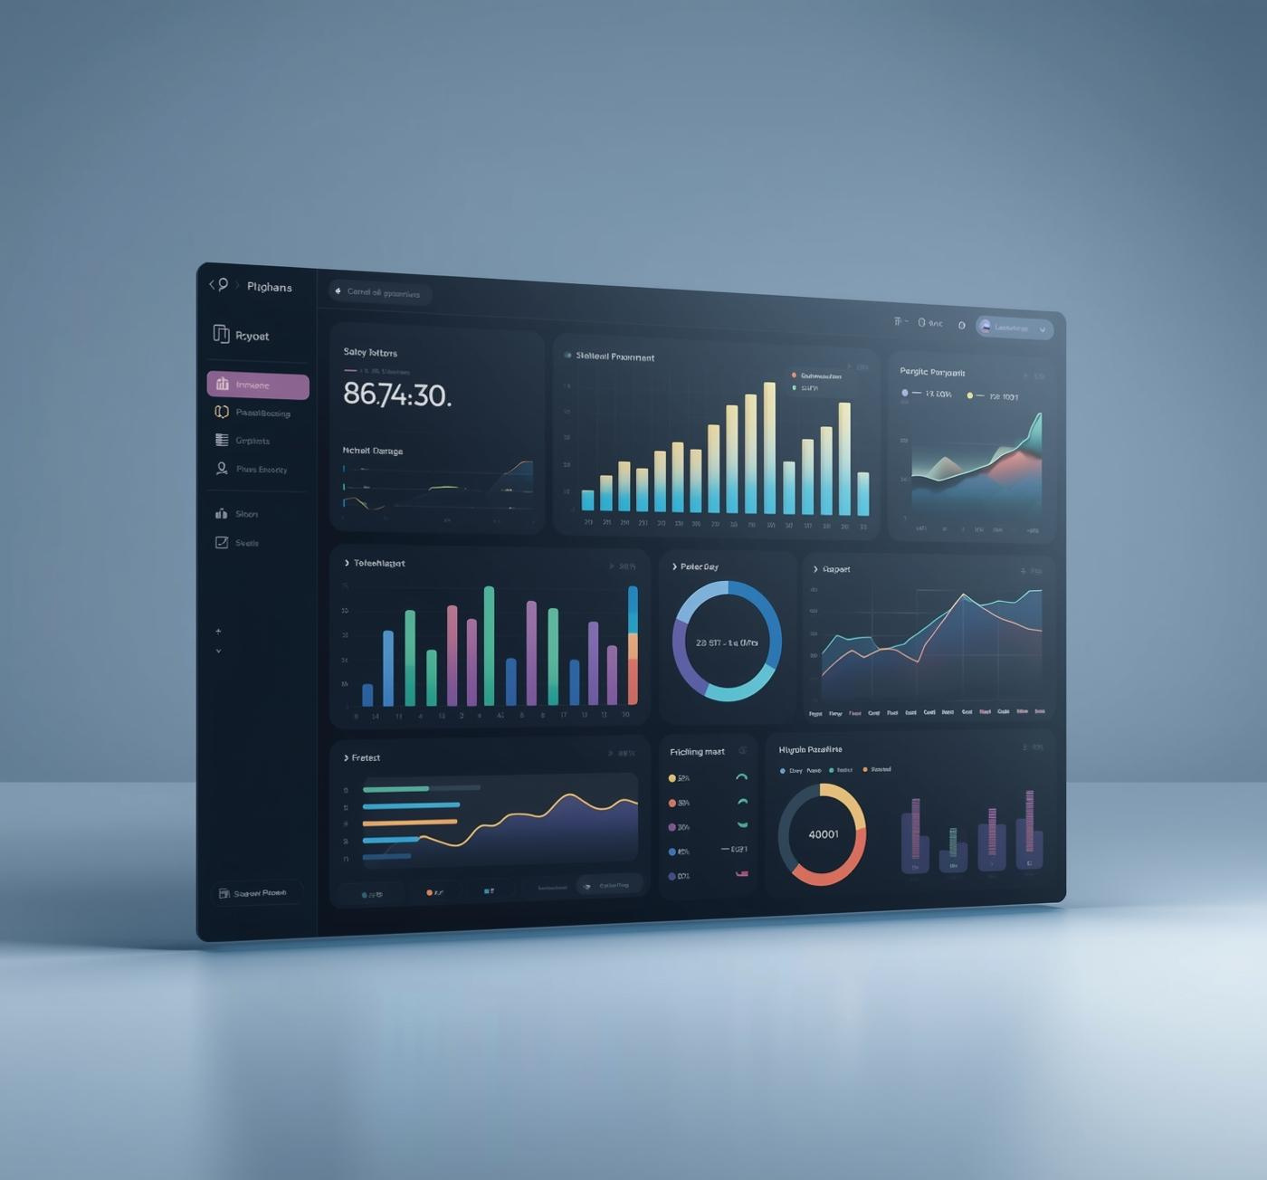
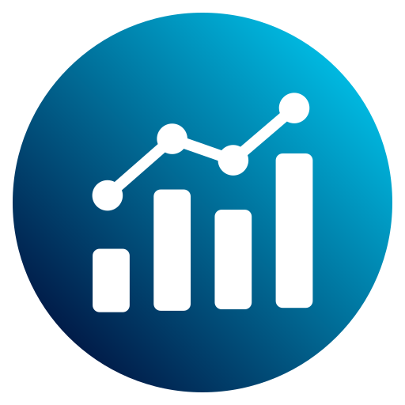
Introduction
Banks face challenges in understanding loan performance, customer behavior, and repayment trends due to large volumes of financial data. This project analyzes two datasets—Banking Loan Dataset and Credit/Debit Transaction Dataset—to identify risk patterns, financial behavior, branch activity, and operational performance. Through dashboards and SQL analysis, we aim to provide data-driven insights that help improve decision-making and financial planning.
3

Slide 3
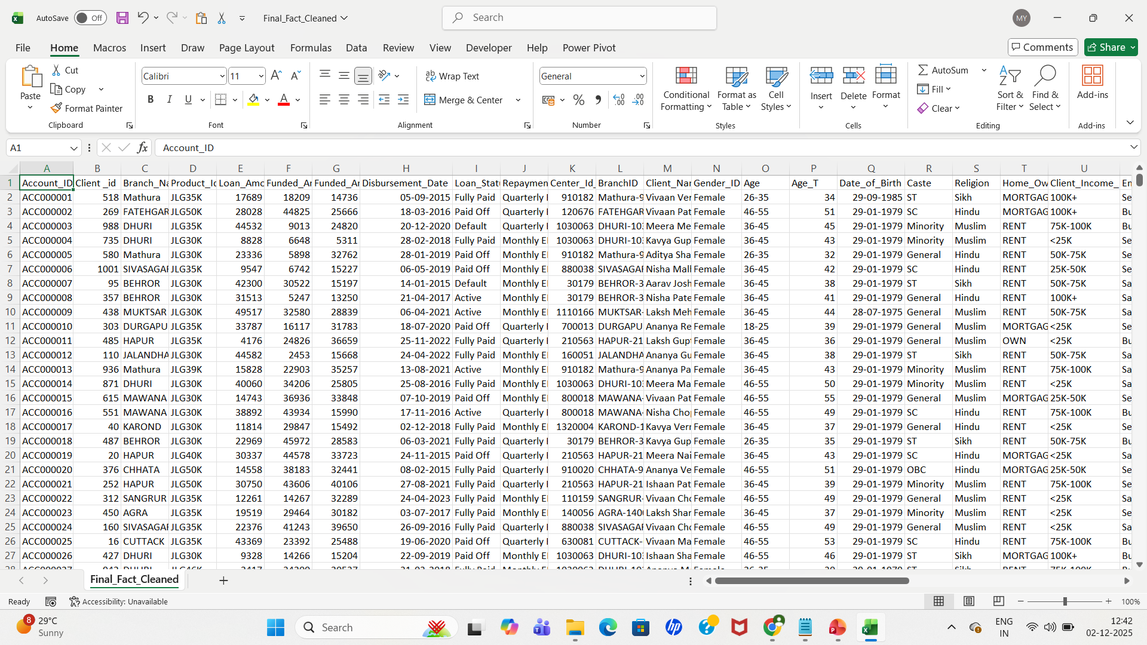
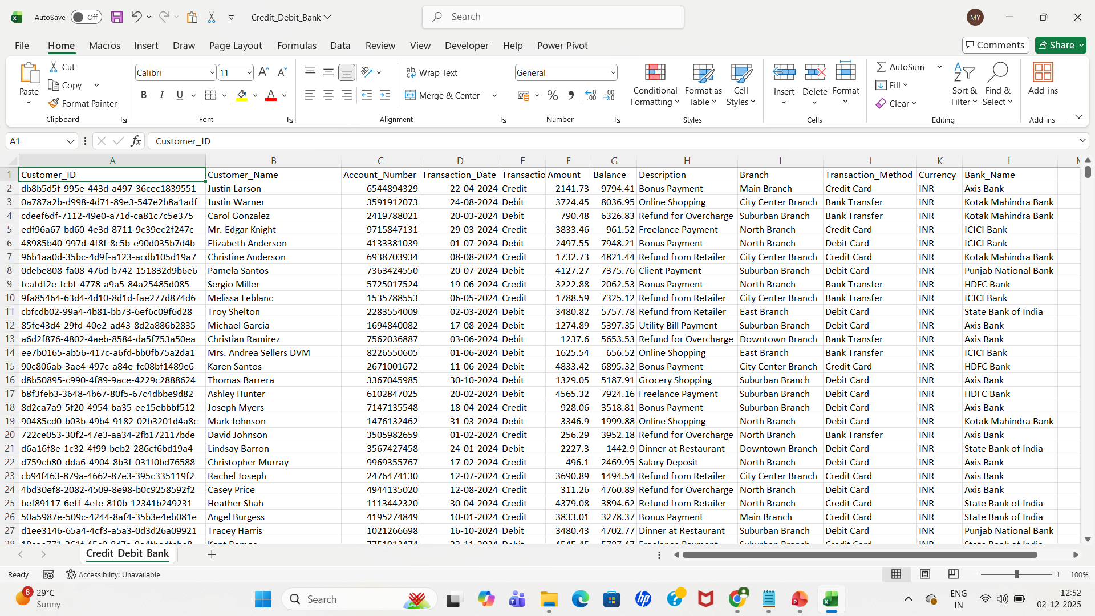
Dataset Overview
Banking Dataset Includes: Loan details, customer demographics, repayment behavior, credit score, branch information.
Credit/Debit Dataset Includes: Transaction type, balance changes, transaction method, date, and branch activity.
4

Slide 4
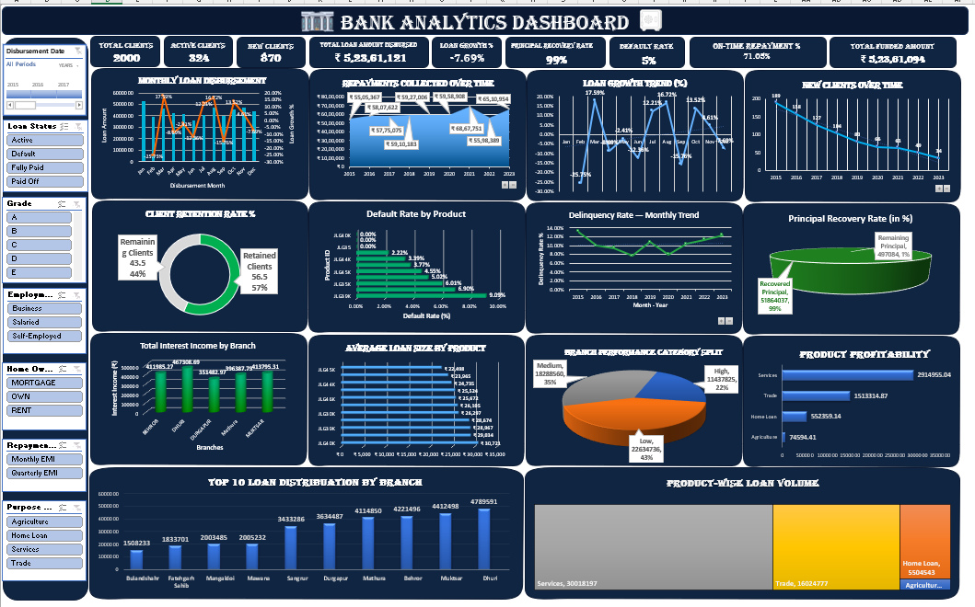
Banking Excel Dashboard
5

Slide 5
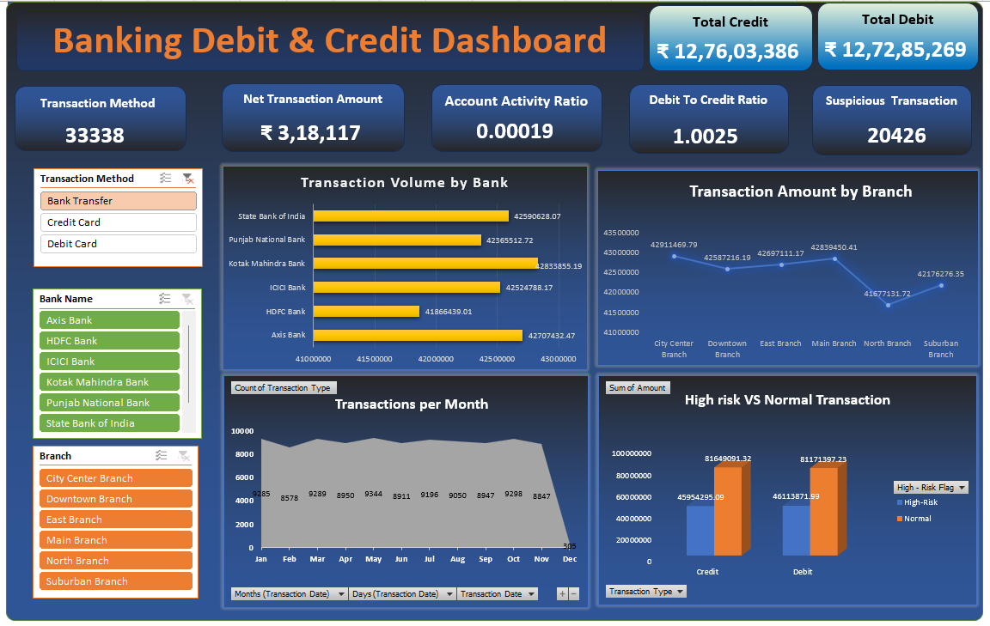
Credit / Debit Excel Dashboard
6

Slide 6
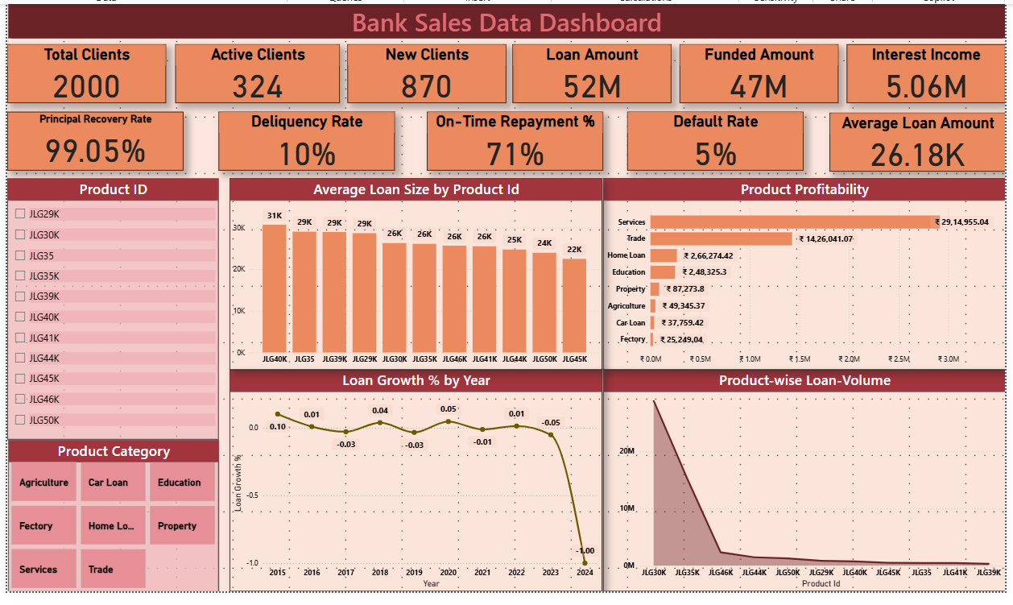
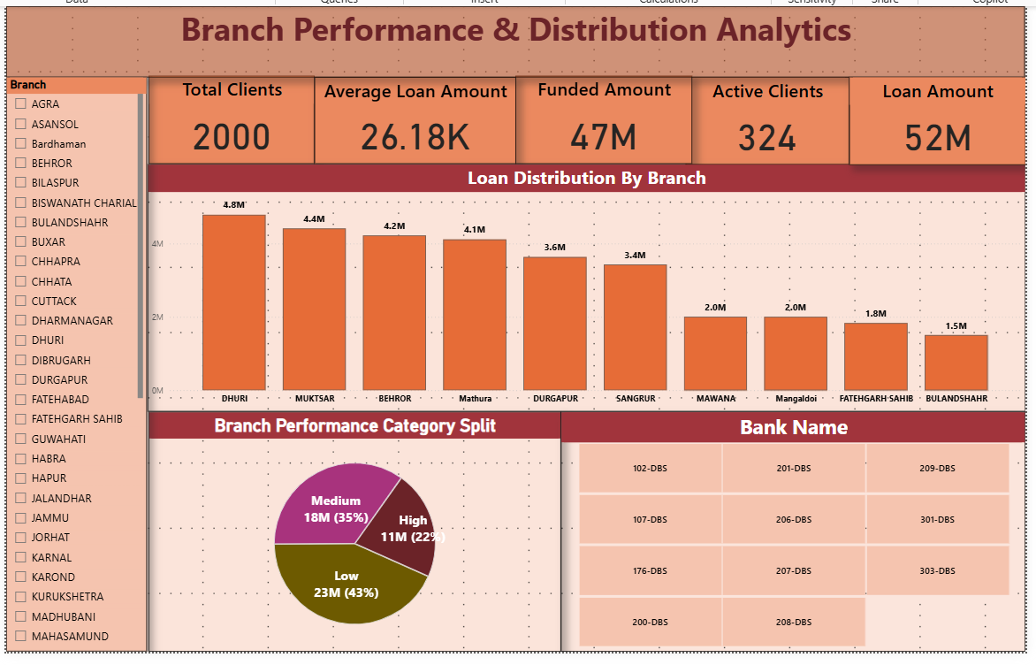
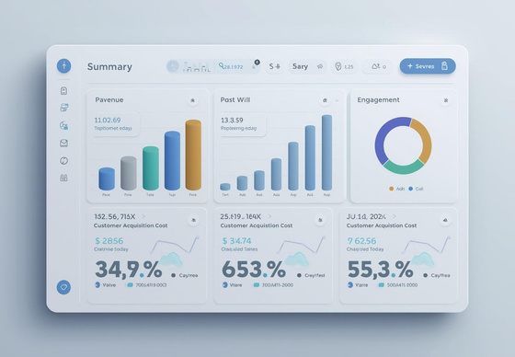
Banking Power BI Dashboard
7

Slide 7
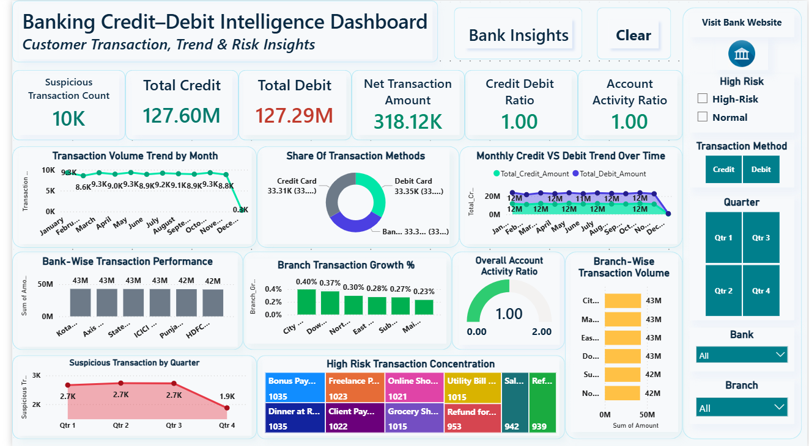
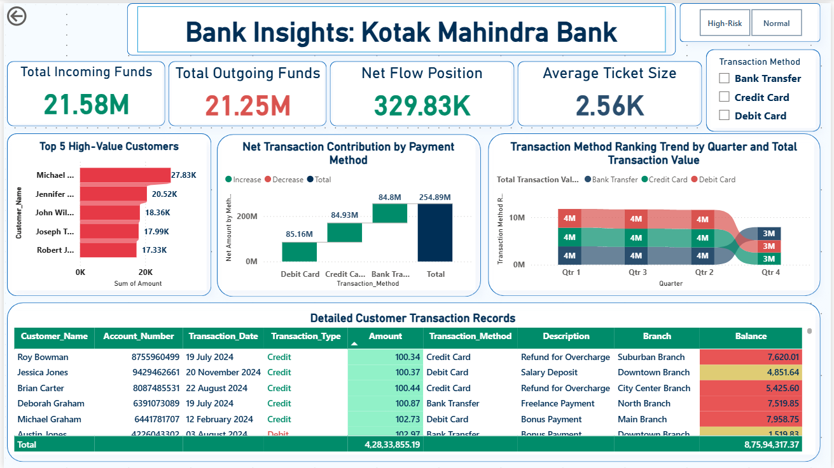
Credit / Debit Power BI Dashboard
Drill Through
8

Slide 8
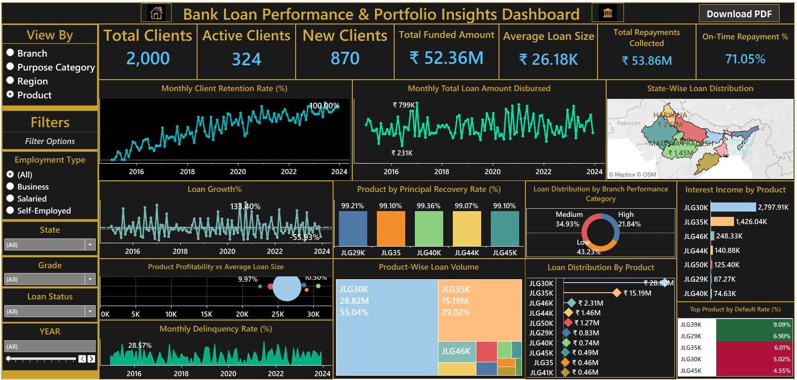
Banking Tableau Dashboard
9

Slide 9
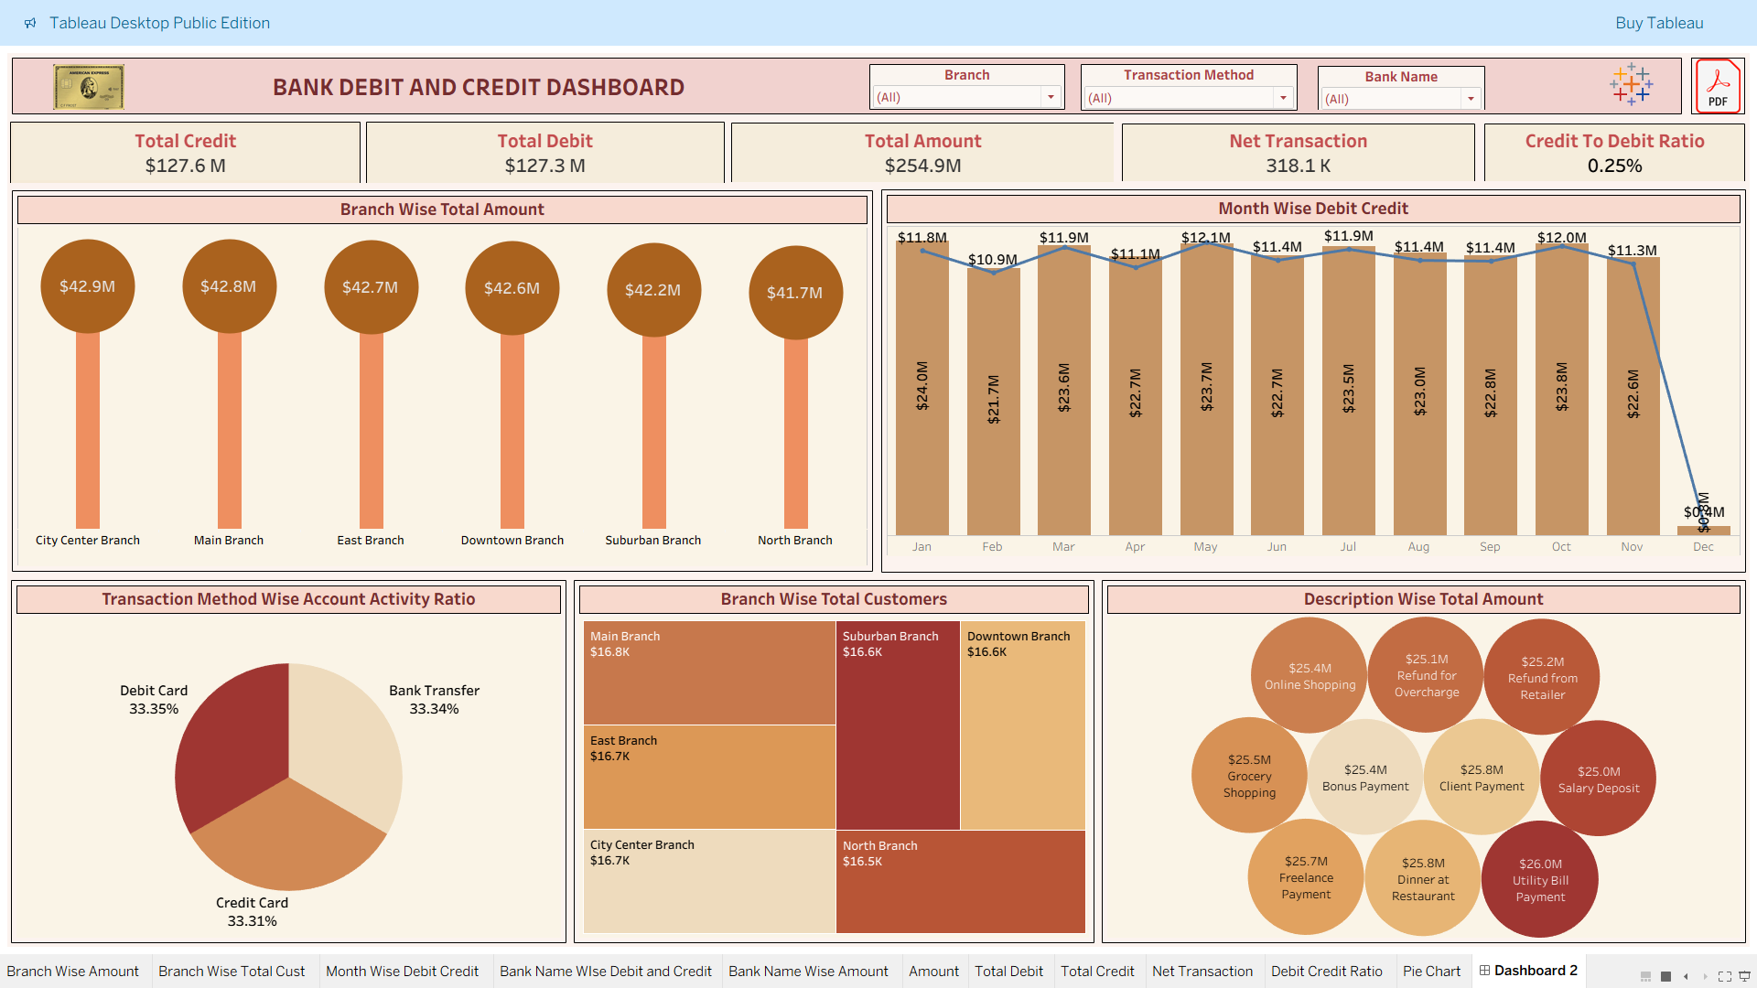
Credit / Debit Tableau Dashboard
10

Slide 10
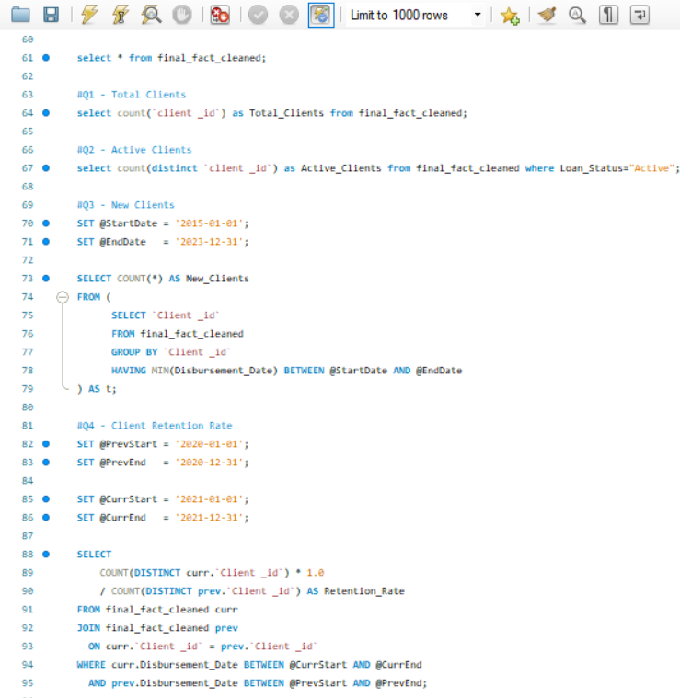
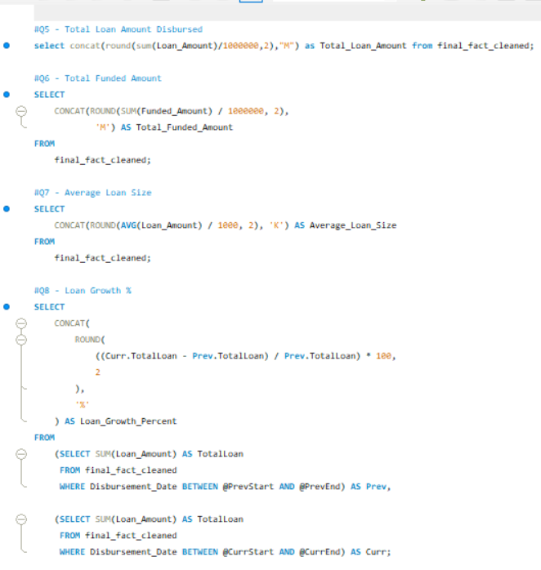
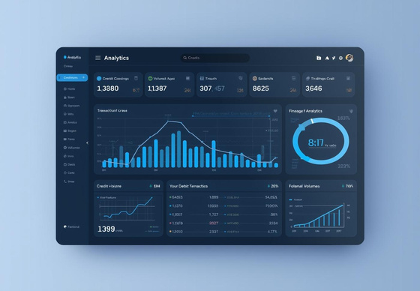
Banking SQL Queries
11

Slide 11
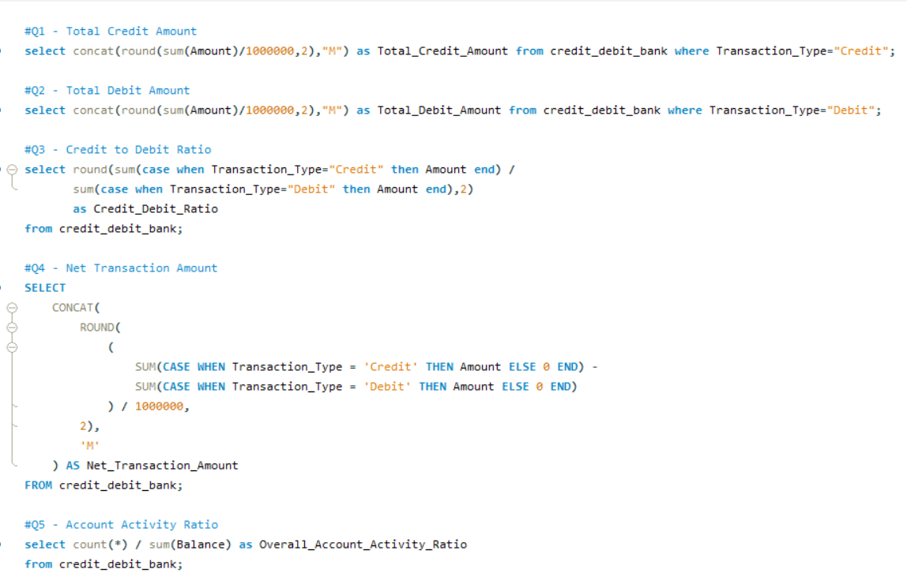
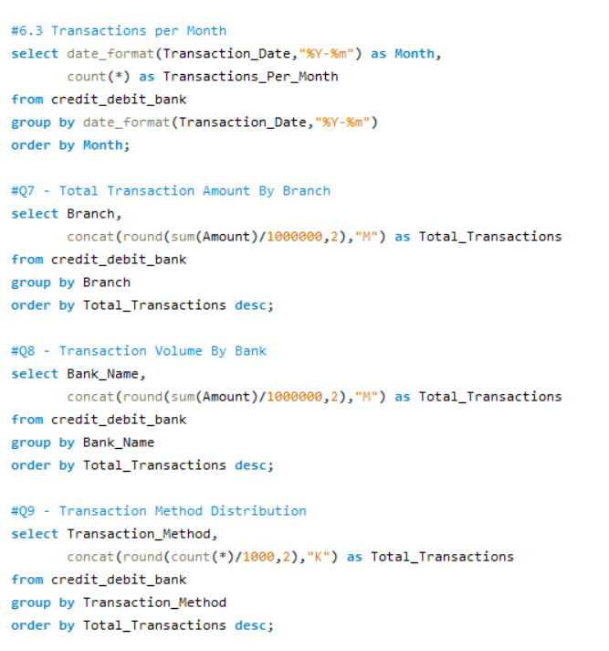
Credit / Debit SQL Queries
12

Slide 12

Business Insights & Findings
BANKING DATA
CREDIT / DEBIT DATA
Loan portfolio shows strong year-on-year retention approaching 100%.
Monthly loan disbursement remains stable with consistent demand.
Uttar Pradesh regions lead in overall loan distribution and activity.
Principal recovery rates across loan products remain above 99%.
Branch performance is dominated by medium and low categories.
JLG30K product leads all loan volumes with the highest contribution.
Delinquency rates remain controlled with predictable patterns.
Loan growth shows steady upward movement despite fluctuations.
Credit and debit transactions are nearly balanced with a 1:1 ratio.
Suspicious transactions are high, indicating strong monitoring needs.
Monthly transaction volume remains stable across the year.
Digital methods (credit/debit cards) dominate overall transactions.
Branches maintain consistent transaction volume around 42–43M.
Branch transaction growth % is low, showing limited expansion.
High-risk transactions cluster around specific spending categories.
Account activity ratio remains ideal at 1.00 across customers.
13

Slide 13
Challenges & Future Enhancements
CHALLENGES:
Inconsistent date formats and missing values increased cleaning time across both datasets.
Merging large banking tables with client & branch data required careful standardization.
Transaction records lacked uniform descriptions, making classification difficult.
Handling outliers in loan amounts and suspicious transactions affected accuracy.
Ensuring dashboard performance with multiple slicers and visuals was challenging.
FUTURE ENHANCEMENTS :
Implement predictive models to forecast loan defaults and delinquency risks.
Integrate fraud detection models for identifying unusual or high-risk transactions.
Automate real-time dashboards using APIs or daily scheduled data refresh.
Build customer segmentation to identify high-value & at-risk customer groups.
Add alert systems to monitor high-value, frequent, or suspicious transactions.
Deploy dashboards as a web/phone app for branch managers and decision-makers.
14

Slide 14

Conclusion
This project effectively analyzed both banking and credit–debit datasets to deliver meaningful insights that support better decision-making in loan performance, customer behavior, and transaction trends. Using Excel, Power BI, Tableau, and SQL, we built clear and interactive dashboards that highlight key risks and opportunities. Overall, the analysis demonstrates how data analytics can improve banking efficiency, strengthen risk monitoring, and enable smarter, data-driven strategies.
THANK YOU !!!
15

