Slide 1
Contact And Networking Project

Slide 2
Team Name: Social Brandits
About this template
Krishna Hudge
Yukti Handuja
Kanchan Joshi
Phalguni Nagrath
Rameshwar Suryawanshi
Onkar Joshi
Shirshendhu Panday
Vedant Chaubey
Vedantini Gaikwad
Shubham Tapele

Slide 3

Features:
Users:
Contact:
Friends:
Admin:
Contacts can be registered user or non-registered
Contact can be edited by a user
Contact can be deleted by a user
Search contacts
Search Registered Users
View and Edit Profile Of Contacts
Add, Edit or Delete a contact
Send friend request
Block a user while a request is sent
Ignore a request
Accept a request
Can Disable a User if Blocked by more than 3 Users
Can view Summary of registered Users

Slide 4
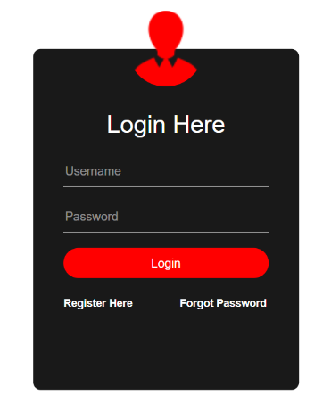
User Interface:
User Login Window

Slide 5
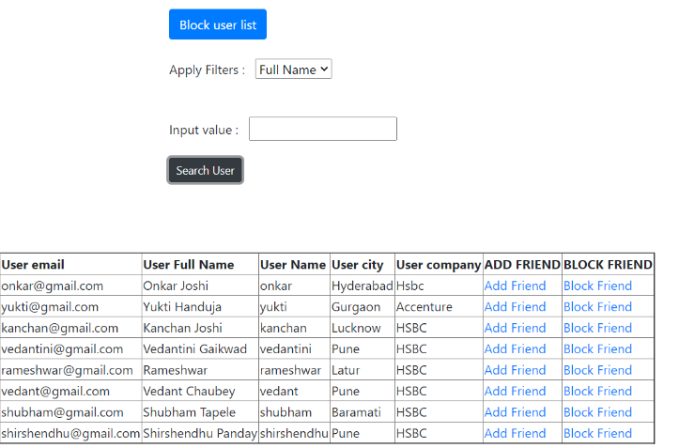
User Friend List

Slide 6

Learnings:
Technical Learnings
Implementation of MVC layered architecture.
Integration of servlets and JSP to map with various urls.
Designing the UI using HTML, CSS, JS and Bootstrap
Non-technical Learnings
Remote Working
Collaborating with colleagues
Various aspects of GIT for sharing individual work with the team
Time Management
In depth knowledge of documentation and naming convention

Slide 7
Thanks!
ANY QUESTIONS?
…
You can find me at:
@username
user@mail.me

