Slide 1

Data Analytics Internship
At ApexPlanet Software Pvt. Ltd.
Task 4 :
Data Storytelling & Statistical Validation
Presented By
Student Name: Onkar Abhiman Londhe
College Name: S.b Patil College Of Engineering Pune
Department: Computer
Email ID: onkarlondhe1139@gmail.com

Slide 2
Agenda
Task 1: Data Collection & Data Cleaning
Task 2: Exploratory Data Analysis (EDA)
Task 3: Data Visualization & Dashboard
Task 4: Data Storytelling & Statistical Validation

Slide 3
Task 1: Data Collection & Data Cleaning
Collected dataset related to business operations (e.g., product sales dataset).
Dataset includes multiple attributes such as product details, price, sales metrics and timestamps.
Goal: Prepare structured data for analysis.
Performed preprocessing to improve data quality:
Removed duplicate records
Handled missing values
Standardized text fields
Removed outliers using statistical techniques (IQR)
Generated a cleaned dataset for analysis.

Slide 4
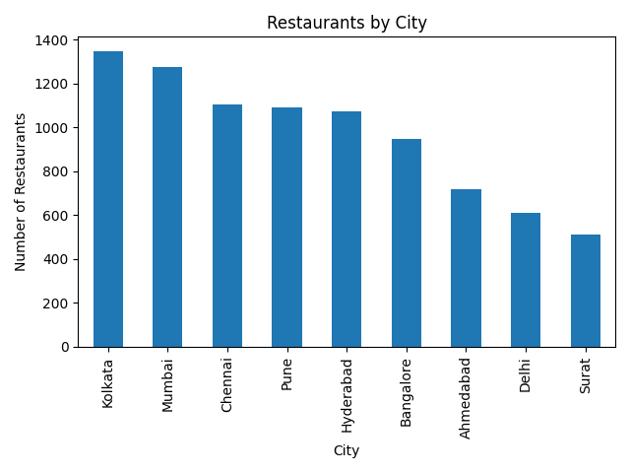
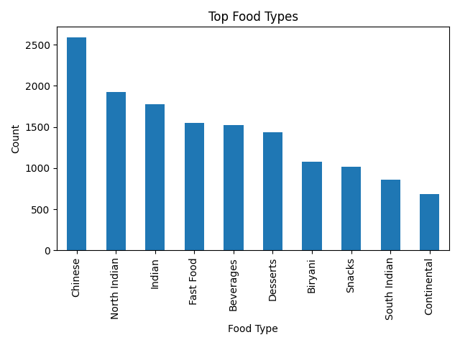
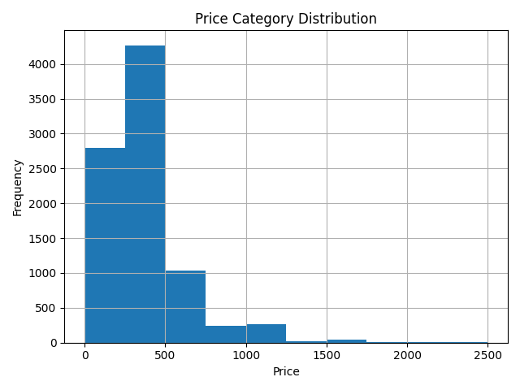
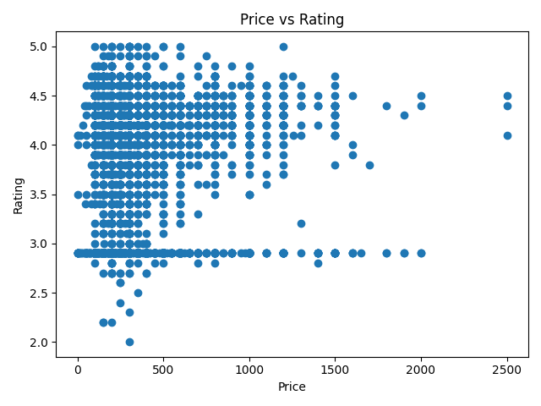
Task 1: Data Collection & Data Cleaning

Slide 5
Task 2: Exploratory Data Analysis (EDA)
Analyzed dataset to understand patterns and relationships:
- Price distribution
- Sales volume trends
- Product level performance
Identification of high-demand items.
EDA Key Insights
Important insights discovered during analysis:
- Some price ranges generate higher sales
- Certain products dominate overall demand
- Sales distribution shows patterns useful for business decisions.

Slide 6
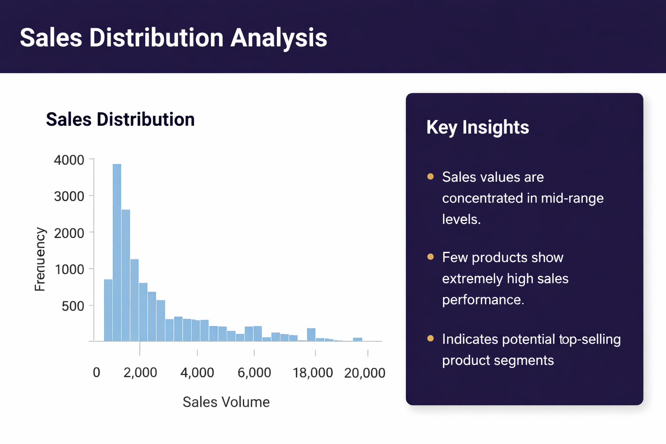
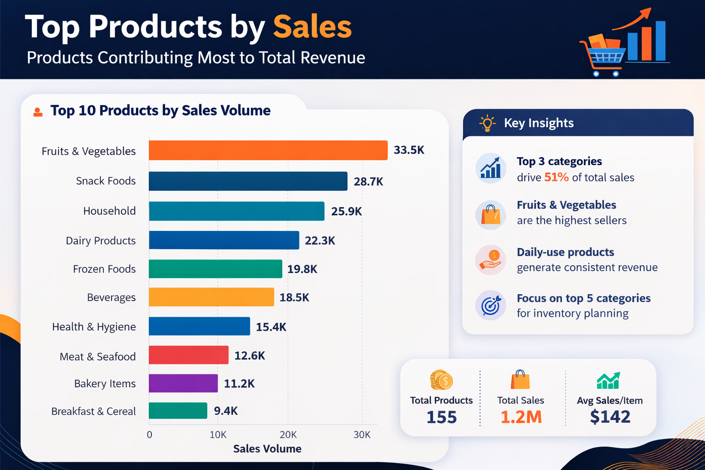
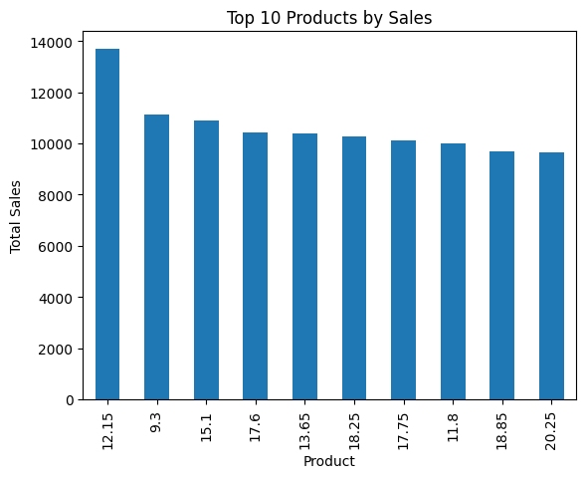
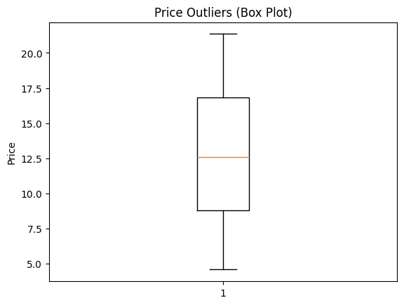
Task 2: Exploratory Data Analysis (EDA)

Slide 7
Task 3 – Data Visualization
Created interactive visualizations to communicate insights effectively.
Tools used: Power BI / visualization tools.
Visuals included:
- Sales trends
- Product performance charts
- Price vs demand analysis
- Category comparisons.
Dashboard Benefits
Interactive dashboard enables:
- Real-time insight exploration
- Better business decision making
- Easy identification of trends and patterns
- Clear communication of analytical results.

Slide 8
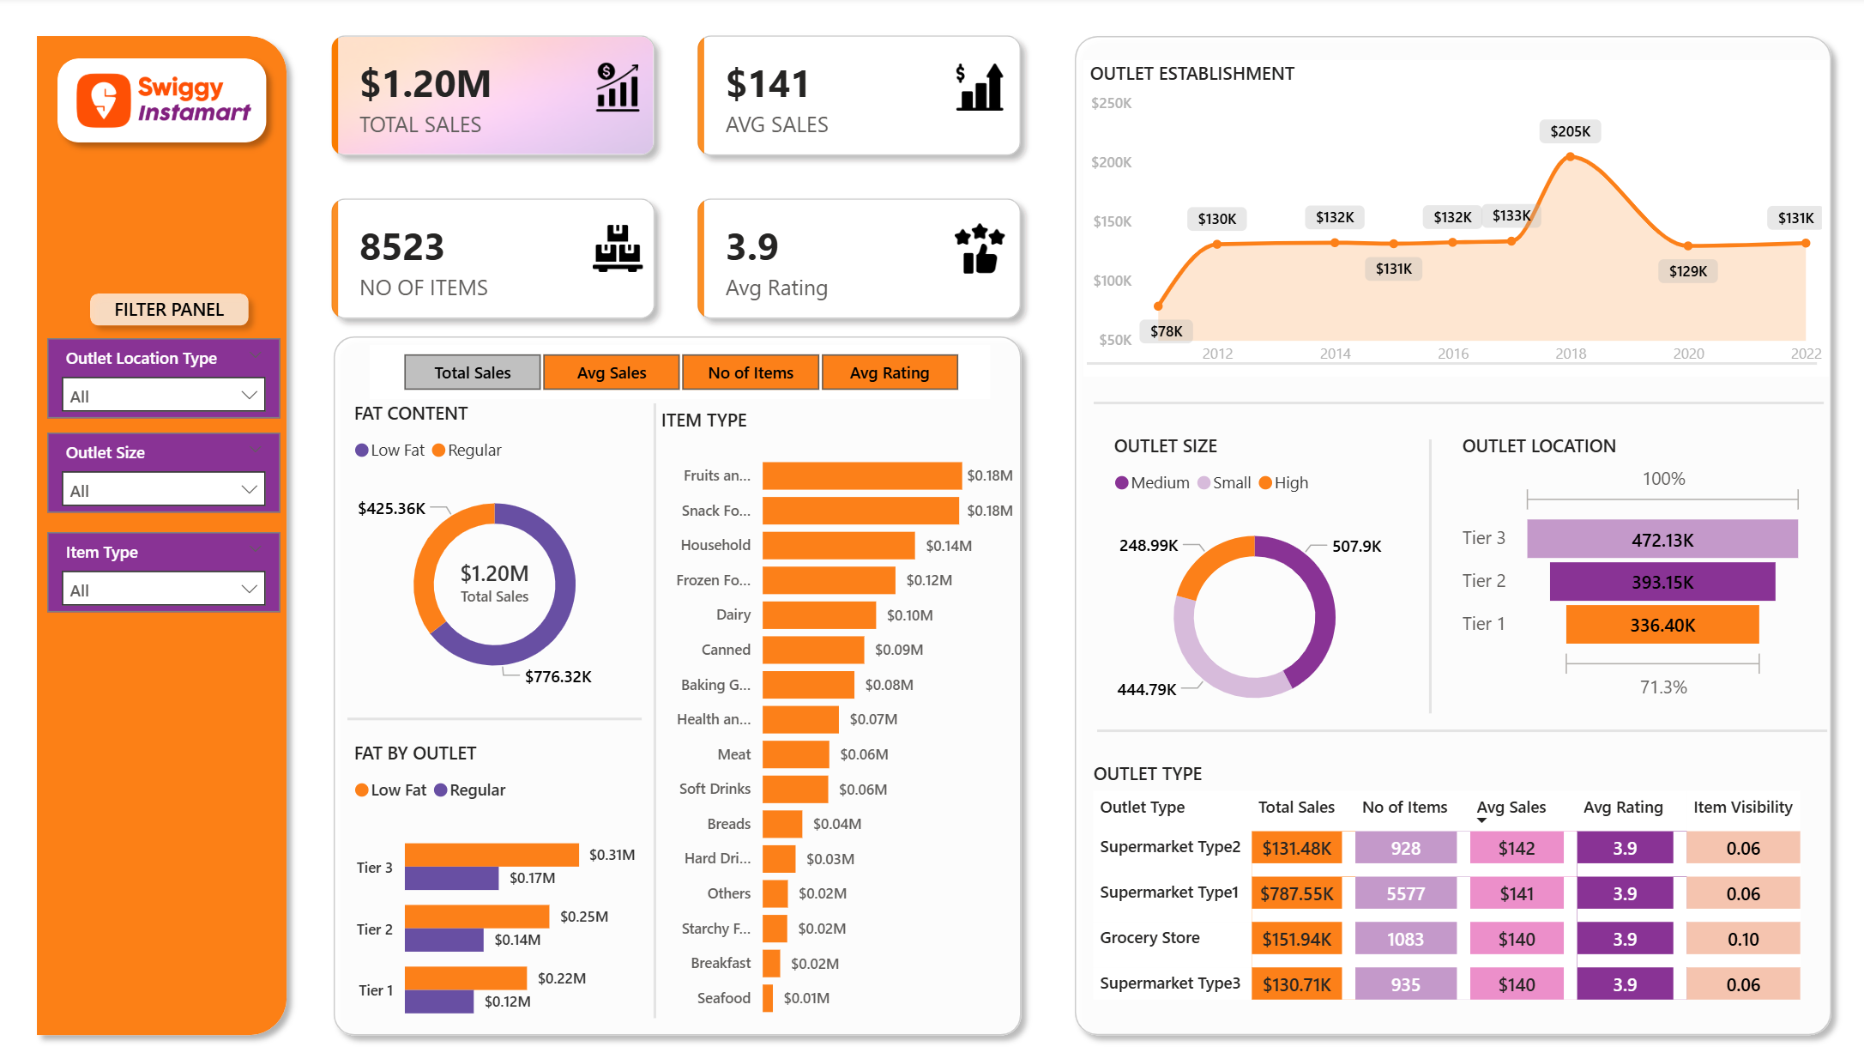
Task 3 – Swiggy Instamart Sales Dashboard Using Power BI

Slide 9
Task 4 – Objective
To synthesize all analysis into a compelling business narrative and use basic statistical methods to add rigor and validate key findings.
Step 1 – Craft the Data Story
Structure findings from Tasks 1–3 into a cohesive narrative for business stakeholders.
The story should include:
- Clear objective
- Analytical insights
- Business conclusions
- Recommended actions.
Step 2 – Develop the Final Presentation
Create a professional presentation deck that is:
- Visual
- Concise
- Insight driven
- Focused on business impact.
Step 3 – Hypothesis Testing
Formulate a testable business hypothesis.
Example:
'A change in strategy or design leads to a statistically significant improvement in performance metrics.'

Slide 10
Statistical Testing Methods
Perform appropriate statistical tests such as:
- T-test (A/B testing)
- Chi-Squared test for proportions
- Basic correlation analysis
These tests validate whether patterns observed in the data are statistically significant.
Interpreting Results
Interpret statistical outputs including:
- P-value
- Confidence intervals
- Test statistics
These results determine whether to accept or reject the hypothesis and derive business conclusions.

Slide 11
Hypothesis Testing
Introduction
Statistical validation was used to confirm analytical findings
Significance Level (alpha) = 0.05
Hypothesis Test 1
Test: Price vs Sales Volume
H0: Price does not affect sales
H1: Price affects sales
Method: Correlation Test
Hypothesis Test 2
Test: Discount vs Sales
H0: Discount does not increase sales
H1: Discount increases sales
Method: T-Test
Hypothesis Test 3
Test: Time vs Sales Volume
H0: Sales are equal across time periods
H1: Sales vary across time periods
Method: ANOVA

Slide 12
Deliverables
GitHub:
TASK 4 : https://github.com/onkarlondhe1139/OnkarLondhe-Task4-Hypothesis-Testing
TASK 1 : https://github.com/onkarlondhe1139/OnkarLondhe-Task1-DataWrangling
TASK 2 : https://github.com/onkarlondhe1139/OnkarLondhe-Task-2-EDA-BI
TASK 3 : https://github.com/onkarlondhe1139/OnkarLondhe-Task3-PowerBI-Dashboard

Slide 13
Conclusion
Combining data analysis, visualization, storytelling, and statistical validation enables organizations to make informed, data‑driven decisions and clearly communicate insights to stakeholders.

Slide 14
THANK YOU…

