Slide 1

Project Title – Car Market Analysis – Car Dekho Data
AICTE STU ID : STU691884604e8cc1763214432
Internship ID : INTERNSHIP_17830691666a4779eecfe8a
Student Name : Onkar Abhiman Londhe

Slide 2

PROBLEM STATEMENT
Used-car listings vary by price, fuel type, transmission and usage level.
It is difficult to identify which factors are most associated with selling price.
Buyers and sellers need data-driven benchmarks for reasonable pricing.
This project analyzes historical Car Dekho data to uncover pricing patterns and market trends.
The goal is to support better buying, selling and inventory decisions.

Slide 3
Project Description
This project performs an end-to-end exploratory analysis of Car Dekho used-car data using:
Python
Pandas
NumPy
Matplotlib
Seaborn
Dataset Contains :
Car Name
Manufacturing Year
Selling Price
Present Price
Kilometers Driven
Fuel Type
Seller Type
Transmission
Previous Owner Information
Analysis Performed The workflow covers :
Data inspection
Data cleaning
Feature engineering
Descriptive statistics
Categorical comparisons
Mileage analysis
Age analysis
Price-retention analysis
Correlation analysis
Identification of important pricing patterns

Slide 4

WHO ARE THE END USERS?
🚗 Car Buyers
Compare cars and identify reasonable prices.
🏷️ Car Sellers
Estimate competitive selling prices.
🏢 Car Dealers
Understand demand and pricing patterns.
📦 Used-Car Businesses
Support inventory and pricing decisions.
📊 Data Analysts / Business Teams
Derive actionable insights from automobile data.

Slide 5

Technology Used
Technology | Purpose
Python | Core programming and analysis
Pandas | Data loading, cleaning, grouping and aggregation
NumPy | Numerical calculations and feature engineering
Matplotlib | Data visualization
Seaborn | Statistical visualization and correlation heatmap
Jupyter Notebook | Interactive development and documentation

Slide 6
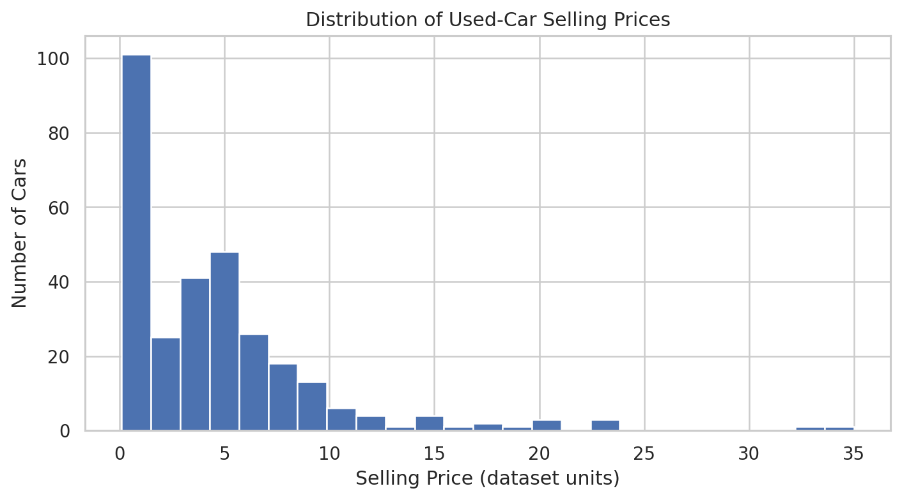
RESULTS
Github Link

Slide 7
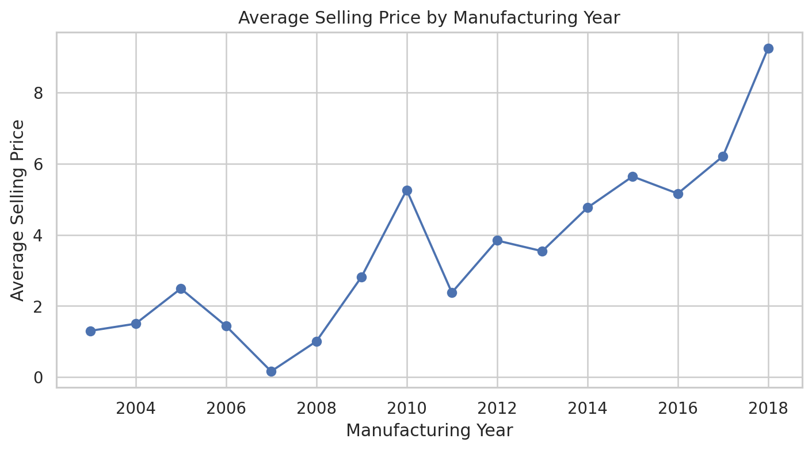
RESULTS
Github Link

Slide 8
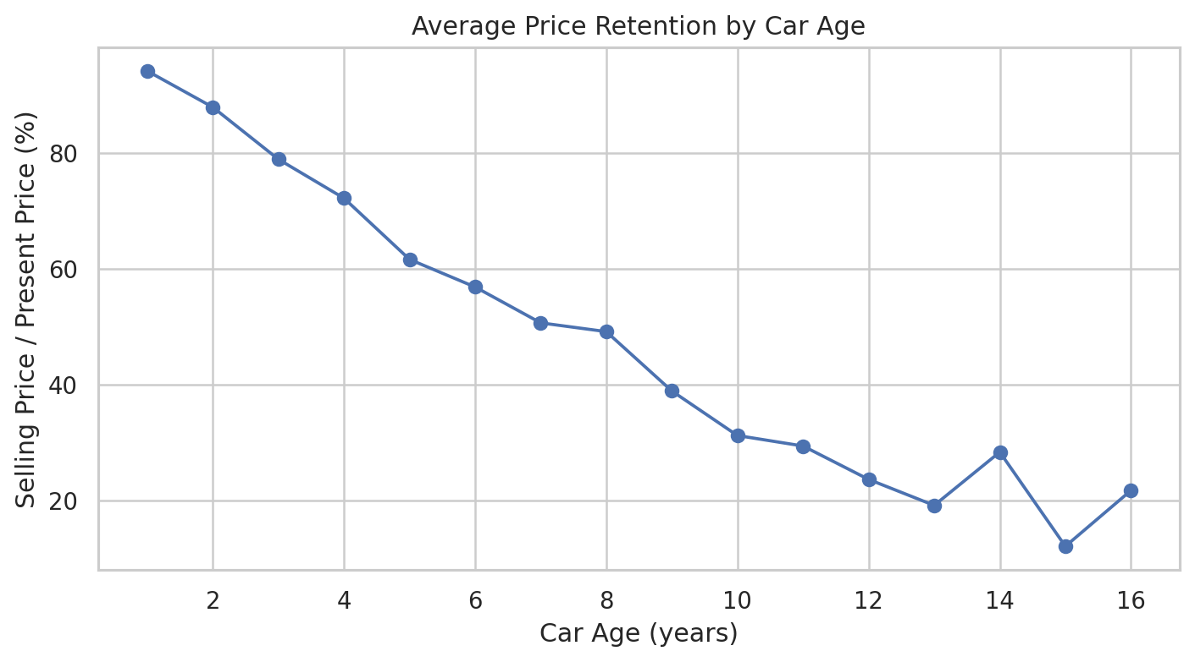
RESULTS
Github Link

Slide 9
Thank you
.

