Slide 1
Covid-19 Analysis using R

Slide 2
Shiny Dashboard
Implemented Shiny Dashboard compare 2 countries for analysing data related to Covid-19.
Working project compares 2 countries with number Covid 19 New Cases,Recovered Cases and Deaths.

Slide 3
Objective
Understanding how covid19 affected different countries.
Analysing New Cases, Recovered Cases, Deaths comparing two countries with help of graph.

Slide 4
Packages Used:
Shiny - Host standalone apps on a webpage or embed them in R Markdown documents or build dashboards.
readr - deal with reading in large flat files quickly.
dplyr - dplyr is a new package which provides a set of tools for efficiently manipulating datasets in R.
tidyr- Packages in the R language are a collection of R functions, compiled code, and sample data.
stringr - The stringr package provide a cohesive set of functions designed to make working with strings as easy as possible

Slide 5
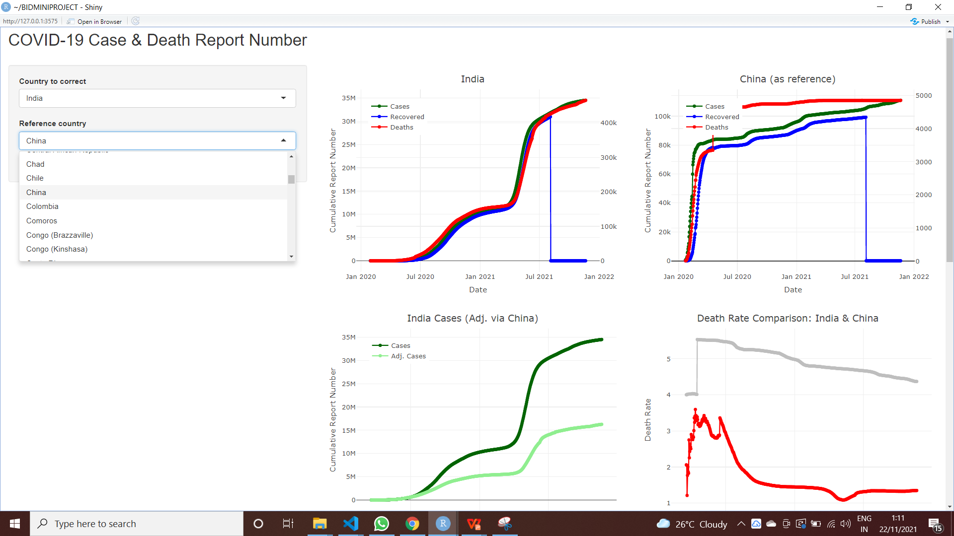
Output:
Shiny App

Slide 6
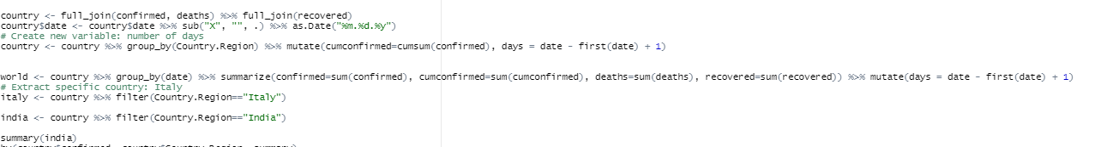
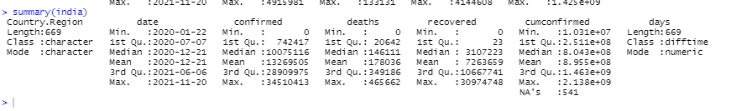
Summary of C-19 cases in India

Slide 7
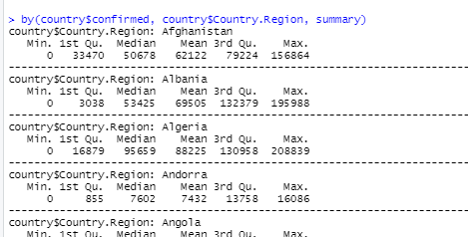
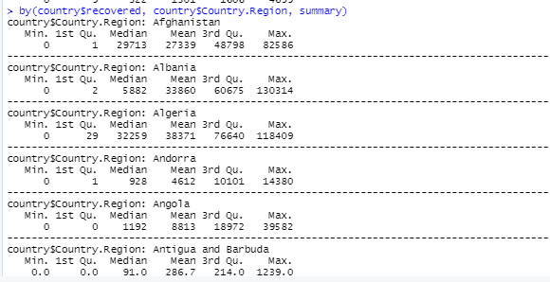
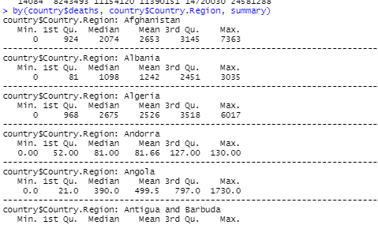
Data by country of Confirmed , Recovered cases and Deaths
by(country$confirmed, country$Country.Region, summary)
by(country$deaths, country$Country.Region, summary)
by(country$recovered, country$Country.Region, summary)

Slide 8

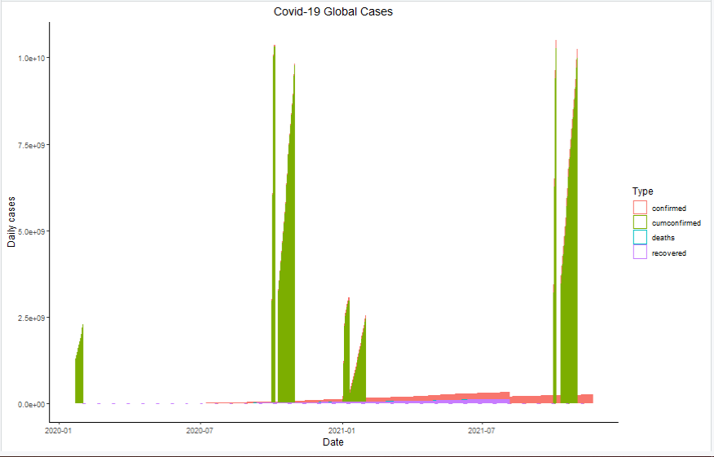
Covid-19 Global Cases

Slide 9
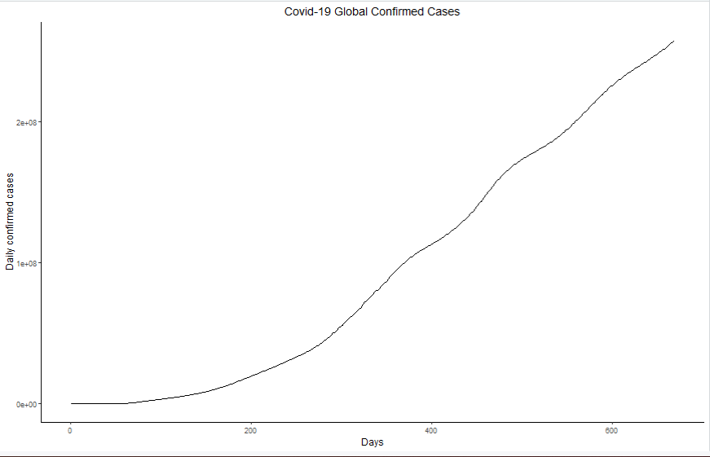
Covid-19 Confirmed Cases

Slide 10

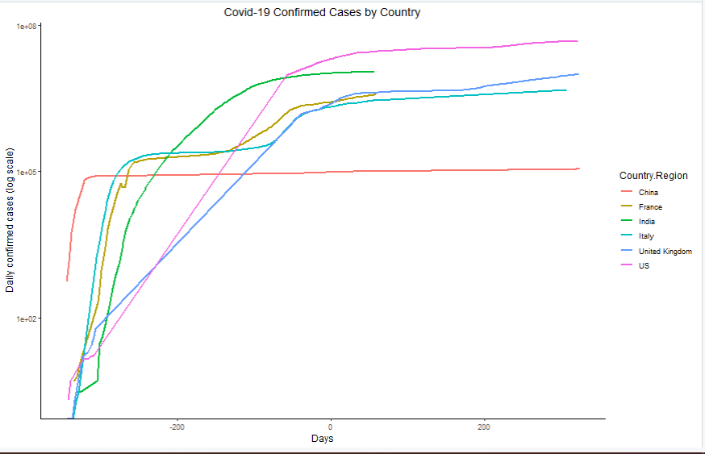
Confirmed Cases by Country

Slide 11
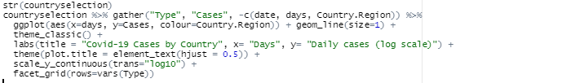
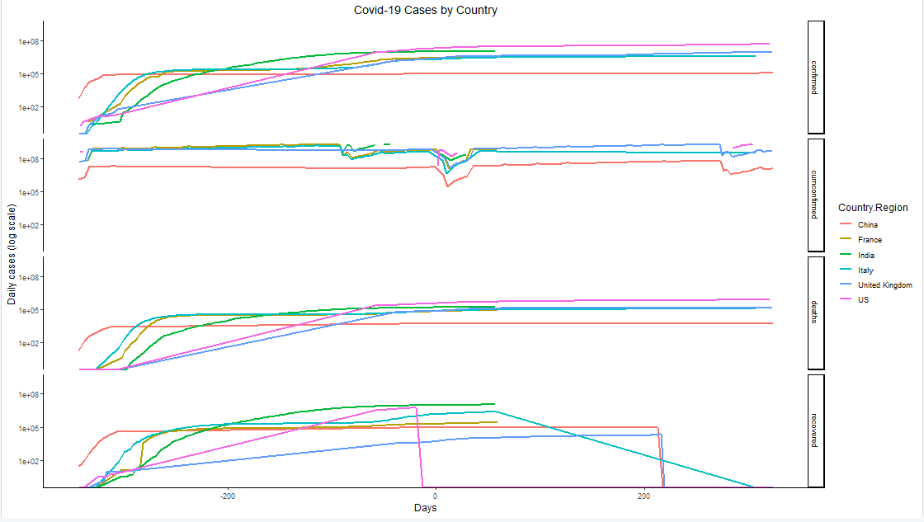
Confirmed,Cumconfirmed,Deaths,Recovered data by Country

Slide 12
Thank You!

