Slide 1
Application of Dijkstra’s Algorithm in Map
Analysis Of Algorithm - Project
Onkar Krishna Mundekar

Slide 2
Dijkstra’s Algorithm
Dijkstra's algorithm or Dijkstra's Shortest Path First algorithm , SPF algorithm is an algorithm for finding the shortest paths between nodes in a graph
We overestimate the distance of each vertex from the starting vertex. Then we visit each node and its neighbors to find the shortest subpath to those neighbors.
The algorithm uses a greedy approach in the sense that we find the next best solution hoping that the end result is the best solution for the whole problem.

Slide 3
Advantages:
It is used in finding Shortest Path.
Dijkstra's algorithm is its considerably low complexity
Disadvantages:
It do blind search so wastes lot of time while processing.
It cannot handle negative edges

Slide 4
Technology Used:
Application is developed in Python language
Package Used:
tkinter
The tkinter package (“Tk interface”) is the standard Python interface to the Tk GUI toolkit.

Slide 5
Complexity of Dijkstra’s Algorithm
Time Complexity
The time complexity for Dijkstra Algorithm using an array is O(V^2) and if priority queue is implemented, we can further improve the complexity to O(E log V).
Space Complexity
Space complexity you add both input and extra space in total taken.Here, Space complexity=input space+extra space= O(V^2)+O(1)=O(V^2)

Slide 6
Working of Dijkstra’s in current Application
Algorithm is used for finding out which way to be followed based on the distance.
For example as per above graph, application will take Sion as source and Colaba as destination.
Then it will calculate all possible paths and select shortest path based on the distance calculated for every path
After selection of shortest path it will print below information
1.minimum distance between source and destination
2.shortest route on map

Slide 7
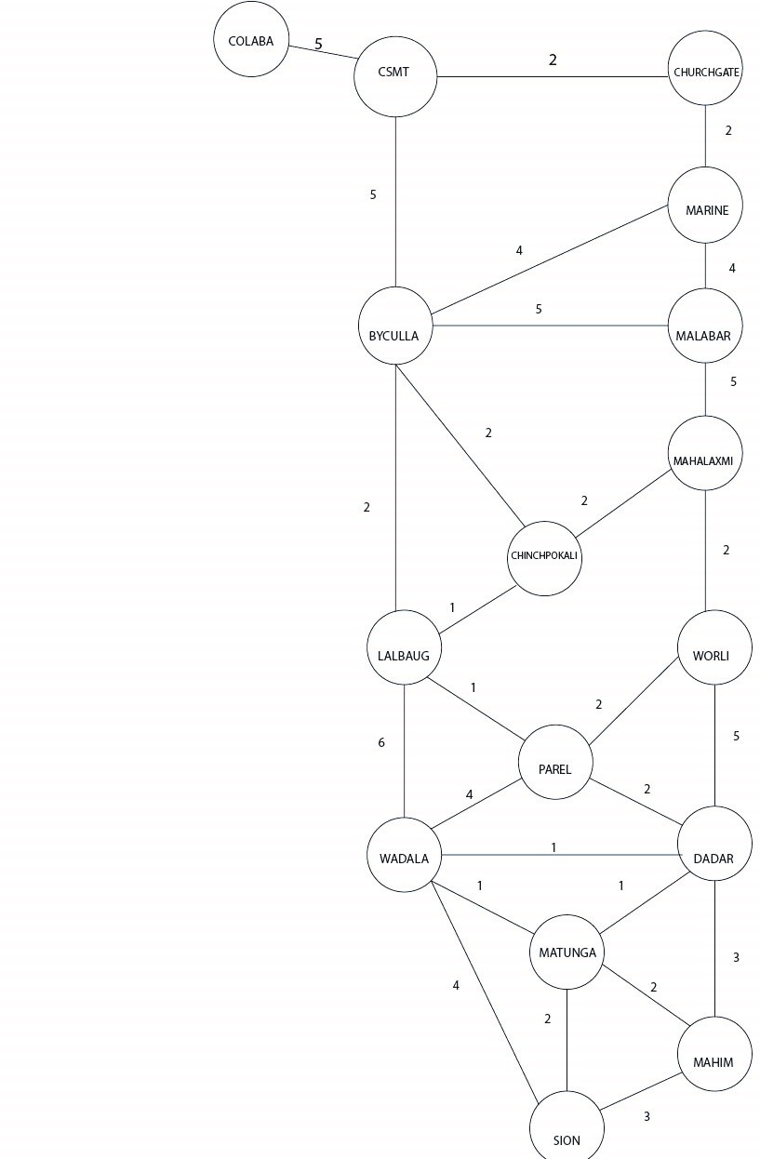
Graph: This is a weighted graph, where circles are vertices showing places and edges representing distance between two places.

Slide 8
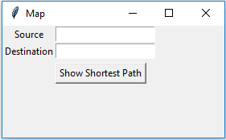
Output:

Slide 9
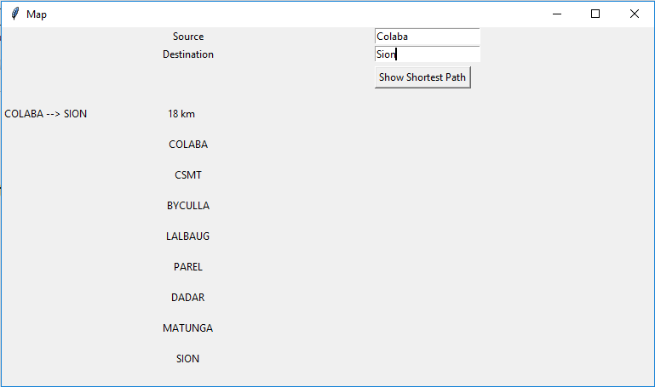
Output:

Slide 10
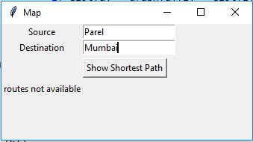
Output: When user enter invalid source or destination

Slide 11
THANK YOU

