Slide 1
Guessing Game
NLP Mini-Project
Onkar Krishna Mundekar
Msc Part I | Roll No 618

Slide 2

Basic rule to win this game is to match your guess with computer’s thinking.

Slide 3
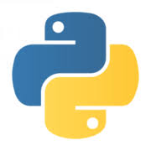
Libraries Used:
SpeechRecognition
PyAudio
Classes Used:
Recognizer()
Microphone()

Slide 4
SpeechRecognition
Speech recognition is the process of converting spoken words to text. Python supports many speech recognition engines and APIs, including Google Speech Engine
The first component of speech recognition is, of course, speech. Speech must be converted from physical sound to an electrical signal with a microphone, and then to digital data with an analog-to-digital converter. Once digitized, several models can be used to transcribe the audio to text.

Slide 5
PyAudio
PyAudio is a set of Python bindings for PortAudio, a cross-platform C++ library interfacing with audio drivers.
PyAudio provides Python bindings for PortAudio, the cross-platform audio I/O library. With PyAudio, you can easily use Python to play and record audio on a variety of platforms.

Slide 6
recognizer() The Recognizer Class. All of the magic in SpeechRecognition happens with the Recognizer class. The primary purpose of a Recognizer instance is, of course, to recognize speech.

Slide 7
microphone()
Microphone is a context manager. You can capture input from the microphone using the listen() method of the Recognizer class inside of the with block. This method takes an audio source as its first argument and records input from the source until silence is detected.

Slide 8
Working Of Current Project
Computer will select one word from given list
User will have 3 tries
Its time to speak!
one guess from list
to match with computer
If enable to match with computer selected word
You Lose!
If guess is correct you win! or try guess 2

Slide 9
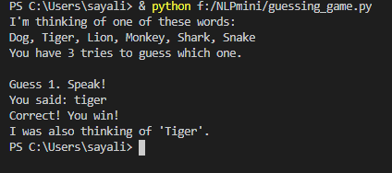

Output
Correct Guess in first try
When recognizer() unable to recognize speech

Slide 10
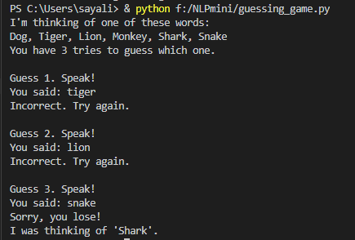
Output
You lose!

Slide 11
THANK YOU

