Slide 1
Home automation

Slide 2
Objective
Home automation system controls its objects such as windows , doors, lights, and also few gas detectors, alarm using micro-controller or computer technology.
The automation system helps you to access your doors with the help of a computable device such as smart phones or tablets connected to a network, and access by means of secured pins to authorize the access.
In this project we are implementing home automation system with IOT and we will show the implementation of smart garage system using Cisco Packet Tracer.

Slide 3
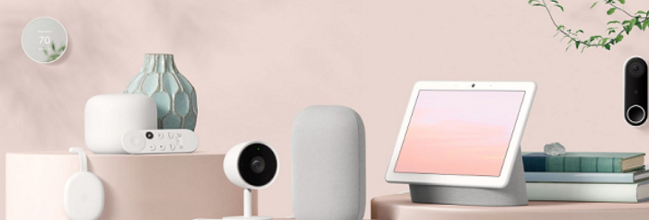
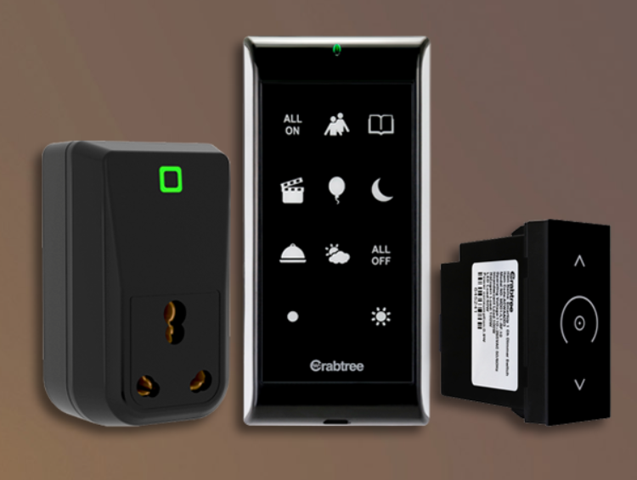
Exisiting Home automation devices
Google Nest
All Google Nest products work with each other and a number of other smart home devices by staying connected with Wifi.
Nest products work with smart locks, smart lightbulbs, and other smart devices and appliances.
Smart H
A complete retrofit range which fits in the existing switch box, by replacing the manual switch with smart switch.
Modular glass finish touch switches which changes the décor of your home.

Slide 4
System overview
This automation helps us to reduce the temperature in the house by opening the doors and windows when the CO2 emmissons reaches greater than the threshold.
As all are IoT devices ,they can interact with one another based on the conditions defined by the owner.
We can monitor the house using the IP camera that is installed in the doorway which reduces human effort of constant checking the front door.
Scheduling the lights to turn on/off based on schedule reduces the human effort as well reduces the power consumption.
Building a home automation system which is smart and secure both at the same time will make our life’s easier as these days human’s are thinking smart rather than working hard ,hence we are motivated to implement the same using packet tracer.

Slide 5
Methodology
To Implement Home automation System , we will be using cisco packet tracer ,which includes different smart objects used for home automation such as smart door, smart window, smart door, smart light , smart sensors, fire sprinkler ,and different sensors are included.
To control these smart objects and sensors, microcontroller (MCU) and IoT server are used.
To connect every smart object in the house we use Wifi and connect them through a gateway and control them with a smartphone.
Different Types of conditions are written on to the smart objects based on the user requirement to control the house and security is assured to user by implementing the pin lock system in the mobile.

Slide 6
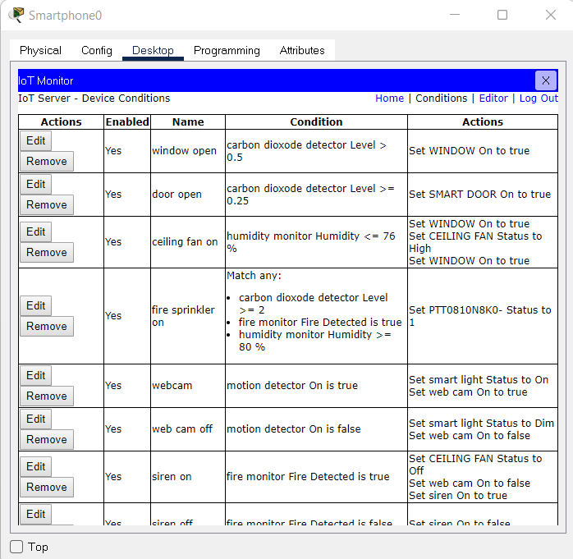
Device configurations

Slide 7
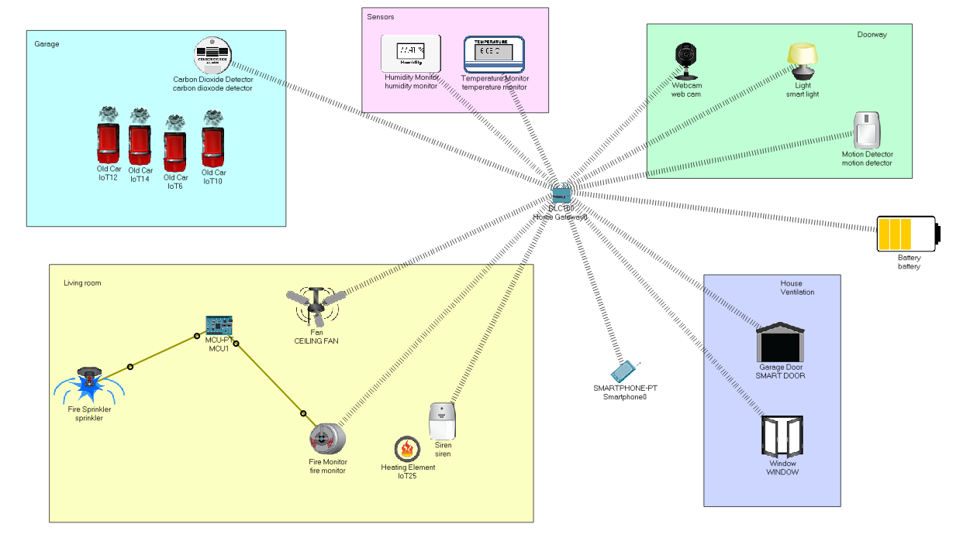
Our home automation system created with cisco packet tracer.

Slide 8
System cost
Motion detector sensor - Rs.100
CO2 detector sensor - Rs.500
Fire detector sensor - Rs.100
Humidity / Temperature monitor price - Rs.200
Raspberry Pi 4 Model B with 4GB Ram - Rs.4600
Total cost : ~ Rs.6000

Slide 9
Thank you!

