Slide 1
Wireless and Mobile Communications

Slide 2

Hospital Networking

Slide 3




Hospital Management Workflow

Slide 4
Abstract:
This project describes the network design of Health care management or Hospital. In this network topology the nodes (i.e., computers, switches, routers or other devices) are connected to a local area network (LAN) and network via links
We have used Cisco Packet Tracer for designing the network topology

Slide 5
Hospital Segments:
General ward
Covid-19 Isolation Ward
Clinical Area
IT Department
Entrance Reception
Lobby and Parking

Slide 6
Implementation

Slide 7
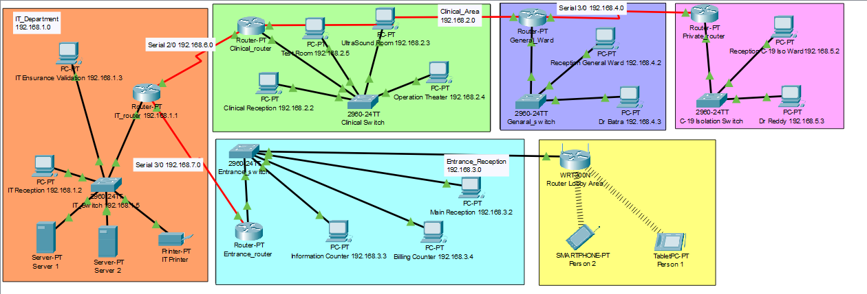

Slide 8
Cost of Network
Cisco Switch - Rs 18,000 for 1 * 5 = Rs 90,000
Cisco Router - Rs 26,000 for 1 * 6 = Rs 1,56,000
Cisco Server - Rs 29,000 for 1 * 2 = Rs 58,000
Cisco Computer - Rs 20,000 for 1 * 13 = Rs 2,60,000
Total Cost for Network = Rs 5,64,000

Slide 9
Conclusion
We have designed network topology of hospital (Health care Management System).This topology can also be implemented on higher level of hospitals.

Slide 10
Thank You

