Slide 1
GIS-Real World Case Study
Onkar Krishna Mundekar
MSc Part-I | Roll No.618

Slide 2
House Renting In Mumbai
In this project, we will try to analyze the apartments in Mumbai for rent or sale in 2020 and draw conclusions based on some predefined conditions

Slide 3
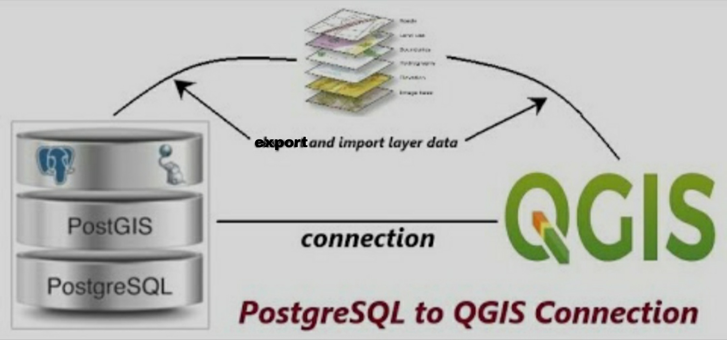
Technology Used:
QGIS
PostgreSQL (open source object-relational database system)
PostGIS (adds support for geographic objects to the PostgreSQL)

Slide 4
Implementation

Slide 5
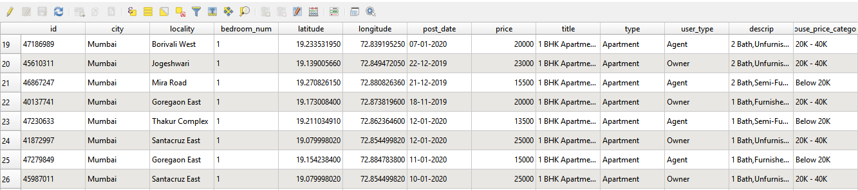
Mumbai House Price dataset from Kaggle.

Slide 6
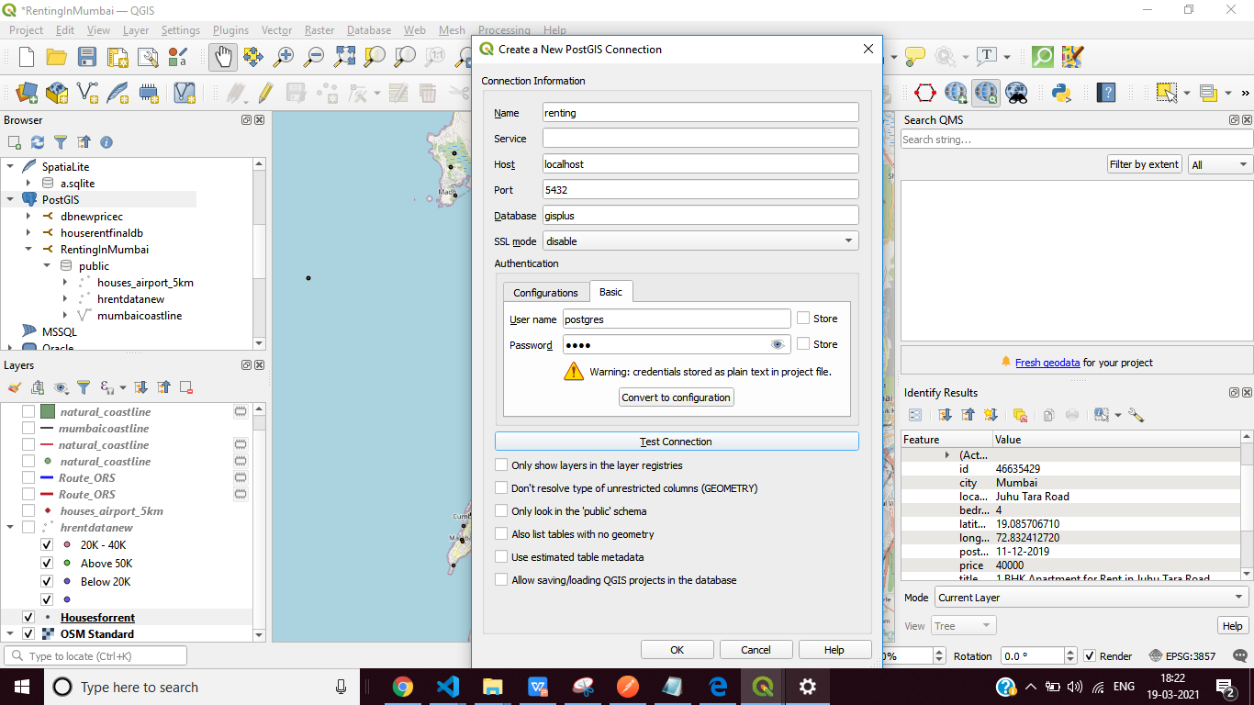
Connecting postgis and QGIS

Slide 7
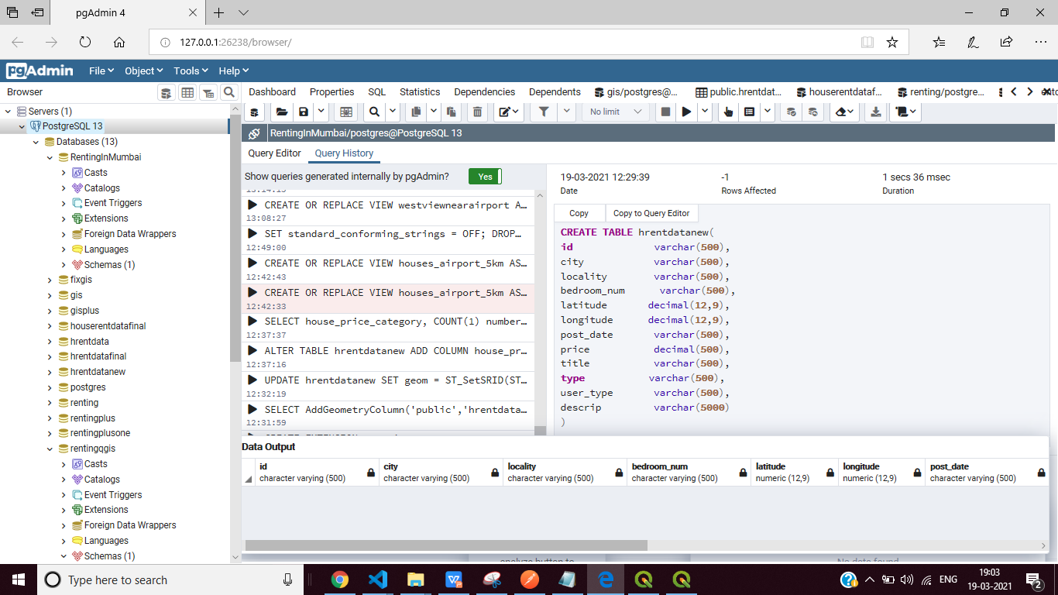
PgAdmin4 (database management tool )

Slide 8
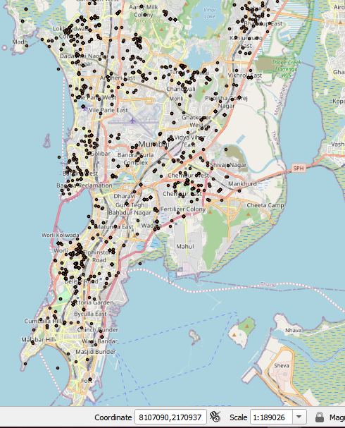
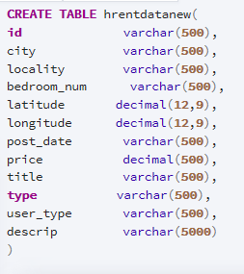


Querry add csv data on map

Slide 9
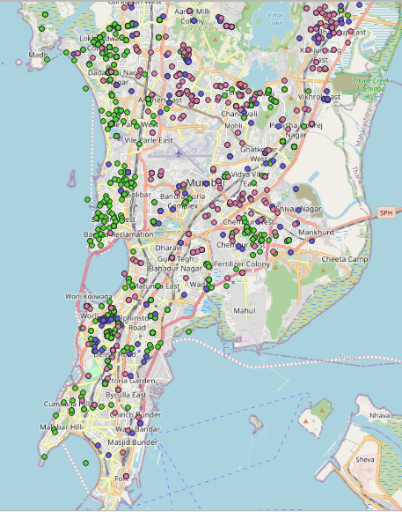
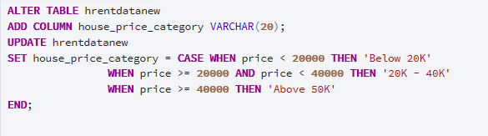
Categorize by price range

Slide 10
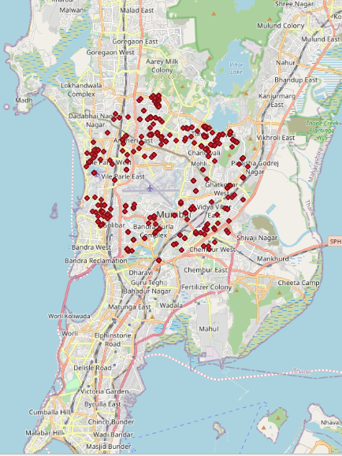
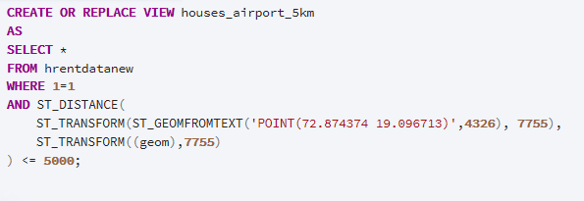
Querry to find houses near airport

Slide 11
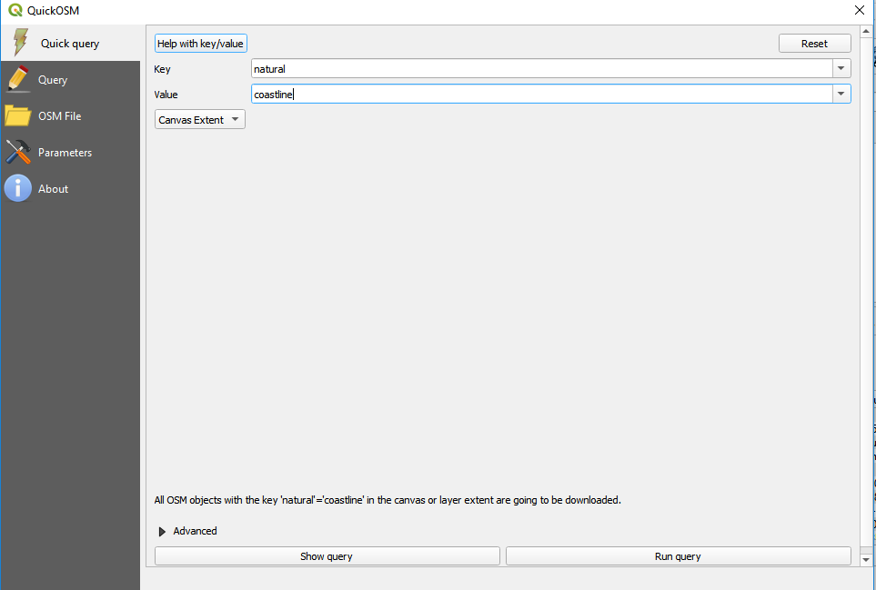
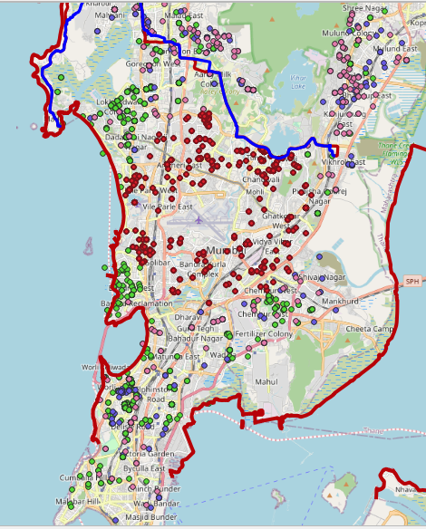
Adding coastline

Slide 12
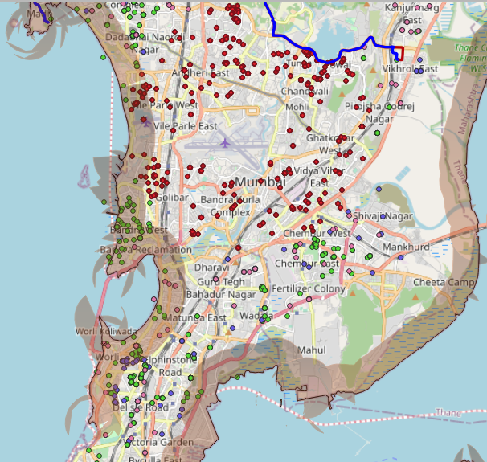
Coastline Buffer
select
ogc_fid,
full_id,
name,
st_buffer(wkb_geometry,0.001,'side=left')as buffer_zone
from mumbaicoastline;

Slide 13
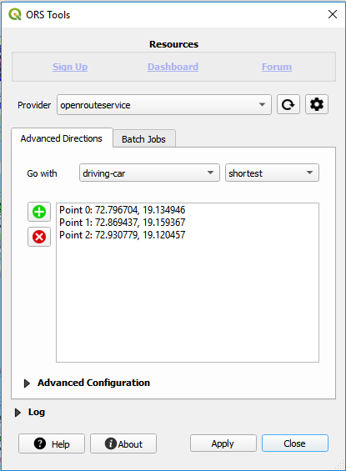
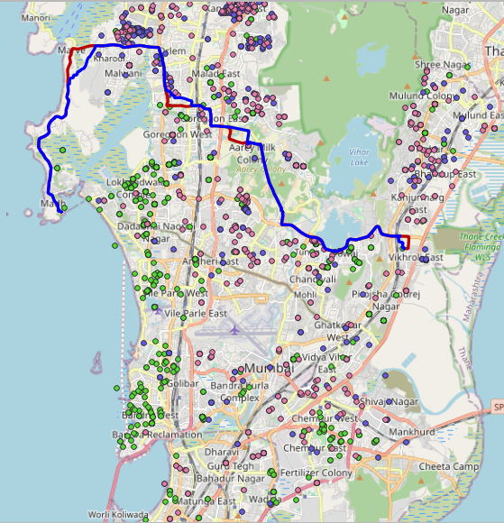
Finding shortest & longest path using ORS Tool

Slide 14
THANK YOU

