Slide 1
🌧️ Rainfall Prediction
Using Machine Learning
Presented by:
Gaurav Nugurwar (DS80)
Rishabh Onkar (DS81)
Samruddhi Pachapohar (DS82)
Tanvi Padole (DS83)

Slide 2
Introduction & Problem Statement
• Rainfall prediction is important for agriculture, water management and disaster prevention.
• Weather conditions change continuously, making accurate prediction difficult.
• Machine Learning can learn patterns from historical weather data.
• Goal: predict rainfall amount or Rain/No Rain from weather conditions.
2

Slide 3
Objectives
01
Predict rainfall
02
Find key factors
Use historical weather data to estimate rainfall.
Analyze humidity, temperature, pressure and other features.
03
Compare models
04
Easy output
Evaluate multiple ML algorithms.
Show prediction through a simple dashboard.
3

Slide 4
Methodology / Project Workflow
Data Collection
Data Cleaning
Preprocessing
Feature Selection
Model Training
Evaluation
Prediction
Input Features
Temperature
• Humidity
• Pressure
• Wind Speed
• Cloud Cover
• Previous Rainfall
• Month
4

Slide 5
Machine Learning & Technology
• Algorithms: Linear Regression, Decision Tree, Random Forest and XGBoost.
• Python libraries: Pandas, NumPy, Scikit-learn, Matplotlib and Seaborn.
• Web application: Flask + HTML + CSS + JavaScript.
• Evaluation: MAE, RMSE, R² Score; Accuracy/F1-score for classification.
⭐ Random Forest
5

Slide 6
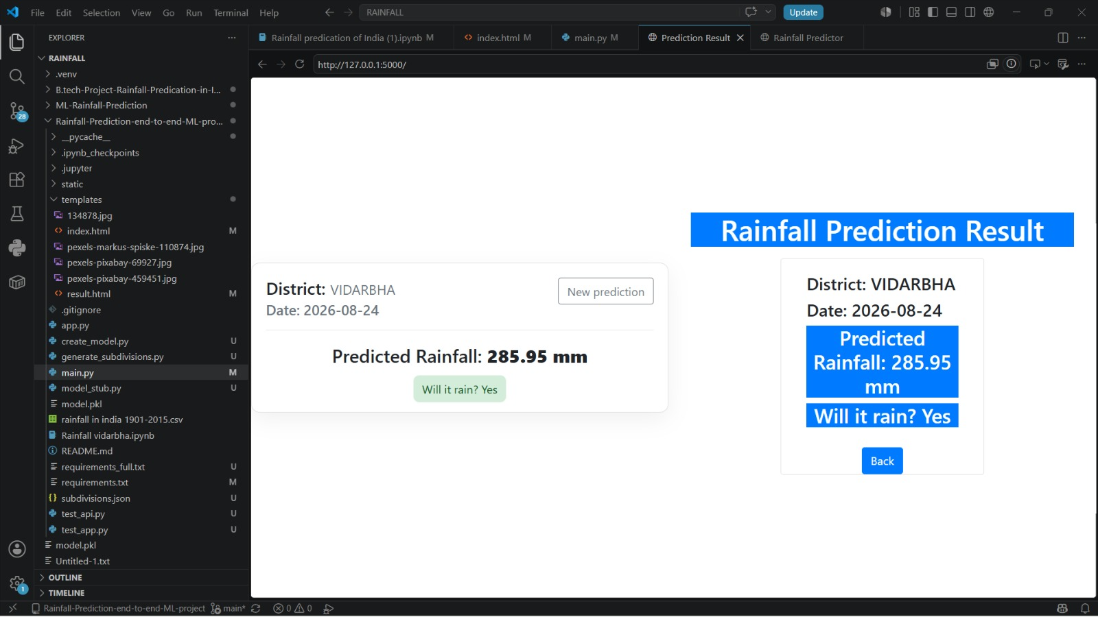
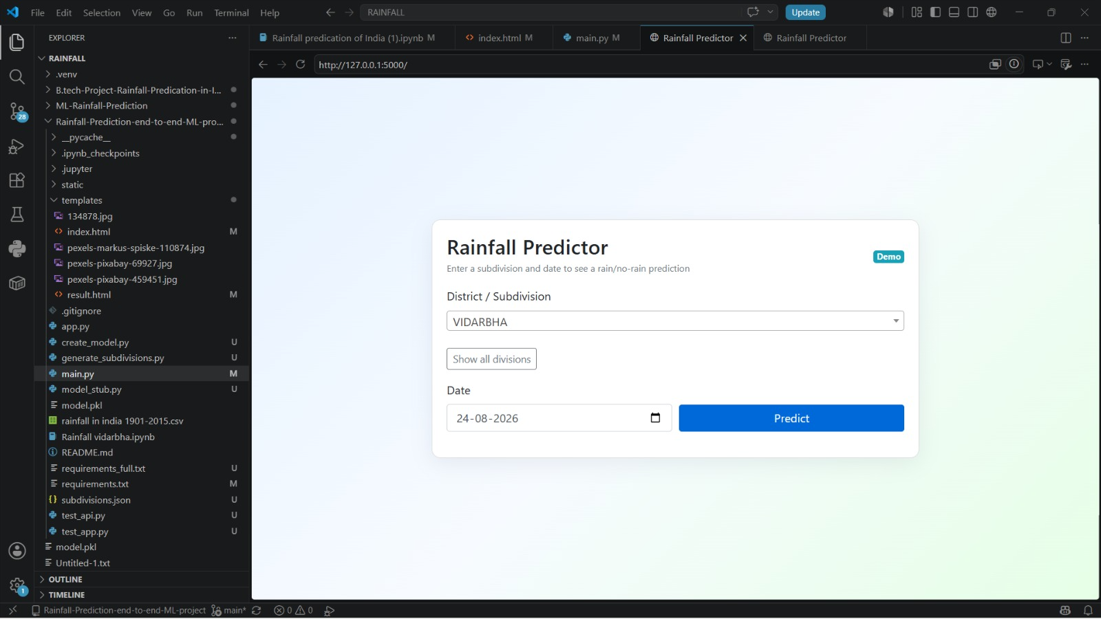
Expected Result & Applications
6

Slide 7
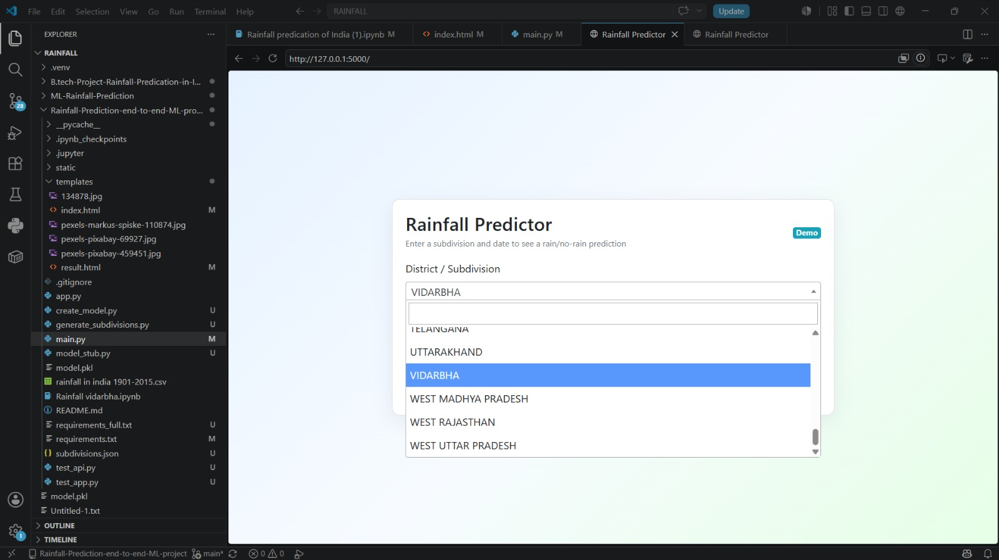
Expected Result & Applications
Applications
🌾 Agriculture
💧 Water resource management
🚨 Flood/disaster management
🏙️ Urban planning
🌱 Environmental monitoring
6

Slide 8
Conclusion & Future Scope
• Machine Learning can identify useful patterns from historical weather data.
• The proposed system can predict rainfall based on atmospheric conditions.
• The model can support agriculture, water management and disaster planning.
• Future: real-time weather APIs, LSTM/GRU, 7-day forecasting and flood-risk alerts.
Thank You! 🌧️
7

