Slide 1
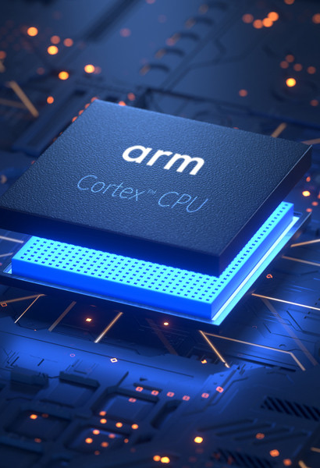
ARM Based SoC Verification
Presenter Name

Slide 2
Agenda
ARM Based SoC Architecture
PCR Verification
UVM TB Design
Boot Flow
Bringup and CPU Boot
GLS/DFX Verification
Fabric Verification

Slide 3
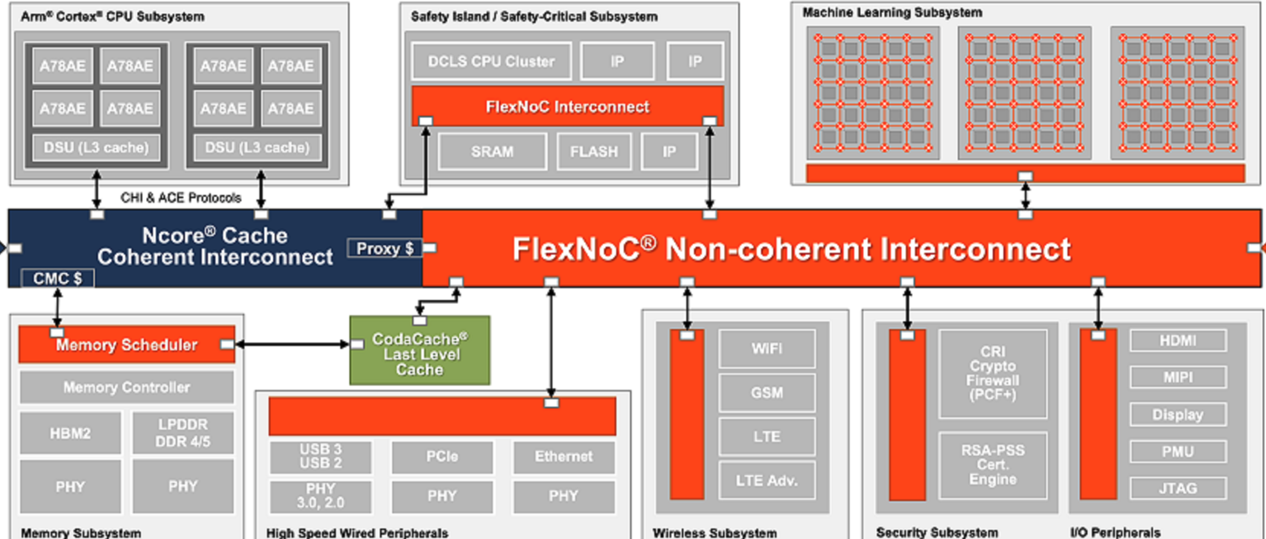
ARM Based SoC Architecture

Slide 4
ARM Based SoC Architecture
A-Class Based Cluster
M-Class Based Subsystem for Security/PCR Management
Fabric
Coherent Interconnect
CCI/CMN
Non-Coherent Interconnect
NI-Tower
GIC Interrupt controller
LSIO
Subsystems
LPDDR Subsystems
HSIO Subsystem
Debug CSS600 Components

Slide 5
ARM Based SoC Architecture
A-Class Based Cluster (ARMv8/v9 Architecture)
Big Core
Medium Core
Little Core
M-Class Based Subsystem for Security/PCR Management
M85/M55 Core
AON subsystem
Powering up Interconnect/PLLs
Init Subsystems
Fabric
Interconnects/Memory map
GIC/Interrupt map

Slide 6
ARM Based SoC Architecture
Debug
APB ROM Table for Discovery
AHBAP/AXIAP Memory View
AP/DP Ports
CTI
Trace
Security
Secure Transactions using CPU MMU Tables, IO Masters SMMU page tables
RME features
Debug Security
SPIDEN/NIDEN
Boot
M-Class Authentication using OTP

Slide 7
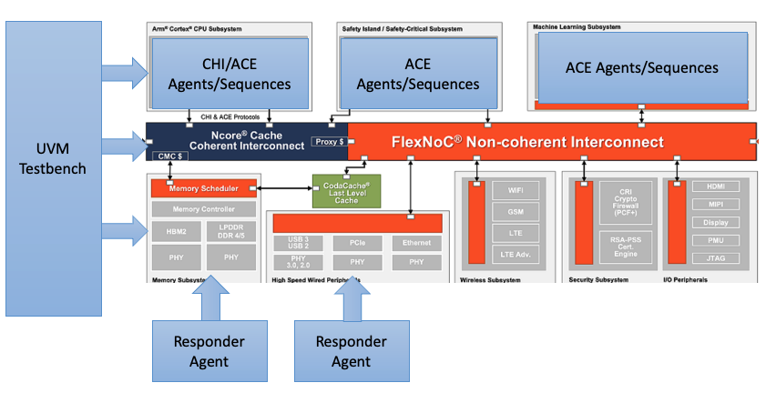
ARM Based SoC : UVM Testbench Design
Clock/Reset Agents
P/Q Channel Agents
CHI Agents
ACE Agents
Memory responders
MailBox
Test End Mechanism
Coverage/Scoreboard

Slide 8
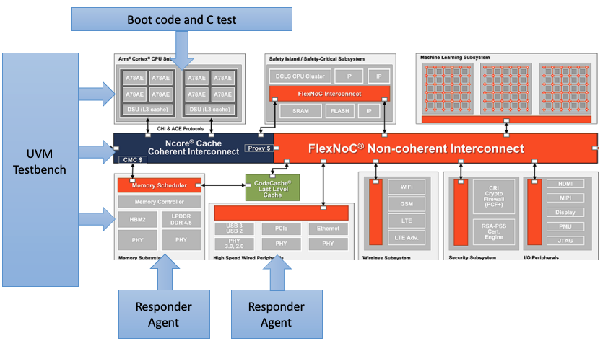
ARM Based SoC : C + UVM Testbench Design
ASM Code for A/M Class processor
ARM RVDS compiler
Scatter file to generate hex code
Preload of hex code
Reset/Clock to CPU RTL using UVM TB
CPU Executing Boot Code and C-Test as
Test End mechanism (C + UVM Drop objections)

Slide 9
ARM Based SoC : C + UVM Testbench Design
SoC Bringup and C-Testcase execution
ASM Code
boot.s
Init general purpose registers (x0-x30, r0-r12)
Init stack pointer and vector table
system_init()
jump to __main
Internally Jumps to main()
vect.s
Vector table
Page Tables for A-Class Processor
C-Code
All Drivers (GIC/SMMU/PL011/DDR … )
Memory map definition mem_map.h
Interrupt map definition intr_map.h
armclag to compile .asm files
armclag to compile .c files
armlink to link .o files using scatter load
elf2hex converter to get hex files
readmemh to preload the files

Slide 10
ARM Based SoC : C + UVM Testbench Design
Reset Handler (ASM Code)
run_phase clock/reset sequences
Identification of Core
Event/mail_box wait
System_init
event to trigger sequences
main()
Coverage/scoreboarding
test_end()
drop_objections

Slide 11
ARM Based SoC : Bringup and CPU Boot
Preload hex code in reset vector pointed memory
2. Core starts executing after reset / clock
Enable tarmac for debugs
CPU Powers up and executes bootcode + simple hello_world test, write to LSIO UART and prints

Slide 12
ARM Based SoC : Software Library
Software Boot code Library availability for A/M/R Cores
2. Software interrupt handling for A+M class processors
Memory read/write functions
Power C-Library
Drivers for LSIO and Peripherals
Deep knowledge on both GCC and ARM compiler

Slide 13
ARM Based SoC : Fabric Verification
Memory map verification using UVM Agents
2. Interrupt map, connectivity + functional verification
3. Debug discovery
4. IOPAD
5. Fuse

Slide 14
ARM Based SoC : PCR Verification
Clock domain verification
Clock gating/ungating
All clock q-channel q-active contributor checks
2. Power Verification
Functional verification scenarios
Power domain ON->OFF/FUNC/FULL_RET->WARM_RESET
3. Power Verification : UPF
PST verification
Clamp assertions
QPA Assertions
Clock gating + Power scenarios

Slide 15
ARM Based SoC : Boot Flow
Verification of Boot Flow Specific to the SOC
Running Software BootFlow on RTL

Slide 16
ARM Based SoC : GLS Verification
Zero Delay
NRF
LEC Clean DFT Inserted netlist
TB Updates due to bit-blasted flattened netlist
X-prop debugs
BISR
Memory repairs

Slide 17

Thank you

