Slide 1

Point to be discuss are:
Inheritance:
Types of inheritance
Single inheritance
Multilevel inheritance
Hierarchical inheritance
Multiple inheritance
Hybrid inheritance
Constructors in inheritance
Destructor in inheritance
NKOCET, Solapur Prof. Shinde Reshma U.

Slide 2
Inheritance:
NKOCET, Solapur Prof. Shinde Reshma U.

Slide 3
Inheritance:
The capability of a class to derive properties and characteristics from another class is called Inheritance.
NKOCET, Solapur Prof. Shinde Reshma U.

Slide 4
Inheritance:
The capability of a class to derive properties and characteristics from another class is called Inheritance.
Inheritance is the mechanism which allows us to extend new class from existing class.
NKOCET, Solapur Prof. Shinde Reshma U.

Slide 5
Inheritance:
The capability of a class to derive properties and characteristics from another class is called Inheritance.
Inheritance is the mechanism which allows us to extend new class from existing class.
Inheritance support reusability feature of c++.
NKOCET, Solapur Prof. Shinde Reshma U.

Slide 6
Inheritance:
The capability of a class to derive properties and characteristics from another class is called Inheritance.
Inheritance is the mechanism which allows us to extend new class from existing class.
Inheritance support reusability feature of c++.
Here existing class is also known as Base class and new class is called as Derived class
NKOCET, Solapur Prof. Shinde Reshma U.

Slide 7
Inheritance:
The capability of a class to derive properties and characteristics from another class is called Inheritance.
Inheritance is the mechanism which allows us to extend new class from existing class.
Inheritance support reusability feature of c++.
Here existing class is also known as Base class and new class is called as Derived class
After inheriting one class from another class, all propertied of base class becomes properties of derived class without redeclaration.
NKOCET, Solapur Prof. Shinde Reshma U.

Slide 8
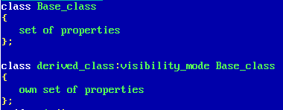
Inheritance:
The capability of a class to derive properties and characteristics from another class is called Inheritance.
Inheritance is the mechanism which allows us to extend new class from existing class.
Inheritance support reusability feature of c++.
Here existing class is also known as Base class and new class is called as Derived class
After inheriting one class from another class, all propertied of base class becomes properties of derived class without redeclaration.
NKOCET, Solapur Prof. Shinde Reshma U.

Slide 9
Inheritance:
The capability of a class to derive properties and characteristics from another class is called Inheritance.
Inheritance is the mechanism which allows us to extend new class from existing class.
Inheritance support reusability feature of c++.
Here existing class is also known as Base class and new class is called as Derived class
After inheriting one class from another class, all propertied of base class becomes properties of derived class without redeclaration.
Visibility_mode can be:
Public
Private
protetced
NKOCET, Solapur Prof. Shinde Reshma U.

Slide 10
Inheritance: Visibility mode:
NKOCET, Solapur Prof. Shinde Reshma U.

Slide 11
Inheritance: Visibility mode:
Private:
NKOCET, Solapur Prof. Shinde Reshma U.

Slide 12
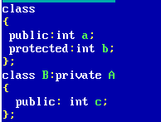
Inheritance: Visibility mode:
Private: consider following code:
NKOCET, Solapur Prof. Shinde Reshma U.

Slide 13
Inheritance: Visibility mode:
Private: consider following code:
Here class A data a, b are public, protected respectively.
but for class B it will become private
NKOCET, Solapur Prof. Shinde Reshma U.

Slide 14
Inheritance: Visibility mode:
Private: consider following code:
Here class A data a, b are public, protected respectively.
but for class B it will become private
Protected:
NKOCET, Solapur Prof. Shinde Reshma U.

Slide 15
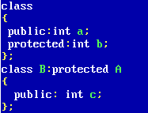
Inheritance: Visibility mode:
Private: consider following code:
Here class A data a, b are public, protected respectively.
but for class B it will become private
Protected: consider following code:
NKOCET, Solapur Prof. Shinde Reshma U.

Slide 16
Inheritance: Visibility mode:
Private: consider following code:
Here class A data a, b are public, protected respectively.
but for class B it will become private
Protected: consider following code:
Here class A data a, b are public, protected respectively.
but for class B it will become protected
NKOCET, Solapur Prof. Shinde Reshma U.

Slide 17
Inheritance: Visibility mode:
Private: consider following code:
Here class A data a, b are public, protected respectively.
but for class B it will become private
Protected: consider following code:
Here class A data a, b are public, protected respectively.
but for class B it will become protected
Public:
NKOCET, Solapur Prof. Shinde Reshma U.

Slide 18
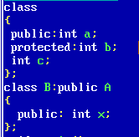
Inheritance: Visibility mode:
Private: consider following code:
Here class A data a, b are public, protected respectively.
but for class B it will become private
Protected: consider following code:
Here class A data a, b are public, protected respectively.
but for class B it will become protected
Public: consider following code:
NKOCET, Solapur Prof. Shinde Reshma U.

Slide 19
Inheritance: Visibility mode:
Private: consider following code:
Here class A data a, b are public, protected respectively.
but for class B it will become private
Protected: consider following code:
Here class A data a, b are public, protected respectively.
but for class B it will become protected
Public: consider following code:
Here a, b, c are public, protected, private data of class A resp.
Though class B has been derived from class A, only data ‘a’
will become derived for class B.
NKOCET, Solapur Prof. Shinde Reshma U.

Slide 20
Inheritance: Visibility mode:
Private: consider following code:
Here class A data a, b are public, protected respectively.
but for class B it will become private
Protected: consider following code:
Here class A data a, b are public, protected respectively.
but for class B it will become protected
Public: consider following code:
Here a, b, c are public, protected, private data of class A resp.
Though class B has been derived from class A, only data ‘a’
will become derived for class B.
Hence its important to note that there is no way to break security mode
NKOCET, Solapur Prof. Shinde Reshma U.

Slide 21
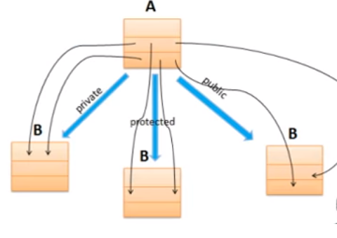
Inherited derived class from base class with “Private mode”
All kinds (protected, public) properties of base class becomes private properties for derived class
Hence both user1 and user2 can not access that properties
Inherited derived class from base class with “Protected mode”
All kinds ( protected, public) properties of base class becomes protected properties for derived class
Hence user1 can not access base class properties but user2 can access that properties.
Inherited derived class from base class with “Private mode”
Protected properties of base class becomes protected properties for derived class.
Public properties of base class becomes public properties for derived class
NKOCET, Solapur Prof. Shinde Reshma U.

Slide 22
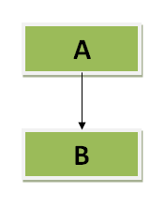
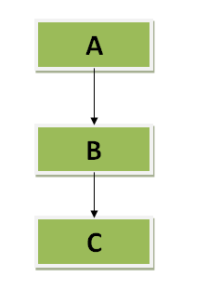
Types of inheritance:
1.Single Inheritance:
If The architecture of inheritance have one base class and one derived class, we can say that it is single architecture
In following figure we can see class A is only base class and there is only one derived class B
2.Multilevel Inheritance:
In the architecture of inheritance if we derived one class from such class which is already derived from other class is called as multilevel inheritance.
NKOCET, Solapur Prof. Shinde Reshma U.

Slide 23
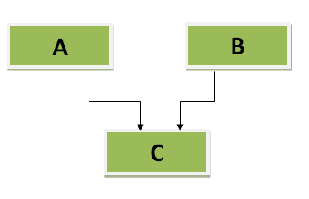
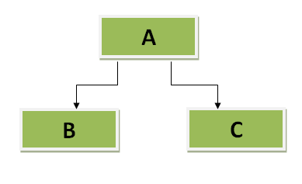
Types of inheritance:
1.Multiple Inheritance:
If one derived class have more than one base class, that architecture is called as multiple inheritance.
In following figure we can see that class C has been derived from two classes, class A and class B.
2.Hierarchical Inheritance:
If one base class will have more than one derived classes, then such architecture is called as hierarchical inheritance.
In following figure we can see that base class A have two derived classes class B and class C
NKOCET, Solapur Prof. Shinde Reshma U.

Slide 24
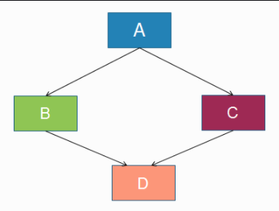
Types of inheritance:
This architecture is combination of hierarchical inheritance and multiple inheritance.
Consider the following figure where class A have two derived classes class B and class C. Afterwards class B and class C have common derived class D.
Problem with Hybrid inheritance:
When class D get inherited from B and C, class D will have two set of properties class A, one via class B and other via class C
Hence when object of class D try to access properties of class A, it get confuse ( ambigious) to access which copy and compiler gives an error.
To solve this problem C++ provided one feature in the form of “virtual base class”
NKOCET, Solapur Prof. Shinde Reshma U.

Slide 25
Constructor, destructor in inheritance:
NKOCET, Solapur Prof. Shinde Reshma U.

Slide 26
Constructor, destructor in inheritance:
See the following program where class A is base class and class B is derived from A publicly.
NKOCET, Solapur Prof. Shinde Reshma U.

Slide 27
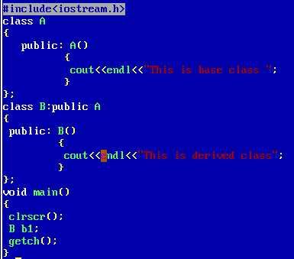
Constructor, destructor in inheritance:
See the following program where class A is base class and class B is derived from A publicly.
NKOCET, Solapur Prof. Shinde Reshma U.

Slide 28
Constructor, destructor in inheritance:
See the following program where class A is base class and class B is derived from A publicly.
In main() function we have created object b1 of class B. Hence b1 is responsible for calling B() constructor.
NKOCET, Solapur Prof. Shinde Reshma U.

Slide 29
Constructor, destructor in inheritance:
See the following program where class A is base class and class B is derived from A publicly.
In main() function we have created object b1 of class B. Hence b1 is responsible for calling B() constructor.
B() constructor is responsible for calling A() constructor.
NKOCET, Solapur Prof. Shinde Reshma U.

Slide 30
Constructor, destructor in inheritance:
See the following program where class A is base class and class B is derived from A publicly.
In main() function we have created object b1 of class B. Hence b1 is responsible for calling B() constructor.
B() constructor is responsible for calling A() constructor.
Hence object in main() first call to derived class constructor, then derived class constructor calls base class constructor. Base class constructor get executes and then derived class constructor get executes
NKOCET, Solapur Prof. Shinde Reshma U.

Slide 31
Constructor, destructor in inheritance:
See the following program where class A is base class and class B is derived from A publicly.
In main() function we have created object b1 of class B. Hence b1 is responsible for calling B() constructor.
B() constructor is responsible for calling A() constructor.
Hence object in main() first call to derived class constructor, then derived class constructor calls base class constructor. Base class constructor get executes and then derived class constructor get executes
Order of Calling constructor:
NKOCET, Solapur Prof. Shinde Reshma U.

Slide 32
Constructor, destructor in inheritance:
See the following program where class A is base class and class B is derived from A publicly.
In main() function we have created object b1 of class B. Hence b1 is responsible for calling B() constructor.
B() constructor is responsible for calling A() constructor.
Hence object in main() first call to derived class constructor, then derived class constructor calls base class constructor. Base class constructor get executes and then derived class constructor get executes
Order of Calling constructor:
Derived → Base
NKOCET, Solapur Prof. Shinde Reshma U.

Slide 33
Constructor, destructor in inheritance:
See the following program where class A is base class and class B is derived from A publicly.
In main() function we have created object b1 of class B. Hence b1 is responsible for calling B() constructor.
B() constructor is responsible for calling A() constructor.
Hence object in main() first call to derived class constructor, then derived class constructor calls base class constructor. Base class constructor get executes and then derived class constructor get executes
Order of Calling constructor:
Derived → Base
Order of execution of constructor:
NKOCET, Solapur Prof. Shinde Reshma U.

Slide 34
Constructor, destructor in inheritance:
See the following program where class A is base class and class B is derived from A publicly.
In main() function we have created object b1 of class B. Hence b1 is responsible for calling B() constructor.
B() constructor is responsible for calling A() constructor.
Hence object in main() first call to derived class constructor, then derived class constructor calls base class constructor. Base class constructor get executes and then derived class constructor get executes
Order of Calling constructor:
Derived → Base
Order of execution of constructor:
Base → Derived
NKOCET, Solapur Prof. Shinde Reshma U.

Slide 35
Constructor, destructor in inheritance:
See the following program where class A is base class and class B is derived from A publicly.
In main() function we have created object b1 of class B. Hence b1 is responsible for calling B() constructor.
B() constructor is responsible for calling A() constructor.
Hence object in main() first call to derived class constructor, then derived class constructor calls base class constructor. Base class constructor get executes and then derived class constructor get executes
Order of Calling constructor:
Derived → Base
Order of execution of constructor:
Base → Derived
Exactly opposite scenario is there for
Destructor:
NKOCET, Solapur Prof. Shinde Reshma U.

Slide 36
Constructor, destructor in inheritance:
See the following program where class A is base class and class B is derived from A publicly.
In main() function we have created object b1 of class B. Hence b1 is responsible for calling B() constructor.
B() constructor is responsible for calling A() constructor.
Hence object in main() first call to derived class constructor, then derived class constructor calls base class constructor. Base class constructor get executes and then derived class constructor get executes
Order of Calling constructor:
Derived → Base
Order of execution of constructor:
Base → Derived
Exactly opposite scenario is there for
destructor:
Order of execution of destructor :
NKOCET, Solapur Prof. Shinde Reshma U.

Slide 37
Constructor, destructor in inheritance:
See the following program where class A is base class and class B is derived from A publicly.
In main() function we have created object b1 of class B. Hence b1 is responsible for calling B() constructor.
B() constructor is responsible for calling A() constructor.
Hence object in main() first call to derived class constructor, then derived class constructor calls base class constructor. Base class constructor get executes and then derived class constructor get executes
Order of Calling constructor:
Derived → Base
Order of execution of constructor:
Base → Derived
Exactly opposite scenario is there for
destructor:
Order of execution of destructor :
Derived → Base
NKOCET, Solapur Prof. Shinde Reshma U.

Slide 38
Calling Parameterized constructor in Inheritance:
NKOCET, Solapur Prof. Shinde Reshma U.

Slide 39
Calling Parameterized constructor in Inheritance:
Suppose base class constructor is parameterized
and derived class constructor is default construc
-tor. in this situation how and where to pass par
-ameter to base class constructor?
NKOCET, Solapur Prof. Shinde Reshma U.

Slide 40
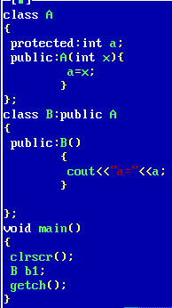
Calling Parameterized constructor in Inheritance:
Suppose base class constructor is parameterized
and derived class constructor is default construc
-tor. in this situation how and where to pass par
-ameter to base class constructor?
NKOCET, Solapur Prof. Shinde Reshma U.

Slide 41
Calling Parameterized constructor in Inheritance:
Suppose base class constructor is parameterized How to solve this????
and derived class constructor is default construc
-tor. in this situation how and where to pass par
-ameter to base class constructor?
NKOCET, Solapur Prof. Shinde Reshma U.

Slide 42
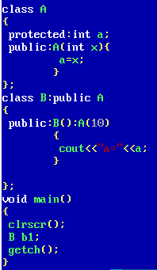
Calling Parameterized constructor in Inheritance:
Suppose base class constructor is parameterized How to solve this????
and derived class constructor is default construc
-tor. in this situation how and where to pass par
-ameter to base class constructor?
NKOCET, Solapur Prof. Shinde Reshma U.

Slide 43
Nesting Of Classes:
NKOCET, Solapur Prof. Shinde Reshma U.

Slide 44
Nesting Of Classes:
If we defined one class within another class, it is called as nesting of class.
NKOCET, Solapur Prof. Shinde Reshma U.

Slide 45
Nesting Of Classes:
If we defined one class within another class, it is called as nesting of class.
This means one class can be declared inside the scope of another class. And it will be considered as a part of outer class.
NKOCET, Solapur Prof. Shinde Reshma U.

Slide 46
Nesting Of Classes:
If we defined one class within another class, it is called as nesting of class.
This means one class can be declared inside the scope of another class. And it will be considered as a part of outer class.
Here class B has declared inside class A.Such type of implementation is called as nesting of classes.
NKOCET, Solapur Prof. Shinde Reshma U.

Slide 47
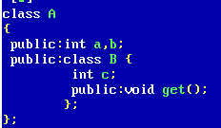
Nesting Of Classes:
If we defined one class within another class, it is called as nesting of class.
This means one class can be declared inside the scope of another class. And it will be considered as a part of outer class.
Here class B has declared inside class A.Such type of implementation is called as nesting of classes.
NKOCET, Solapur Prof. Shinde Reshma U.

Slide 48
Nesting Of Classes:
If we defined one class within another class, it is called as nesting of class.
This means one class can be declared inside the scope of another class. And it will be considered as a part of outer class.
Here class B has declared inside class A.Such type of implementation is called as nesting of classes.
Though class B is part of class A object of such class cant access A class data.
NKOCET, Solapur Prof. Shinde Reshma U.

Slide 49
Nesting Of Classes:
If we defined one class within another class, it is called as nesting of class.
This means one class can be declared inside the scope of another class. And it will be considered as a part of outer class.
Here class B has declared inside class A.Such type of implementation is called as nesting of classes.
Though class B is part of class A object of such class cant access A class data.
Creating object of class B: A::B:: b1;
NKOCET, Solapur Prof. Shinde Reshma U.

Slide 50
Nesting Of Classes:
If we defined one class within another class, it is called as nesting of class.
This means one class can be declared inside the scope of another class. And it will be considered as a part of outer class.
Here class B has declared inside class A.Such type of implementation is called as nesting of classes.
Though class B is part of class A object of such class cant access A class data.
Creating object of class B: A::B:: b1;
Defining class B function: void A::B::get() {-----}
NKOCET, Solapur Prof. Shinde Reshma U.

Slide 51
Nesting Of Classes:
If we defined one class within another class, it is called as nesting of class.
This means one class can be declared inside the scope of another class. And it will be considered as a part of outer class.
Here class B has declared inside class A.Such type of implementation is called as nesting of classes.
Though class B is part of class A object of such class cant access A class data.
Creating object of class B: A::B:: b1;
Defining class B function: void A::B::get() {-----}
Now try to guess here how class A accesses data of class B and how class B accesses data of class A
NKOCET, Solapur Prof. Shinde Reshma U.

Slide 52
NKOCET, Solapur Prof. Shinde Reshma U.

Slide 53
NKOCET, Solapur Prof. Shinde Reshma U.

Slide 54
NKOCET, Solapur Prof. Shinde Reshma U.

Slide 55

NKOCET, Solapur Prof. Shinde Reshma U.

