Slide 1
Template and Exception Handling Class:SE-CSE-II Subject: OODP By Shinde R.U.

Slide 2
Template In c++
Template is powerful feature of c++
It is a way of generic programming
Programmer can write single function to work on different data type input.
It support reusability and flexibility.

Slide 3
Function Template
It is generalized way of function implementation.
Declaration:
template function declaration starts with keyword template and is followed by function definition.
Example:
template<class T>
void even(T a, T b)
{
----
----
}

Slide 4
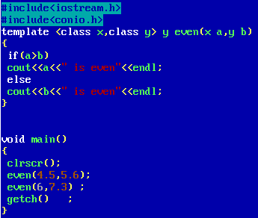


Slide 5
Class Template
Like function template we can implement class template
When we create two object of one class, data member of both class will have same type.
If program demand two object of same class with different type, then we have to implement such class with template.
Hence template class in c++ is a feature which allows programmer to generalize an object.

Slide 6
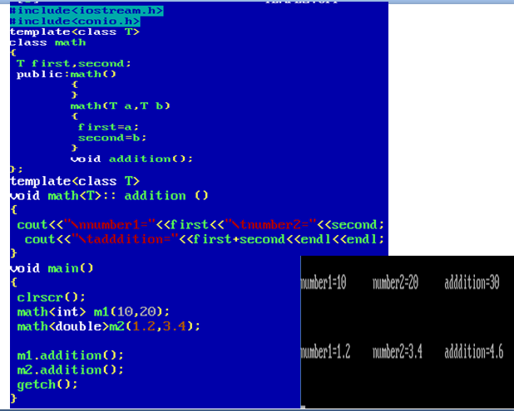

Slide 7
Exception
Exception is a run time anomalies or unusual condition due to which program may end or interrupt while execution.
Such anomalies like division by zero, accessing an array out of bound.
Such abnormal situations interrupt further program. Hence it is very important to handle such situations.
And such handling mechanism is called as Exception handling mechanism

Slide 8
Exception Handling Mechanism
This mechanism is a provision to detect and report an exception so that run time action can be possible.
Exception handling mechanism is build upon three keywords
1. try
2.catch
3.throw

Slide 9
Working of Exception Handling Mechanism(EHM)
Steps in EHM:
1.Finding and hitting an exception
2.Informing that an exception has occurred.
3. Receive the relative exception.
4. Takes corrective action.
To execute according to this try catch throw work as follows.

Slide 10
Try, catch, throw
try:
It is block of statement which may generate an exception.
throw :
When an exception get generate in try block , it will be thrown by throw keyword
throw works in try block itself
catch :
It is different block from try block. catch block catches an exception which is thrown by try block

Slide 11
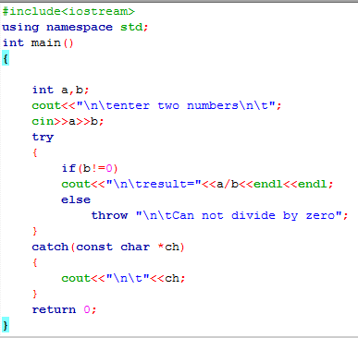

Slide 12
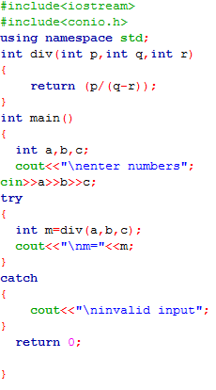

Slide 13
Rethrowing an Exception
Sometimes it may be possible that catch block is itself unable to handle an exception generated by respective try block
In such situation we have to rethrow an exception

